Slide 1
Simplified internet search for citizens of Ukraine in foreign country
Search4Ukraine

Slide 2
Agenda
Introduce the problem
Use Cases
Methodology
Implementation
Results
Conclusion

Slide 3
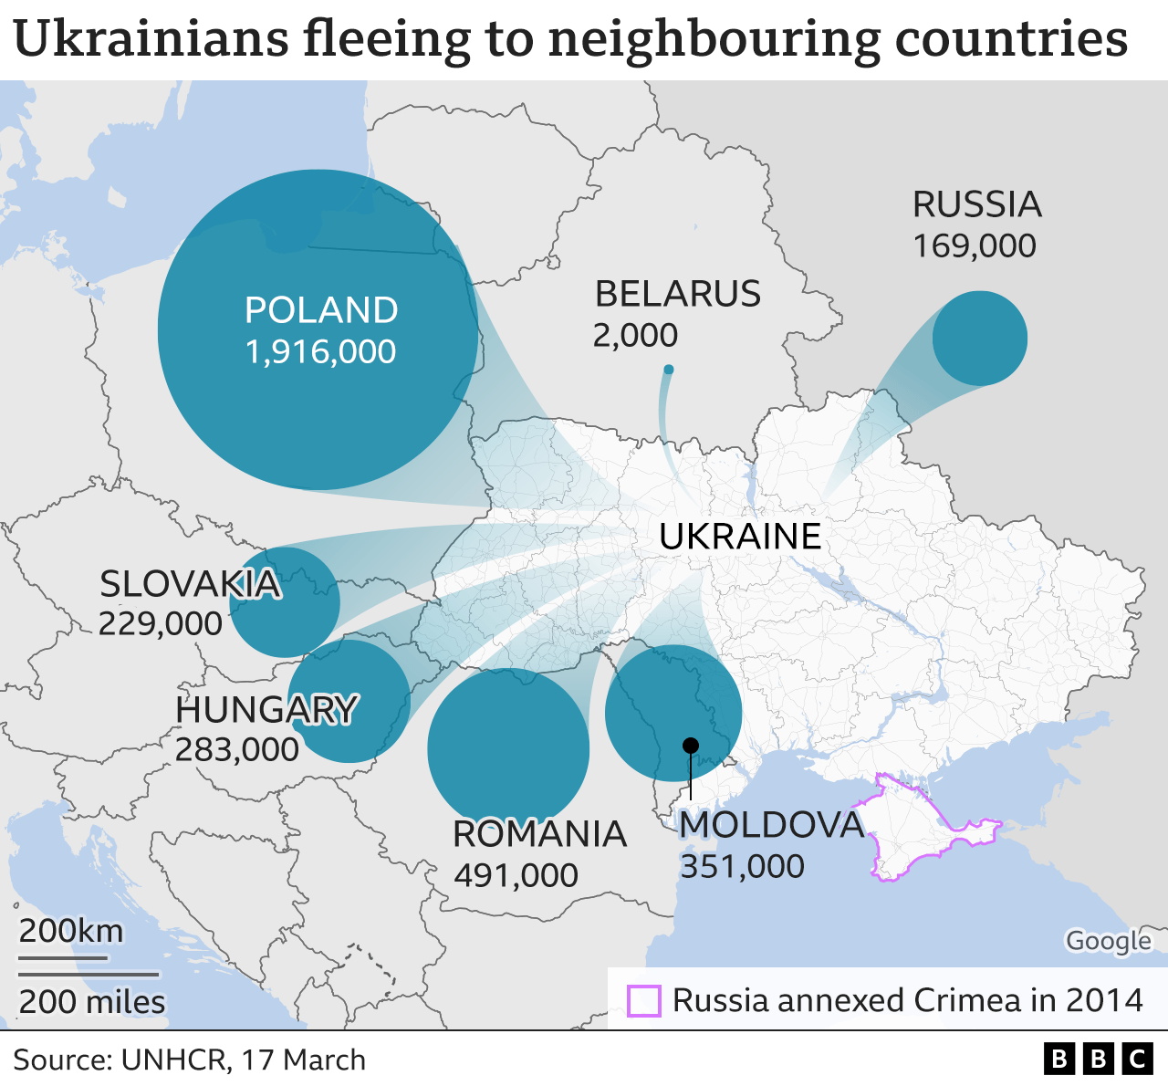
The problems and facts
Which foreign web sources are reliable?
How to find and read them quickly?
There is no universal platform for knowledge sharing!
Language gap and different alphabetic

Slide 4
Use cases
EN: “cheap accommodation Bratislava”
SK: “lacné ubytovanie Bratislava”
"searchTime": 0.470463,
"totalResults": "836000",
UA: “дешеве проживання Братислава”
"searchTime": 0.41129,
"totalResults": "3190",
Google prioritize searches which match used language
Most results source pages contains foreign language after all

Slide 5





Methodology
Simplified searching for relevant information
Best results for local country
Translate search input text to local country language
Adjust and optimize search strings
Mark and recommend reliable sources
Approved by government
Non-profit organizations
Translate whole websites to Ukraine language
Platform and forum - knowledge base
User friendly by design
Collect statistics, what are refugees actually looking for and address it.

Slide 6
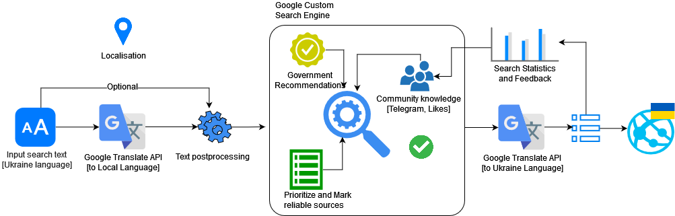
Implementation

Slide 7
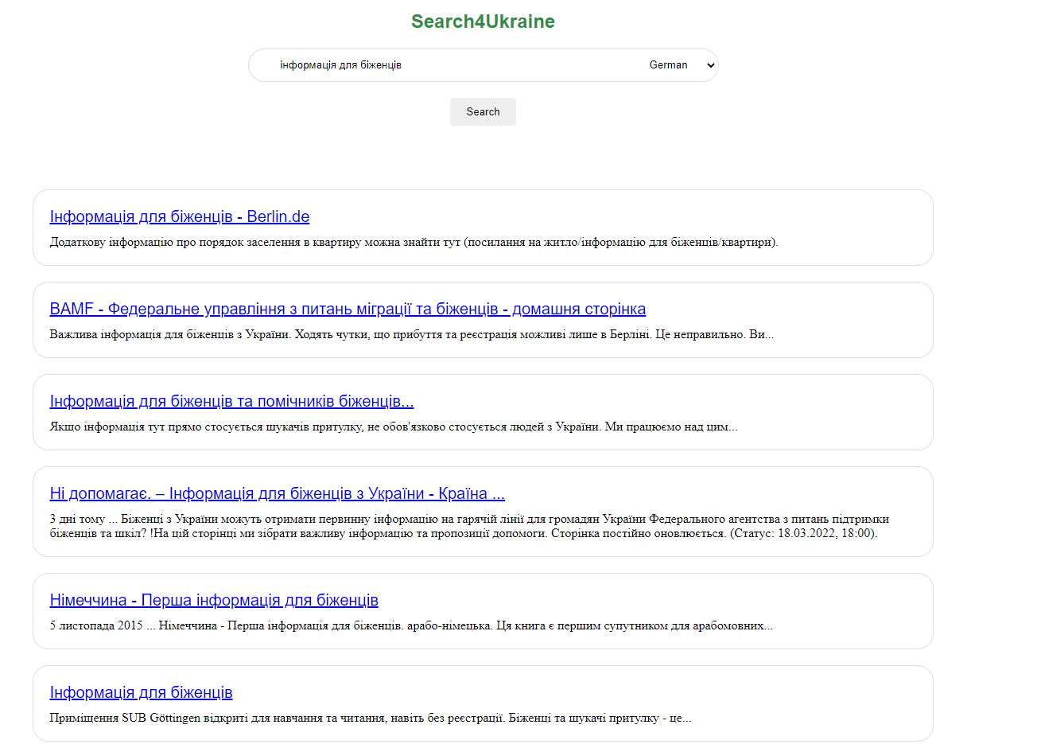
Demo

Slide 8
Results
A way to search and read reliable sources
quickly
using only a smartphone
benefits from knowledge sharing
in user friendly environment

Slide 9
Conclusion
Search engines essentially act as filters for the wealth of information available on the internet. They allow users to quickly and easily find information that is of genuine interest or value, without the need to wade through numerous irrelevant web pages. So making a search engine in a native language of so many set of users is a big form of empowerment for the people, which brings information closer to the people and this brings about a whole lot of possibilities for the people.
One of the shortcomings in our project is the translation of the searched web pages to the native languages of the users, and this can be overcomed by using the app on a built specific web browser app that translate the text of a web app to the native languages of the users.

