Slide 1

Oconee County Fire Rescue (OCFR)
Team 20
Elizabeth Culkin, Lindsey Hume, Omkar Tamhankar, Chris Stanko

Slide 2
Value Proposition

Slide 3
What problem(s) are you trying to solve?
Department would like an online system that tracks its members and their contact information
Need to track the certifications and certification status (current/expired) of each of the volunteers
IT personnel and resources are limited – best option would be cloud deployment

Slide 4
What are the business outcomes you want to achieve?
Members & Certifications
Reports
Edit/Update
Based on Expired Certifications
View
Add
Delete
Connect Certifications with Members
Based on Radio Number & Station Number

Slide 5
Describe scope, time, and resources to provide this deliverable.
Scope:
Timeline:
Resources:
Will be relevant for all fire departments within Oconee County
Fully functional web application will take 1 month to complete with a team of 4 developers at a rate of $30/hr
Developers will need sample data for multiple people, certifications, and how Oconee County wants the data to relate

Slide 6
Share your vision for the next version; describe scope, time & resources to accomplish it.
Scope:
Log-in page to provide more security for viewing, adding, and editing members
Downloadable CSV reports
Visual data validation
Time:
Enhanced functional web application will take 2 weeks to complete with a team of 4 developers at a rate of $30/hr
Resources:
Log-in requirements of users
Dummy log-in data

Slide 7
Demo

Slide 8
Describe your approach to solving the problem.
Prepare an ER Diagram to understand the components of the application
Design HTML/CSS pages
Separate adding functions from editing/deleting functions
Implement one API using VueJS at a time
Mimic adding, editing, & deleting members for adding, editing, & deleting certifications
Resolve Errors
Deploy to the cloud after the application is fully functioning

Slide 9
Show a working application, highlighting how your solution & the key features address the business problem.
Team 20 Project Link

Slide 10
Briefly explain and provide business justification for the technology stack.
Frees up Felicia Smoake to focus on high-level tasks
Application is hosted in the cloud so county does not need to maintain a server and network infrastructure to host it
Application code is on GitHub so it can be open-source shared to all fire departments

Slide 11
Lessons Learned

Slide 12
How did you self-organize?
Team Dynamics
If an error would continually occur for an individual or pair, another individual or pair would take over to provide a new perspective
Work for about an hour and then check back-in to understand progress
Keep a to-do list for tasks and errors still needing to be resolved
Team Structure
Work as Full Team (Group of 4)
Work in Pairs
Work Individually
Communication Methods
Zoom Meetings
Group Text Messages
Effectiveness (who built which parts of the application?)
All took part in each of the pieces of the development

Slide 13
What was your process for designing and building this system?
Data Model
Table Creations in Database
HTML & CSS – Page Building & Formatting/Styling
APIs using VueJS
Deploy to the Cloud
Design Documents

Slide 14
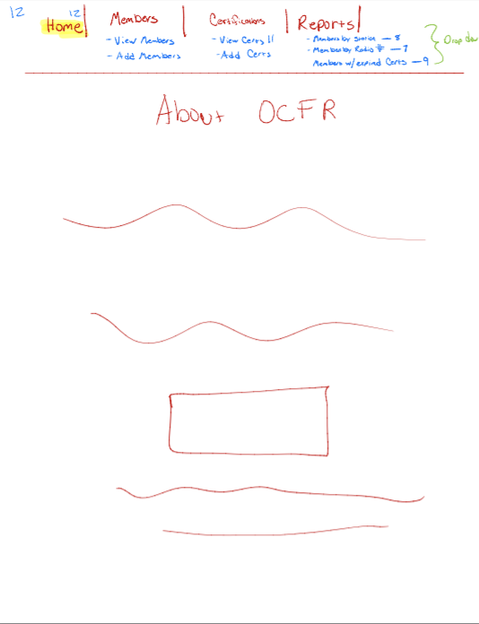
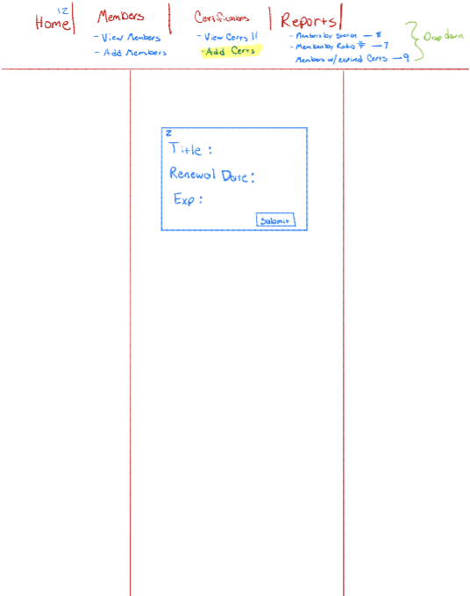
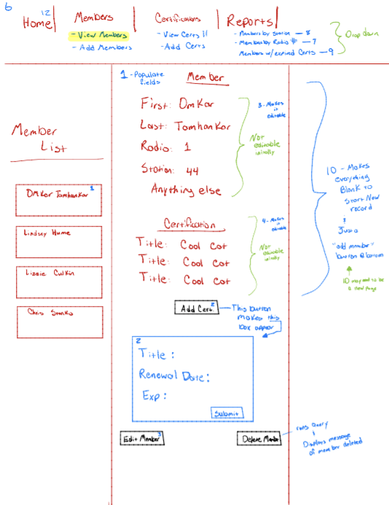
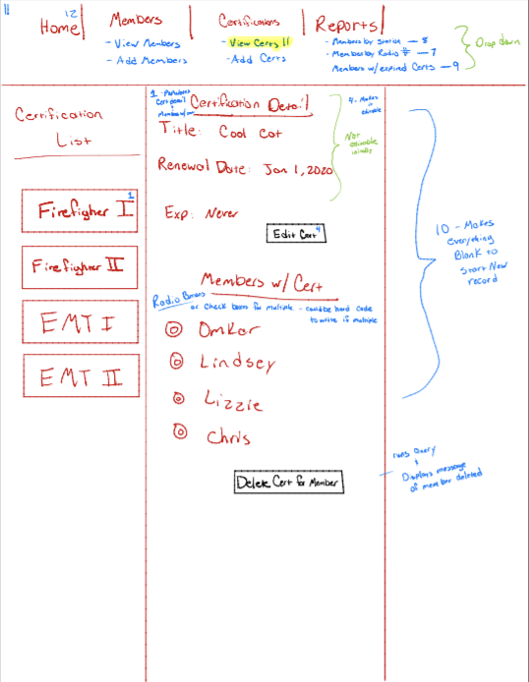
Design Documents
Home Page
Add Certification Page
View Members Page
View Certification Page

Slide 15
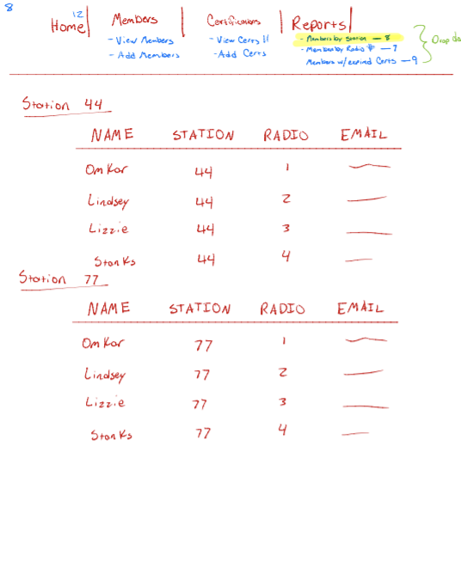
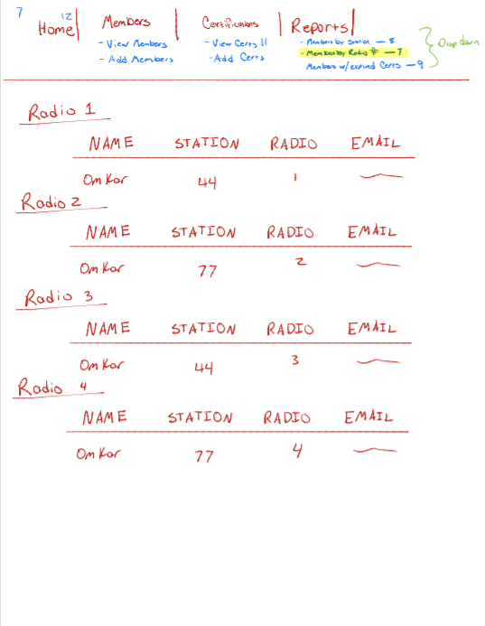
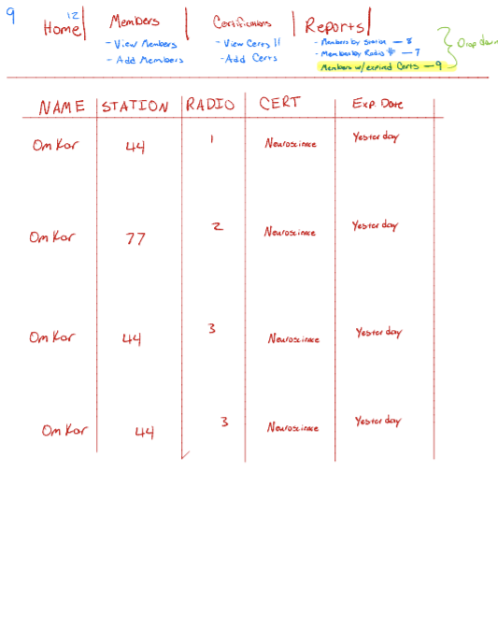
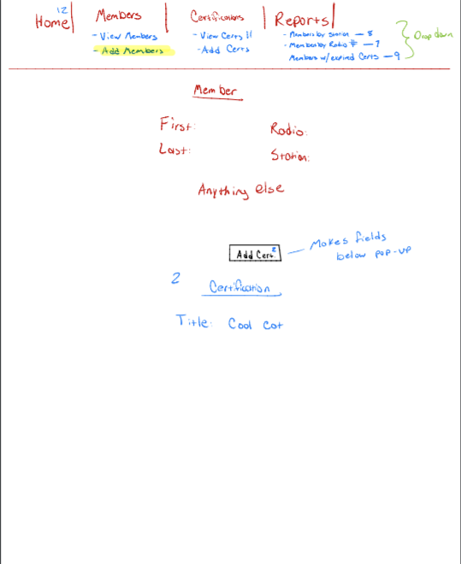
Design Documents Continued
Members By Station Report Page
Members By Radio Report Page
Expired Certifications Report Page
Add Members Page

Slide 16
What did you learn as individuals (technical or other)?
Elizabeth Culkin
Omkar Tamhankar
Lindsey Hume
Chris Stanko
How amazing GitHub is
What full-stack development looks like
How valuable containerization can be
Productivity benefit with distributed development
How to implement a full-stack application
Fully virtual development is not necessarily an obstacle
The value in walking away from an error
Better understanding of how different uses of VueJS (such as adding and updating) are similar
Even “perfect” code will have bugs
How to create a fully-functional application from scratch
How time-consuming debugging can be
The value of version control systems (GitHub)

Slide 17
Appendix

Slide 18
User Stories
As a user, I can add a member with all information*
Done when:
As a user, I can add a certification with all information*
Done when:
I can view a list of certifications and respective members that have those certifications by fetching an API
As a user, I can associate a specific member with a specific certification
Done when:
As a user, I can view a list of members with expired certifications
Done when:
As a user, I can view members by radio number and station number
Done when:
There is an add member page that posts to the DB
I can view a list of members and their respective certifications dynamically by fetching an API
There is an add certification page that posts to the DB
I can view each member and their certifications dynamically from an API
There is an input field when associating a member with a certification
There is a reports page that dynamically pulls information and sortable by radio & station

Slide 19
Risks and Mitigations
Risk | Consequence | Likelihood | Severity | Mitigation
Many new employees are hired | Initial data entry may take time | Moderate | Low | Next iteration implement a CSV data file input
A new fire dept. wants to adopt web application | Tailoring solution for specific data/Initial data entry may take time | Low/Moderate | Low | Simple to change inputs in DB & Next iteration implement a CSV data file input
Date earn certification does not have to be “before” date expired certification | Inaccuracy in analysis of earned certifications against time period | Moderate | Low | Next iteration will require rules for date inputs
Any person has the capability of adding a member, updating a member, or deleting a member | Inaccurate data | Moderate/High | High | Next iteration will implement a log-in page to control who has access to add, update, & delete members

Slide 20
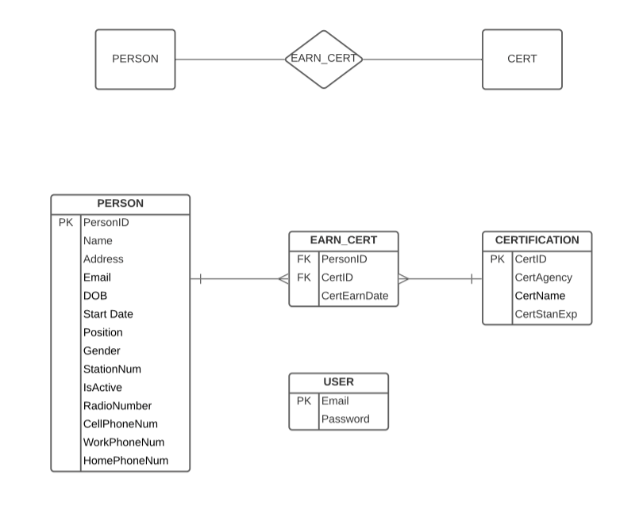
Data Model of Entities

Slide 21
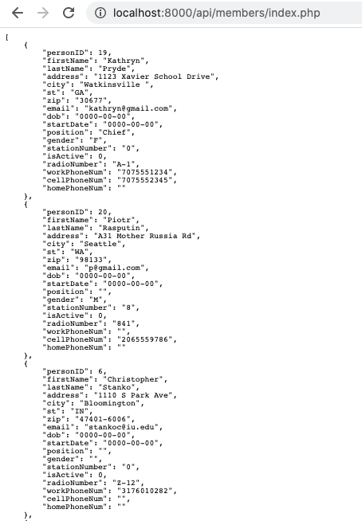
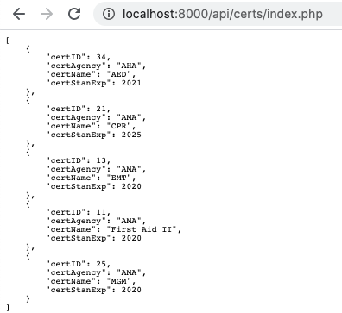
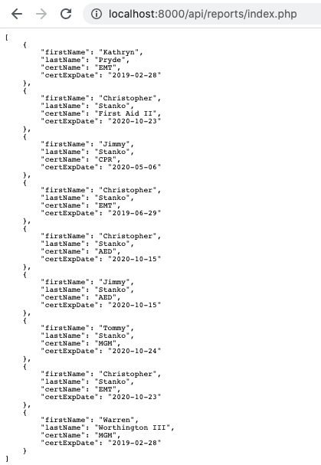
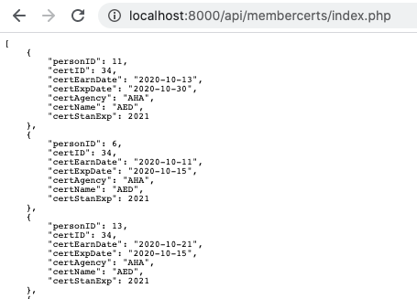
API Endpoints - Members - Certifications - Member Certifications Association - Records

