Slide 1
ERP Post-Simulation Analysis
Team 20
Elizabeth Culkin, Omkar Tamhankar, Lindsey Hume, Chris Stanko

Slide 2
Agenda
Initial Business Strategy
Initial Team Strategy
Process to Achieve Business Strategy
Adjustments
Loan Payment Adjustments
Strategy Wrongs
Strategy Rights

Slide 3
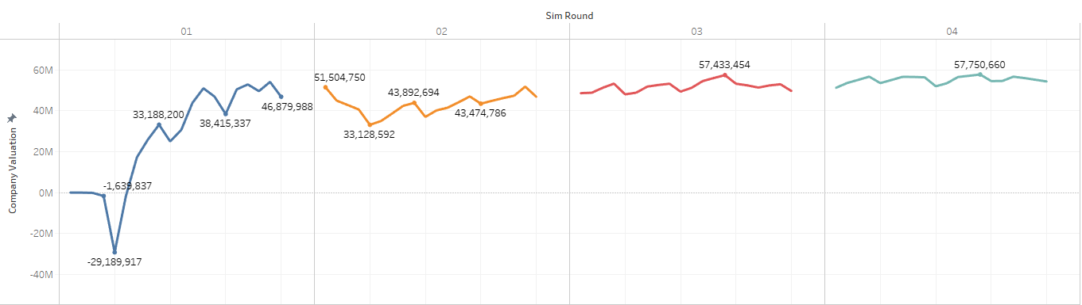
What was the initial business strategy of your team?
Goal: Maximize company valuation
Assumption: Maximizing net income → maximizing company valuation
Strategy: Sell the highest quantity product in combination with achieving the highest profit margin to achieve maximum net income.
Requirements: Change BOM and product price at least once
Dependency: BOM could not be changed for product quantity > 1000 units
Company Valuation increased significantly

Slide 4
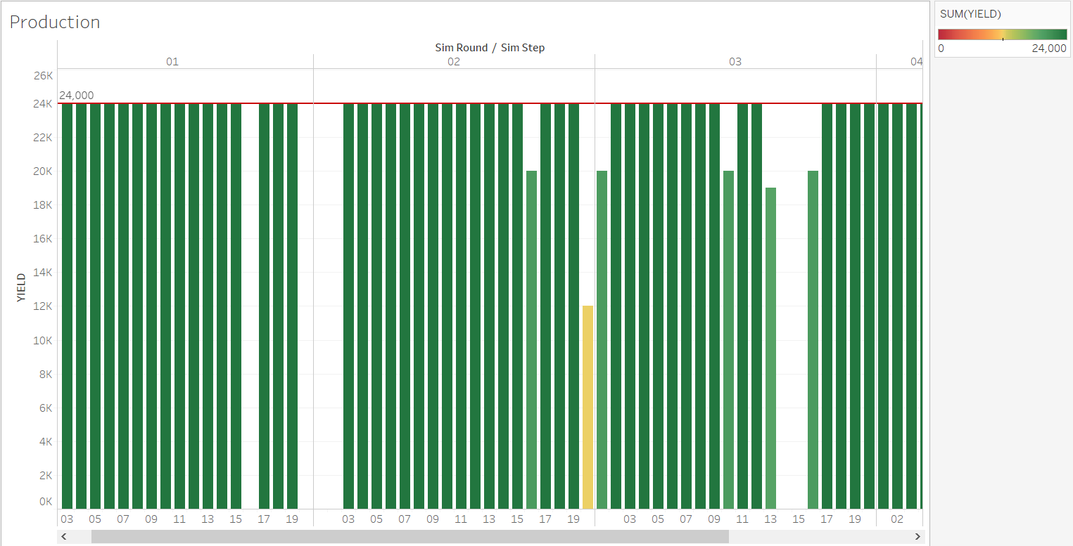
What was the initial team strategy of your team?
Goal: Maximize production capacity & run a new MRP at the earliest 5 days after the previous run
Strategy: High communication between all team members, with each member assigned separate tasks
Omkar: Perform MD61
Lindsey: Perform MD01
Elizabeth: Perform ME59N & CO41
Chris: Post/remove marketing expense, track the sim round/day, & track financials.
Dependency: All planned orders needed to be converted before MRP could run again
Overall Production: 69.25%
4

Slide 5
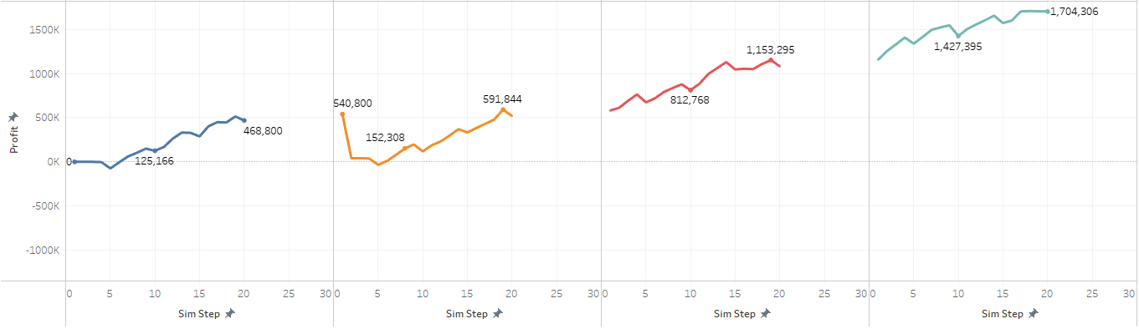
How did our team plan to achieve our chosen business strategy?
Tactics included:
Sell only 500g sized products to maximize distribution channels and markets
Start with only selling 500g Nut Muesli to reduce production downtime due to cleaning machines
Switch to 500g Blueberry Muesli to successfully change the BOM without running out of product
Maximize profit margin by switching production to Blueberry Muesli
Change BOM of Blueberry Muesli to minimum ratio of blueberries to save on raw materials expense
Increase price of Blueberry Muesli to maximize profit margin
Allocate money towards marketing in distribution channels where marketing has a high effect on consumer behavior
Initially forecast a bulk order for 240,000 units of 500g Nut Muesli
This gave us a buffer of product as we did not run MRP until at least every five days due to it taking five days to successfully receive raw materials to convert planned orders
No price increase
WITH price increase

Slide 6
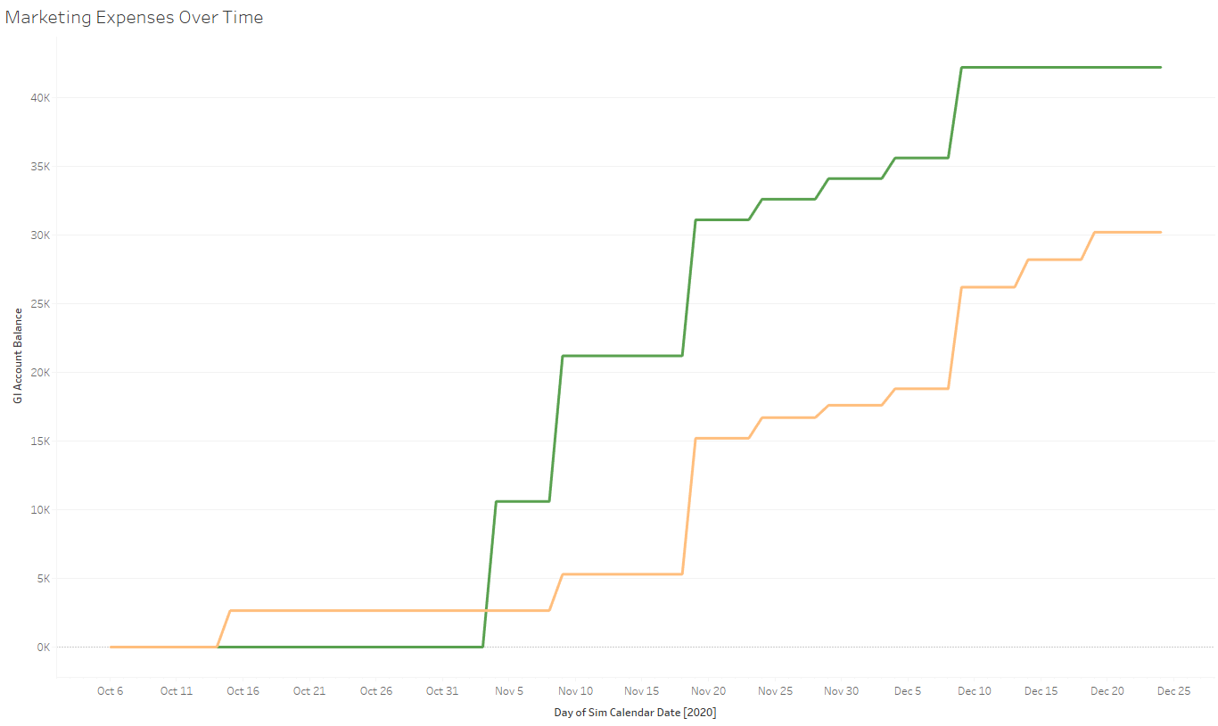
How did you adjust the team/business strategy during the game?
We started off by selling only 500g Nut Muesli
Marketing Strategy (initially €500 to each region, and we changed the allocation as necessary)
We were constantly recalculating the forecast based on raw materials and packaging amounts we had in stock
Based on inventory of finished projects, our marketing expense was adjusted
Initially planned to increase production capacity; however, we did not believe ROI was strong enough to pursue this plan
Decided to pay off parts of our loan to decrease interest
Consistent Marketing Expenses

Slide 7
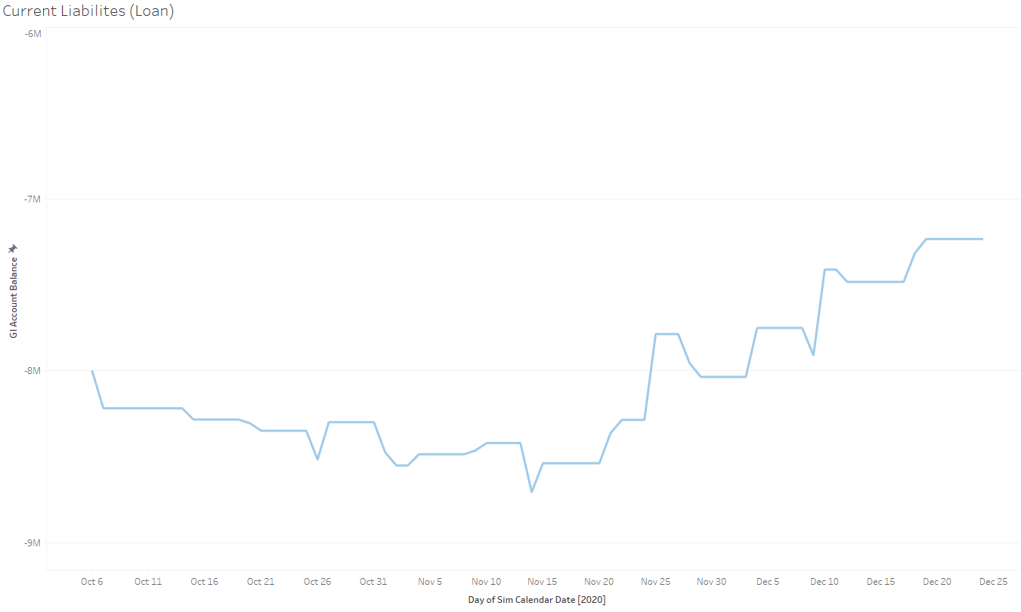
Loan Payment Adjustment
500K Loan Pay-off
500K Loan Pay-off

Slide 8
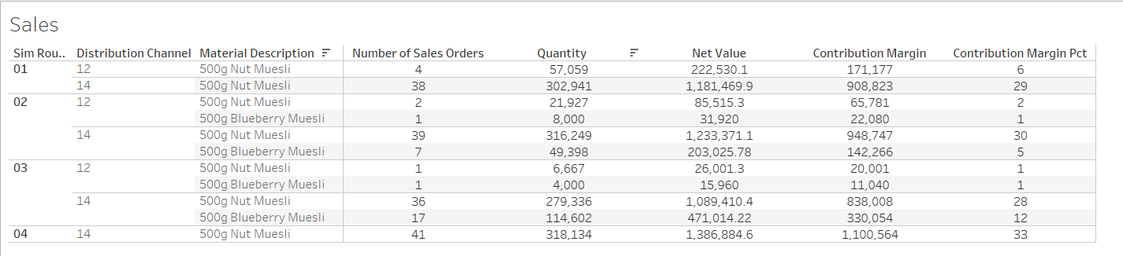
What went wrong in the strategy during the final simulation, if any? Why?
For some reason, although we stopped forecasting for Nut Muesli and began forecasting exclusively for Blueberry Muesli, we never stopped producing Nut Muesli.
We were unable to troubleshoot this issue and therefore we faced delays in daily production, as our warehouse continually switched production between the 2 products.

Slide 9
What went right in the strategy during the final simulation, if any? Why?
Overall, production was above average as we achieved 69.25% productivity
Resulted from carefully planning our forecasts & not running MRP too soon
We never exceeded our capacity for finished goods, raw materials, or packaging materials
Resulted from constantly monitoring our capacity before forecasting
Consistently increased company valuation
We invested approximately 2-3% in marketing expenses which would naturally enhance our brand image
We paid on our loan multiple times which eliminated some current liabilities each time, not only decreasing our interest expense, but increasing our current ratio thereafter.
Achieved highest gross margin percentage out of all teams in our section of the simulation: 76.651%
This can easily be attributed to the increase in price and the fact our team intentionally sold the nut muesli starting the simulation because it had the highest margin of al products.
Avoided running MRP too soon & thus affecting production time due to a delay in receiving raw materials & packaging materials
Resulted from good communication between all team members

