Slide 1
Netflix has been stagnant in project management.
Situation
Netflix is currently using Waterfall (SDLC) for IT Project implementation.
Complication
Netflix's IT projects have consistently ran over-budget and have not met initial requirements.
Question
How can Netflix improve its IT project management?

Slide 2
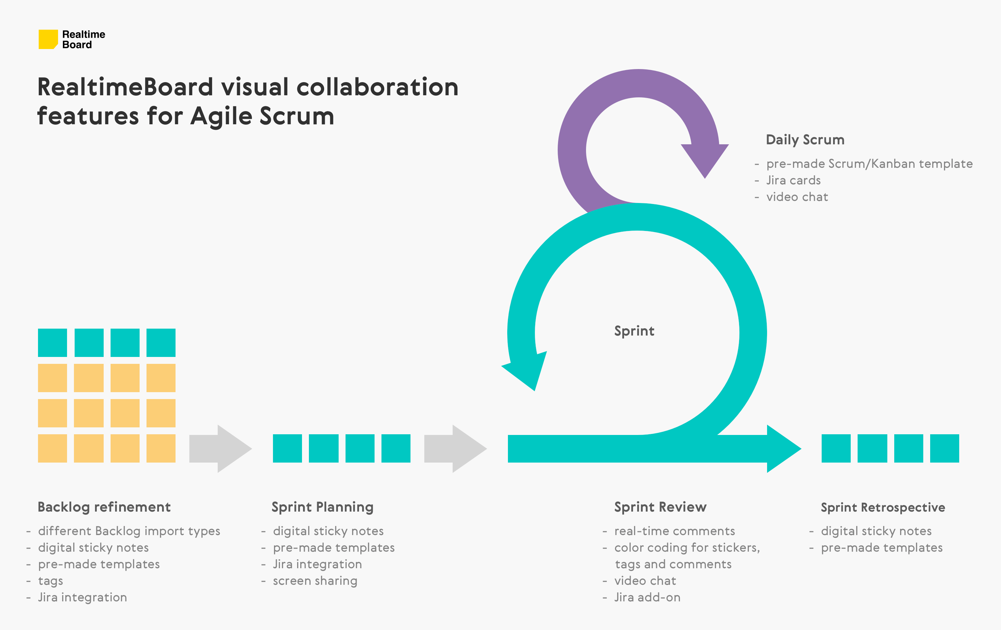
Netflix should approach project development with Agile methodology.
Visibility of project details
Increased team efficiency (collaborative culture)
Adaptive vs predictive
Ability to scale
Ability to focus on business value and users
Stakeholder engagement
Predictable costs/schedule (sprints)
Focuses on the product being delivered

