Slide 1

Managing IT Priorities for Volkswagen of America (VWoA)
20/20 Vision
Elizabeth Culkin, Lindsey Hume, Chris Stanko, Omkar Tamhankar

Slide 2

Agenda
Overview
Recommendation
Plan
Timeline
Financial Impact
Risks & Mitigation
Conclusion
2

Slide 3



VWoA is focusing on product diversification and must utilize IT effectively.
VWoA has seen large fluctuations in sales and interest when they introduce a new vehicle to their fleet, which is known as the Himalayan effect. Over the years, VWoA heavily invested in marketing and sales to combat this trend. Inevitably, IT was viewed as a source of overhead, which led to the outsourcing of IT twice. These outsources left VWoA with no IT knowledge, major project overhead, and no true leadership. In order to reverse both the Himalayan effect and underperforming IT, VWoA has embraced a product diversification strategy and re-prioritized their budget to focus on their core processes.
The re-prioritization budget process immediately increased and allocated the IT budget, bypassing the requirements of project approval. This has left many business units unhappy and questioning the overall fairness and necessity for the new process.
How can the IT budget be effectively allocated to yield consistent sales revenue, while also obtaining buy-in and trust from the other business units at VWoA?
Overview | Recommendation | Plan | Timeline | Financial Impact | Risks & Mitigation | Conclusion
3

Slide 4
By opening a new revenue stream through online sales and implementing customer analytics through Salesforce Einstein, IT can secure consistent sales growth for VWoA.
Sales Cloud Einstein (Salesforce)
Real-time Consumer Analytics
Ultimately Decreasing Marketing Expenses
Taking Customer Orders on the Web
Bringing Convenience to Consumers
Avenue to use Salesforce Einstein
Gathering Data
Overview | Recommendation | Plan | Timeline | Financial Impact | Risks & Mitigation | Conclusion
4

Slide 5

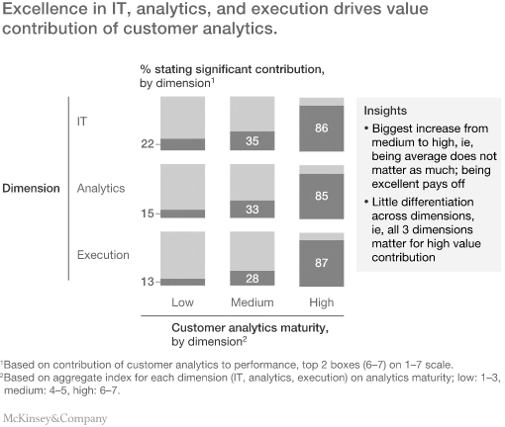
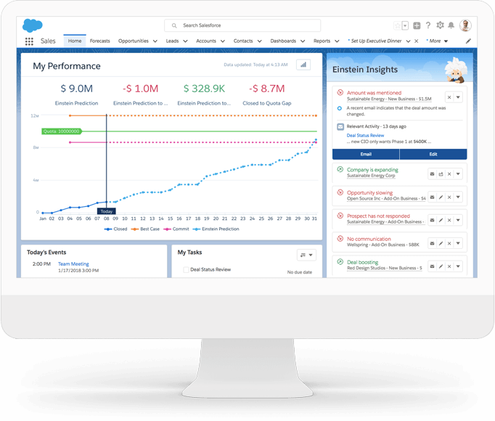
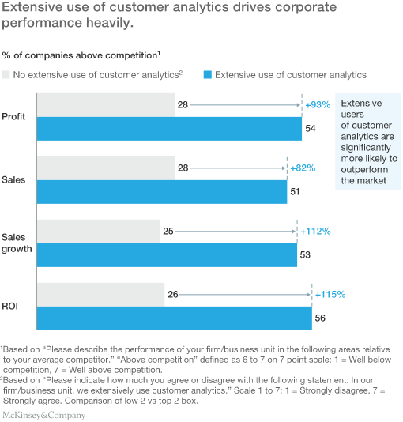
Sales Cloud Einstein will enable VWoA to build customer loyalty through its analytics capabilities.
Research Insights
Sales Cloud Einstein
Business Capabilities
Improve decision-making to forecast sales and avoid the Himalayan Effect
Enable precision marketing
Expand dealerships based on customer locations
*analytics graphics taken from McKinsey
Overview | Recommendation | Plan | Timeline | Financial Impact | Risks & Mitigation | Conclusion
5

Slide 6
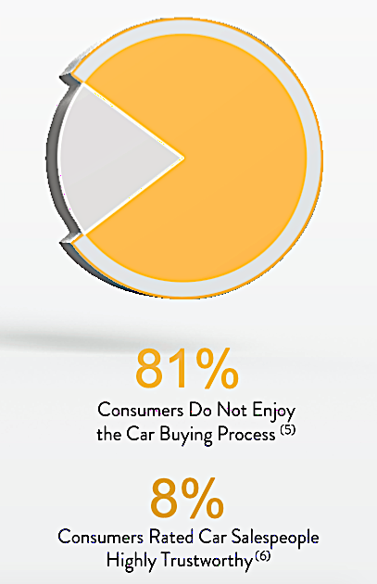
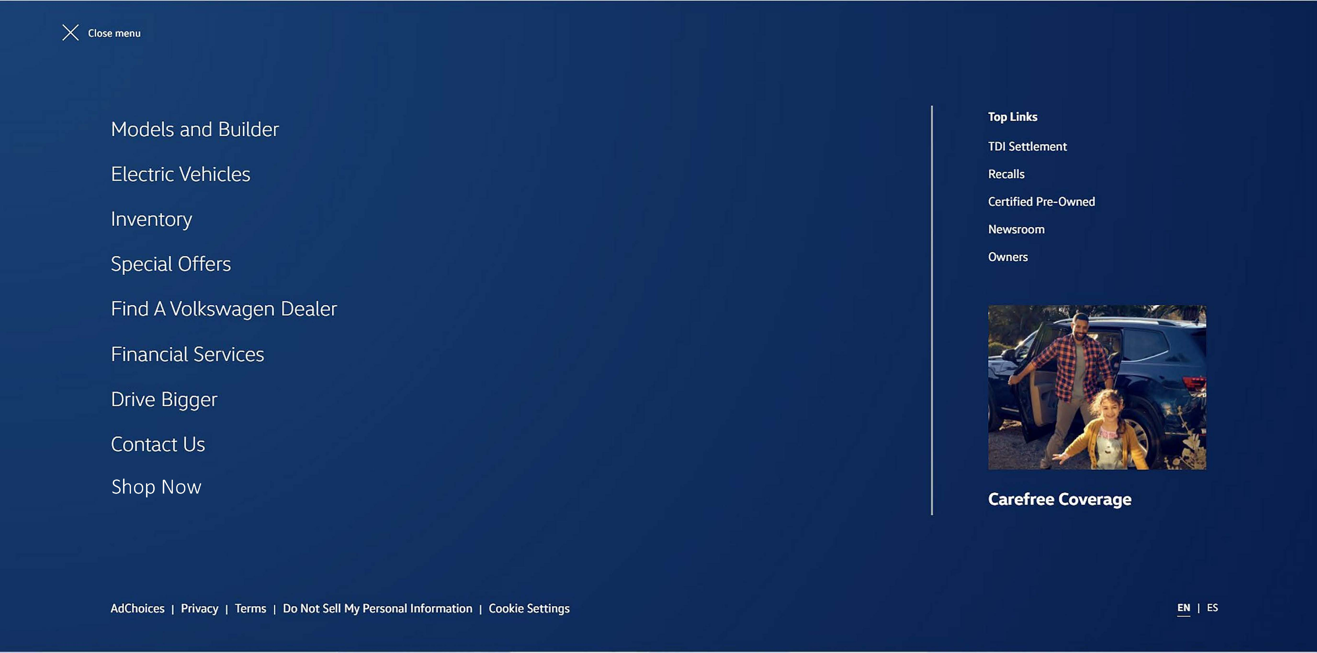
Online ordering will give VWoA a competitive advantage among auto-manufacturers in a transforming digital economy.
Research Insights
Online Ordering
Business Opportunities
Simple and seamless new sales channel, optimizing supply flow
Differentiated customer experience
Removes restrictions based on geographic availability of cars
*analytics graphics taken from Carvana
(5) DealerSocket 2016 Independent Dealership Action report – Represents North American consumers
(6) 2015 Gallup Poll
Overview | Recommendation | Plan | Timeline | Financial Impact | Risks & Mitigation | Conclusion
6

Slide 7
Consumer analytics will provide VWoA the opportunity to understand their customers and market at a much lower cost.
Salesforce Use on Website
Business Uses
“Shop Now”
Online selling and data tracking capabilities will allow VWoA to:
Know what their customers want
Market what customers want without surveying or other expensive tactics
Easily follow up with them knowing exactly what they are interested in online
Phone
Email
Letter
Expedite the logistics of the dealer
Tracks customer geographics, clicks, and includes “share” option to infer what customers want
“Apply for Loan” Option
Tracks & associates clicks, webpage views, and customer interest options with customer information to use in Salesforce Einstein
*Salesforce Einstein implementation commence after website APIs are developed and working*
Overview | Recommendation | Plan | Timeline | Financial Impact | Risks & Mitigation | Conclusion
7

Slide 8
VWoA’s CRM and online ordering plan aligns with the overarching strategy and offers a high business value.
The Situation
The Big Idea: IT will be aligned with business objectives to better support business goals. Supporting Trends: Non-contact options due to COVID-19. What created this opportunity? Historically, IT has been discarded & undervalued, but with the right budget and alignment, IT can support and enable VWoA business capabilities.
The Tactics
Solution Summary: Utilize the $16 million IT budget effectively to support all VWoA functions. Development Plan: The biggest challenge will be synchronizing IT & other business units to benefit VWoA. Channel Plan: Market the online-ordering option to customers to demonstrate the ease and convenience. Customer Validation Plan: Evaluate key analytics to understand if the online-ordering process is maximizing engagement with customers.
Criteria | Score
Strategic Fit | 4
Technological Risk | 4
Change Management Risk | 3
Revenue Potential | 4
Hurdles to Entry | 3
Total | 18
The Strategy
Value Proposition: This concept will reverse the past mistakes of outsourcing IT, leading to little IT knowledge at VWoA. Rather, IT will be an enabler and leader, contributing to key business functions to support the product diversification strategy. The Revenue Model: Focus on product diversification. Enable the IT to support business initiatives, leading to a decrease in costs in future years. Market Attack Elements: Utilizing IT to support marketing capabilities that lead to an increase in sales. Key Milestones: Sustained or increase in sales to demonstrate IT solutions are contributing to sales and marketing.
Overview | Recommendation | Plan | Timeline | Financial Impact | Risks & Mitigation | Conclusion
8
Notes:
For the IT-controlled spend, lay out a high level road map and investment portfolio demonstrating alignment to the business strategy (think of a "one page strategy" approach, slightly more detailed, with an implementation focus)

Slide 9
The updates and Salesforce Einstein implementation will span over the course of 8 months.
 | Month 1 | Month 2 | Month 3 | Month 4 | Month 5 | Month 6 | Month 7 | Month 8
Planning
Req Gathering
Design/Build
Test
Training (Customer Service)
Web Site Release
Configure (APIs)
Data Migration
Test (Einstein w/ Web)
Analytics Training
SF Live on Web
11/15 – 30
11/25 – 1/1
1/2 – 1/30
1/30 – 2/19
2/15 – 3/19
Nov 16 – 27
Nov 30 – Jan 1
Nov 30 – Jan 1
2/25 – 3/26
3/22 – 30
3/27 – 4/15
4/10 – 25
Overview | Recommendation | Plan | Timeline | Financial Impact | Risks & Mitigation | Conclusion
9

Slide 10
Over the course of 5 years, IT will transition from a supporting business unit to an aggressive business unit.
IT Budget 1% of Sales
IT Budget 4% of Sales
INVESTMENTS
COMPETITIVE ADVANTAGE
2%
FUTURE OPPORTUNITY
0%
INVESTMENTS
COMPETITIVE ADVANTAGE
30%
FUTURE OPPORTUNITY
10%
CORE PROCESSES
23%
SUPPORTING THE BUSINESS
24%
CORE PROCESSES
25%
SUPPORTING THE BUSINESS
15%
5 Year Plan
OPERATIONS
PLANNED UPGRADES
24%
GENERAL MAINTENANCE
27%
OPERATIONS
PLANNED UPGRADES
10%
GENERAL MAINTENANCE
10%
INVESTMENTS: 49% | OPERATIONS: 51%
Avg. Project Size: $5M | Planned/General: 8:9
INVESTMENTS 80% | OPERATIONS 20%
Avg. Project Size: $2M | Planned/General: 1:1
Overview | Recommendation | Plan | Timeline | Financial Impact | Risks & Mitigation | Conclusion
10

Slide 11

VWoA needs to focus on communication, analytics, and training to avoid likely risks with the new IT budget spending.
Risks | Mitigations
Resistance from other business units | Inform managers the strategic benefit of initiatives so they can build trust & support within their teams
Unpredictable sales patterns due to COVID pandemic | Utilize Sales Cloud Einstein to perform stochastic-demand analysis to determine optimal inventory levels to maintain & ship
High priority projects result in negative NPV | Perform an analysis every quarter & recalibrate course of action if needed
Online ordering does not increase sales | Market the convenience of the new online-ordering option to regions that are not near a VW dealership
Employees misunderstand the capability of Salesforce Einstein | Implement training days for IT employees and non-IT employees to understand how to user Einstein and the cross-functional capabilities
1
4
5
Impact
3
2
Likelihood
Overview | Recommendation | Plan | Timeline | Financial Impact | Risks & Mitigation | Conclusion
11

Slide 12





Leveraging customer analytics and a digital sales platform will ensure consistent sales growth as it expands its product portfolio.
Embrace IT as a driver of business strategy
Implement CRM and online ordering
Drive consistent long-term sales growth
Improve customer loyalty and optimize supply flow
Secure strong US foundation to support expanded product portfolio
Overview | Recommendation | Plan | Timeline | Financial Impact | Risks & Mitigation | Conclusion
12

Slide 13
Appendix
13

Slide 14
Issue Tree
How?
How?
How?
How?
How can the IT budget be effectively allocated to yield consistent sales revenue, while also obtaining buy-in and trust from the other business units at VWoA?
Increase Revenue
Decrease Cost
Sell More Cars
Implement CRM
New Infrastructure
Improve Supply Chain Availability of Cars
Implement Oracle NetSuite
Implement SAP S4 HANA
Increase Ease of Ordering
Implement Automation
Customer Ordering from VWoA Website
Implement RPA
Move Current IS into Cloud
Major Analytics
Salesforce Einstein
14

Slide 15
Hypothesis Tree – Salesforce Einstein
VWoA can decrease costs by utilizing Salesforce Einstein.
VWoA can spend less time & resources on manual data entry
The software can automate data entry
VWoA can decrease marketing expense
The software can perform analytics to focus marketing strategies
The software can perform analytics to strengthen customer relationships
Why?
Why?
15

Slide 16
Hypothesis Tree – VWoA Website
Why?
Why?
VWoA can increase revenue through customers’ ordering from VWoA’s website.
Customer satisfaction increases
Ordering process is faster
Increase customer engagement
Website data can be linked to Salesforce Einstein
Software can perform analytics to strengthen customer relationships
Ordering process is easier
Expand customer base
Reach more geographic areas
16

Slide 17
VWoA RACI Matrix
Responsibility / Role | CEO | CIO | IT Dept | Web Content Editor | Data Analyst | Marketing Dept
Modify website to allow consumers to shop for vehicles directly from VWoA website. | I | I | C | R |  | A
Modify website to allow consumers to apply for a loan directly on the VWoA website. | I | I | C | R |  | A
Track and gather website consumer data (geography, clicks, views, etc.) | I | A | I |  | R | CI
Implement Salesforce Einstein into VWoA | CI | A | R | I | I
Integrate Salesforce Einstein with website to gather consumer data | I | A | R | C | C | I
17

Slide 18
Financials Explanation
Function | Qty. / Cost / Percentage
2019 Car Sales Estimate | 360,000
Average Price of a Volkswagen Vehicle | $18,000
Total Sales | $6,480,000,000
Budget | $60,000,000
IT Budget of Sales | $60,000,000 / $6,480,000,000 ≈ 1%
General Maintenance | $16,000,000 / $60,000,000 ≈ 27%
Core Processes | $14,000,000 / $60,000,000 ≈ 23%
Planned Upgrades | $14,400,000 / $60,000,000 ≈ 24%
Supporting the Business | $14,400,000 / $60,000,000 ≈ 24%
Competitive Advantage | $1,2000,000 / $60,000,000 ≈ 2%
*note: the estimates for Planned Upgrades, Supporting the Business, & Competitive Advantage were split based on the $30,000,000 left for enterprise projects. The splits were estimated based on the cost portfolio of an IT function for a Support Organization.
18

