Slide 1

Real Success in a Virtual World
Project North Star
Elizabeth Culkin | Lindsey Hume | Chris Stanko | Omkar Tamhankar

Slide 2
LongLife Pharma's future rests on sales and technology innovation.
LongLife's 2020 US
Revenue:
~$20 Billion
Direct Sales = 40% of Total Revenue
How can LongLife Pharma adapt its direct sales approach and utilize technology to retain and grow its consumer base?
Notes:
Under the leadership of Catherin McGill, LongLife's revenue for the US market has grown to ~$20 billion today.
40% of the organization's revenue, through direct sales, is under threat, due to the COVID 19 pandemic.
How can LongLife Pharma adapt its direct sales approach and utilitze technology to retain and grow its consumer base?

Slide 3
20 years of industry dominance is an innately human and data-drive endeavor.
Service Oriented Model
Data Analytics
Prosperous Sales Future

Slide 4
Accelerate Sales by Focusing on People
Medical Expertise
Physician Ambassadors Program
Networking
Liaison
Service Oriented Model
Healthcare
Engagement
Customer Care Program
Personal Connections

Slide 5
The Customer Care Program is a three-day virtual training program for all current sales employees that will be supervised by 5 managers.
Session 1: Keep the Customer Engaged
Creativity Brainstorming
Session 2: All About Healthcare
General Healthcare Knowledge
Understanding Patient Experience
Session 3: Customer-Relationship Best Practices
How to Interact with Professionals
Customer Etiquette
Mock Situations

Slide 6
The Physician Ambassadors Program is a two-day virtual onboarding program for 15 selected physicians that will be overseen by the program managers
Day 1: Intro to Sales
Marketing Techniques
Day 2: LongLife Products 101
Clinical Trial Expertise
Ongoing Outcomes Research
Communication is Key
Presentation Tips

Slide 7

The physician ambassadors are carefully selected based on the criteria listed below.
Strong Network Base
Region of the US
Northeast (3)
Southwest (3)
West (3)
Southeast (3)
Midwest (3)
Well-known and highly respected
Employed as a physician
for at least 15 years

Slide 8
Analytics as a feed-forward loop to better marketing, sales, and bottom-line growth
CRM
Satisfaction Percentage
Order Amounts
Specific Regions
Hospital Partnership

Slide 9
Partnering with hospitals will provide an opportunity for unrealized advertising potential.
Sales and Advertising
Develop patient registry to track drug performance metrics
Mutually Beneficial Relationship
Hospitals will learn triage and diagnostic best practices
Leverage performance metrics to build data-driven advertising campaigns and sales strategy
Academic research publication of clinical insights
Improve research institution reputation
Indirect marketing of LongLife medications
Notes:
Partner with research institutions to study key drug performance indicators
Mutually benefitial relationship
LongLife – Performance metrics can be leveraged to drive sales and advertising
Hospitals – Triage and diagnostic improvement
Reference BCG article: https://www.bcg.com/publications/2013/biopharmaceuticals-marketing-sales-essentials-for-pharma-key-account

Slide 10
Our data driven CRM module will enable valuable analytics.
Extract deep consumer insights
Client & Sales data by region
Key Performance Indicators
Benchmark Service Oriented Model 6 months after go-live
Market LongLife Pharma's medications against competitors
Outcomes
Length of treatment
Future uses
Insights to guide future marketing and sales strategies
Notes:
Implement customer care program in specific regions – use these same 5 regions to gather data
Compare sales data in customer care program and legacy sales program regions
After gathering data for 6 months, we will evaluate & analyze to compare where sales are high or lacking, & determine what region(s) we need to add more sales focus
If competitors have public claims, then we can use those. If they don't have data, we have a competitor advantage as we have data to back up our products.

Slide 11
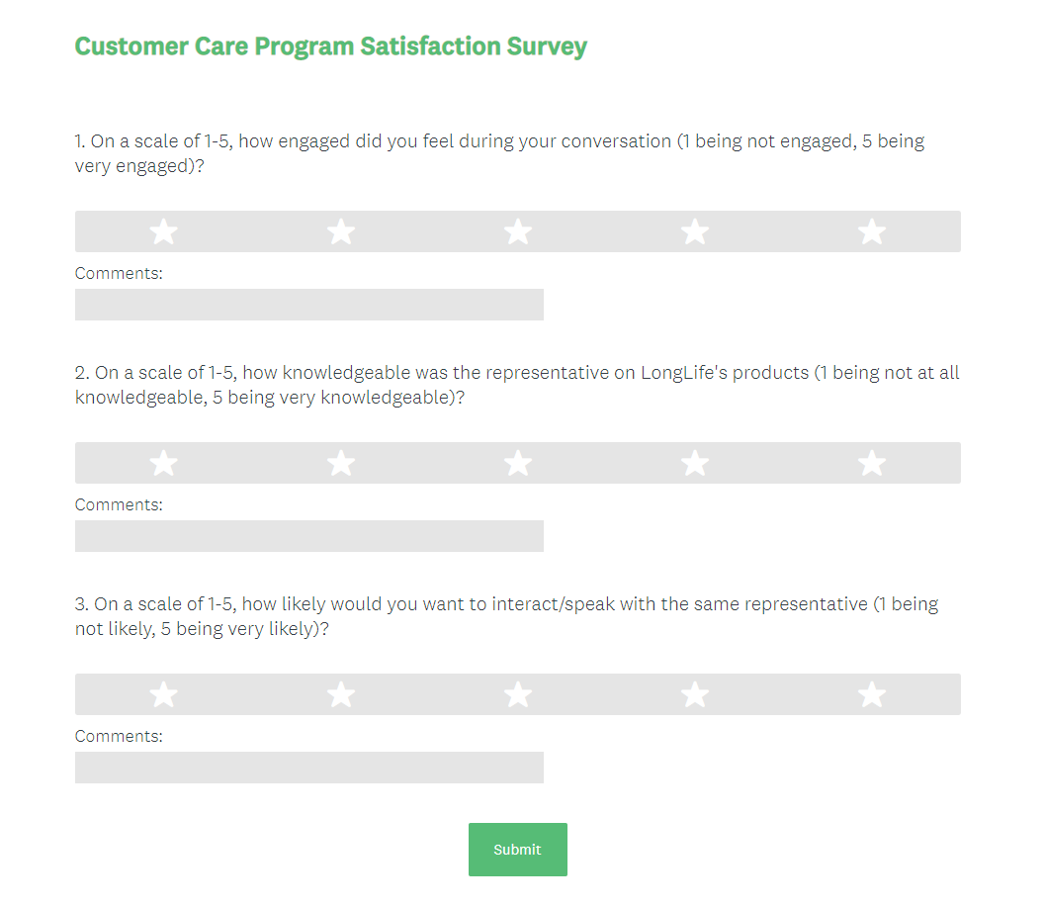
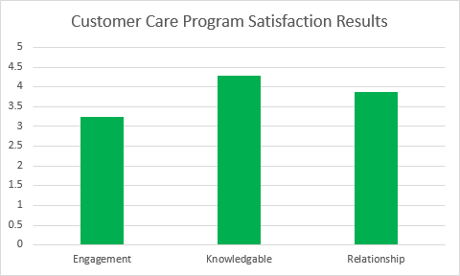
We will track the effectiveness of the Customer Care Program through survey feedback provided by our clients.
Notes:
Some of the deliverables we will be delivering to you throughout the process
Will be these surveys.

Slide 12
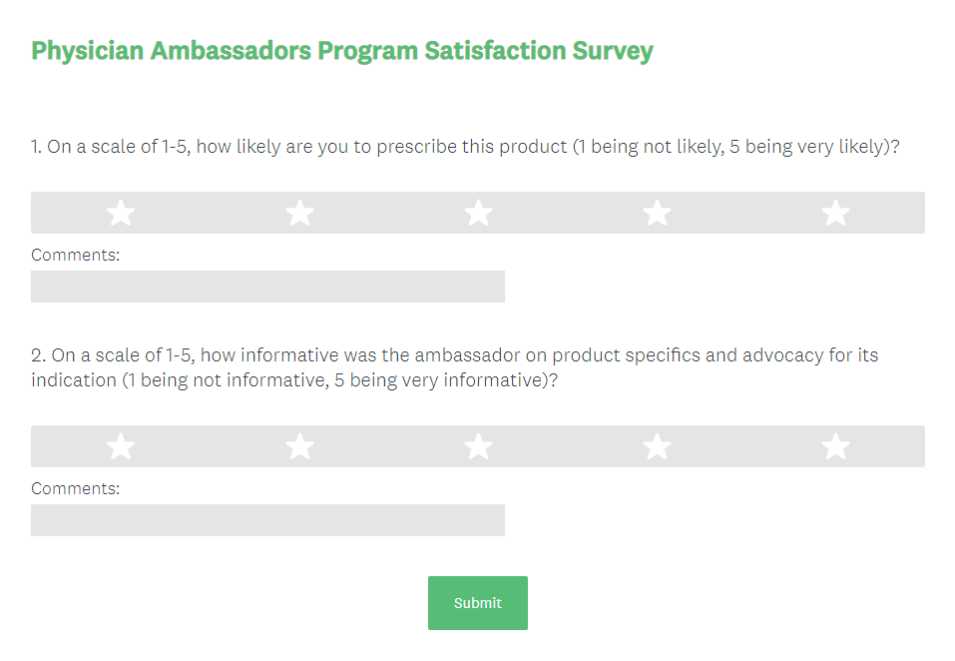
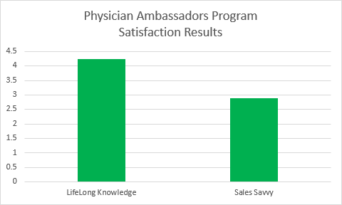
We will observe the performance of the Physician Ambassadors Program through survey responses from the potential customers.

Slide 13
Positive Net Present Value After 1 Year
Initial Costs
Training Sales Reps | $ 2,880,000
Training Ambassadors | $ 72,000
CRM Module Setup | $ 500,000
TOTAL INITIAL COST | $ 3,452,000
Net Present Value
2 Year NPV | $ 4,522,087
5 Year NPV | $ 24,746,356
Recurring Costs
Ambassador Salaries | $ 1,050,000
CRM Modules | $ 205,200
Hospital Partnership | $ 1,011,000
TOTAL RECURRING COST | $ 2,266,200
Discount Rate | 15%

Slide 14
Risks
Lack of buy in to people-first training program
Insufficient interest in becoming an ambassador
Dynamic CRM time frames
Mitigation
Communicate strategic goal of people-first tactic
Commissioned pay structure
Phased implementation approach
Data Interception, Modification, & Interruption
Data Confidentiality, Integrity, & Avalibility
Notes:
Risks
Finding a hospital to work with
Our drugs are not high performers
Training is not effective
Ambassadors do not have the network and connections we believe they do
CRM module takes longer to implement and to be effective than we believe
Mitigation
Finding Hospital: Starting with hospitals that have done similar projects
Drugs don’t perform: Analytics & feedback will tell us what is needed and we can adapt
Training Effectiveness:
Ambassadors Don’t have network: Pay structure mainly commissioned based somehow
CRM module: We need the data first, so we have extra time (bad mitigation)

Slide 15
Focusing on people and introducing new data is a must for LongLife to continue dominating the pharmaceutical world.
Service Oriented Model
Ambassador Hiring & Training
Hospital Partnership
Sales Representative Training
CRM Analytics Implementation

Slide 16
Appendix

Slide 17
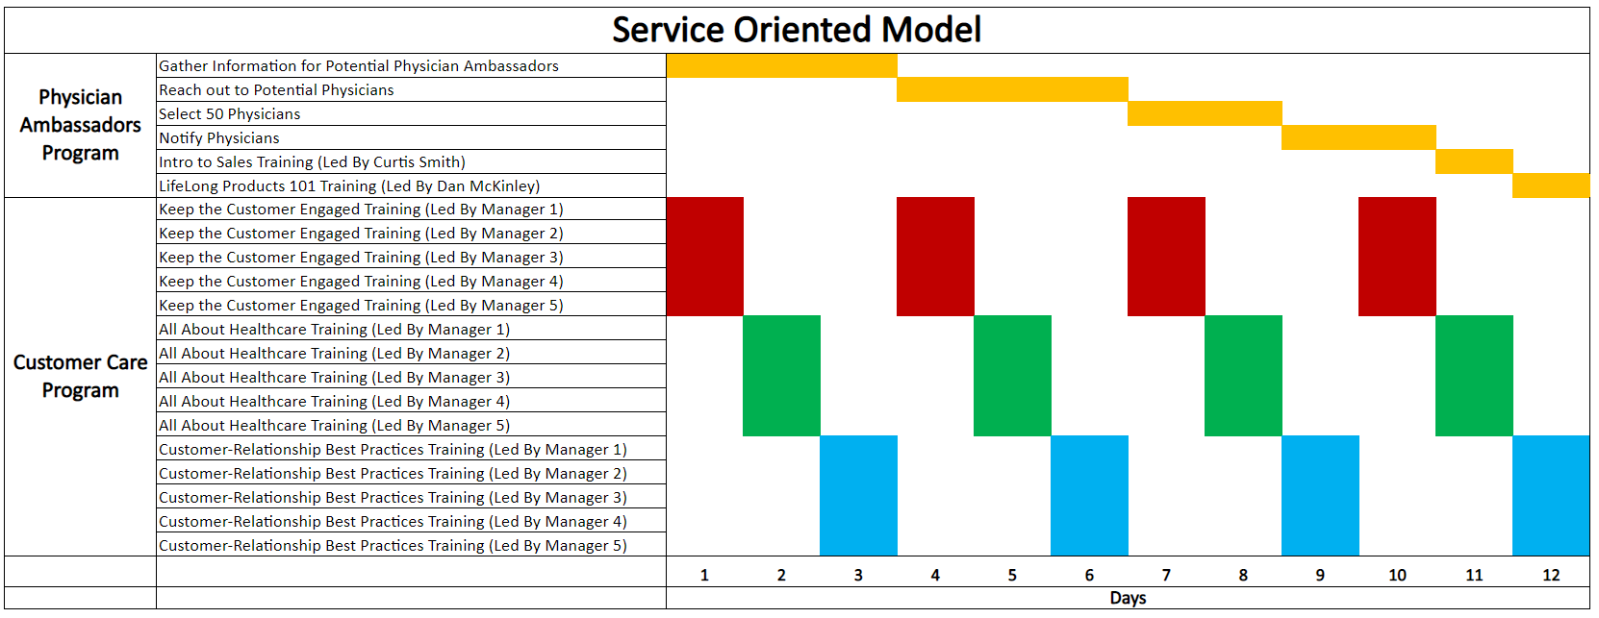
Sales Timeline

Slide 18
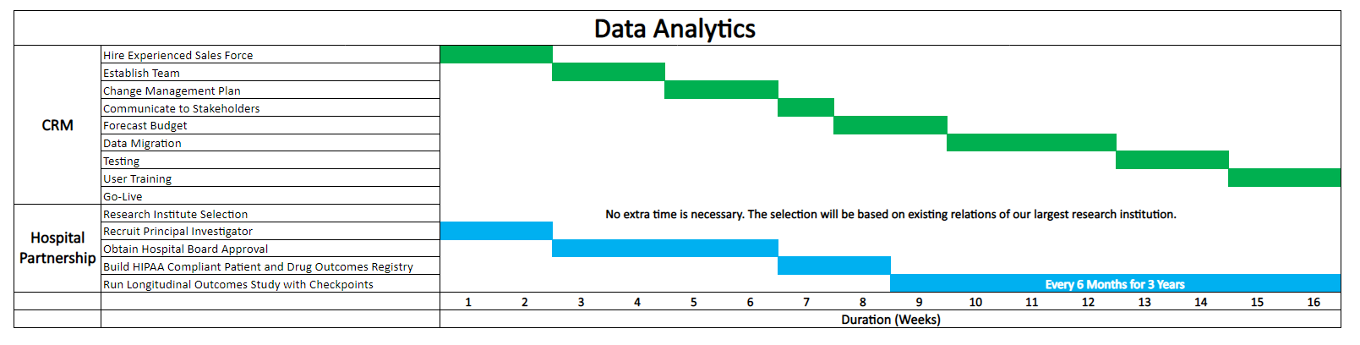
Data Timeline

Slide 19
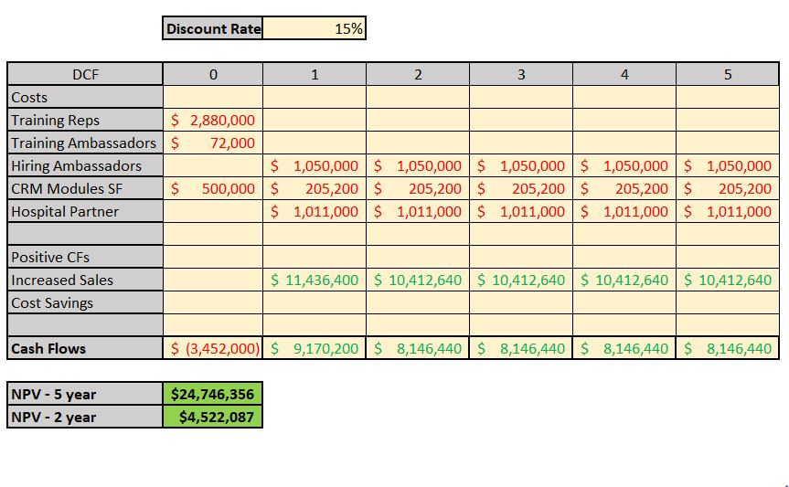
Cost-Benefit Analysis Calculations

Slide 20
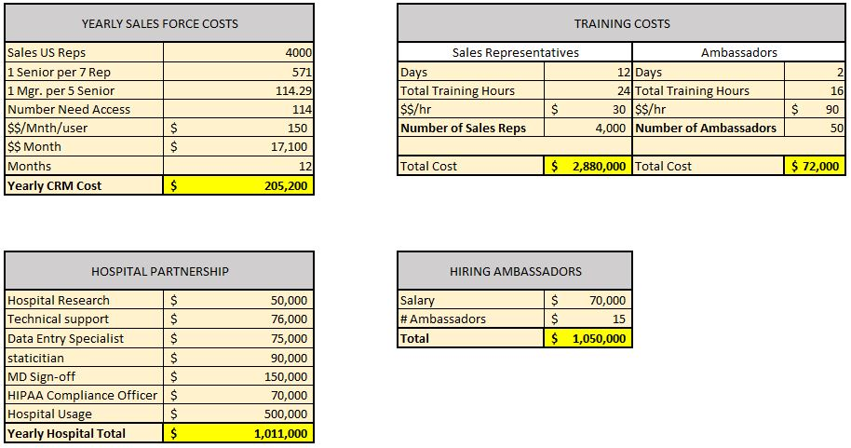
Cost-Benefit Analysis Calculations

Slide 21
Interview Insights with Dr. Ajay Jain, Gastroenterology
Requirements to successfully BEGIN an engagement with a busy physician
Offer a BRIEF information source such as electronic brochure or slide deck about the drug in question
Schedule a follow-up call – with explicit time frame and suggested duration
Without BOTH of these components, there is a HIGH likelihood that the physicians will immediately delete the email
Physicians are busy, stressed, overworked, and constantly pitched
Engagements must be clearly-defined
Drug facts must be meaningful and concise
Follow-up and next steps must require little to no effort on the physician's side
Ongoing engagements MUST be personable, not pitchy or sales-oriented

Slide 22

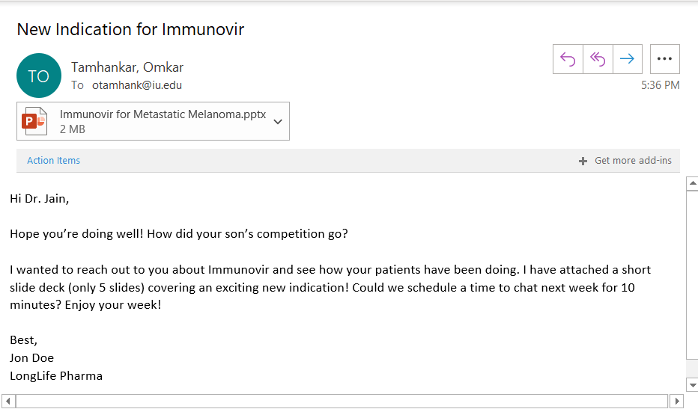
Example Engagement

Slide 23
Example Virtual Call
Call scheduled a week ahead of time for 12:00pm - 12:30pm with Dr. Jain
Zoom link provided in invite email
Panera Bread delivered by GrubHub to Dr. Jain's office at 11:45am for him to eat lunch during the call
This will fulfill a virtual lunch call experience
Conversation should be personable
Build a relationship over time
Quality Medications
Quality Relationships
High Sales Quantity

Slide 24
Drug Outcomes Data Collection Options
Existing Outcomes Research
Pros
Marginal to insignificant cost to collect studies executed independently
Shorter time frame to gather studies and synthesize performance metrics
Cons
Portfolio of drugs with performance metrics limited to what has been studied
No control on the metrics being investigated
Inconsistent source of data collection
Questionable quality of studies
Questionable trustworthiness of principal investigators of studies
In-house Data Collection
Pros
Total control of specific measurable metrics
100% consistency and reliability of outcomes data
After initial study, all future studies can follow similar templates for execution
Cons
Expensive process to create hospital partnerships and scrape data from EMRs
Lengthy time frame to run longitudinal outcomes studies and determine results

Slide 25
Sources
"At Your Service" Model to Help Pharma Be More Patient-Focused. (n.d.). Retrieved August 28, 2020, from https://social.eyeforpharma.com/commercial/your-service-model-help-pharma-be more-patient-focused-0
Cort. Valuing Pharmaceutical Assets: When to Use NPV vs RNPV. 2019, www.alacrita.com/whitepapers/valuing-pharmaceutical-assets-when-to-use-npv-vs-rnpv.
How the COVID-19 Pandemic is Impacting Pharma Sales Interactions with Healthcare Providers: Blog. (2020, May 15). Retrieved August 28, 2020, from https://www.everestgrp.com/2020-05 how-the-covid-19-pandemic-is-impacting-pharma-sales-interactions-with-healthcare providers-blog-.html
Staton, Tracy. Does Pharma Spend More on Marketing than R&D? A Numbers Check. 21 May 2013, www.fiercepharma.com/regulatory/does-pharma-spend-more-on-marketing-than-r-d-a numbers-check.

Slide 26
Manifestation of Sales and Analytics Proposal
Proposal
Sales
Analytics
Customer Experience
Impact and meaningful personal engagement
High precision marketing targets
Process
Training program
CRM implementation and research execution
People
Sales reps and physicians
Principal Investigator, data analytics team, and enterprise systems specialists
Technology
Food delivery applications, virtual conferencing application, and email
CRM, DBMS, and EMR

