Slide 1
AI Pokemon Battler
Nick Sucietto, Alex Turner, Eric Wolff
Advisor: Dr. John Gallagher

Slide 2
Goals
To create an AI Agent that can participate in a Pokemon battle and is capable of beating human opponents.
To create an environment in which a player can test the strengths of new teams before playing against human opponents

Slide 3
Intellectual Merits
The battler is able to perform complex decision making (selecting moves, switching Pokemon, predicting opponents’ moves)
In the dynamic environment of Pokemon, the battler must be able to adapt to new strategies and teams
Allows for a controlled environment in which users can attempt new strategies before battling human opponents

Slide 4
Broader Impacts
Allows players in the competitive scene to create and test teams before exposing them to other players
Allows for creation of better opponents for future games
The strategies and decisions that the battler makes could be transferred to other similar environments

Slide 5
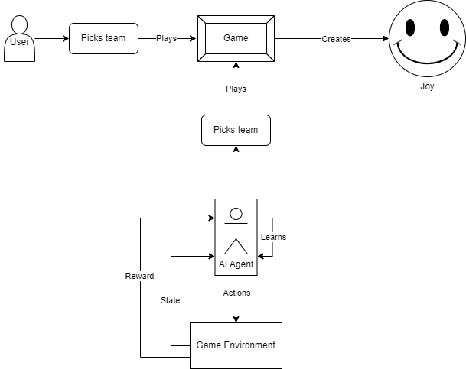
Design Specifications
The AI Agent is a Deep Q Network variant that was trained in an OpenAI gym environment using a local Pokemon Showdown server. The user builds and runs the server locally and runs a script to battle the bot.

Slide 6



Technologies
Dueling Double DQN- variant of the Deep-Q Network that addresses the issue of overestimation bias in Q-learning by decoupling the action selection and evaluation processes. The split output (dueling) improves learning in environments where actions might not affect the game state in a meaningful way. This is the reinforcement learning algorithm used to train our agent.

Slide 7
Milestones
Set up the pokemon simulator
Get pokemon simulator servers working locally.
Write programs to query the servers.
Test to ensure that battle mechanics work properly.
AI
Write the AI
Research reinforcement learning.
Figure out architecture.
Define reward Criteria.
Train the AI
Battle real people to test
(Time-dependent) Other battle types
Implement double battles.

Slide 8
Results
Currently the agent is able to beat a heuristic function bot we use for benchmarking performance and is capable of beating human opponents. As we continue towards our expo demo we will continue to train the agent to improve its performance.
We will also try to streamline setting up the environment to make it easier to be able to set up a battle against the bot during the demo.

Slide 9
Challenges
The biggest challenge was getting the agent to communicate properly with the pokemon showdown environment. There are also a lot of edge cases in pokemon battles that we had to try to account in creation and training of the agent.

