Slide 1
Cuckoo Filter on the GPU
Tim Dortmann

Slide 2
Contents
Approximated Membership Query Filters
Why the Cuckoo filter
How to parallelise to run efficiently on the GPU
Benchmarks

Slide 3
AMQ Filters
Imagine you have a (static) set of items
Want to quickly check if something is part of said set
Should be fast with minimal memory usage
Often used in databases/distributed systems
We’re okay with a few false positive
Bloom filter as the “standard” solution
What if we also want to support deletion?

Slide 4
Why the Cuckoo Filter
Either better FPR at same space or less space for same FPR
Only stores a fingerprint per item (n lowest bits of hashed item)
Supports deletion
Lookup is still guaranteed constant time
In theory no false negatives
GPU is interesting to support massive batches

Slide 5
Implemented Variants
Hybrid Approach (GPU only for lookups, no buckets)
CPU only (single-threaded)
GPU only (this is where all the optimisations happened)

Slide 6
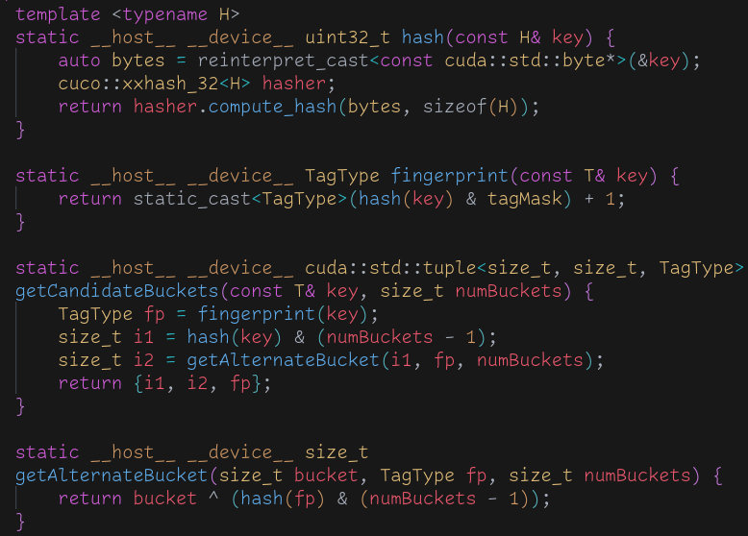
How does the filter work
Most parts behave identically to a normal hash table
Except we only store a “fingerprint” of the key
=> No rehashing, responsibility falls on the user
Item can be in one of exactly 2 buckets
Thanks to XOR you only need to know one bucket index

Slide 7
How to parallelise (Querying)
There is no dependency between threads
Just find the two potential buckets and search through them
Use multiple streams to hide latency and work on multiple chunks in parallel

Slide 8
How to parallelise (Insertion)
The nature of the algorithms means we jump around like crazy (this is bad for obvious reasons)
Each bucket has a spinlock for threads to acquire
Use the tag to calculate an initial index in the bucket to improve performance
As the table fills up the number of collisions grows rapidly
=> Kernel runs slower
Can deal with this to an extent by again overlapping copy and compute

Slide 9
Benchmark Setup
AMD Ryzen Threadripper 3990X, NVIDIA 4090
Generate a ton of random numbers on the host
Insert them all into the table and then query them all
Assert that results are as expected
Several rounds of this process and take the average
Deletion is implemented and works but not part of the benchmark

Slide 10
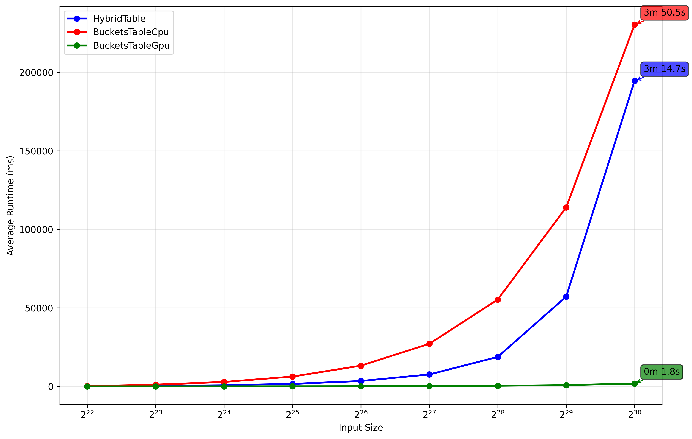
Runtime/Space Comparison
The GPU only variant is significantly faster (110x and 130x)
Space wise the hybrid one is by far the least efficient
CPU variant more efficient space wise (no locks, no extra device view)
Runtime variance is quite high (presumably due to the randomness)

Slide 11
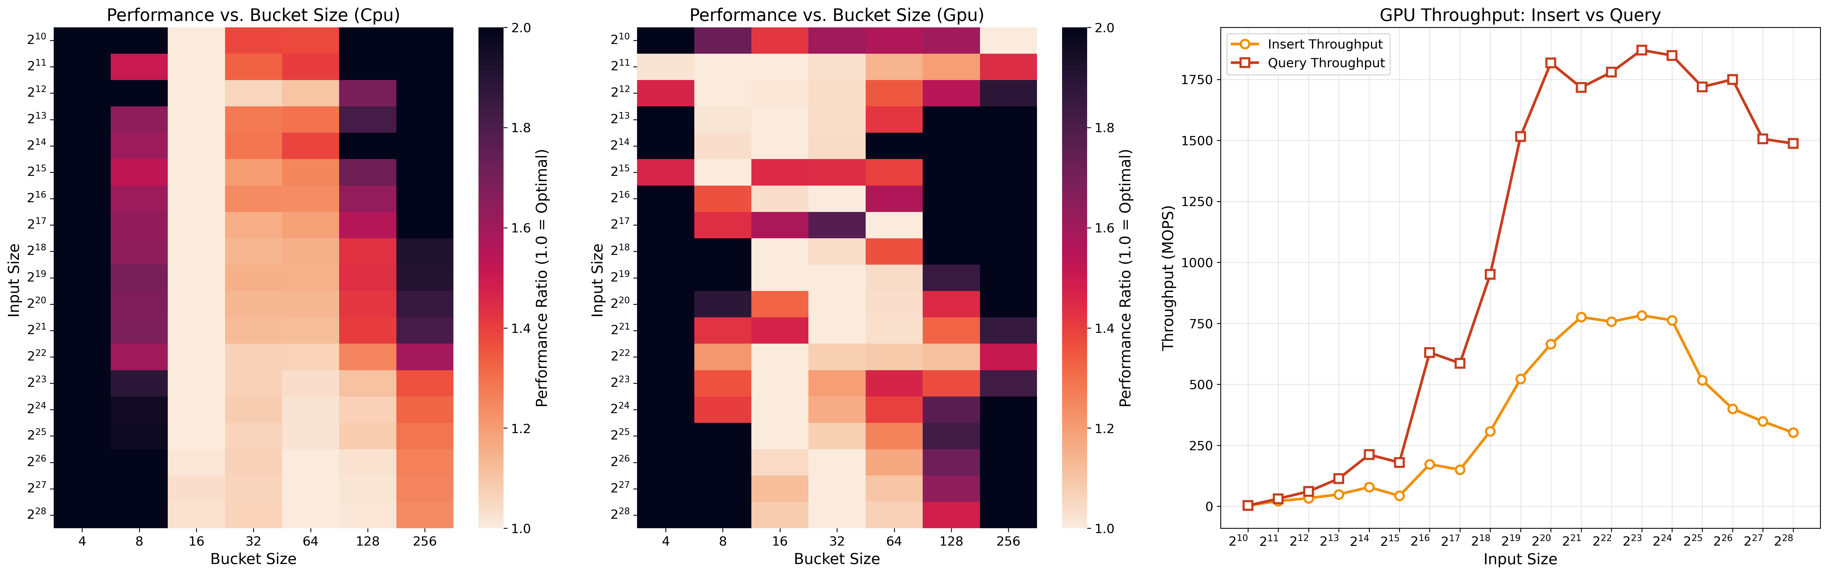
Performance Analysis

Slide 12
Thank you for your attention!
Any questions?

