Slide 1
電腦攻擊與防禦
The Attack and Defense of Computers
Dr. 許 富 皓

Slide 2
Sniffer

Slide 3
Packet Sniffer
A Packet sniffer (also known as network or protocol analyzer or Ethernet sniffer) is
  computer software (usually)
  or
  computer hardware
that can intercept and log traffic passing over
  a digital network
  or
  part of a network.
As data streams travel back and forth over the network, the sniffer captures each packet and eventually decodes and analyzes its content according to the appropriate RFC or other specifications.
Notes:
telnet、ftp都沒有加密(不要使用)

Slide 4
DOWNLOAD AREA
Sniffers – Windows
Qarchive
Sniffers – Linux
Wireshark

Slide 5
Badware_{[StopBadWare][ricky]}

Slide 6
Badware Websites
A badware website is a website that helps distribute badware, either intentionally or because it has been compromised.
Many normal, legitimate websites are infected and turned into badware websites without the knowledge of their owners.

Slide 7
Definition of Badware
Badware is software that fundamentally disregards a user’s choice about how his or her computer or network connection will be used.

Slide 8
Purposes of Badware
Some badware is specifically designed for criminal, political, and/or mischievous purposes.
Some badware may not have malicious intentions, but still fails to put the user in control.
  for example, a browser toolbar that helps you shop online more effectively but does not mention that it will send a list of everything you buy online to the company that provides the toolbar.

Slide 9
Malicious Behavior of Badware
stealing bank account numbers, passwords, company secrets, or other confidential information
tricking the user into buying something that he or she doesn't need
sending junk email (spam), or sending premium text messages from a mobile device
attacking other computers
distributing more badware

Slide 10
Malware
Badware performed malicious behavior is often referred to as malware.
It includes
  Viruses
  Trojans
  Rootkits
  Botnets
  Spyware
  Scareware
  and more.

Slide 11
Examples of Badware
free screensavers that surreptitiously generate advertisements
malicious web browser toolbars that take your browser to different pages than the ones you expect
keylogger programs that can transmit your personal data to malicious parties

Slide 12
Badware Distribution
Some manufacturers bundle badware with other applications without disclosing that it’s part of the package.
Through badware websites.
Some badware is put on your PC when you play online games.

Slide 13
How can badware websites harm my computer? (1)
Some badware websites infect your computer with badware using drive-by downloads.

Slide 14
Drive-by Download
Drive-by downloads occur when a website automatically (and often silently) installs software as soon as you visit the site; no clicking is necessary.
Typically this kind of attack takes advantage of a vulnerability or “hole” in your web browser, a browser plug-in, or other software on your computer.

Slide 15
How can badware websites harm my computer? (2)
Social engineering attacks are also common ways for badware websites to distribute badware.
  These attacks take advantage of human nature by tricking people into installing badware.

Slide 16
Social Engineering Attack Examples
A popular trick shows a fake virus scan that indicates that your computer is infected and encourages you to download and/or purchase a tool to remove the infection.
Another popular trick is offering to display a video that sounds interesting, but only after you install a plug-in or codec that is “required” to view the content.

Slide 17
Common Types of Badware Behavior on Compromised Websites _{[stopbadware]}
The three most common types of badware behavior StopBadware sees on compromised websites are
  malicious scripts
  .htaccess redirects
  hidden iframes

Slide 18
Malicious Scripts (1) _{[stopbadware]}
Malicious scripts are often used to redirect website visitors to a different site, or to load badware from another source.
See how the following script misspells "analytics"?
Some malicious scripts use names that look like they're coming from legitimate sites.

Slide 19
Malicious Scripts (2) _{[stopbadware]}
These scripts will often be injected by an attacker into the content of your web pages.
Sometimes, instead of injecting the entire script into your web pages, the attacker will only inject a pointer to a .js or other file that the attacker saves in a directory on your web server.

Slide 20
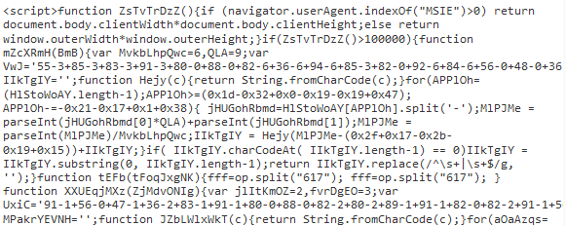
Malicious Scripts (3) _{[stopbadware]}
Many malicious scripts (like the one below) use obfuscation to make them more difficult for antivirus scanners to detect.

Slide 21
.htaccess Redirects _{[stopbadware]}
The Apache web server, which is used by many hosting providers, uses a hidden server file called .htaccess to configure certain access settings for directories on the website.
Attackers will sometimes modify an existing .htaccess file on your web server or upload new .htaccess files to your web server containing instructions to redirect users to badware websites.

Slide 22
Hidden iframes (1) _{[stopbadware]}
An iframe is a section of a web page that loads content from another page or site.
Attackers will often inject malicious iframes into a web page or other file on your server.
Often, these iframes will be configured so they don't show up on the web page when someone visits the page, but the malicious content they are loading will still load, hidden from the visitor's view.

Slide 23
Hidden iframes (2) _{[stopbadware]}
<iframe src=“http://youneed.info/in.php” width=0 height=0 frameborder=0>

Slide 24
Common Symptoms of Badware Infection (1)
I’m constantly bombarded with pop-ups:
  Although browsing certain websites may cause you to see occasional pop-up advertisements, if you find that you are being inundated with pop-ups there is a good chance that these ads are being displayed by unwanted software that is installed on your computer.
  You may even start to see pop-ups when you aren’t connected to the internet, which is an even stronger indication that your computer is infected with badware.

Slide 25
Common Symptoms of Badware Infection (2)
My homepage or browser preferences have changed:
  Many types of badware change your
    browser settings
    or
    operating system settings
  in order to
    show advertisements
    or
    make their own websites more visible.
  If when you start your browser you are taken to a page you didn’t select, or your internet toolbar is no longer functioning correctly, your computer may be infected.
  You may also find that you no longer have control to change your settings or preferences back to their defaults.

Slide 26
Common Symptoms of Badware Infection (3)
My computer is running slowly:
  Many types of badware can put a significant load on your system without ever identifying itself.
  The resources used by these programs to
    show advertisements
    transmit information
    or
    track your behavior
  can crash or slow your computer.
  If you find that your computer is
    crashing
    or
    running slowly
  with increased frequency, you may have badware.

Slide 27
Side-Effect
Incessant pop-up ads are one possible side-effect.
Sometimes peoples' computers slow down or even crash.
Sometimes peoples' personal information is abused, and there have been reported cases of identity theft.

Slide 28
Who support badware?_{[ricky]}
Ans.
  It's the Wild West of aggressive marketing and an industry supported by
    shadowy online marketers
    small application vendors
    and
    website operators.

Slide 29
stopBADware.org_{[sBw]}
stopBADware.org is a partnership among
  academic institutions
  technology industry leaders
  and
  volunteers
all of whom are committed to protecting Internet and computer users from the threats to privacy and security that are caused by bad software.

Slide 30
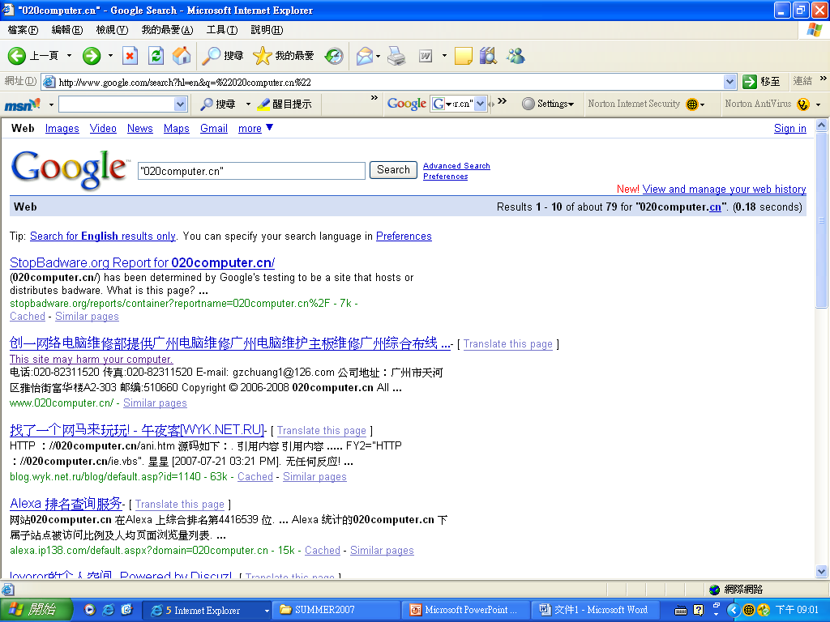
Dangerous Web Site _{[stopbadware]}
Google search keyword: "020computer.cn"
Assignment:
Use a sniffer to check what information is sent back to the malicious site.

Slide 31
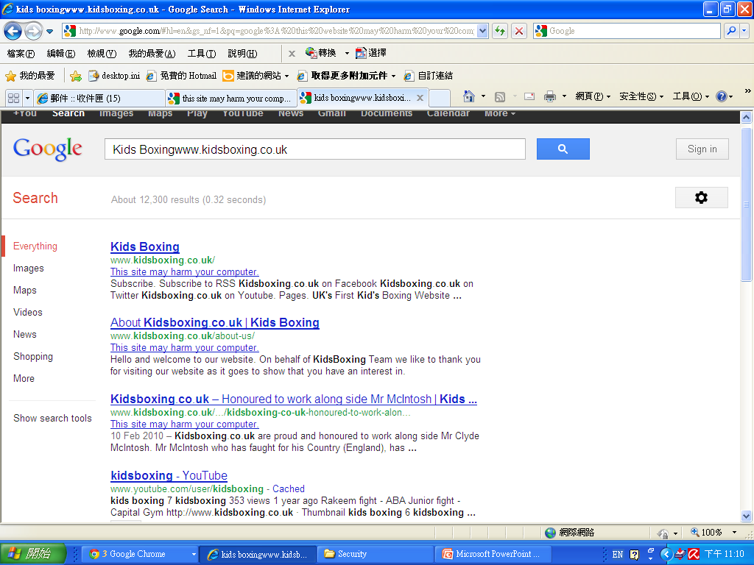
Dangerous Web Site
www.kidsboxing.co.uk/

Slide 32
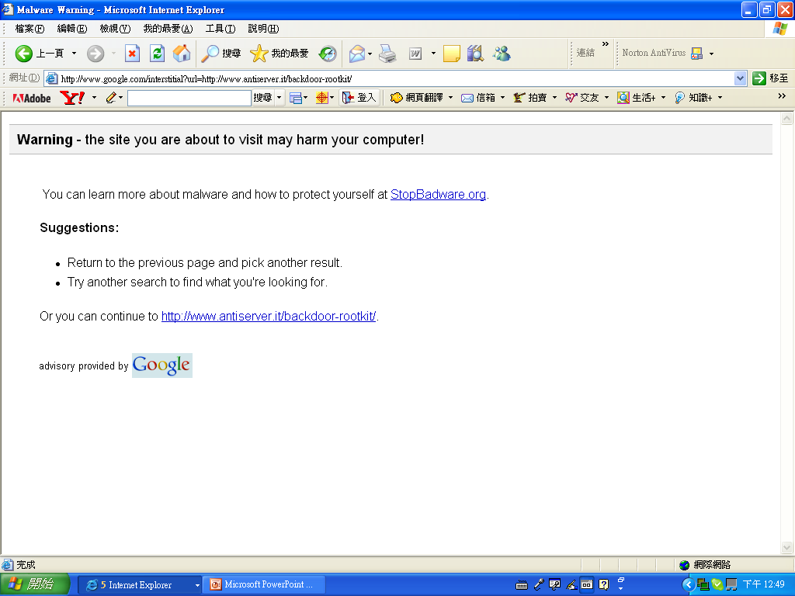
Dangerous Web Site
http://www.antiserver.it/backdoor-rootkit/
This is an old Google warning page.

Slide 33
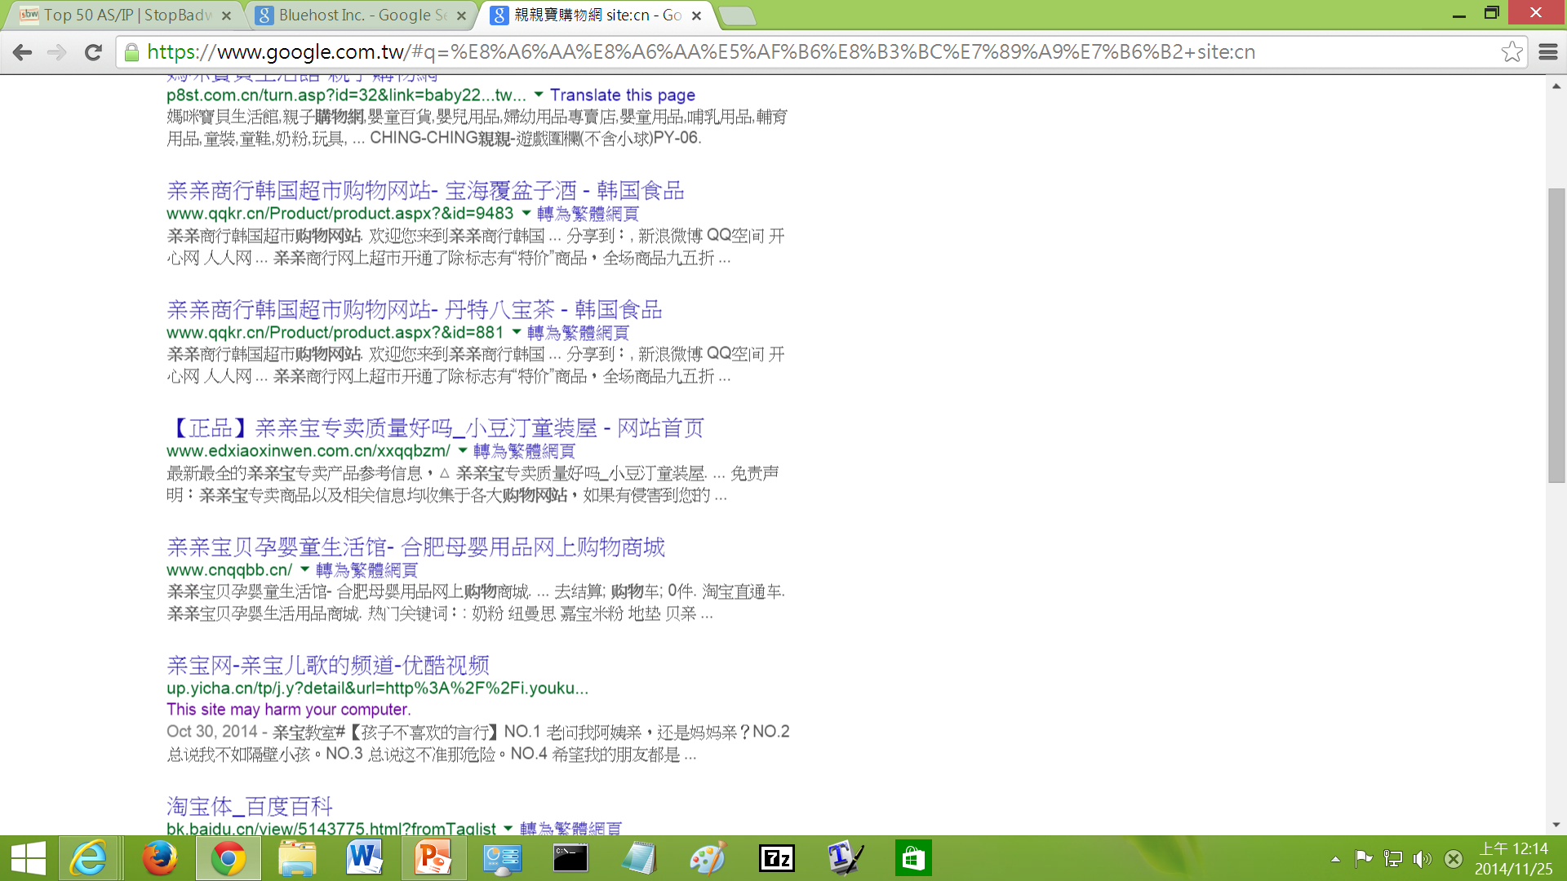
Dangerous Web Site

Slide 34
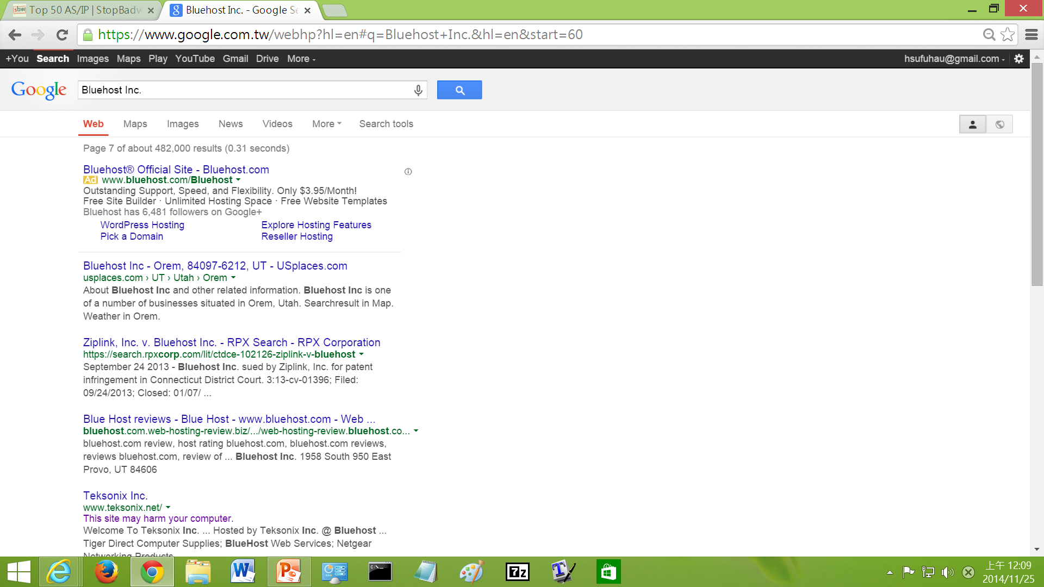
Dangerous Web Site

Slide 35
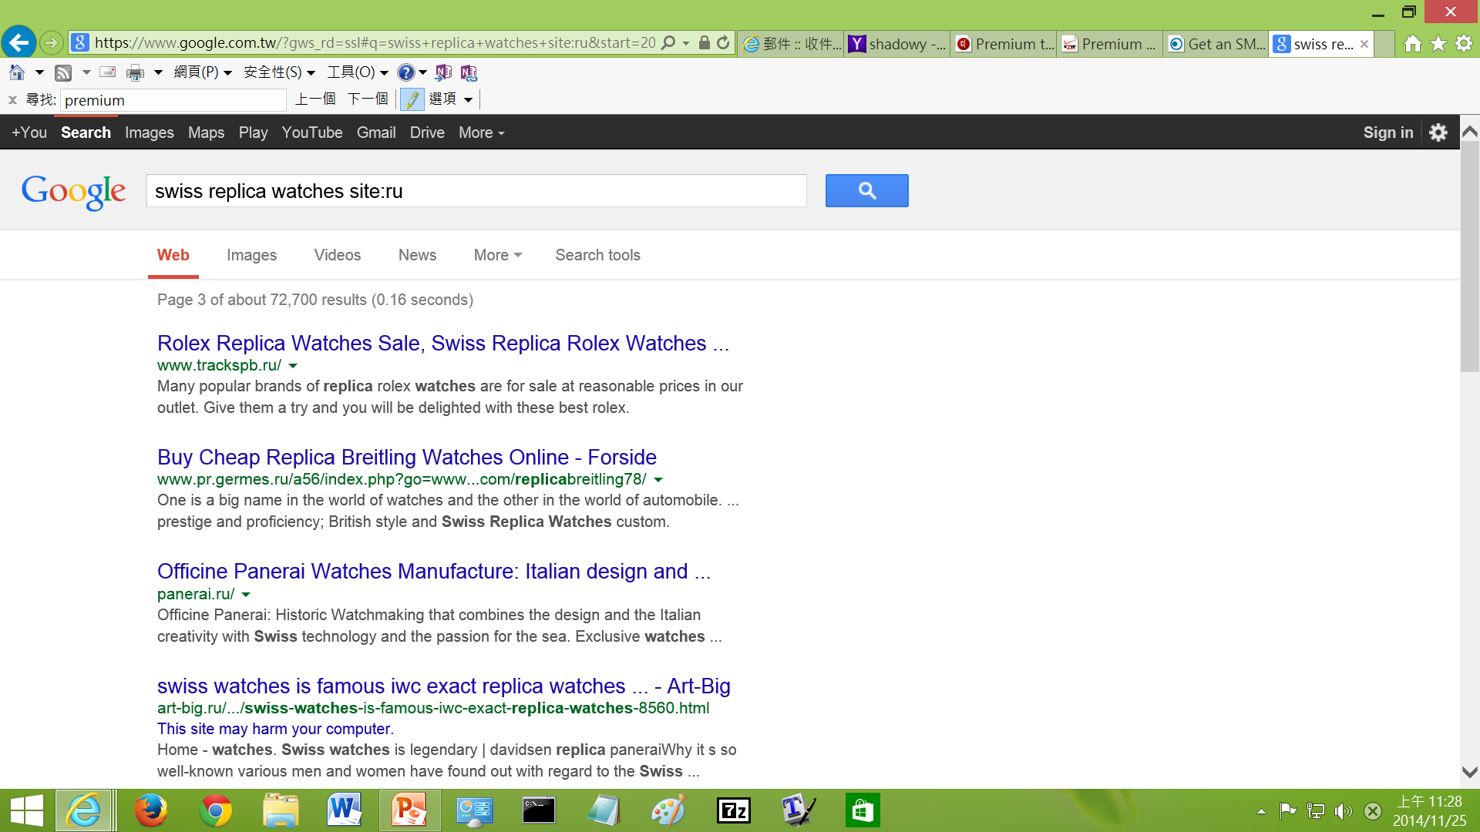
Dangerous Web Site

Slide 36
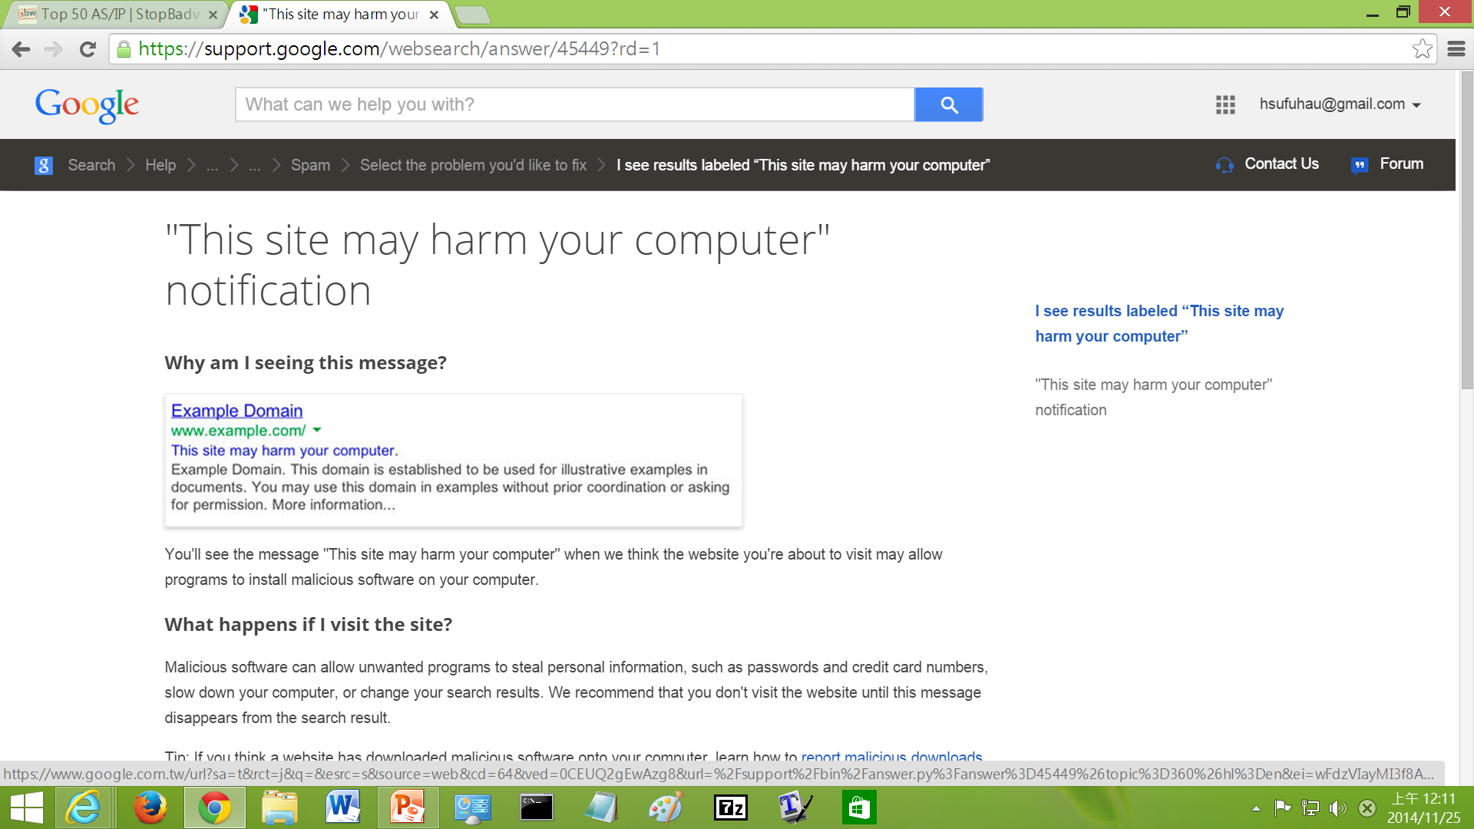
"This site may harm your computer" Notification

Slide 37
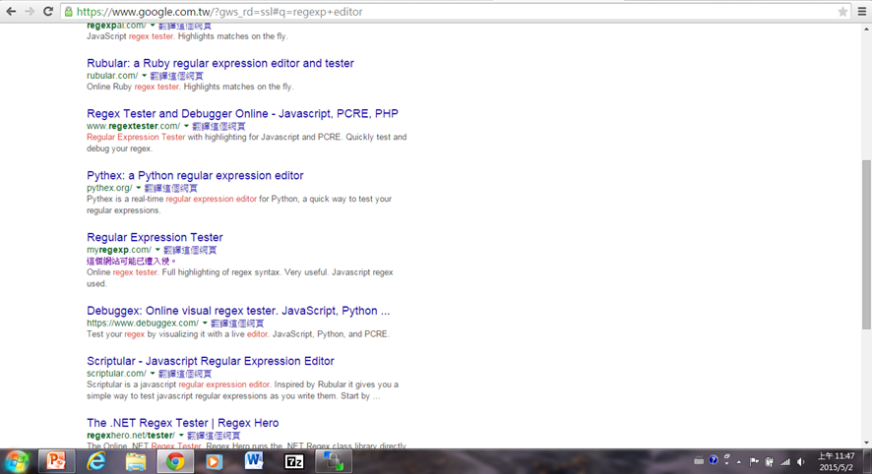
Dangerous Web Site

Slide 38
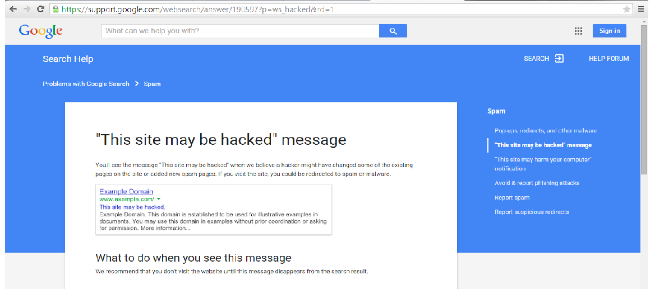
"This site may be hacked" message

Slide 39
Rootkit

Slide 40
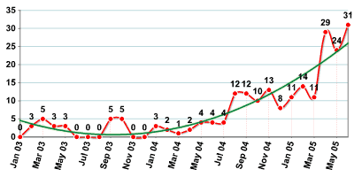
Increase in Use of Rootkits in Malicious Programs
As the following graph shows, rootkits are becoming more and more widely used in order to mask the presence of malicious code on infected systems.

Slide 41
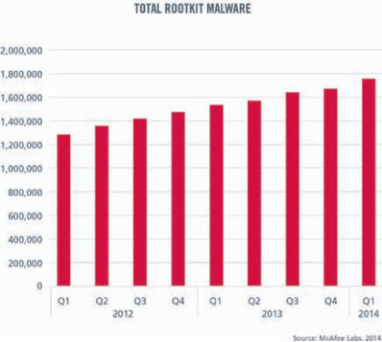
Total Rootkit Malware _{[Mcafee]}

Slide 42
What Is Rootkit_{[Saliman Manap]} (1) ?
Rootkit name are combination from two words, “root” and “kit”.
  “Root” was taken from “root,”
    a name of UNIX administrator, which is the highest-access level in UNIX environments.
  “kit” can be referred as tools.
From this word we can interpret rootkit as
  tools
  or
  collection of tools
that enable an attacker to keep the root power on the compromised system.
In order to keep the continuously power over the compromised server, he/she should hide their presence from being detected by administrator.
Notes:
Rootkit 本身不會危害電腦

Slide 43
What Is Rootkit (2) ?
The best meaning we can describe rootkit is it is a tool or collection of tools that
  hide an attacker presence
  and
  at the same time give the attacker ability to keep full control the server or host continuously without being detected.

Slide 44
Information to Hide
A rootkit is a set of software tools intended to conceal
  running processes
  files
  system data
thereby helping an intruder to maintain access to a system whilst avoiding detection.

Slide 45
Access Level Required to Install Rootkits
In UNIX environment the attacker installs a rootkit on a computer after first obtaining the access level, either by user-level access or administrator-level access.
Administrator-level access is needed for most rootkit installation.
  This can be done by exploiting known remote vulnerabilities to gain the root-level access.
If the attackers only have user-level access,
  local exploit
  or
  cracking administrator password
need to be done in order to get full access level
before rootkit successfully installed.

Slide 46
Common Rootkit Usage (1)
Hide all sorts of tools useful for attacks
  This includes tools for further attacks against computer systems the compromised system communicates with.
    such as keyloggers which can record account info. issued from the compromised computer.
  A common abuse is to use a compromised computer as a staging ground for further attack.
    This is often done to make the attack appear to originate from the compromised system or network instead of the attacker.
    Tools for this can include
      tools to relay chat sessions
      e-mail spam attacks.

Slide 47
Common Rootkit Usage (2)
Allow the programmer of the rootkit to see and access
  user names
  and
  log-in information
for sites that install them.
The programmer of the rootkit can store unique sets of log-in information from many different computers.
    This makes the rootkits extremely hazardous, as it allows Trojans (e.g. ssh, telnet) to access this personal information while the rootkit covers it up.

Slide 48
Other Tools That May Also be Contained in a Rootkit
As attacker undercover tools, rootkit programs must have a capability to mask the intrusion and his presence.
The rootkit may consist of several other utilities such as:
  Back door programs
  Packet sniffers
  Log-wiping utilities
  Log editor
  Miscellaneous programs
    DDoS program
    IRC program:
      This IRC bot will connect to the nets and log on some server waiting for the attacker to issue a command to them.
    Attacker utility
    System patch

Slide 49
Rooted Computers and OSes
Rootkits are known to exist for a variety of operating systems such as
  Linux
  Solaris
  and
  versions of Microsoft Windows.
A computer with a rootkit on it is called a rooted computer.

Slide 50
Download Rootkits
Rootkits
Rootkits – Windows (1)
Rootkits – Windows (2)
Rootkits – Linux

Slide 51
Categories of Rootkits

Slide 52
General Classification of Rootkits
There are several rootkit classifications depending on
  whether the malware survives reboot
  and
  whether it executes in user mode or kernel mode.
Persistent Rootkits
Memory-Based Rootkits
Library Level Rootkits
Application Level Rootkits
Kernel Level Rootkits
Virtualised Rootkits

Slide 53
Persistent Rootkits
A persistent rootkit is one that activates each time when a system boots.
Because such malware contains code that must be executed automatically each time
  when a system starts
  or
  when a user logs in,
it must
  store code in a persistent store, such as file system
  configure a method by which the code executes without user intervention

Slide 54
Memory-Based Rootkits
Memory-based rootkits are malware that has no persistent code and therefore does not survive a reboot.
Notes:
Pros : 一般掃毒軟體不掃memory

Slide 55
Library Level
Library rootkits commonly patch, hook, or replace system calls with versions that hide information about the attacker.
Notes:
patch : 改掉原本code中的一部分
hook : 取代function table中的位置
replace : 全部換掉

Slide 56
Application Level
Application level rootkits may replace regular application binaries with Trojanized fakes.
or
They may modify the behavior of existing applications using hooks, patches, injected code, or other means.

Slide 57
Kernel Level Rootkits
Kernel level rootkits add additional code and/or replace a portion of kernel code with modified code to help hide a backdoor on a computer system.
  This is often accomplished by adding new code to the kernel via a device driver or loadable module, such as
    Loadable Kernel Modules in Linux
    or
    device drivers in Microsoft Windows.
  These rootkits often have serious impacts on entire system stability if mistakes are found to be present in the kit's code.
Kernel rootkits can be especially dangerous because they can be difficult to detect without appropriate software.

Slide 58
Virtualized Rootkits
Virtualized rootkits are the lowest level of rootkit currently produced. These rootkits work by modifying the boot sequence of the machine to load themselves instead of the original operating system.
Once loaded into memory a virtualized rootkit then loads the original operating system as a Virtual Machine thereby enabling the rootkit to intercept all hardware calls made by the guest OS.

Slide 59
for Unix Family _{[Saliman Manap]}

Slide 60
Categories of Rootkits – Unix Family
We can categories the rootkit into two types.
  Application rootkit
    established at the application layer.
  Kernel rootkit
    establish more deep into kernel layer.

Slide 61
Application Rootkits

Slide 62
Application Rootkit
Application rootkit was the conventional rootkit and widely used in loosely environment.
The method using by application rootkit is replacing the good system application with Trojaned system file.
The Trojaned system file
  will provide backdoor to hide the attackers presence
  will not log any
    connection
    and
    activity
  done by the attacker.

Slide 63
Programs Replaced to Hide Attacker Presence (1)
ls, find, du
  Trojaned system files will be able to hide
    attacker files
    directories
    and
    stuff that have been brought into the system
  from being listed.
ps, top, pidof
  All these programs are process monitor programs.
  Trojaned programs will hide attacker processes from being listing.

Slide 64
Programs Replaced to Hide Attacker Presence (2)
netstat
  netstat is used to check network activity such as
    open port
    network connections established and listening.
  Trojaned netstat will hide processes installed by attackers such as
    ssh daemon
    or
    other services.
killall
  Trojaned killall will not be able to kill attacker process.

Slide 65
Programs Replaced to Hide Attacker Presence (3)
ifconfig
  When sniffer is running, PROMISC flag is set to the NIC.
  ifconfig is a handy utility to set and to view setting of ethernet NIC.
  Trojaned ifconfig will not display the PROMISC flag when sniffer is running. This is useful to hide sniffer from being detected.
crontab
  Trojaned crontab will hide the attacker’s crontab entry.
tcpd, syslogd
  Trojanised tcpd and syslog will not log any connection made by attacker.
  tcpd also capable to bypass tcp wrapper enforcement.

Slide 66
Programs Contained Backdoors
chfn
  A root shell can be gain if a backdoor password is entered.
chsh
  A root shell can be gain if a backdoor password is entered as new shell.
passwd
  A root shell can be gain if a rootkit password is entered as current password.
login
  can log into any username including root if a rootkit password is entered after a password prompt.
bd2
  Trojaned rpcbind program will allow the attacker to run arbitrary commands on the target system.

Slide 67
Network Daemons with Backdoors
inetd
  Trojaned inetd will open ports for attackers to log in.
  The password must be entered in the first line to gain root access.
rshd
  Trojaned so that if the username is the rootkit password, a root shell is bound to the port, i.e.,
  rsh [hostname] - l [rootkit password]
sshd
  Sometime a ssh daemon is installed to give the attacker secure channel from being capture by authorized sniffer.

Slide 68
Sniffer Program
linsniffer
  A small network sniffer for Linux.
sniffchk
  A program to check and to make sure a sniffer is still running.
le
  Solaris Ethernet packet sniffer.
snif
  another packet sniffer for Linux.
sniff-10mb
  A sniffer designed to work on a 10mbps Ethernet connection.
sniff-100mb
  A sniffer designed to work on a 100mbps Ethernet connection.

Slide 69
Other Utilities
fix
  installs a Trojaned program (e.g., ls) with the same timestamp and checksum information.
wted
  wtmp editor. You can modify the wtmp.
z2
  erases entries from wtmp/utmp/lastlog.
bindshell
  binds a root shell to a port (port 31337 by default).
zap3
  erased their tracks from wtmp, utmp, lastlog, wtmpx, and utmpx.
  zap3 looks for log files in commonly used log directories such as/var/log, /var/adm, /usr/adm, and /var/run.

Slide 70
Other Methods to Hide Files
a hidden directory or file
  Files or directories beginning with dot “.” are easiest method to hide stuff from administrator eyes.
  A directory or file begins with dot “.” will not be listed by ls command unless flag –a is used.
directories which is not usually checked by administrator
  several favorite place such as /var, /dev, or /lib.

Slide 71
Kernel Rootkits

Slide 72
Kernel Rootkits
Kernel rootkits are powerful rootkits which are less detectable than application rootkits.
By manipulating and exploiting kernel capability it’s become hardest rootkit to detect because it can bypass conventional system integrity checker at application layer.

Slide 73
OSes Targeted by Kernel Rootkits
Although the first release of kernel rootkits was mainly written for Linux but it can be modified to be ported to other operating systems as well.
Several document was written for other operating systems,
  For FreeBSD; Attacking FreeBSD with Kernel Modules was written by pragmatic/THC on Jun 1999.
  For Solaris; Solaris Loadable Kernel Modules written by Plasmoid / THC in 1999.
  For windows some development on rootkit can be access at http://www.rootkit.com

Slide 74
The Kernel Modules_{[Hitchhiker's World ]}
Kernel modules are basically programs that can be dynamically loaded and unloaded from a running kernel.
The idea is to keep the memory footprint of the kernel as small as possible, loading only those drivers that are needed at the moment.

Slide 75
Initialize a Kernel Modules _{[Hitchhiker's World ]}
When the module is loaded, it is first "linked" with the running kernel.
A module usually imports the addresses of various functions in the kernel. These are setup first.
Other house-keeping activities like adding the module's name and information to a linked list of modules are also done.

Slide 76
System Calls
A system call is a function through which a user level process get the services provided by the kernel.
Basically, a system call is a service provided by the OS to programs.
  For instance,
    if you want to read a file, you'll use a system call,
    if you want to list files in a directory, you'll use a system call,
    if you want to open a socket, even then you'll use a system call.

Slide 77
System Call Table
Associated with each system call, there is a system call service routine.
The addresses of all system call service routines are stored at the system call table.
In Linux, the sys_call_table pointer being defined in entry.S points to the system call table.

Slide 78
System Call Abuse
After a kernel module is loaded into the kernel, it becomes a part of the kernel; hence, it can access and modify the system call table.
By modifying a system call table entry to point to another function, a rootkit can hook her/his function into the corresponding system call, thus change the behavior of the system call.

Slide 79
Get the Address of System Call Table
In earlier versions of the kernel, the sys_call_table address was exported.
You could just put an extern void ** sys_call_table and it would work.
That's no longer the case in 2.6. Here, you'll have to retrieve the address from either the system.map file (which contains memory addresses of all symbols in the kernel) or by running nm on the vmlinux file which is the uncompressed image of the kernel.

Slide 80
System Call sys_read (1)
Many programs get their input
  by reading from its standard input, that's a sys_read on file descriptor 0
  by opening /dev/console and reading from there.
Now, devices we're interested in are
  /dev/ttyN which are basically the virtual consoles
  /dev/pts/N which are pseudo terminals
    xterm consoles, remote ssh sessions, etc are run on these devices.
Now every character device is identified by a unique major and minor number
  all /dev/ttyN will have the same major number but different minor numbers.
  Data structures in the process hold information about what kind of device each file descriptor points to.
Notes:
Major number : 相同種類device會一樣
Minor number : 每個device都不同

Slide 81
Hook System Call sys_read (2)
Whenever our code gets control, we check to see if the read is on file descriptor 0 and if so, what kind of device that points to.
We check to see if file descriptor 0 points to one of the devices we're interested in and if so which one - this helps us separate logs in different consoles to different files.

Slide 82
Hook System Call sys_read (3)
You could hook sys_read and just hide contents of certain parts of files.

Slide 83
System Call getdents
Another interesting system call is getdents, used to list files in a directory.
You can hook this (and its extended version getdents64) to hide
  files
  and
  directories
    P.S.: like say the directory in which you store your log files.

Slide 84
Hiding Processes
Also, since process information is maintained as directories in /proc, and a program like ps uses getdents on /proc to list processes, a similar technique can also be used to hide processes.

Slide 85
Hiding the Module – through sys_read
One approach could be to hook the sys_read system call on /proc/modules and filter out references to our module.

Slide 86
Hiding the Module – through Module List
The kernel maintains records of all loaded modules in a linked list.
When a module is unloaded, its entry is removed from this list.
Now, if in our init function itself, we delete our module from this list, then our module becomes invisible. It also becomes impossible to unload this module

Slide 87
Hiding Network Connections
Similar to process hiding, hiding network connection can be done by preventing it to be log inside
  /proc/net/tcp
  and
  /proc/net/udp files.
The idea for kernel rootkit is trojaned the sys_read(). Whenever reading these two files and a line matching certain string, the system call will hide it from user.

Slide 88
Hiding the Sniffer
To hide the sniffer is basically hiding the promiscuous flag of the network interface.
The system call to Trojan in this case is sys_ioctl().

Slide 89
Hiding Symbols in the LKM
Normally functions defined in the LKM will be exported so that other LKM can use them.
Hiding these symbols is necessary and macro can be used is EXPORT_NO_SYMBOLS. This will prevent any symbol from being exported.

Slide 90
Communicating with LKM
After LKM rootkit was installed, now the attackers want to tell the kernel to hide another file. How can he do it?
  Ans.: We know the normal way from the user land to talk to kernel land is through the system calls, so kernel rootkit have to modify some system calls.
    For example,
      kernel rootkit could replace sys_settimeofday().
      When a special parameter is passed, trojaned system call will do appropriate things for attacker.

Slide 91
Redirecting File Execution
Sometimes, the attacker may want to replace the system binaries, like login, but doesn't want to change the file.
  Kernel rootkit can replace sys_execve().
  Thus, whenever the system tries to execute the login program, it will be re-directed to execute the attacker's version of login program.

