Slide 1
Writeups

Slide 2
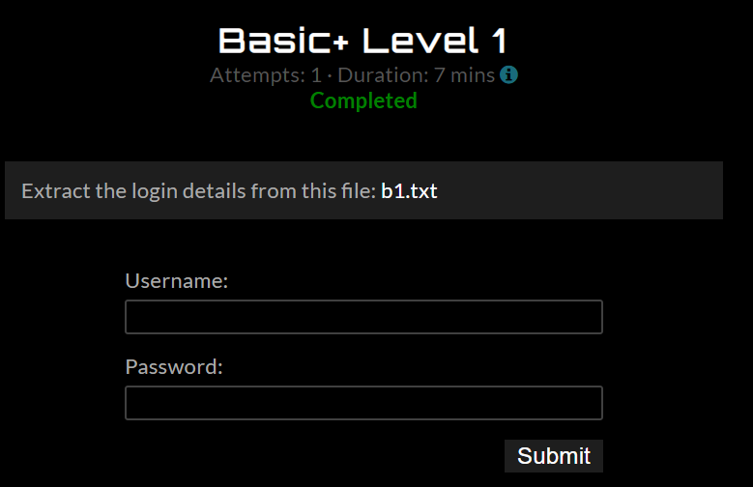

Slide 3
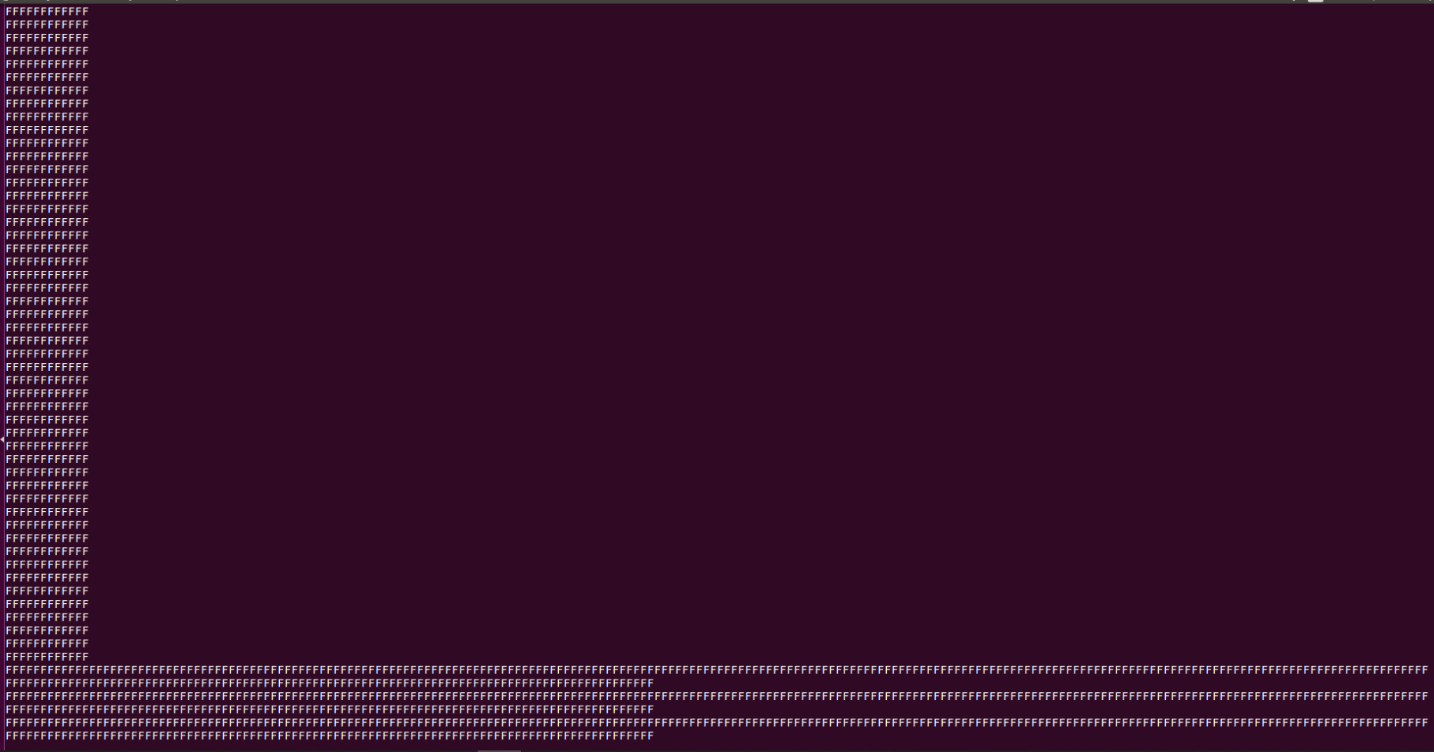
$strings b1.txt

Slide 4
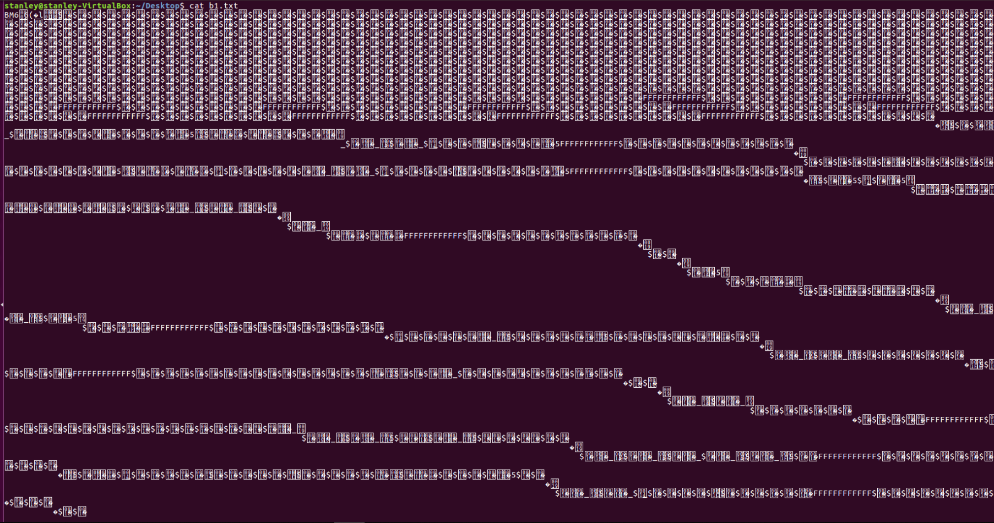
$cat b1.txt

Slide 5

$file b1.txt
b1.txt: PC bitmap, Windows 3.x format, 213 x 108 x 24
BMP file format
Rename the file with extension “.bmp” ($mv b1.txt b1.bmp)

Slide 6
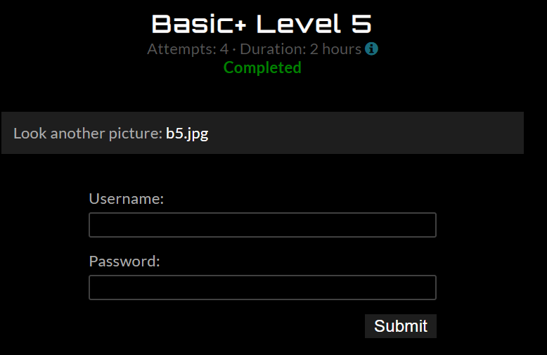

Slide 7


Slide 8
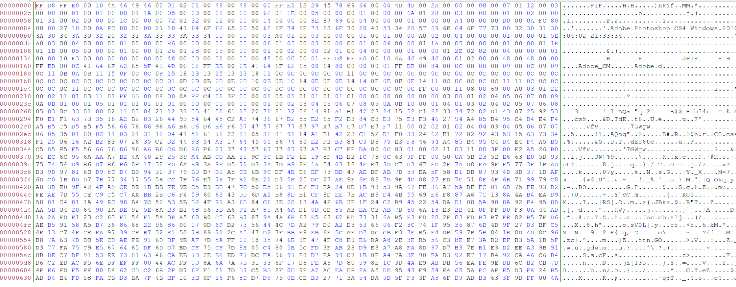
Use hex editor to open b5.jpg

Slide 9
JPEG format start with FF D8 end with FF D9

Slide 10
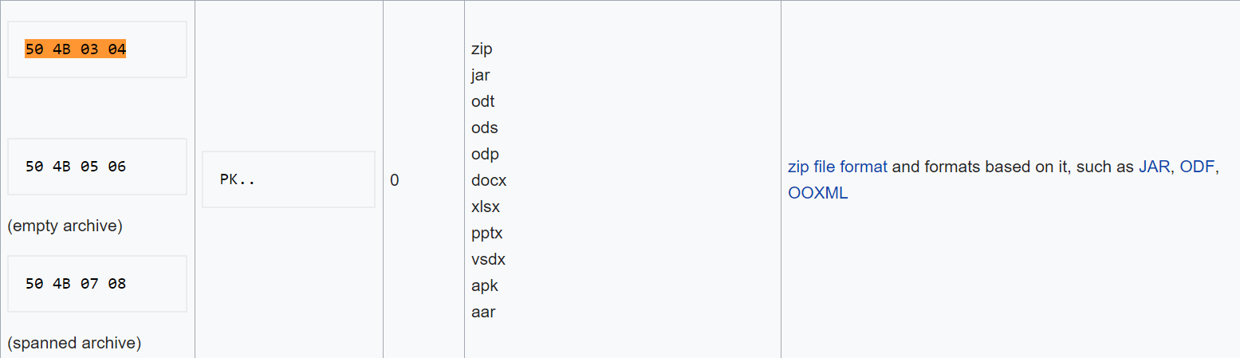
Find file format that start with 50 4B
.zip file

Slide 11
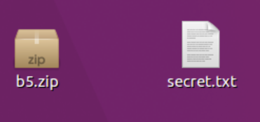
Save the remain content with file extension “.zip”
Unzip file <b5.zip> ($unzip b5.zip)

