Slide 1
Pwnable.kr

Slide 2
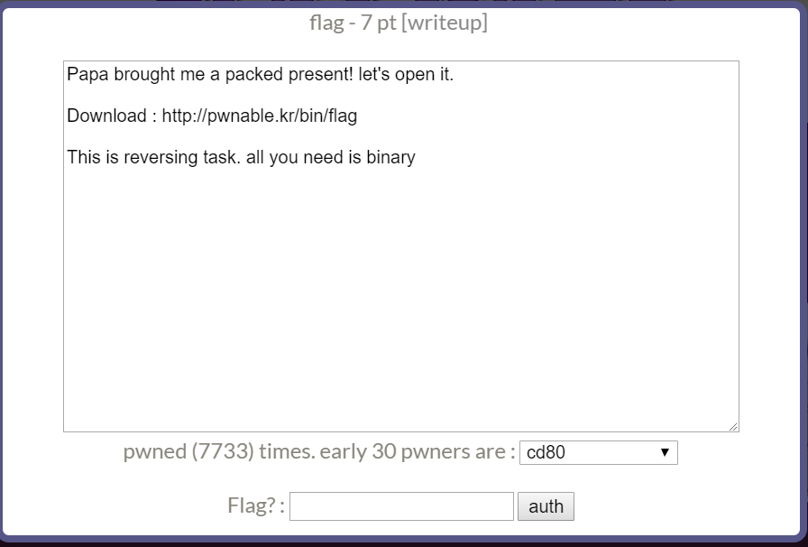

Slide 3
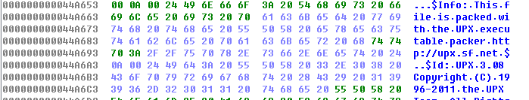
Use IDA_Pro
Look at the hex
Find out it is packed by ”UPX”

Slide 4
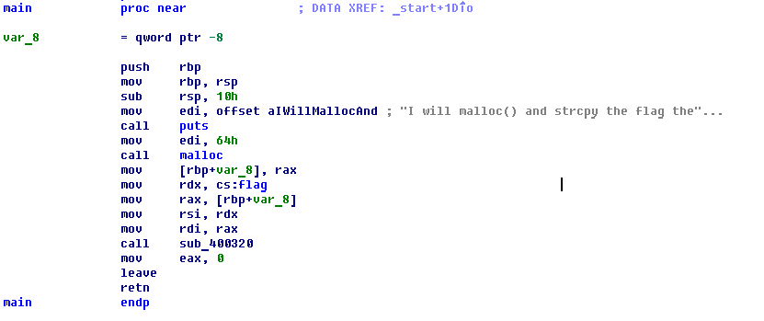
Type command “$upx –d flag” to unpack the flag file
Find main function

Slide 6
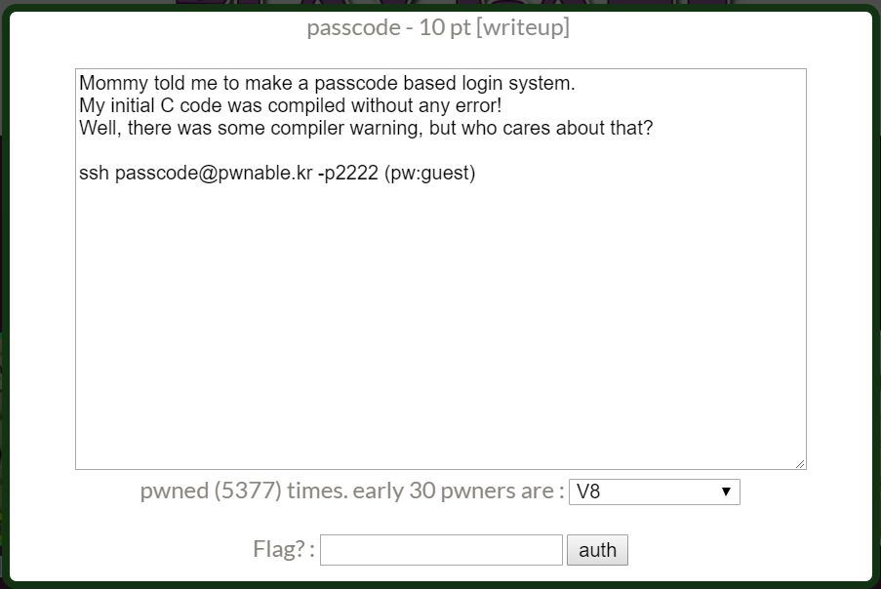

Slide 7
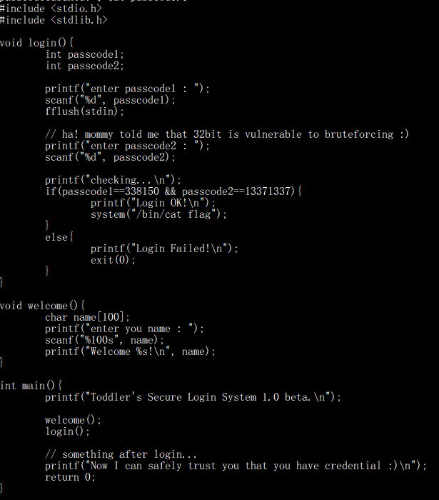

Slide 8
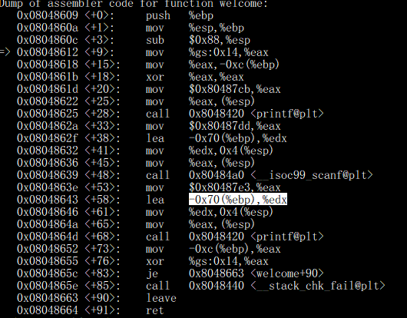
name buffer’s address

Slide 9
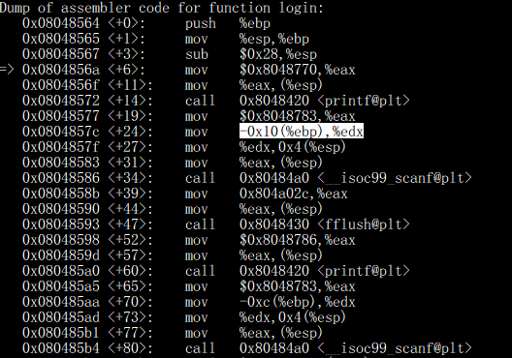
ebp is still at the same location
passcode1’s address
passcode2’s address

Slide 10
Size of name buffer = 100
0x70 – 0x10 = 96
0x70 – 0xc = 100
We can control the value of passcode1
We can’t control the value of passcode2

Slide 11
PLT and GOT
1. Each entry of PLT will store the address of entry of GOT
2. The entry of GOT stores the address of each function
3. Since GOT can be rewrote, we can change the content of GOT to store another function’s
address
4. Then we can call the original function in cpp code, however the program will execute another
function that we rewrite
Notes:
Dynamic linking
Only the functions that is originally in the library will be stored in GOT, the function we write by ourselves won’t
Reference : https://systemoverlord.com/2017/03/19/got-and-plt-for-pwning.html

Slide 12
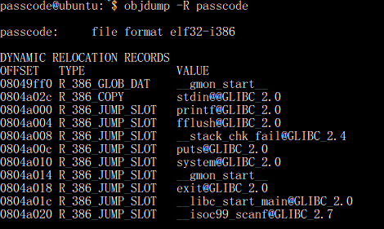

Slide 13
Find the location of printf and system(“/bin/cat flag”)
Notes:
80485e3 instead of 80485ea because the esp is initialized

Slide 14
0x80485e3 = 134514147
Notes:
Since scanf use %d we need to transform hex to int

