Slide 1


Slide 2
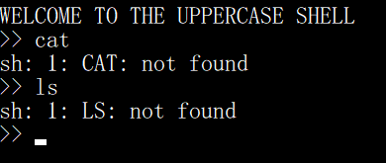

Slide 3
Bash special parameters
$0 = name of shell script
$1, $2, $3, … = 1~N th parameters of this shell
$# = the number of parameters
$@ = all the parameters ( Each parameter is considered independent )
$* = all the parameters ( If there are double quotation marks the parameters will be considered as one value )
$_ = the last parameter
$$ = process ID
$! = process ID of the last executing process
Notes:
Like CPP we can add parameters after shellscript while executing.
int main(int argc, char *argv[])
argv[0] = $0
argv[1] = $1
…

Slide 4
Notes:
To get a new shell, simply type $0 and we can execute this shell
sh is a command language interpreter that executes commands read from a command line string, the standard input, or a specified file

Slide 5
