Slide 1
Writeups

Slide 2
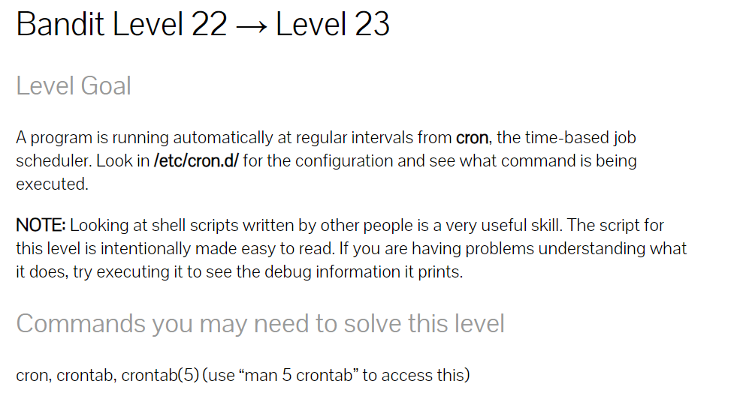

Slide 3
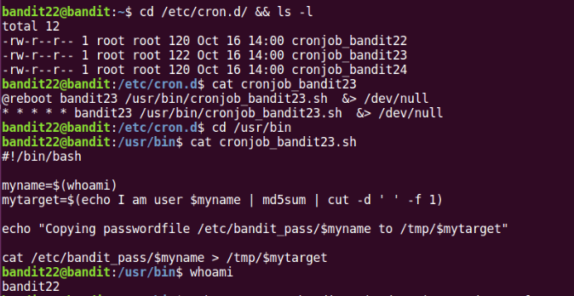

Slide 4
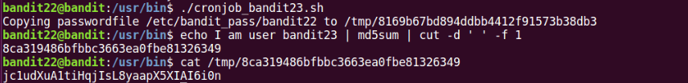
Since we want to get the passwordfile of bandit23
execute the same line but with bandit23

Slide 5
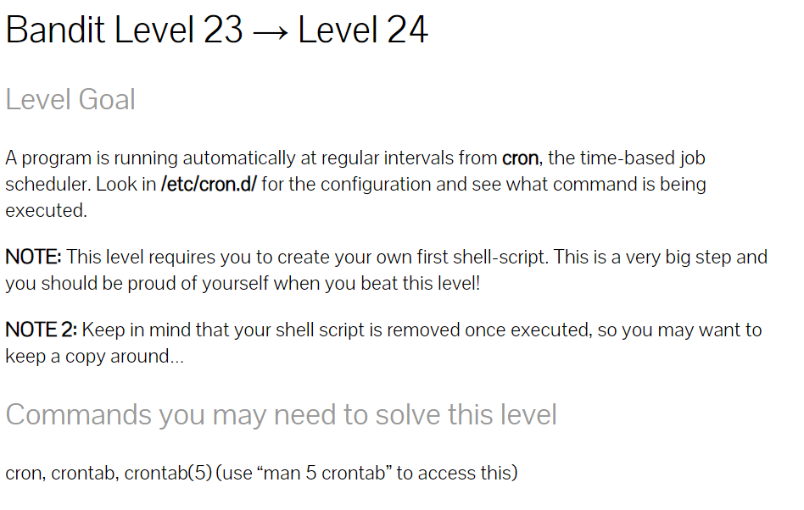

Slide 6
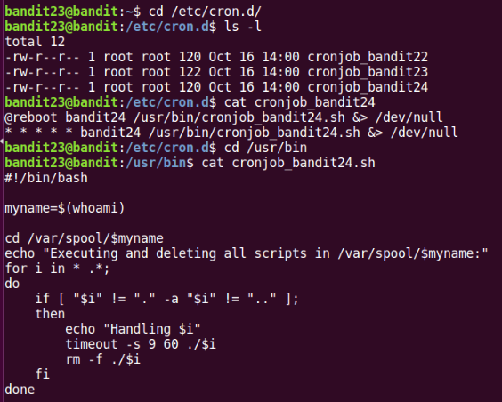

Slide 7
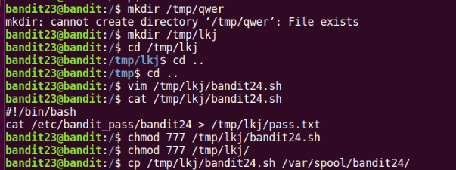
Remember to change the permissions of ‘read’ , ‘write’ , ‘execute’ of file and folder
Notes:
Owener/group/others 各自有自己的 read/write/execute
-rwx-rwx-rwx
R : 4
W: 2
X : 1
權限是累加的 : rw- : (4+2+1)(4+2+1)0 = 770

