Slide 1
Pwnable.kr
Use After Free

Slide 2
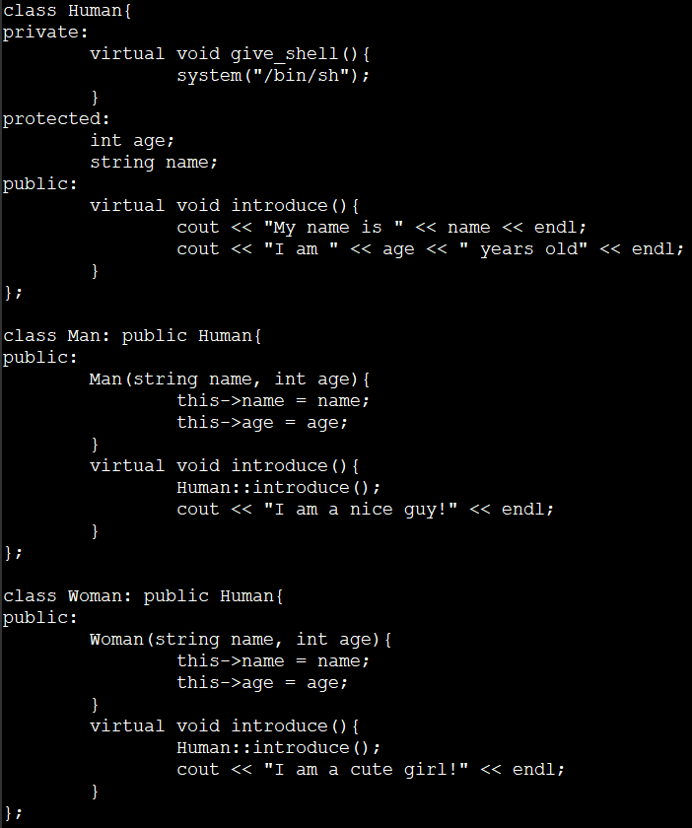

Slide 3
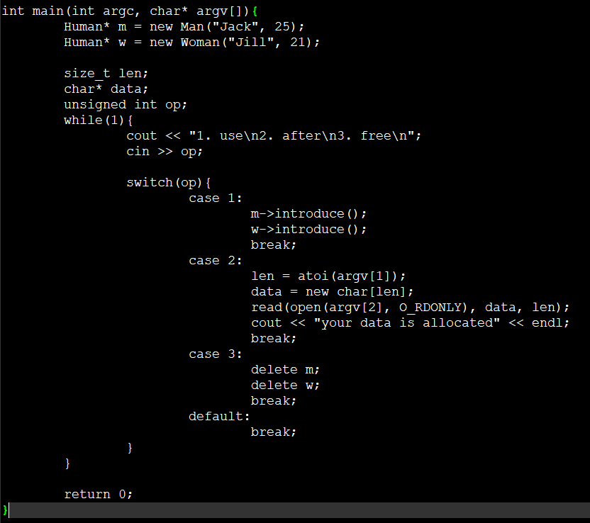

Slide 4
free
呼叫free()釋放記憶體時
如果記憶體塊小於256kb
dlmalloc並不馬上將記憶體塊釋放回記憶體
而是將記憶體塊標記為空閒狀態

Slide 5
Use After free
第一次申請的記憶體空間
在釋放過後沒有進行記憶體回收
導致下次申請記憶體的時候再次使用該記憶體塊
使得以前的記憶體指標可以訪問修改過的記憶體
Notes:
Reference : https://www.itread01.com/p/129648.html

Slide 6
Virtual table
Compiler constructs a vtable for each classes which has virtual function
The Child class inherits everything from the Parent class’s vtable
When the Child class has the same virtual function, change the address of that function in vtable
Private function cannot be inherited
However if private function is also a virtual function the vtable in the Child class will still have the this private virtual function, which is exactly the same as the Parent class
Each entry in vtable points to a function
Every class has a vtable
Each vtable is pointed by vptr

Slide 7
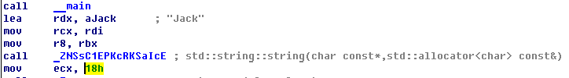
First check on how many sizes does a “Man class” need
0x18 = 24

Slide 8
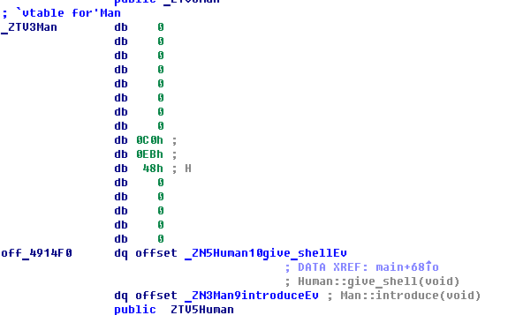
Find the virtual table for Man
Find the address of virtual function give_shell & introduce
Rewrite the pointer so that when calling man->introduce() it will actually call
man->give_shell()

Slide 9
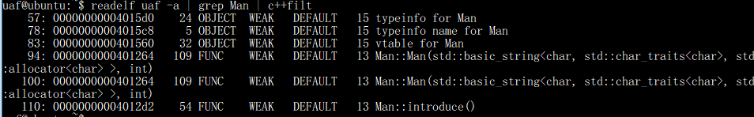
Notes:
c++filt :反重整C++符號為可讀方式

Slide 10

From the upper figure we can find out that v4 is basically virtual pointer of Man
From the lower figure we can find out that by calling man->introduce() the address will be v4 + 8
Thus the to make the pointer point to man->give_shell(), we need to make vptr subtract 8 => 0x401570 – 8 = 0x401568

Slide 11
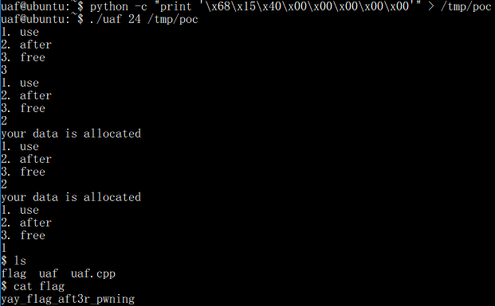
Remember to allocate twice
Since we first free m and then free w, the data will be allocated to w first instrad of m

