Slide 1
Home
Quick facts
History
Public facilities
Quiz
Sitemap
Culture & Recreation
Education
Healthcare
Railway

Slide 2
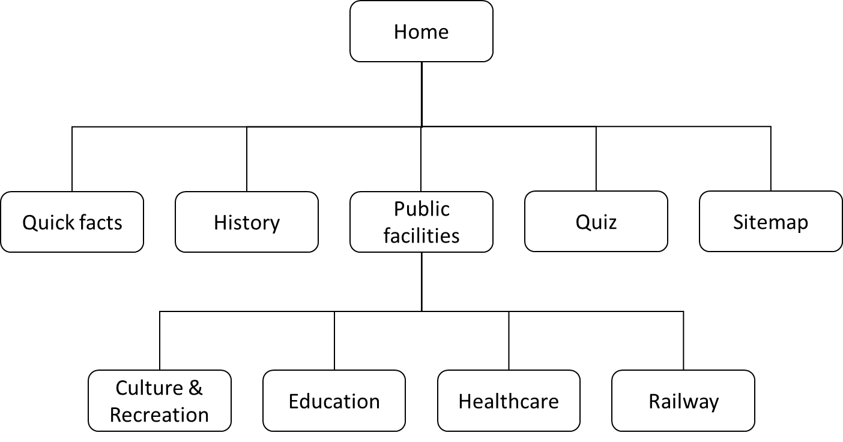

Slide 3
Home
home.html
Quick facts
facts.html
History
history.html
Public facilities
facilities.html
Quiz
quiz.html
Sitemap
sitemap.html
Culture & Recreation
recreation.html
Education
education.html
Healthcare
healthcare.html
Railway
railway.html

Slide 4
