Slide 1
Predicting Heart Disease from Clinical Indicators
A reproducible logistic regression prototype
Stanley Ewenike, PhD
NHS England Band 7 Data Scientist Technical Test

Slide 2
The Problem
Binary classification: does this patient have heart disease?
Context
920
55%
14
Patients present with chest pain. A predictive model helps triage those likely to have coronary heart disease.
Data: UCI multi-study dataset (920 patients, 4 source studies, 14 clinical features).
Target: binary indicator derived from num > 0.
patients
disease
features
across 4 studies
overall prevalence
clinical + demographic
Approach
Guiding Principle
1. Explore data, flag quality issues
2. Select features, handle missingness
3. Build reproducible sklearn pipeline
4. Evaluate on CV + hold-out test
5. Interpret + recommend next steps
"Prototype over precision":
Working end-to-end pipeline with defensible choices, not leaderboard accuracy. Modular RAP-compliant project: every decision traceable, every result reproducible (seed = 42).

Slide 3
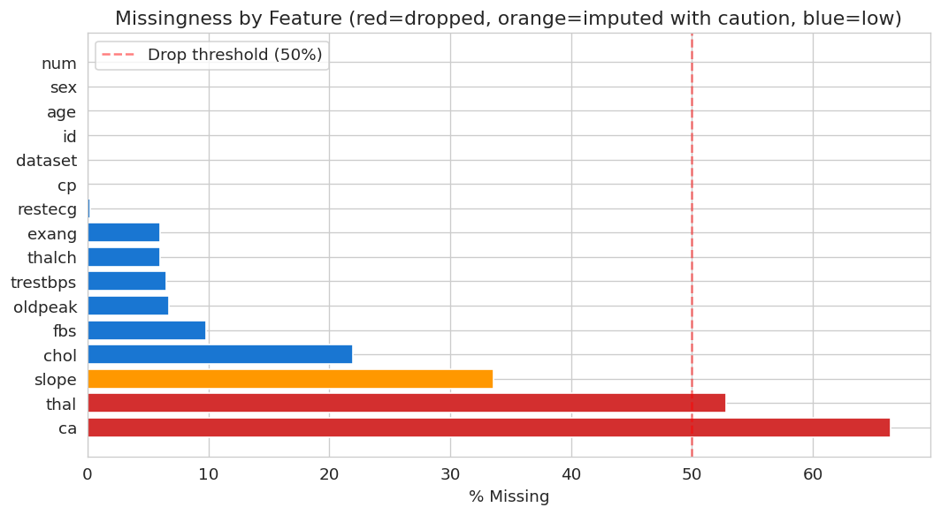
Data Exploration (1 of 2)
Missingness and data quality drive early design choices
Key findings
ca: 66% missing
number of major vessels by fluoroscopy
thal: 53% missing
thalassemia result
slope: 34% missing
ST segment slope at peak exercise
Other features <10% missing
Data quality issue:
trestbps = 0 and chol = 0 in 172 records — physiologically impossible, recoded as missing.

Slide 4
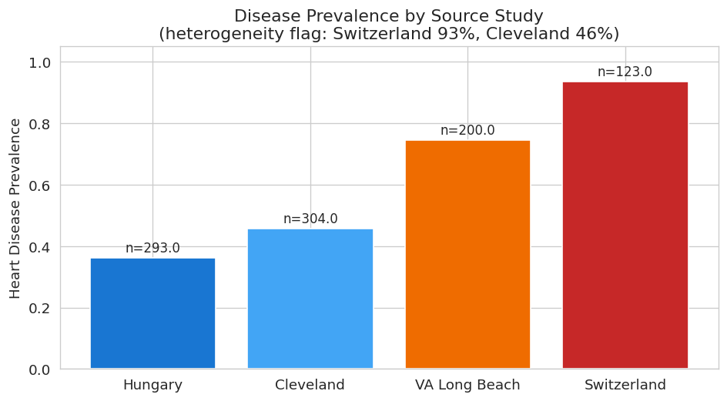
Data Exploration (2 of 2)
Source-study heterogeneity is the biggest analytical risk
Why this matters
Prevalence varies 36% to 94% across studies.
Likely reasons:
selection effects (referral pathway)
diagnostic protocol differences
age/sex case-mix variation
Risk: confounding by study site.
If ignored, the model may learn 'Switzerland' as a disease proxy rather than true clinical signal.
My mitigation: include dataset as a feature so the model conditions on study site explicitly.

Slide 5
Design Decisions
Four choices that define the model
Feature set
Missing data
Drop ca and thal (>50% missing). Keep slope with imputation. Include dataset as feature.
Median imputation for numeric, mode for categorical, inside a sklearn Pipeline.
Why: Imputation above ~50% is unreliable. Dropping 2 features costs less than introducing noise.
Why: Embedded imputation prevents train/test leakage. Median is robust to outliers.
Model choice
Evaluation
Logistic regression with L2 regularisation.
80/20 stratified split + 5-fold CV on train. Metrics: ROC-AUC, recall, precision.
Why: Interpretable coefficients, clinical standard, suits 736 training rows, strong baseline before tree methods.
Why: Recall prioritised — false negatives (missed diagnoses) carry more clinical risk than false alarms.

Slide 6
Pipeline Architecture
Modular RAP-compliant project, single-command reproducible
Project structure
RAP principles satisfied
heart_disease_rap/
config.yaml # all params
main.py # orchestrator
requirements.txt
README.md RAP.md
src/
config.py
data_loader.py # stage 1
eda.py # stage 2
preprocess.py # stage 3
train.py # stages 4-6
evaluate.py # stage 7
tests/
test_pipeline.py # 4 tests
data/raw/
outputs/ # generated
Version controlled
Git + config.yaml; every run logged with seed and metrics in run_summary.json.
Modular and reusable
Seven single-purpose modules. Preprocessor, data loader, evaluator are independently reusable.
Automated and orchestrated
Single command: python main.py. No notebook cells, no manual steps.
Documented
README, RAP.md, module docstrings, function type hints, structured logging.
Tested
Four pytest cases: DQ, target derivation, preprocessor, end-to-end smoke test.
Open source and reproducible
No proprietary tools. Fixed seed. Identical metrics on every run.

Slide 7
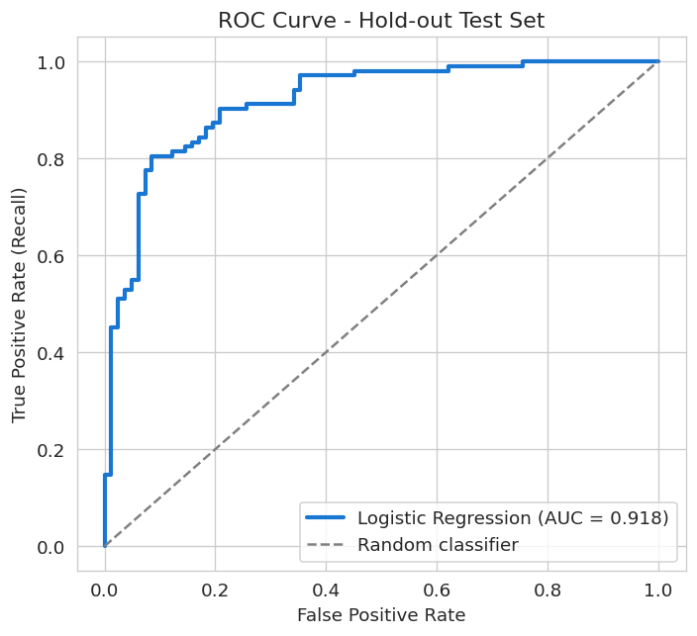
Model Performance
Strong discrimination, recall prioritised
CV ROC-AUC
Test ROC-AUC
0.890
0.918
+/- 0.019 over 5 folds
held-out 184 patients
Recall
Precision
0.902
0.829
92/102 disease cases caught
92/111 flagged truly diseased
Confusion matrix (test set, n=184)
 | Predicted: no disease | Predicted: disease
Actual: no disease | 63 (TN) | 19 (FP)
Actual: disease | 10 (FN) | 92 (TP)

Slide 8
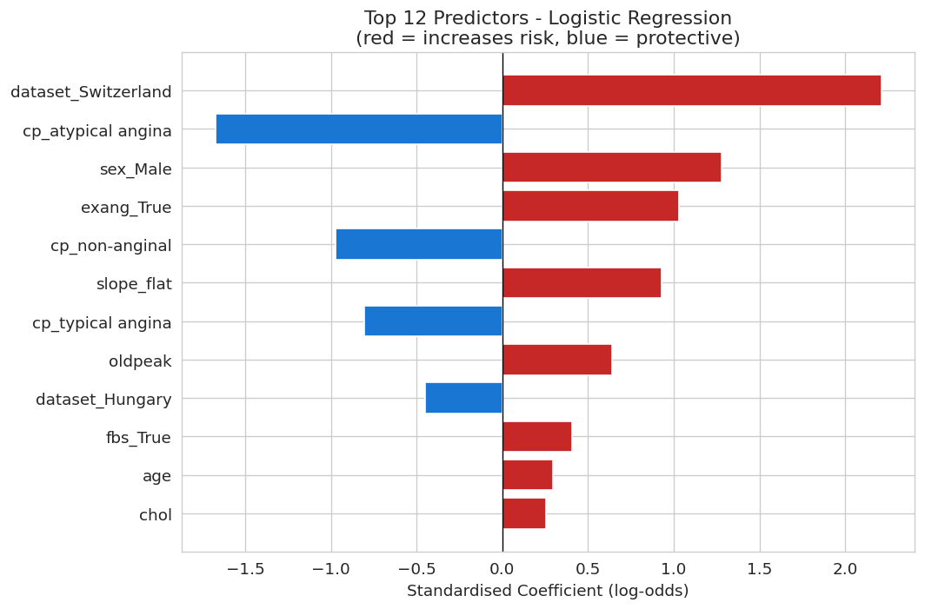
Interpretation
The model's top predictors are clinically plausible
Does this make clinical sense?
Clinically consistent:
Male sex: higher risk
Exercise-induced angina: strong positive
Atypical / non-anginal chest pain: protective
ST depression (oldpeak), age: positive
Flag: dataset_Switzerland dominates
Strongest coefficient (+2.2). Driven by 94% disease prevalence in Swiss subset, not clinical signal.
Interpretation rule:
Trust the clinical-feature coefficients. Treat the dataset coefficients as case-mix adjustment, not as causal drivers.

Slide 9
Limitations and Next Steps
How to take this prototype forward
Methodological
Data
Operationalisation
Test tree-based models (RF, gradient boosting) for non-linear signal.
Formal study-stratified analysis to separate clinical from site effect.
Calibration analysis + Brier score, not just discrimination.
Fairness audit by sex and age group.
Recover ca and thal where clinically feasible.
External validation on UK NHS patient data.
Link with outcome data (MI, mortality).
Expand features: medication, family history, comorbidity.
Package pipeline behind an API for clinical tool integration.
MLOps: monitoring, drift detection, retraining schedule.
AQA / model-governance sign-off before any real-world use.
Clinician-facing UI with explainability (SHAP values).

Slide 10
Summary
A reproducible logistic regression prototype delivering 0.92 ROC-AUC on held-out test data.
Designed to be defended, not just deployed.
End-to-end pipeline, seed-controlled, runs in one command.
Explicit handling of missingness, data errors, and study heterogeneity.
Recall 0.90 prioritised — clinically appropriate for screening.
Clear roadmap for methodological, data, and operational next steps.
Questions welcome.

