Slide 1

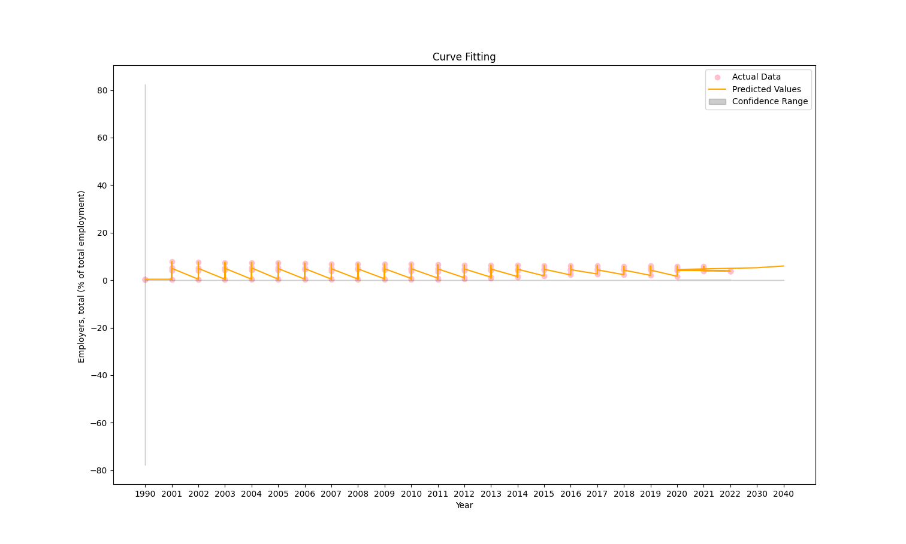
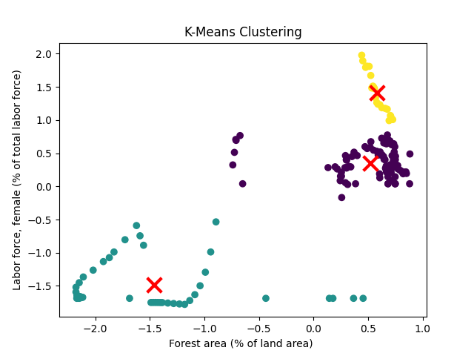
Clustering and fitting
ABSTRACT:
This study employs a two-fold analytical approach, starting with K-Means clustering to categorize countries based on their levels of female labor force participation and forest area. The Silhouette Score is utilized to assess the quality of clustering. Subsequently, a time series analysis is conducted to model and predict trends in the percentage of employers in total employment. A simple linear regression model is employed, and confidence intervals are calculated to provide a range of predicted values.
Data Preprocessing:
The code includes several data preprocessing steps to ensure that the dataset is suitable for analysis.
Loading the Data
Selecting Relevant Columns
Handling Missing Values
Converting Data Types
Normalization
K-Means Clustering
Time Series Data Handling
Conversion to NumPy Arrays
Introduction:
In an era characterized by dynamic socio-economic changes, understanding global patterns in forestry, female labor force participation, and employment structure is crucial for informed decision-making. This analysis focuses on a dataset encompassing variables such as forest area, female labour force participation, and total employment structure across various countries. The aim is to employ a combination of K-Means clustering and time series modelling to unravel underlying trends, identify distinct clusters, and predict future employment dynamics.
K means clustering:
The selected numerical columns ('Labor force, female' and 'Employers, total') are normalized using z-score normalization to ensure comparable scales.The K-Means algorithm is applied to the normalized data with three clusters (n_clusters=3).
Cluster assignments are added as a new column ('Cluster') to the dataframe.
The silhouette score is calculated to evaluate the quality of the clustering. It measures how well-separated the clusters are, with a higher score indicating better-defined clusters . A scatter plot is generated to visualize the clusters in two-dimensional space, using the 'Forest area' and 'Labor force, female' features.
Each point represents a country, with colors indicating the assigned cluster.
Cluster centroids are marked with red 'X' markers.
Curve Fitting:
Data Extraction:
Time series data for years and employers' percentage of total employment is extracted.
Data Cleaning:
NaN and infinite values in the employment data are removed or replaced.
Model Definition:
A simple linear regression model is defined as
Employment=a×Year+b, where
a and b are the model parameters.
Model Fitting:
The curve_fit function from SciPy is used to fit the linear regression model to the time series data. It estimates the parameters
a and b that best describe the relationship between years and employment.
year | Employers, total (% of total employment)
2020 | 4.5031383
2030 | 5.23719803
2040 | 5.97125776
Future predictions:
Conclusion:
The fitting study sheds light on the anticipated employment patterns as well as the regional grouping of the nations through the combination of time series modelling and clustering. The linear regression model depicts the relationship between time and employment, while the Silhouette Score aids in evaluating the quality of the clusters. Finding trends and comprehending the data are made easier by the visualisation. The accuracy and applicability of the analysis might be improved by additional exploration and refining.
Datasourcelink https://databank.worldbank.org/reports.aspx?source=2&series=AG.LND.FRST.ZS&country=#
GithubLink : https://github.com/stanleygundapu/clusteringandfitting.git
Studnet name: Stanley moses gundapu
Student id :22082366

