Slide 1
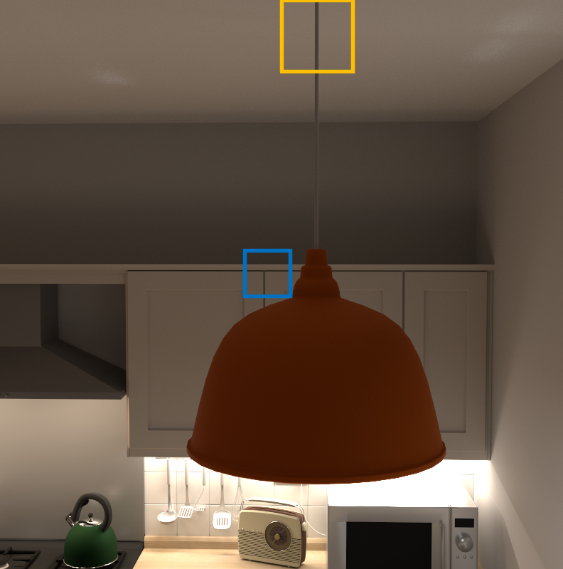


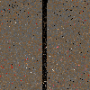
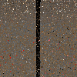






Ours
(w/o accumulation)
Ours
(w/ accumulation)
Kitchen
ReSTIR GI
ReSTIR FG
Reference
RMSE: 0.346
RMSE: 0.238
RMSE: 0.104
RMSE: 0.109
RMSE: 0.259
RMSE: 0.172
RMSE: 0.112
RMSE: 0.111
1 frame (1280x800)
41.30ms
42.69ms
43.83ms
44.43ms

