Slide 1
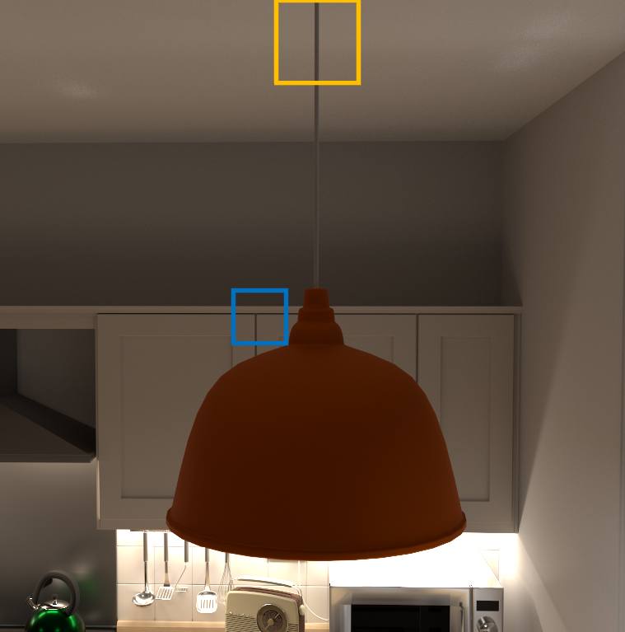










Kitchen
ReSTIR GI
ReSTIR PT
ReSTIR FG
Ours
Reference
RMSE: 0.352
RMSE: 0.245
RMSE: 0.253
RMSE: 0.117
RMSE: 0.259
RMSE: 0.196
RMSE: 0.178
RMSE: 0.136
1 frame
43.85ms
135.64ms
45.97ms
85.54ms

