Slide 1
Separation Logic Faulty Logic and Monads
Yin Wang

Slide 2
A Survey Project (sort of)
Motivated by highly suspicious connections between Separation Logic, Faulty Logic, and monads
Reading list of 20+ papers
Bored by Faulty Logic because stopped worrying about high energy particles from space
Discovered connections between Separation Logic and ST monad
Discovered the essence of Separation Logic (hopefully)

Slide 3
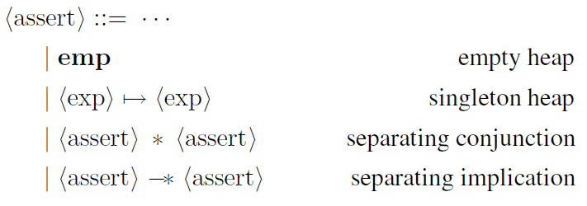
Recap of Separation Logic [Reynolds 2002]

Slide 4
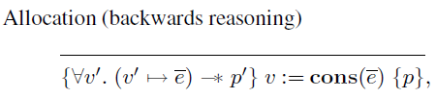
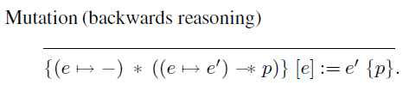
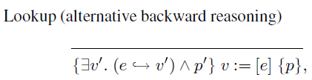
Inference Rules

Slide 5
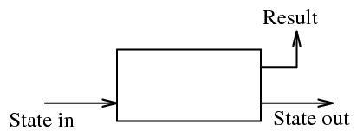
ST Monad [Launchbury 1994]
(ST s a) is a computation which transforms a state “indexed by type s”

Slide 6

State Transformers
Mutable reference
indexed by “type s”
Composing Transformers (bind)

Slide 7

Encapsulation
rank-2 polymorphism (similar to System F) to encapsulate state with help from type system
ensures “single-threaded access” statically

Slide 8
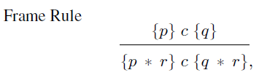
Does Separation Logic Support Multi-threaded access?
“By using the frame rule, one can extend a local specification, involving the variable and parts of the heap that are actually used by c. Thus the frame rule is the key to local reasoning about the heap.”

Slide 9
“Local reasoning”: A feature or a restriction?
“We can talk about other parts of the heap, as long as they are disjoint from what we talk about here.”
“We can talk about the same heap part only once.”

Slide 10
Implementation of ST monad
“The state of each encapsulated state thread is represented by a collection of objects in heap-allocated storage.”

Slide 11
The Connection?
The Frame Rule and runST have the same purpose: to ensure single-threaded heap access.
Neither ST monad nor Separation Logic support multi-threaded heap access.
Separation Logic talks about the heap locally
ST monad uses the heap locally
Can ST monad “talk” too?

Slide 12
Model Separation Logic with ST monad
Original plan: ST monad with state indexed by Separation Logic formulas
Use thenST (bind) to do the inference
Abandoned because a better way is found!

Slide 13
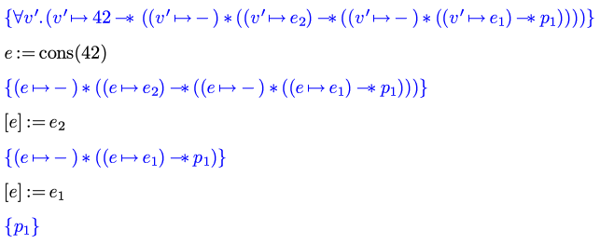
The Essence of Separation Logic
freshly bound (eigen) variable
Verification Condition generation:
1
2
3
separating implication = continuation?

Slide 14
Not Quite Continuation
The “premise” of separating implication can be anywhere in the heap
Nondeterministic continuation
PSPACE complexity

Slide 15
Symbolic Execution vs Separation Logic
So we see that the extracted Separation Logic precondition resembles a “program” with
nondeterministic control flow
variables in “SSA form”
Seems to be redundant work. Can we do without extraction of Separation Logic formulas?

Slide 16
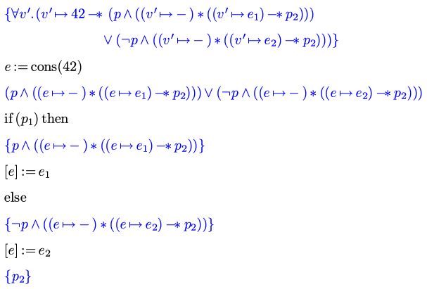
What about Branching?

Slide 17
Strategies for Branches
Conditions should be put into control-flow if cannot be determined statically, hoping it will be eliminated by resolution.
State :: Disj(Conj Formula, (Stack, Heap))
Loop invariants can be treated similar way (put invariants into control flow)

Slide 18
Prototype Implementation
An interpreter to produce the state (primitive status)
A theorem prover that can handle nondeterminism for heaps (TODO)

Slide 19
Is This Model Checking?
Model Checking is for verifying that a specific model satisfies the specification.
The “model” generated by the interpreter is NOT only a specific model.
It is a “WLOG model”, because it prohibit access to the underlying representation of the heap and addresses.
This model does not entail extra information.
Every heap cell can be thought of an “atomic formula” without names

Slide 20
Relation to Separation Logic
Symbolic execution says what Separation Logic can possibly “say” as the post-condition.
Unlike Separation Logic, it doesn’t say it until it is forced to speak.
A theorem prover must be used to force the model to speak.
Likely to be undecidable with quantifiers (same limitation as Separation Logic.)

Slide 21
Future Directions
Implement the theorem prover which can handle nondeterministic heap as input.
Possibly need to change the interpreter to be reversible (rewrite in Coq?).
Why do I want to do this after all? Separation Logic is a very impractical tool. C/C++ already have symbolic execution tools (e.g. clang checker).
But I learned a lot about state, threads and concurrency.

Slide 22
Thank you!
Questions?

