Slide 1
The Little Register Allocator
Yin Wang

Slide 2
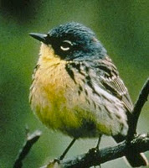
The name of the game
“See that bird? It's a Spencer's warbler. Well, in Italian, it's a Chutto Lapittida. In Portuguese, it's a Bom da Peida. In Chinese it's a Chung-Long-tah, and in Japanese it's a Katano Tekeda. You can know the name of the bird in all the languages of the world, but when you're finished, you'll know absolutely nothing whatever about the bird. You'll only know about humans in different places, and what they call the bird. So let's look at the birds and see what it's doing -- that's what counts!”
-- Richard Feynman, The Making of a Scientist

Slide 3
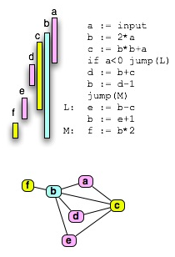

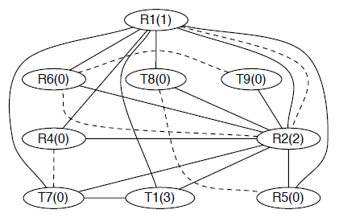
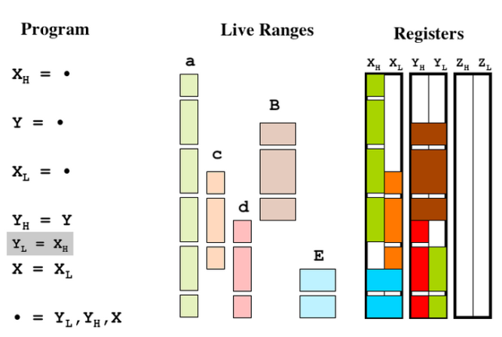
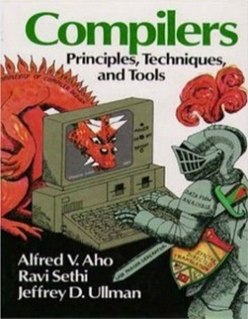
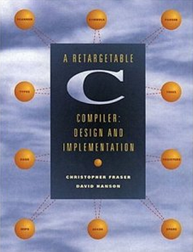
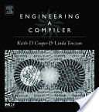
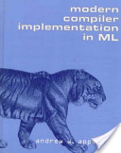
The game of the name
Let’s look at the register allocator and see what it’s doing …

Slide 4
Names, Registers, Stack
Why do we need names in programs?
Because we want to refer to values.
Why do processors have registers?
Because its circuits need to refer to … values.
So, are registers analogous to names?
Yes. They are of the same essence, holders of values.

Slide 5
Can we use registers to stand for names?
Yes. Because the values of names can also live in registers.
Can I say that names can live in registers?
You may say so, although it is their values that are living.
Can ALL names live in registers?
Not necessarily. Processors have very few registers, because they are expensive.

Slide 6
Where do the rest of the names live?
The stack.
What is the stack?
A large and cheap off-processor space where names can live.
Can processors do arithmetic on the stack?
No. They have to load the operands into registers first.

Slide 7
The Life of Names
A name lives either in an expensive register or a cheap stack slot.

Slide 8
Register Allocation
What is register allocation?
The process of deciding where and when each name lives.
Does it take a long time to move value between register and stack?
Yes. It is a major cost of time.
What should be the goal of register allocation then?
To minimize register-stack traffic.

Slide 9
Model
What is a model?
It is a table which tells you where each name lives.
Does it keep track of register and stack separately?
Yes, for maximum accuracy.
Can you show me an example model?
There you are!
x : r1
y : r2
z : r3
u : fv0
v : fv1

Slide 10
Model and Reality
model
x : r1
y : r2
z : r3
u : fv0
v : fv1
physical machine
r1
r2
r3
Stack
x
y
z
u
v
r4
r5
r6
sp

Slide 11
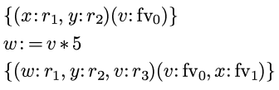
Model Transformer Semantics
How do models relate to each other?
Models relate to each other according to some inference rules, similar to that of Hoare Logic.
x : r1
y : r2
v : fv0
“premodel”
as Hoare-triple-style notation:
w := v * 5
w : r1
y : r2
v : r3
v : fv0
x : fv1
“postmodel”

Slide 12
Births of Names
When are names created?
When they are assigned a value.
y : r2
“premodel”
w := 1
w : r1
y : r2
“postmodel”

Slide 13
Deaths of Names
Will names ever die?
Yes. When we no longer refer to them.
Where does x die?
After x is added with 1, but before assigning to y. I mean, here:
y := x + 1
x := 1
y := x + 1
z := y * 2
END
How do we signify where a variable dies?
We mark their endings, like:
y := x + 1, {x}

Slide 14
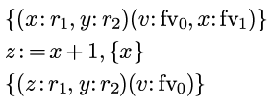
Deletion in Model
What happens to a model when a name dies?
It is deleted from the model (for both register and stack parts).
x : r1
y : r2
v : fv0
x : fv1
“premodel”
z := x + 1, {x}
z : r1
y : r2
v : fv0
But actually, the deletion happens here!
“postmodel”

Slide 15

Midmodel
x : r1
y : r2
v : fv0
x : fv1
model transformer for “z := x + 1”
premodel
x + 1, {x}
midmodel
y : r2
v : fv0
z := x + 1, {x}
z :=
postmodel
z : r1
y : r2
v : fv0

Slide 16
Why midmodel?
Why is there a midmodel?
Because the instruction must takes at lest two cycles to finish. x is already dead in the second cycle.
This is why z can reuse the register of x.
x dead
x alive
+
x
z
1
z := x + 1, {x}
clock signal
Time

Slide 17
The Bigger Picture

Slide 18
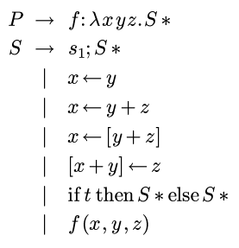
Input Language
UIL (unified intermediate language) after removing complex operands (remove-complex-opera*)
Procedure definitions
Sequencing
Arithmetic
Assignments
Memory references
Branching
Calls (with trivial arguments)

Slide 19
Two Pass Allocation
x := 1
y := x + 1
z := y * 2
END
x := 1, {}
y := x + 1, {x}
z := y * 2, {y}
END, {z}
r1 := 1
r1 := r1 + 1
r1 := r1 * 2
END
Backward scan for marking deaths of names
Forward model transformation and rewriting

Slide 20
Reduction in compiler passes
Nine passes of nanopass compiler reduced to two.
impose-calling-conventions
uncover-frame-conflict
pre-assign-frame
assign-new-frame
finalize-frame-locations
uncover-register-conflict
assign-registers
assign-frame
finalize-locations
mark-deaths
allocate

Slide 21
Starting Model
What is the model at the beginning of a procedure?
It is pre-determined by calling conventions.
f (x, y, z) =
u := x + 1
v := u * 2
z / v
$ret : r0
x : r1
y : r2
z : fv0
Suppose r1, r2 are parameter registers, r0 is return address register. z has to be put into stack.

Slide 22
What is $ret in the initial model?
It is the return address set by the caller.
What is the essence of it?
It is the continuation “k” in a CPSed functional program:
f x y z k =
k (z / ((x + 1) * 2))

Slide 23
Primitive Model Transformers
Transform the input model into new ones
May emit instructions for loads and stores
Save
Load
Shuffle
SAVE
Regs
SHUFFLE
Stack
sp
LOAD

Slide 24
Examples
x : r1
y : r2
z : fv0
x : r1
y : r2
u : r3
z : fv0
SAVE({x, y})
fv1 <- x
fv2 <- y
LOAD({x, z})
fv1 <- u
r3 <- z
x : fv1
y : fv2
z : fv0
x : r1
y : r2
z : r3
z : fv0
u : fv1

Slide 25
What is the essence of the inserted instructions from SAVE and LOAD?
They are actually doing “live range splitting” on-the-fly.
What is the difference between splitting and spilling?
Spilling puts the whole life span of a name in stack. Splitting only puts part of its life span in stack.

Slide 26
Branching
What if different registers are assigned to the same variables in different branches
We need to shuffle them for consistency.

Slide 27
if x < 5
x : r1
x : r1
y := 1
z : = 2
z := 1
y : = 2
Need shuffle:
r2 <-> r3
x : r1
y : r2
z : r3
x : r1
z : r2
y : r3
w := y+1

Slide 28
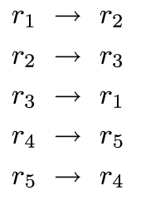
Shuffling
Shuffling may happen at
Procedure calls
Join points
Shuffling is like permutation

Slide 29

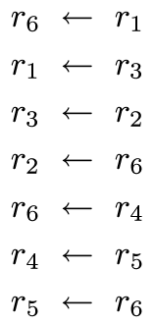
Handling Shuffling
Break permutation into cycles (or paths):
Generate code to move variables in cycles:

Slide 30
Related Work
Mostly graph coloring (extensions) and linear scan (extensions).

Slide 31
Assumptions of Graph Coloring
A variable either lives in a register throughout its life time, or lives in a stack location throughout its life time
A variable lives in the same register or stack location throughout its life time
But actually,
A variable may live in a register, move to a stack location, and then move back to a (possibly different) register.
A variable may live in both a register AND a stack location.
Graph Coloring doesn’t capture this kind of semantics and may generate inefficient code.

Slide 32
Goal of Graph Coloring
Goal: minimizing the number of allocated registers. (Doesn’t aim at reducing memory traffic!)
Produces good code only if no spilling happens. Otherwise no guarantee about memory traffic
Spilled variables may introduce unpredictably many memory references

Slide 33
Is it still Graph Coloring?
Still need backtracking for “optimal” allocation because of join points
Maybe reducible to SAT (thus a graph), but a much more complex graph (may contain continuations of the allocator)
Needs further investigation

Slide 34
Compare with Linear Scan
It never spills, but linear scan spills.
Does “online live range splitting”
existed partly in extended linear scan
usually done in a separate pass and thus offline (as in LLVM option “pre-alloc-split”)

Slide 35
Implications to Verified Compilation
The model transformer semantics may be used to simplify formal verification of register allocation
Formerly this is done by dynamic “validation” and not static verification (as in CompCert)

Slide 36
TODOs
Handle instructions with memory operands and other irregularities
Limited form of backtracking
Callee-save registers and link-time optimization
An industrial-strength compiler backend eventually

Slide 37
Acknowledgements
Thanks to R. Kent Dybvig, Andy Keep, Oleg Kiselyov for helpful comments and discussions.

Slide 38
Questions?

Slide 39
Thank you!

