Slide 1
Structural Version Control
Towards
Yin Wang
You know, it’s always safe to put “Towards” in the title
when you haven’t done much ;-)

Slide 2
Q: What’s the best way to solve HARD problems?
A: Don’t solve them. Make them DISAPPEAR.
This often just requires a slight change of DESIGN.

Slide 3
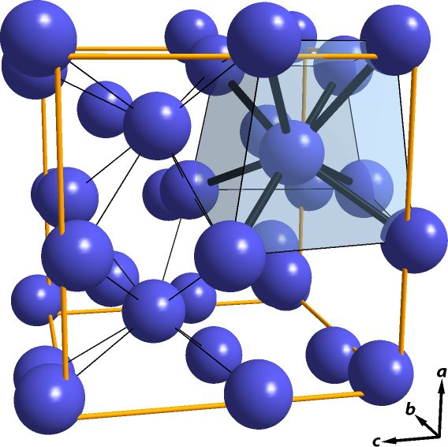
Introducing “Structural Programming”
Disambiguate:
Structural Programming
not Structured Programming
The idea has been decades old
Lambda calculus is even older
“What goes around comes around”

Slide 4
Outline
Structural Editing (other people’s work)
Structural Comparison (my work)
Structural Version Control (vaporware)

Slide 5
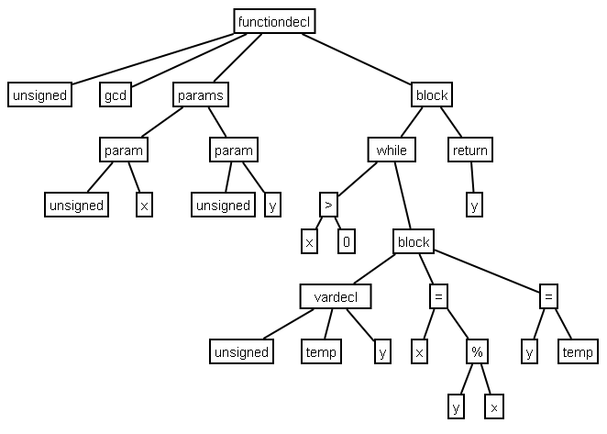
Programs are data structures
Usually called “parse tree” or “AST” (abstract syntax tree)

Slide 6
Data structures are usually encoded as text
keywords, delimeters
function factorial(n) {
if (n == 0) {
return 1;
}
return n * factorial(n - 1);
}
The encoding scheme is called syntax

Slide 7
Parsers
A parser is a decoder from text to data structures
Parsers are tricky to write and hard to debug
We need parsers because we encode programs into text!

Slide 8
Why text?
Write programs that do one thing and do it well
Write programs to work together
Write programs to handle text streams, because that is a universal interface
A universal interface =/= THE universal interface

Slide 9
Text is an inconvenient universal interface
Data has different types: String, Int, records, functions, …
Text is just one type: String
Why should we encode all other types into strings?

Slide 10
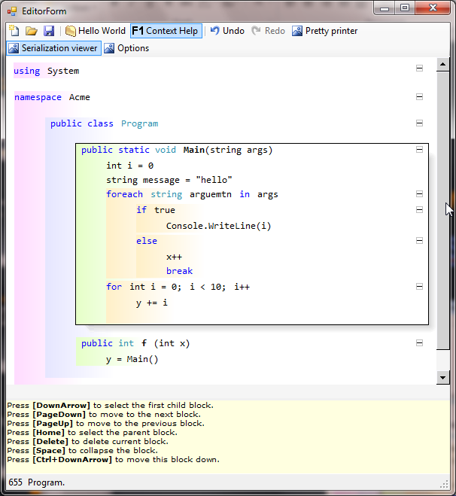
Programming without syntax (demo: Kirill Osenkov’s editor prototype)
See also:
MPS (JetBrains)
Intentional Software
Software Factories (Microsoft)
paredit-mode (Emacs)

Slide 11
Potentials of Structural Editing
Easily extensible to ALL programming languages
Semantics-aware context help (limit number of choices)
Unable to write ill-formed / ill-typed programs
Efficient transformations and refactorizations
Pictures, math formulas together with programs
Incremental compilation at fine granularity
Version control at fine granularity

Slide 12
New problems
How do we display code in emails?
Need to standardize a data format for parse trees
Easy. We have been making standards all the time: ASCII, Unicode, JPEG …
How do we do version control?
No more text means no more “lines”
… means most VC tools will stop working!

Slide 13
Outline
Structural Editing (other people’s work)
Structural Comparison (my work)
Structural Version Control (vaporware)

Slide 14
ydiff: Structural Diff
Language-aware
Refactor-aware
Format-insensitive
Comprehensible output
Open-source
http://github.com/yinwang0/ydiff
Demo

Slide 15
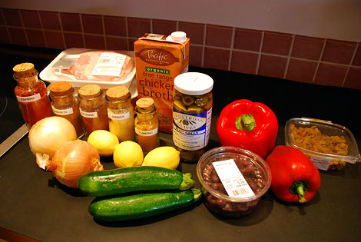
Ingredients
Structural comparison algorithms
Generalized parse tree format
Home-made parser combinator library
Experimental parsers for JavaScript, C++, Scheme, …

Slide 16
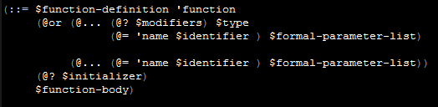
Parsec.ss: Parser Combinator Library in Scheme
Modeled similar to Parsec.hs
Macros make parsers look like BNF grammars (“DSL”)
Left-recursion detection (direct / indirect)

Slide 17
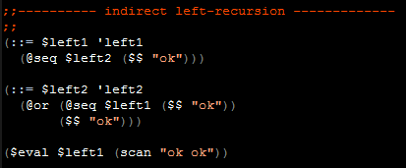
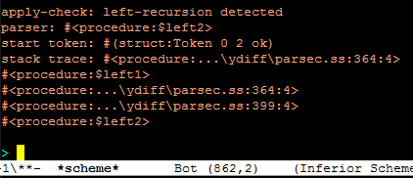
Left-recursion Detection
problem token
trace

Slide 18
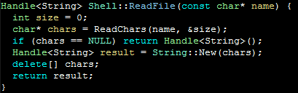
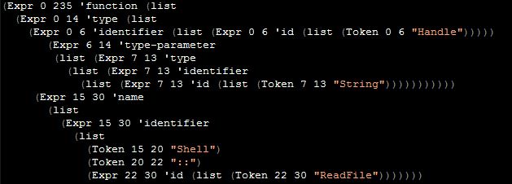
Generalized Parse Tree Format

Slide 19
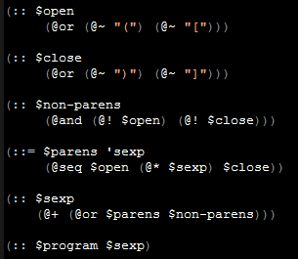
Parsers Built
C++ (596 lines, incomplete, most of C++)
JavaScript (464 lines, complete, may still contain bugs)
(Scheme )

Slide 20
Key Algorithms
Tree Editing Distance (TED)
Move Detection
Substructure Extraction

Slide 21
Tree Editing Distance
Node -> Node –> [Change]
Minimize the number of changes that make the two trees equal
All three cases are equally possible
modify “4” into “5”?
1
cost = 2
1
2
3
2
3
4
5
4
delete “4”?
insert “5”?
cost = 3
cost = 1

Slide 22
Types of Changes
Deletion
Insertion
Modification
Move
Reparent (aka “refactoring”)
TED can handle
Observation: allowing modification generates incomprehensible results

Slide 23
Tree Editing Distance with Recursion
mutual recursion
diff-node
diff-list
Compare two nodes
Compare components of the two nodes

Slide 24
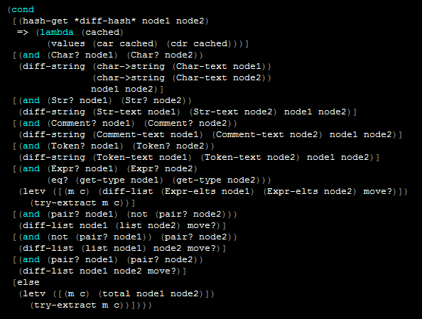
diff-node :: Node -> Node –> [Change]
dispatch on node types
memoization
base cases
only compare nodes of the same type
substructure extraction from the changes
compare subnodes

Slide 25
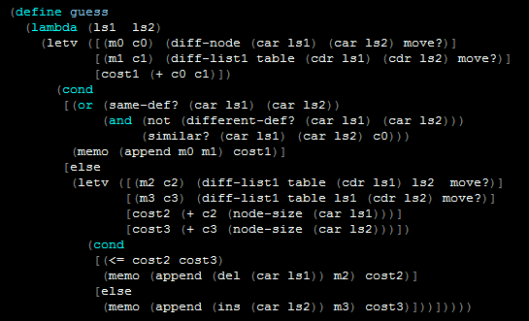
diff-list :: [Node] -> [Node] –> [Change]
compare head nodes
shortcut: same definition or unchanged
Otherwise, two choices:
delete head1
or
insert head2
pick the branch with lower cost

Slide 26
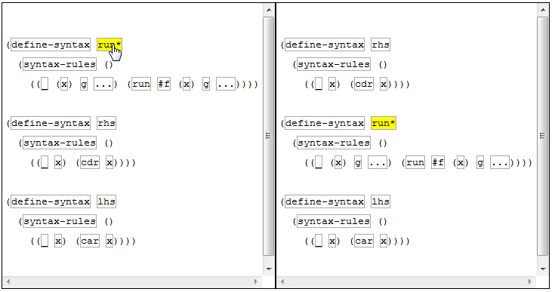
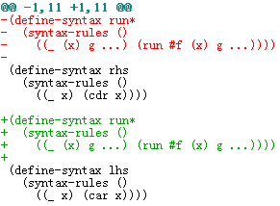
Move Detection
Some moved node can be detected by simple pairwise comparison between DELETED and INSERTED change sets.
normal diff (Git)
ydiff

Slide 27
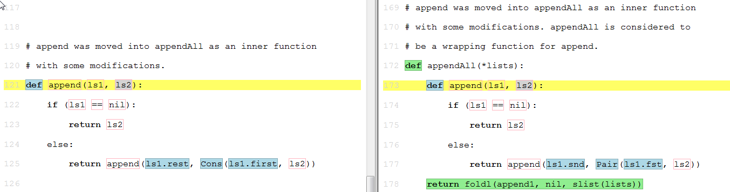
Substructure Extraction
frame: keep as a new change for further extractions

Slide 28
Outline
Structural Editing (other people’s work)
Structural Comparison (my work)
Structural Version Control (vaporware)

Slide 29
Merging in text-based version control
Insert “beer” on line 3
1 apples
2 bananas
3 beer
4 cookies
5 rice
Insert “beer” on line 3
1 apples
2 bananas
3 beer
4 cookies
5 pasta
6 rice
1 apples
2 bananas
3 cookies
4 rice
Insert “pasta” on line 5
1 apples
2 bananas
3 cookies
4 pasta
5 rice
Modifying a line of text changes the line number of consequent lines
Patch that says “insert pasta to line 4” must relocate to line 5
➔ Patch Theory (Darcs)
Insert “pasta” on line 4

Slide 30
Prediction 1: merging will no longer be a problem in Structural Version Control

Slide 31
Modifying Different Nodes
Insert node #323F containing “5” in node #2EA4
Each node has a GUID
1
#3224
#3224
#2EA4
#5B40
1
#3224
1
2
3
#5B40
#323F
#2048
#2EA4
#5B40
#2EA4
2
3
2
3
5
4
#3224
#323F
#3248
#2048
#2048
1
5
6
4
4
#2EA4
#5B40
Insert node #323F containing “5” in node #2EA4
Insert node #3248 containing “6” in node #5B40
2
3
Insert node #3248 containing “6” in node #5B40
#3248
#2048
6
4

Slide 32

Modifying The Same Node
100% conflict-free merging!!
Because the real line can be infinitely divided, we can always sort the numbers into relative positions!
1
1
1
2
3
2
3
2
3
4
5
7
4
6
5
4
6
5
7
0.2
0.5
0.8
0.1
0.2
0.8
0.1
0.2
0.5
0.8
Insert node #2048 containing “6” in node #5B40, at position 0.5
Insert node #2056 containing “7” in node #5B40, at position 0.1
Insert node #2048 containing “6” in node #5B40, at position 0.5
Insert node #2056 containing “7” in node #5B40, at position 0.1

Slide 33
What’s wrong?
All line-based VC tools have this behavior. Try it!
0.2 x = 1
0.5 y = 2
0.8 print y
0.2 x = 1
0.8 print y
0.2 x = 1
0.5 y = 2
0.65 y = 3
0.8 print y
0.2 x = 1
0.5 blah
0.65 y = 3
0.8 print y
Merge succeed,
but bugs introduced!

Slide 34
Modifying The Same Node (a more sensible way)
1
1
1
2
3
2
3
2
3
4
5
7
4
6
5
4
6
5
7
Insert node #2048 containing “6” in node #5B40, between #31FE and #3208
Insert node #2056 containing “7” in node #5B40, before #31FE
Insert node #2048 containing “6” in node #5B40, between #31FE and #3208
Insert node #2056 containing “7” in node #5B40, before #31FE

Slide 35

Modifying The Same Node (again)
Conflict!
1
1
1
2
3
2
3
2
3
4
5
4
7
6
5
4
6
5
7
Insert node #2048 containing “6” in node #5B40, between #31FE and #3208
Insert node #2056 containing “7” in node #5B40, between #31FE and #3208
Insert node #2048 containing “6” in node #5B40, between #31FE and #3208
Insert node #2056 containing “7” in node #5B40, between #31FE and #3208

Slide 36
Some observations into text-base VC tools
Grounds are where programs sit on.
Merging is hard because simultaneous edits change the grounds in different ways, but text-based VC tools don’t have a handle on them.
This is why Darcs uses Patch Theory, which gives us limited power for reasoning about the grounds.
Git uses hash values to locate the grounds, but has larger granularity. Also, hash values have dependency on the contents.
Once we have true handles on the grounds, the problem disappears.

Slide 37
What’s next?
Other scenarios
HOW MUCH and WHAT context to include in the patches?
A descriptive language for patches, and a constraint solver for merging them?
A database-like transaction system for parse tree structures?
Let the structural editor construct the change sets?
Generalize structural programming to natural languages?

Slide 38

Discussions

