Slide 1

Automating x Weekly Report With Python Stanley

Slide 2
Agenda
Dataset summary
Model v2 development
Methodology
Model selection
Feature importance - SHAP
Performance comparison: Model v1 vs Model v2

Slide 3
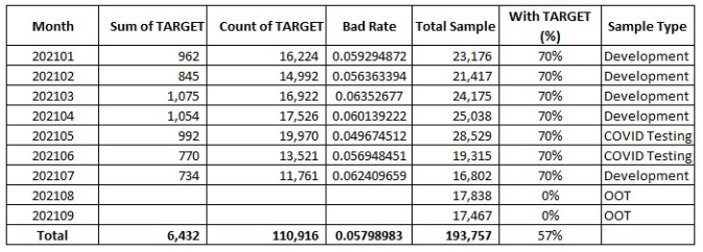

Dataset Summary
Development sample: (202101 to 202104) and 202107
Covid testing sample: 202105 to 202106
OOT sample: 202108 to 202109

Slide 4
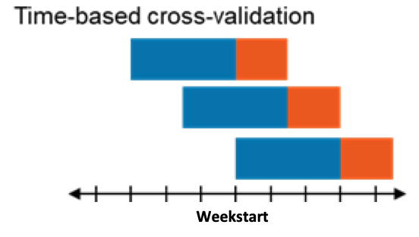
Model v2 Development – methodology
Time based cross-validation
Each fold:
Shifts forward 1 weekstart
Has n week_train (blue)
Has m week_test (orange)
Last n weekstart will be used for final model
Only using development sample type
Weekstart: [2020-12-28 to 2021-04-26] and [2021-06-28 to 2021-07-26]
Weekstart

Slide 5
Model v2 Development – model selection
Model config | Number of features | Mean GINI | STD | Train GINI | Covid testing GINI
No calibration | 21 | - |  |  | 0.3507
model_1 (as baseline) | 21 (current model features) | 0.385 | 0.007 | 0.46 | 0.3709
model_2 | 58 | 0.404 | 0.006 | 0.493 | 0.4042
model_3 | 40 | 0.403 | 0.008 | 0.488 | 0.403
model_4 | 30 | 0.402 | 0.01 | 0.485 | 0.4006
model_5 | 25 | 0.4 | 0.01 | 0.481 | 0.3989
model_6 | 20 | 0.396 | 0.01 | 0.474 | 0.3962
model_7 | 25 (remove high correlated features from model_4) | 0.399 | 0.009 | 0.482 | 0.3977
model_8 | 17 (remove high correlated features from model_6) | 0.395 | 0.009 | 0.471 | 0.3937
Considering the trade-off between performance and number of features, we recommend model_8 as the selected model for production

Slide 6
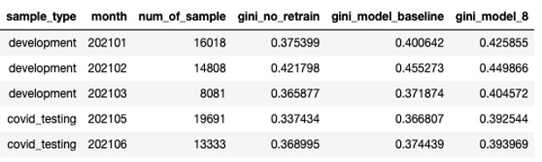
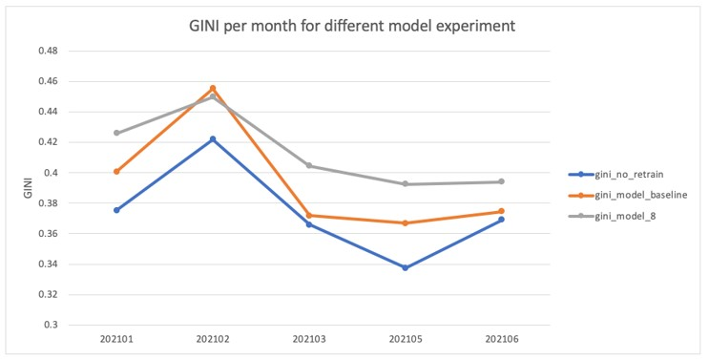
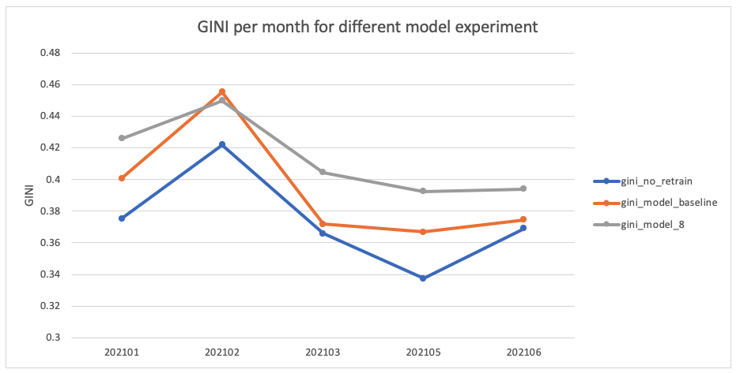
Performance comparison – GINI per month
No calibration vs model_1 (baseline) vs model_8

