Slide 1
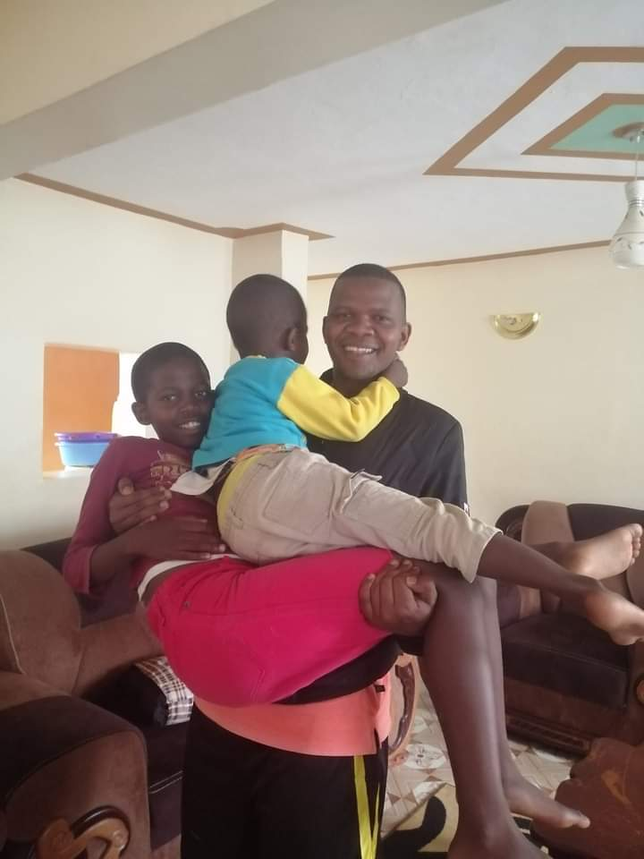
Summary
Father to 2 boys
Husband of 1 wife
Committed Chelsea fan
Adventist

Slide 2
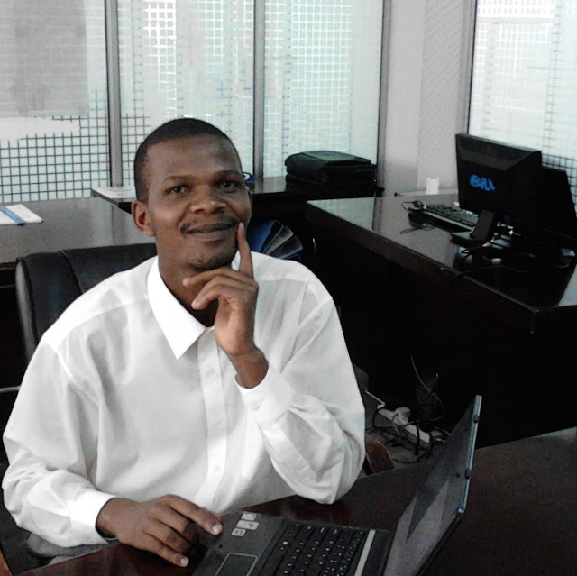
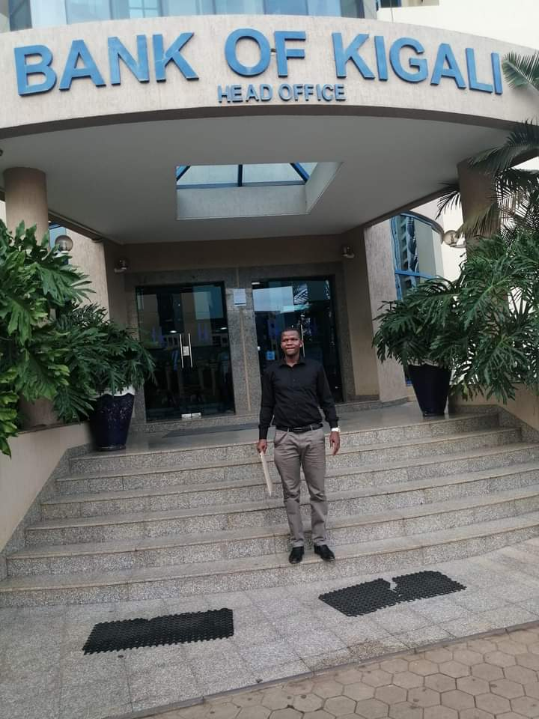
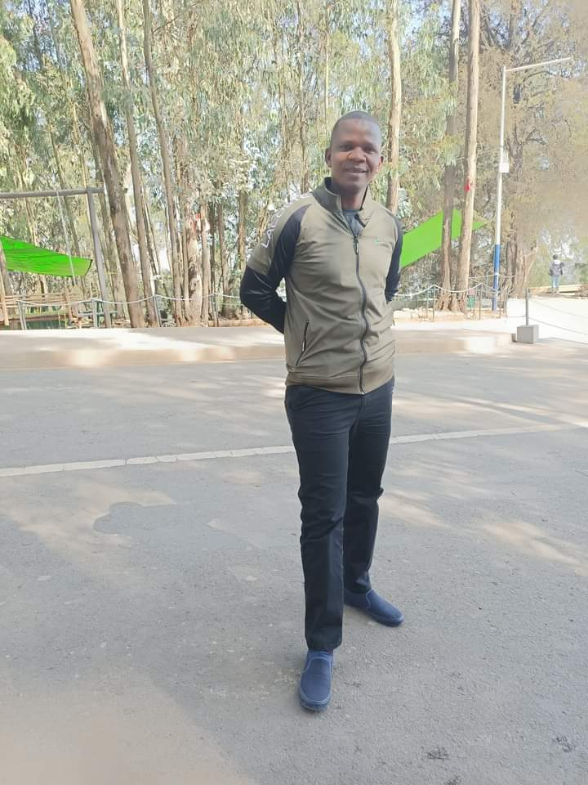

Slide 3


My Career Journey
2011
2012
2014
Systems engineer
Software developer
Lead Software Developer
Safariland wireless
Network support and VB.net software development
BEIN Africa Ltd.
PHP & JAVA 7
Adcare Limited
Java 7/Spring 2.4
2016
2017
2020
IT Solution Architect
Technical BA
Tech Lead/Systems specialist
Safaricom PLC
Java/TIBCO/NoSQL
Co-operative bank ke
Technical specifications and sourcing technical solutions
Safaricom PLC.
Technical leadership and people management

Slide 4
My tech stack
Why Leap
Better my problem-solving skills
Exposure to tech industry-we use vendors for big platforms
Gain interviewing and how to edge technical interviews
Best engineering practices
Future desire to work for MS
Java 8/11
Frontend: JavaScript/CSS/HTML/React- beginner
Basic python
C# looks also interesting and syntactically similar to Java

