Slide 1
Shaders and their applications
Chris Stanwyck

Slide 2
Overview
Historical Perspective
What is a Shader?
Shader environment
Shader applications
Examples
Challenges
Future work

Slide 3
Historical Perspective
Software rendering
Flexible but slow
Hardware Graphics processing pipeline
Fixed function, all pixels produced through same steps
Some configuration allowed but functions don’t change
Each stage in the pipeline performed a certain processing step
Higher performance
Provided baseline and commonality for graphics applications
Straight forward rendering path, although details could vary somewhat
Limited expression and variation of images
Hardware provided necessary performance while limiting features
Phong shading or Gouraud?

Slide 4
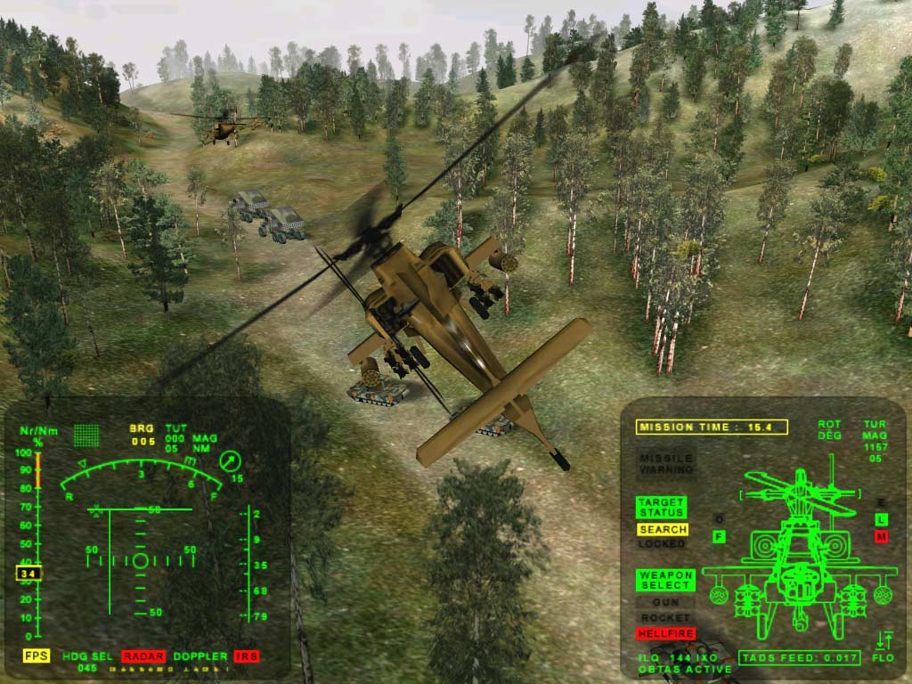
Historical Perspective
3DMark2000 DirectX 7 benchmark (no shaders)

Slide 5
Graphics Pipeline
User Input
Simulate
(includes AI & Physics)
Pose
Cull
Camera Transformations & Projection
Rasterize
Shade
Combine
Post-Process
Image
CGP&P Figure 33.1

Slide 6
What is a shader?
Original purpose was to compute shading
Linear interpolation across triangles used in early Phong lighting, conflated with lighting model
Small program could be used to compute desired model
Could change program based on desired model
Eventually, programmable stages introduced to multiple stages in pipeline
Still called “shaders”
Pixel (fragment), vertex, geometry, tessellation, etc.
Programmability allows flexibility
Can use multiple algorithms/models per scene, per object
Faster hardware allowed for more complex combinations of rendering algorithms

Slide 7
What is a shader (cont.)
From fixed function pipeline, to programmable shaders, to unified shading architecture
Each step allowed more control over rendering
GPU beginning to look more like it’s own operating system
Shaders compiled and run on GPU
Multiple “threads” Multiple “cores”
Data passing semantics
Shading languages

Slide 8
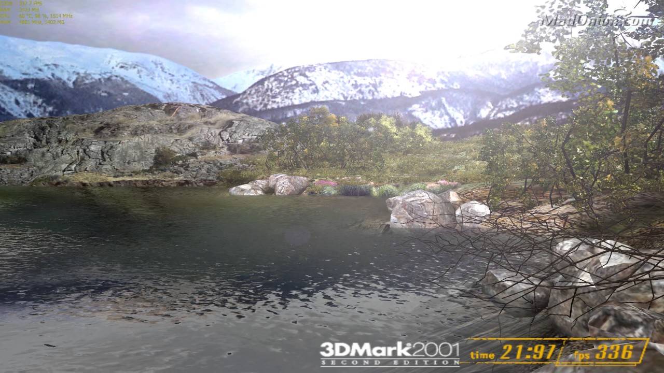
Early Shading Example
3DMark2001 DirectX8.1 Shaders

Slide 9
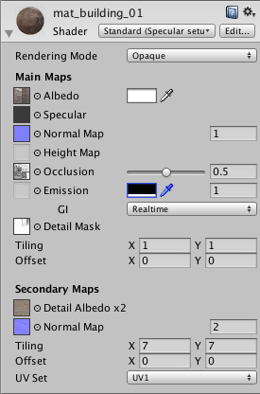
Shader Environment
Shaders written in a “shading language”
GLSL for OpenGL
HLSL for DirectX
Others
Higher levels of abstraction in some environments
E.g. Unity “standard” shaders
Can simply select and configure desired material to represent

Slide 10
Shader Applications
Lighting
Realistic materials
Reflectance
Level of Detail (LOD) programming
Tessellation
Environmental mapping
GPU Compute
Stylistic effects
Cell shading
Cartoon
Anything you can imagine…

Slide 11
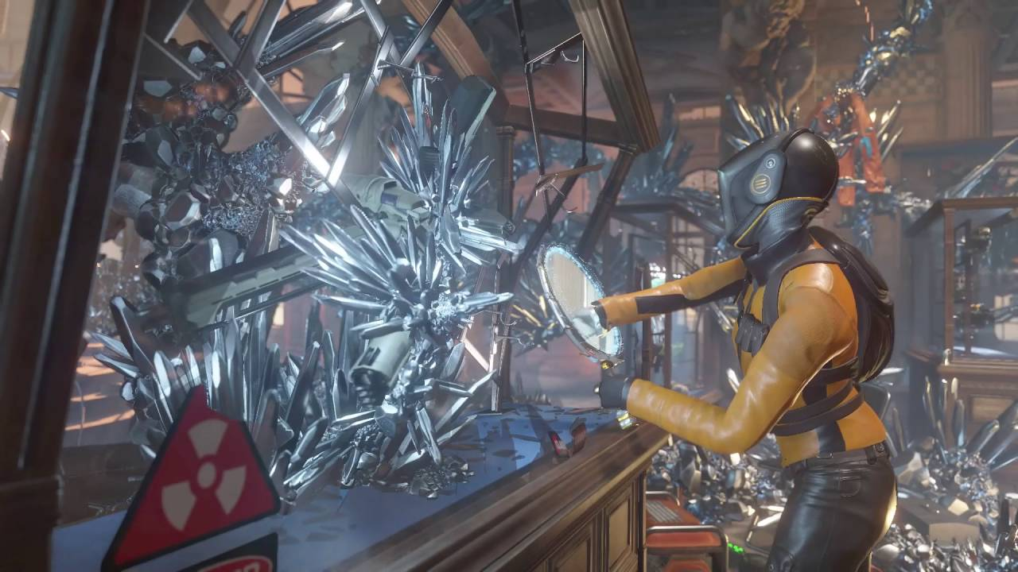
Modern Shading Example
Time Spy DirectX12 Benchmark

Slide 12
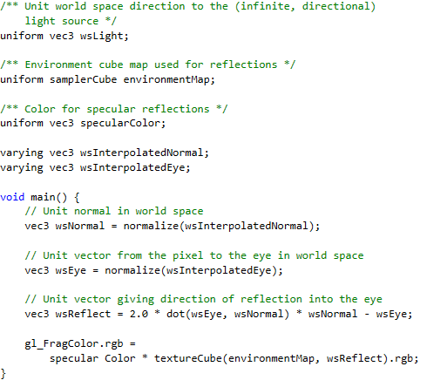
Examples – Env. Mapping
CGP&P Listing 33.7

Slide 13
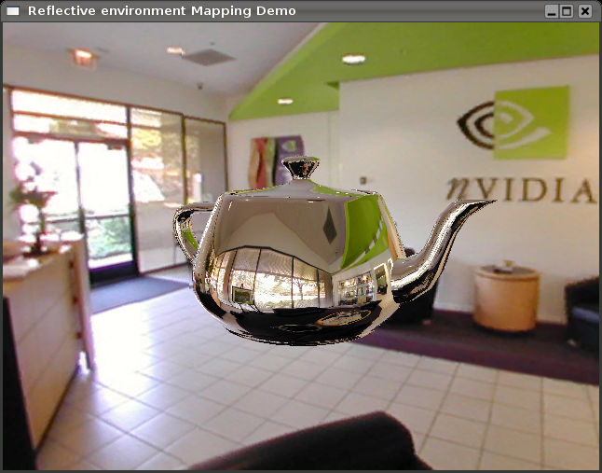
Examples – Env. Mapping
http://schorsch.efi.fh-nuernberg.de/roettger/index.php/Computergrafik/EnvironmentMapping

Slide 14
LOD Programming
Level of Detail (LOD) allows varying representations
Use high LOD for near objects
Low LOD for far objects
Smooth transition important
Requires many different representations
Can be accomplished with shaders
Possible to create one high level object and deconstruct into multiple shader programs
Requires a log of code/images otherwise

Slide 15
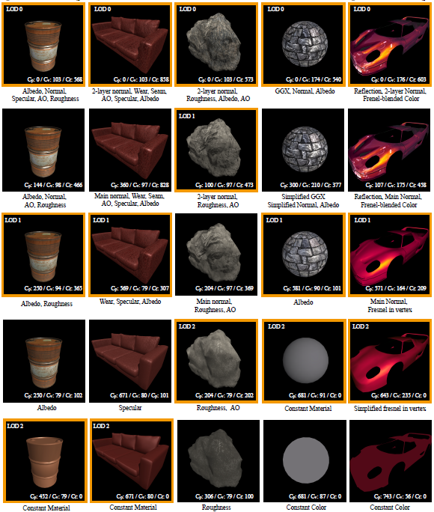
LOD Programming

Slide 16
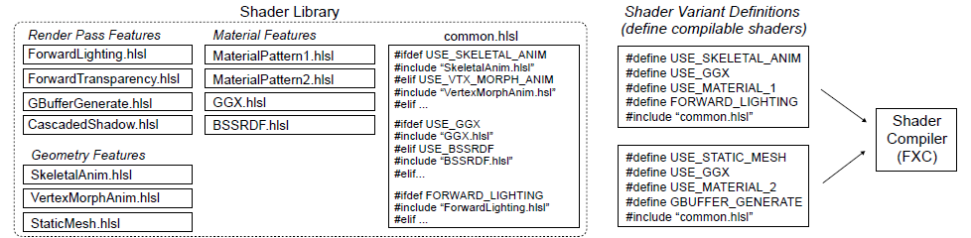
Challenges- Modularity/Binding
Shaders build using #define to create many variants
Not the best method for modularity
Large number of shader variants consumes CPU time
Must bind new parameters for each shader
Shaders replaced wholesale
Shader Components; He et al.

Slide 17
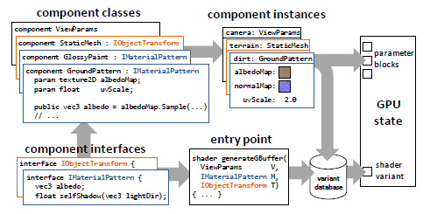
Solution?
Create modular shader components
Only need to bind changed parameters
Reduces CPU overhead
More time to let GPU do work
Shader Components; He et al.

Slide 18
VR Applications
Same basis in computer graphics
Higher computational cost
Realism even more important
Shaders support effects which are useful in this application
Improve performance and user comfort
Depth of Field rendering
Focal planes
Foveated rendering

Slide 19
Future Work
GPU becoming increasing more programmable
Shader programs/languages made to be more object oriented?
GPU OS?
Fully programmable architecture?
FPGA integration?
Truly programmable hardware/pipeline

Slide 20
References
@book{Hughes:2013:CGP, author = {John F. Hughes and Andries van Dam and Morgan McGuire and David F. Sklar and James D. Foley and Steven K. Feiner and Kurt Akeley}, title = {Computer graphics: principles and practice (3rd ed.)}, year = {2013}, month = {July}, day = {20}, isbn = {0321399528}, publisher = {Addison-Wesley Professional}, address = {Boston, MA, USA}, pages = {1264} }

Slide 21
References
@article{He:2015:SRA:2816795.2818104,
author = {He, Yong and Foley, Tim and Tatarchuk, Natalya and Fatahalian, Kayvon},
title = {A System for Rapid, Automatic Shader Level-of-detail},
journal = {ACM Trans. Graph.},
issue_date = {November 2015},
volume = {34},
number = {6},
month = oct,
year = {2015},
issn = {0730-0301},
pages = {187:1--187:12},
articleno = {187},
numpages = {12},
url = {http://doi.acm.org/10.1145/2816795.2818104},
doi = {10.1145/2816795.2818104},
acmid = {2818104},
publisher = {ACM},
address = {New York, NY, USA},
keywords = {level-of-detail, real-time rendering, shader optimization, shader simplification},
}

Slide 22
References
@article{He:2017:SCM:3072959.3073648,
author = {He, Yong and Foley, Tim and Hofstee, Teguh and Long, Haomin and Fatahalian, Kayvon},
title = {Shader Components: Modular and High Performance Shader Development},
journal = {ACM Trans. Graph.},
issue_date = {July 2017},
volume = {36},
number = {4},
month = jul,
year = {2017},
issn = {0730-0301},
pages = {100:1--100:11},
articleno = {100},
numpages = {11},
url = {http://doi.acm.org.umasslowell.idm.oclc.org/10.1145/3072959.3073648},
doi = {10.1145/3072959.3073648},
acmid = {3073648},
publisher = {ACM},
address = {New York, NY, USA},
keywords = {real-time rendering, shading languages},
},

Slide 23
References
http://schorsch.efi.fh-nuernberg.de/roettger/index.php/Computergrafik/EnvironmentMapping
https://docs.unity3d.com/Manual/Shaders.html
www.futuremark.com (none/early/current shading examples)

