Slide 1
Shaders and their applications
Chris Stanwyck

Slide 2
Overview
Historical Perspective
What is a Shader?
Shader environment
Examples
Challenges
Future work

Slide 3
Historical Perspective
Software rendering
Flexible but slow
Hardware Graphics processing pipeline
Fixed function limited configuration
Higher performance

Slide 4
Historical Perspective
Common baseline for graphics applications
Rendering details could vary somewhat
Limited expression and variation of images
Hardware provided performance
while limiting features
Phong shading or Gouraud?

Slide 5
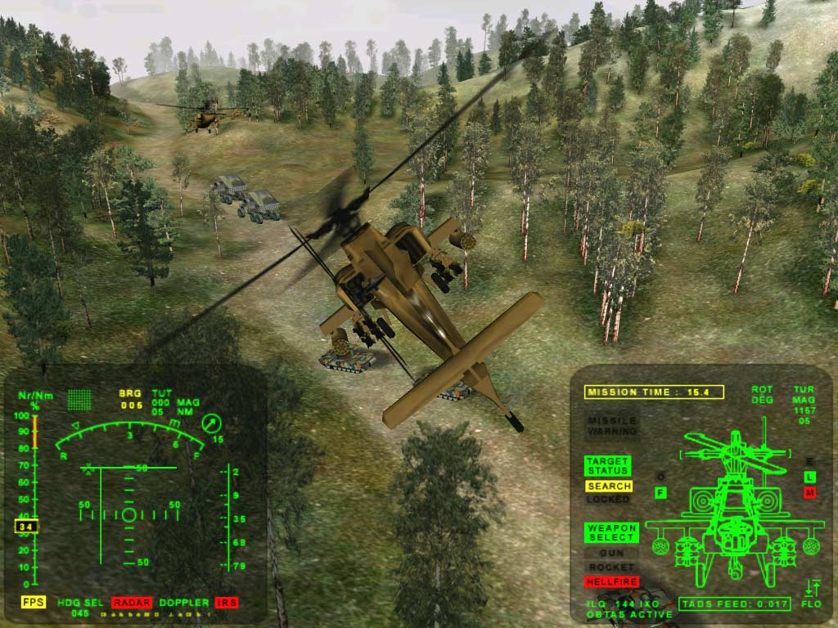
Historical Perspective
3DMark2000 DirectX 7 benchmark (no shaders)

Slide 6
Graphics Pipeline
User Input
Simulate
(includes AI & Physics)
Pose
Cull
Camera Transformations & Projection
Rasterize
Shade
Combine
Post-Process
Image
CGP&P Figure 33.1

Slide 7
What is a shader?
Original purpose was to compute shading
I.E. lighting
Small program for custom algorithm
Programmable stages introduced in pipeline
Still called “shaders”
Pixel (fragment), vertex, geometry, tessellation, etc.

Slide 8
What is a shader?
Programmability allows flexibility
Multiple algorithms per scene, per object
Faster hardware: more complex combinations
Fixed function->programmable->unified architecture
More control over rendering

Slide 9
What is a shader (cont.)
GPU resembling operating system
Shaders compiled and run on GPU
Multiple “threads”
Multiple “cores”
Data passing semantics
Shading languages

Slide 10
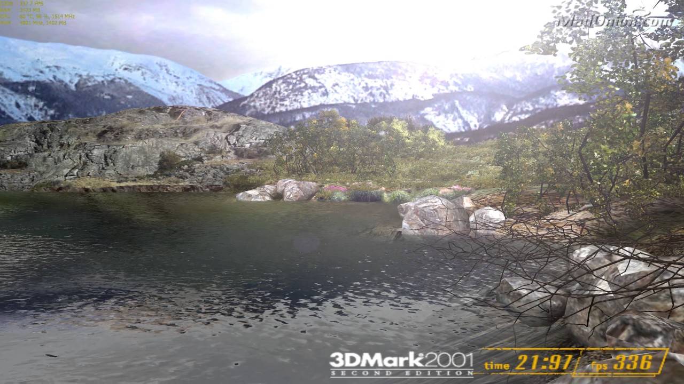
Early Shading Example
3DMark2001 DirectX8.1 Shaders

Slide 11
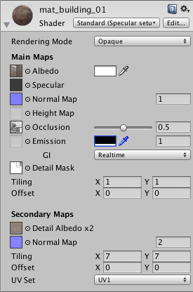
Shader Environment
Shaders written in a “shading language”
GLSL for OpenGL
HLSL for DirectX
Others
Plus higher abstraction levels
E.g. Unity “standard” shaders
Unity Shader Configuration

Slide 12
Shader Applications
Lighting
Realistic materials
Reflectance
Level of Detail (LOD) programming
Tessellation
Environmental mapping

Slide 13
Shader Applications
GPU Compute
Stylistic effects
Cell shading
Cartoon
Anything you can imagine…

Slide 14
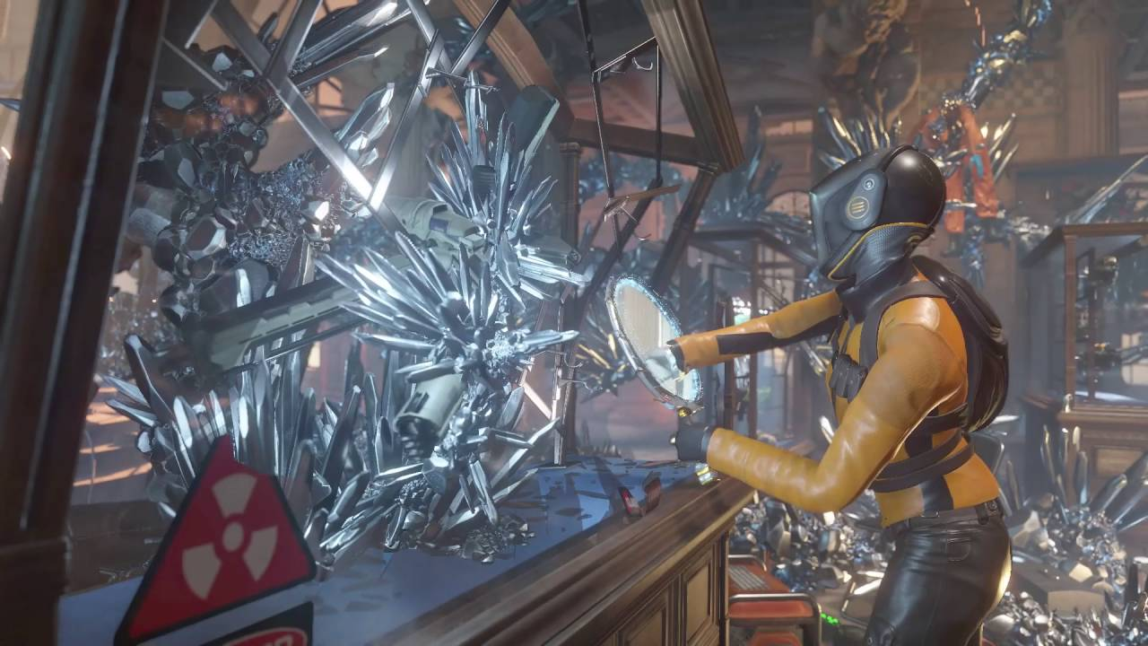
Modern Shading Example
Time Spy DirectX12 Benchmark

Slide 15
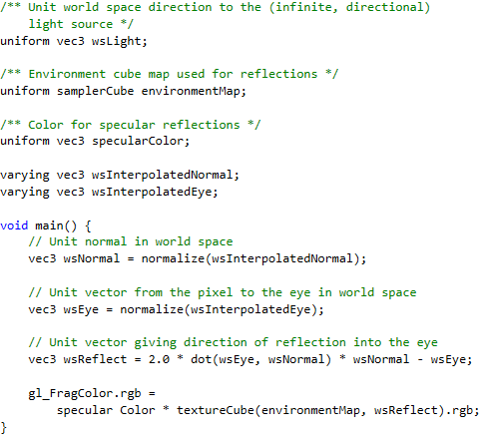
Examples – Env. Mapping
CGP&P Listing 33.7

Slide 16
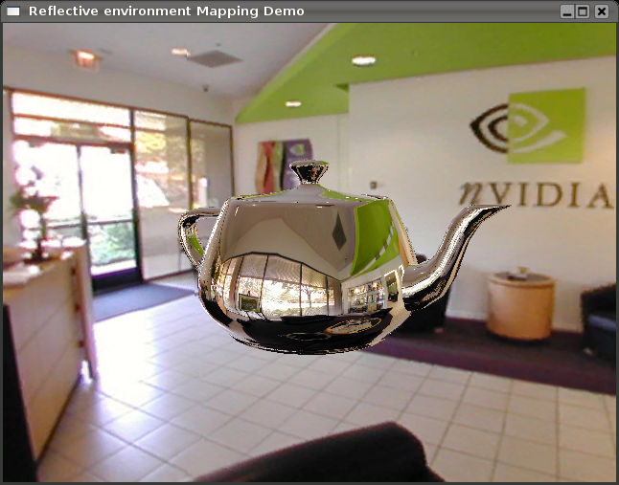
Examples – Env. Mapping
http://schorsch.efi.fh-nuernberg.de/roettger/index.php/Computergrafik/EnvironmentMapping

Slide 17
Level of Detail (LOD) Programming
LOD allows varying representations
Use high LOD for near objects
Low LOD for far objects
Smooth transition important
Requires many different representations
Uses mipmap

Slide 18
LOD Programming
Can be accomplished with shaders
Multiple shaders per object
Each shader creates effect
Remove effect one by one
Set effect distance like mipmap

Slide 19
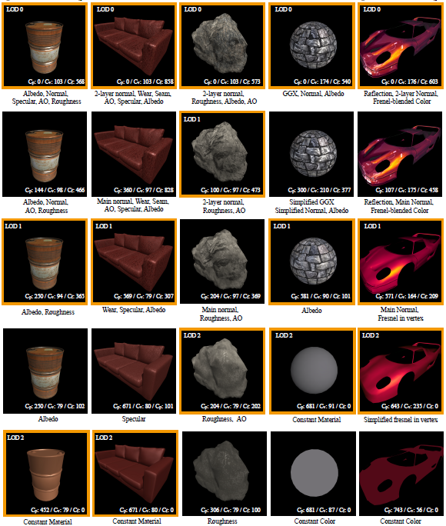
LOD Programming
Shader LOD; He et al.

Slide 20
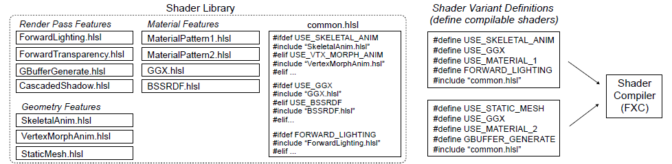
Challenges- Modularity/Binding
Shaders build using #define: variants
Not ideal method for modularity
Many shader variants: more CPU time
Bind new parameters each shader
Shaders replaced wholesale
Shader Components; He et al.

Slide 21
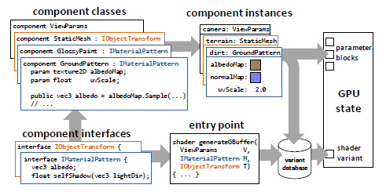
Solution?
Create modular shader components
Only bind changed parameters
Reduces CPU overhead
More time for GPU
Shader Components; He et al.

Slide 22
VR Applications
Same basis in computer graphics
Higher computational cost
Realism even more important

Slide 23
VR Applications
Shaders are useful
Improve performance and user comfort
Depth of Field rendering
Focal planes
Foveated rendering

Slide 24
Future Work
GPU increasing more programmable
Shader programs more object oriented?
GPU OS?
Fully programmable architecture?
FPGA integration?
Truly programmable hardware/pipeline

Slide 25
References
@book{Hughes:2013:CGP, author = {John F. Hughes and Andries van Dam and Morgan McGuire and David F. Sklar and James D. Foley and Steven K. Feiner and Kurt Akeley}, title = {Computer graphics: principles and practice (3rd ed.)}, year = {2013}, month = {July}, day = {20}, isbn = {0321399528}, publisher = {Addison-Wesley Professional}, address = {Boston, MA, USA}, pages = {1264} }

Slide 26
References
@article{He:2015:SRA:2816795.2818104,
author = {He, Yong and Foley, Tim and Tatarchuk, Natalya and Fatahalian, Kayvon},
title = {A System for Rapid, Automatic Shader Level-of-detail},
journal = {ACM Trans. Graph.},
issue_date = {November 2015},
volume = {34},
number = {6},
month = oct,
year = {2015},
issn = {0730-0301},
pages = {187:1--187:12},
articleno = {187},
numpages = {12},
url = {http://doi.acm.org/10.1145/2816795.2818104},
doi = {10.1145/2816795.2818104},
acmid = {2818104},
publisher = {ACM},
address = {New York, NY, USA},
keywords = {level-of-detail, real-time rendering, shader optimization, shader simplification},
}

Slide 27
References
@article{He:2017:SCM:3072959.3073648,
author = {He, Yong and Foley, Tim and Hofstee, Teguh and Long, Haomin and Fatahalian, Kayvon},
title = {Shader Components: Modular and High Performance Shader Development},
journal = {ACM Trans. Graph.},
issue_date = {July 2017},
volume = {36},
number = {4},
month = jul,
year = {2017},
issn = {0730-0301},
pages = {100:1--100:11},
articleno = {100},
numpages = {11},
url = {http://doi.acm.org.umasslowell.idm.oclc.org/10.1145/3072959.3073648},
doi = {10.1145/3072959.3073648},
acmid = {3073648},
publisher = {ACM},
address = {New York, NY, USA},
keywords = {real-time rendering, shading languages},
},

Slide 28
References
http://schorsch.efi.fh-nuernberg.de/roettger/index.php/Computergrafik/EnvironmentMapping
https://docs.unity3d.com/Manual/Shaders.html
www.futuremark.com (none/early/current shading examples)

