Slide 1
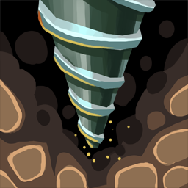

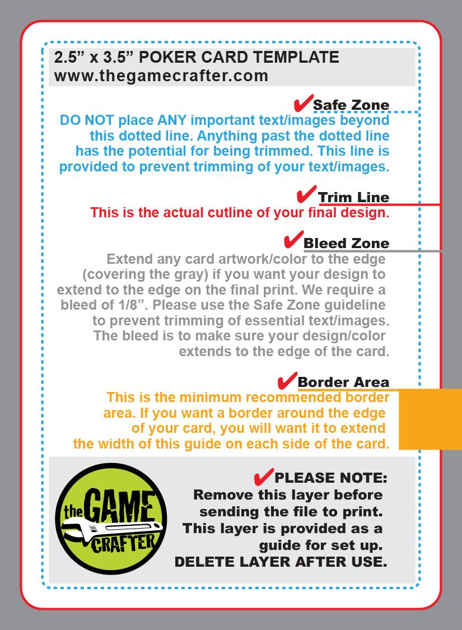
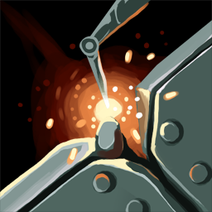
Move
Crawler
3
Space
Move
Crawler
4
Space
Move
Crawler
5
Space
Explore
with Drone
6
Spaces
Explore
with Drone
5
Spaces
Explore
with Drone
4
Spaces
Build
2
Bridge Sections
Build
1
Bridge Sections
Build
1
Bridge Sections
Move
Crawler
1
Space
Move
Crawler
2
Spaces
may mine at each location
Explore
with Drone
4
Spaces

Slide 2
Move
Crawler
3
Space
Move
Crawler
4
Space
Move
Crawler
5
Space
Explore
with Drone
6
Spaces
Explore
with Drone
5
Spaces
Explore
with Drone
4
Spaces
Build
2
Bridge Sections
Build
1
Bridge Sections
Build
1
Bridge Sections
Move
Crawler
1
Space
Move
Crawler
2 Spaces
may mine at each location
Explore
with Drone
4
Spaces

Slide 3


Action Types
Explore with drone:
Drone leave from crawler a moves orthogonally across board. Any new locations are drawn from bag and placed on board as revealed by drone. Drone returns to crawler at end of move.
Move with crawler:
Crawler moves orthogonally across board to only revealed locations. Canyons may only be traversed with bridges.
Build a bridge:
Mine with crawler:
At conclusion of turn the final space of the crawler movement may be mined if possible. Basic mines have one marker added to location to a max of three. Rare mines have one marker added only per location.
3.248 x 4.429
Turn Play
- Play one card from your hand; use either the top or bottom action
- Complete build or movement
- Mine, if possible, at crawler location
- Draw back to 4 cards

Slide 5
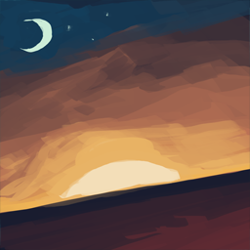
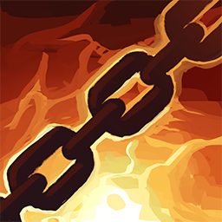
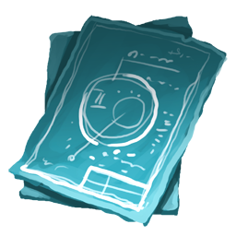
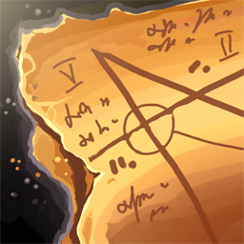


Slide 6
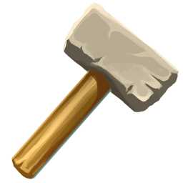
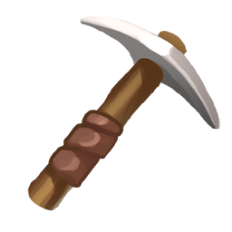
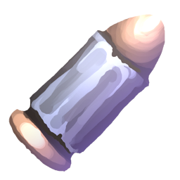

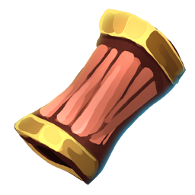
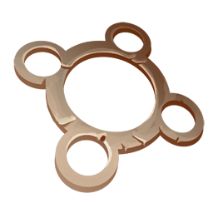

Slide 7
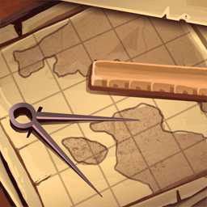
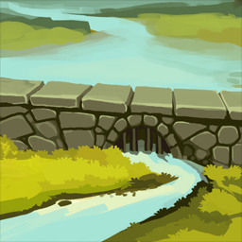


Slide 10

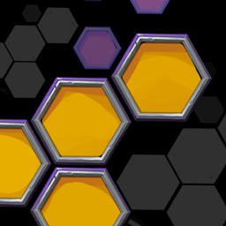




Slide 11
H 104
H 16
H 164
H 104
H 16
H 164
H 104
H 16
H 164
H 104
H 16
H 164

Slide 12
Build
2
Bridge Sections
Build
2
Bridge Sections
Explore
with Drone
7
Spaces
Move
Crawler
1
Space
Move
Crawler
1
Space
Move
Crawler
3
Spaces
Explore
with Drone
7
Spaces
Explore
with Drone
7
Spaces

