Slide 1

e-DBDA PROJECT NSE Futures & Options Data Analysis
Team Members : Mentor Name :
Bhagyashri Bachhav Gaurav Pasupuleti
Kiran Kharat
Mahesh Tanakedar Group No: 21
Purvi Solanki
Siddhesh Shinde

Slide 2
Table of Contents
1 | Data Discovery
2 | Dataset Description
3 | Architecture of the Project
4 | Model Planning and Building
5 | Challenges Faced in Project
6 | Future Scope

Slide 3
Data Discovery
PROBLEM STATEMENT :
The objective of the project is to study and analyse the NSE Futures & Options Data (2000-2020) , deriving the meaningful insights about how the Stock Market has been changed over these years and the impacts on investment strategies of people.
Building a model to predict the Stock price using Machine Learning algorithm and achieving the desired accuracy from the model.

Slide 4
Dataset Description
Data on NSE Equity Derivatives Instruments – Futures & Options in the year range 2000-2020.
Total number of records are approximately 11 Crores.
Total number of features = 16 features.
Data types in the dataset are :
-> 3 string-based features
-> 2 date-based features
-> 10 numerical-based features.

Slide 5
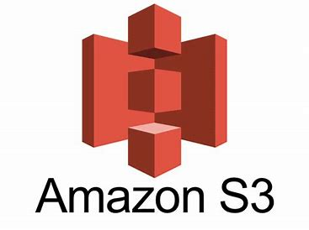



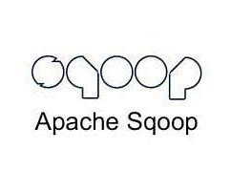




PROJECT ARCHITECTURE
70% data
Data Ingestion from
S3 & RDS
Source data taken to S3 & RDS through EMR
Raw Data Zone
Incremental Data Load
30% data
Ingested data in parquet format stored in S3
PROJECT PART-1
Connecting Hive for
Data Visualization
Processed Data stored in form of Hive Tables
Enriched Data towards Preprocessing stage
Enriched Data Zone
PROJECT PART-2
Machine Learning Model Stage

Slide 6
Challenges faced in Project
“Timestamp” and “Expiry_Date” columns in dataset was facing an issue in processing. So the need was to convert the string format into date format.
Problem was arising in the process of exporting data from Sqoop to RDS and Sqoop directory was not having MySQL by default so the need was to include MySQL connector in the Sqoop directory.
Shell file wasn’t supporting HDFS commands so the data couldn’t be directly get into HDFS hence the dumping of data into S3 was done through AWS CLI command.
Synchronizing the distributed tasks and performing the execution as a whole in automation point of view seemed the most challenging one.

Slide 7
Future Scope of Stock Price Predictor Model
The model can be useful for people interested in doing investments in Stock Market.
Investors always try to find a way to maximize their profits or minimize losses that may happen anytime in a highly volatile Market.
It gives them an idea where and when their securities can get appreciated or depreciated.

