Slide 1
Scientific Programming
Data fitting
Beau De Clercq

Slide 2
Assignment
2/31
We consider the Runge function,
1
𝑓 (𝑥) =
− 1 ≤ 𝑥 ≤ 1.
1 + 25𝑥
2
Take the 17 equidistant and exactly representable interpolation points −1, −7/8, .
. . , −1/8, 0, 1/8, . . . , 7/8, 1.
Compute on the one hand the interpolating polynomial of degree 16 through
these points, either in its Newton or Lagrange form.
Compute on the other hand the natural cubic spline. Plot both interpolants and
.
compare them with the given function 𝑓(𝑥)

Slide 3
Assignment
3/31
Recompute t
he cubic spline through the same points but now with the end
″ ″
conditions 𝑆 (−1) = 𝑓 (−1) = 925/4394 and
″ ″
𝑆 (1) = 𝑓 (1) = 925/4394.
Recompute the interpolating polynomial of degree 16 with the interpolation
points 𝑥 = 𝑐𝑜𝑠(
(𝑖+0.5)𝜋
) 𝑖 = 0, ..., 16
𝑖
17
for . Plot the interpolants again and
compare them with both the interpolating polynomial through the equidistant points and the natural cubic spline.

Slide 4
4/31
Data
-7/8 | 4.965089216446858e-02 | 2/8 | 3.902439024390244e-01
-6/8 | 6.639004149377593e-02 | 3/8 | 2.214532871972318e-01
-5/8 | 9.288824383164006e-02 | 4/8 | 1.379310344827586e-01
-4/8 | 1.379310344827586e-01 | 5/8 | 9.288824383164006e-02
-3/8 | 2.214532871972318e-01 | 6/8 | 6.639004149377593e-02
-2/8 | 3.902439024390244e-01 | 7/8 | 4.965089216446858e-02
-1/8 | 7.191011235955056e-01 | 1 | 3.846153846153846e-02
0 | 1.000000000000000e+00
^{𝑥}₋𝑒₁𝑞
3.84615384^{𝑦}6^{𝑒}1^{𝑞} 53846e-02
^{𝑥}1^{𝑒}/8^{𝑞}
7.19101123^{𝑦}5^{𝑒}9^{𝑞} 55056e-01

Slide 5
5/31
Data
9.618256431728190e-01 | 4.144611428380068e-02
8.951632913550623e-01 | 4.754448664633838e-02
7.980172272802396e-01 | 5.909890466587991e-02
6.736956436465572e-01 | 8.099365932687026e-02
5.264321628773561e-01 | 1.261309125793747e-01
3.612416661871529e-01 | 2.346102406782553e-01
1.837495178165705e-01 | 5.422707852019961e-01
6.123233995736766e-17 | 1.000000000000000e+00
9.9573417^{𝑥}6^{𝑐}2^{ℎ}9^{𝑒}5^{𝑏} 0345e-01
3.8778983^{𝑦}6^{𝑐}0^{ℎ}0^{𝑒}0^{𝑏} 5663e-02

Slide 6
6/31
Data
-3.612416661871529e-01 | 2.346102406782552e-01
-5.264321628773555e-01 | 1.261309125793750e-01
-6.736956436465572e-01 | 8.099365932687026e-02
-7.980172272802395e-01 | 5.909890466587994e-02
-8.951632913550622e-01 | 4.754448664633840e-02
-9.618256431728190e-01 | 4.144611428380068e-02
-9.618256431728190e-01 | 3.877898360005662e-02
-1.837495^{𝑥}17^{𝑐ℎ}8^{𝑒}1^{𝑏}65702e-01
5.4227078^{𝑦}5^{𝑐}2^{ℎ}0^{𝑒}1^{𝑏} 9970e-01

Slide 7
Solution
7/31
”Compute the interpolating polynomial of degree 16 through these points, either in its Newton or Lagrange form”
▶
Newton not available

Slide 8
Solution
7/31
”Compute the interpolating polynomial of degree 16 through these points, either in i▶ts Newton or Lagrange form”
Newton not available
▶
𝑠𝑐𝑖𝑝𝑦.𝑖𝑛𝑡𝑒𝑟𝑝𝑜𝑙𝑎𝑡𝑖𝑜𝑛.𝑙𝑎𝑛𝑔𝑟𝑎𝑛𝑔𝑒(𝑥, 𝑦) 𝑥
using and 𝑦
𝑒𝑞 𝑒𝑞

Slide 9
Solution
7/31
”Compute the interpolating polynomial of degree 16 through these points, either in i▶ts Newton or Lagrange form”
Newton not available
▶
𝑠𝑐𝑖𝑝𝑦.𝑖𝑛𝑡𝑒𝑟𝑝𝑜𝑙𝑎𝑡𝑖𝑜𝑛.𝑙𝑎𝑛𝑔𝑟𝑎𝑛𝑔𝑒(𝑥, 𝑦) 𝑥
using and 𝑦
𝑒𝑞 𝑒𝑞
▶
Monomial representation

Slide 10
Solution
8/31
▶ 7^{L8𝑒}.6^{5𝑞}4^{8(𝑥}0⁷⁾9⁵9⁴⁼0¹0⁷¹6^{8.5}2⁸⁴8⁷⁰9⁸³5⁴⁰9⁸8⁴0⁷¹𝑒⁵−²³1⁴0¹⁷𝑥^{91035𝑒}+⁻⁺6⁴⁰.3⁹⁴7^{𝑥}4¹¹3⁶7⁴⁻7⁵44¹7⁰9¹9⁷4⁰8²7⁸0𝑒 + 04𝑥¹²⁴ +
1³.8⁵1³9³2⁶4⁹2⁶9²22⁴9⁵7²3²5⁴3⁸0⁷𝑒 − 09𝑥¹⁹¹+⁻1⁴.5^{.1}2⁸0⁶6⁹7⁹4⁶6⁸7⁴0⁰6⁸3³2²5⁹2³2⁸𝑒^{𝑒}+⁺0⁰4⁴𝑥^{𝑥810}+⁺
₄1₃..⁵9₇⁰₃2₇⁵₁7₆₁⁸5₂₃⁰7₁⁹1³0₂⁶3₆6₄8₂⁸1₉⁶3₀⁹8₅⁰4₂⁸7𝑒 − 11𝑥⁷⁵ ₋⁻+ ₂3..₂¹5₇⁰1⁰₇9³₅8⁵₉3²₂9³₇4⁸7₄₄7³6⁷0⁷₄3₆1₄0₈¹8_{𝑒}𝑒 ₊+ 02_{𝑥}𝑥⁶⁴ +
3909845389𝑒 − 15𝑥³+ 1.000000000000000𝑒 + 00 ² ⁻

Slide 11
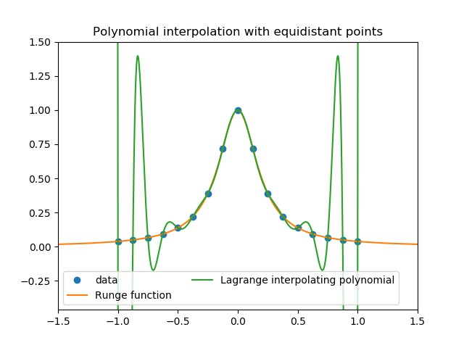
9/31
Solution

Slide 12
10/31
Solution
_𝑡𝑦𝑝𝑒 = ”𝑛𝑎𝑡𝑢𝑟𝑎𝑙”)

Slide 13
10/31
Solution
_𝑡𝑦𝑝𝑒 = ”𝑛𝑎𝑡𝑢𝑟𝑎𝑙”)
▶ Coefficient matrix

Slide 14
Solution
11/31
2.484746048736106e-01 | 1.944765566873651e-01 | 1.057212093473880e-01 | 4.965089216446858e-02
6.426372090151808e-01 | 2.876545335149681e-01 | 1.659875956226798e-01 | 6.639004149377593e-02
1.679170635070875e+00 | 5.286434868956613e-01 | 2.680248481740084e-01 | 9.288824383164006e-02
2.847335610752580e+00 | 1.158332475047245e+00 | 4.788968434168711e-01 | 1.379310344827586e-01
1.088740395946863e+01 | 2.226083329079469e+00 | 9.019488189327096e-01 | 2.214532871972318e-01
-8.100250834294002e+00 | 6.308859813880197e+00 | 1.968816711802669e+00 | 3.902439024390244e-01
-8.499517536363035e+01 | 3.271265751019946e+00 | 3.166332407415186e+00 | 7.191011235955056e-01
... | ... | ... | ...
5.1860415^{𝑎}1^{𝑥}16³63078e-01
0.00000000^{𝑏}0^{𝑥}0²00000e+00
8.14116397^{𝑐}6^{𝑥}146737e-02
3.84615384^{𝑑}6153846e-02

Slide 15
12/31
Solution
8.499517536363035e+01 | -2.860192501034144e+01 | 0.000000000000000e+00 | 1.000000000000000e+00
8.100250834294002e+00 | 3.271265751019943e+00 | -3.166332407415186e+00 | 7.191011235955056e-01
-1.088740395946863e+01 | 6.308859813880204e+00 | -1.968816711802669e+00 | 3.902439024390244e-01
-2.847335610752580e+00 | 2.226083329079463e+00 | -9.019488189327096e-01 | 2.214532871972318e-01
-1.679170635070875e+00 | 1.158332475047240e+00 | -4.788968434168711e-01 | 1.379310344827586e-01
-6.426372090151844e-01 | 5.286434868956613e-01 | -2.680248481740084e-01 | 9.288824383164006e-02
-2.484746048736106e-01 | 2.876545335149692e-01 | -1.659875956226798e-01 | 6.639004149377593e-02
-5.186041511663078e-01 | 1.944765566873653e-01 | -1.057212093473880e-01 | 4.965089216446858e-02
^{𝑎}.^{𝑥}..³
^{𝑏}.^{𝑥}..²
^{𝑐}..^{𝑥}.
.^{𝑑}..

Slide 16
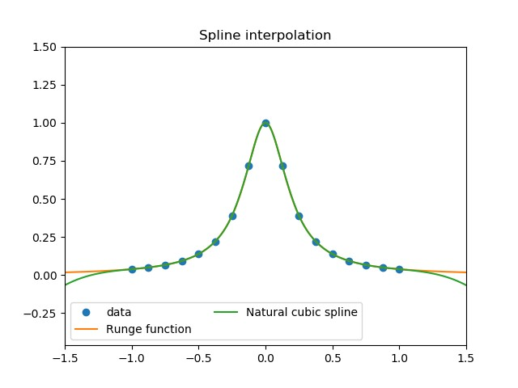
13/31
Solution

Slide 17
Solution
14/31
”Recompute the cubic spline through the same points but now with the end
″ ″
conditions 𝑆 (−1) = 𝑓 (−1) = 925/4394 and
″ ″
𝑆 (1) = 𝑓 (1) = 925/4394”
▶
_{((2,}𝑠𝑐𝑖𝑝_{925/4394),}𝑦.𝑖𝑛𝑡𝑒𝑟𝑝𝑜𝑙𝑎_{(2,}𝑡𝑒.𝐶₉₂₅𝑢𝑏/𝑖₄₃₉₄₎₎₎𝑐𝑆𝑝𝑙𝑖𝑛𝑒(𝑥, 𝑦, 𝑏𝑐_𝑡𝑦𝑝𝑒 =

Slide 18
Solution
14/31
”Recompute the cubic spline through the same points but now with the end
″ ″
conditions 𝑆 (−1) = 𝑓 (−1) = 925/4394 and
″ ″
𝑆 (1) = 𝑓 (1) = 925/4394”
▶
_{((2,}𝑠𝑐𝑖𝑝_{925/4394),}𝑦.𝑖𝑛𝑡𝑒𝑟𝑝𝑜𝑙𝑎_{(2,}𝑡𝑒.𝐶₉₂₅𝑢𝑏/𝑖₄₃₉₄₎₎₎𝑐𝑆𝑝𝑙𝑖𝑛𝑒(𝑥, 𝑦, 𝑏𝑐_𝑡𝑦𝑝𝑒 =
▶ Coefficient matrix

Slide 19
Solution
15/31
3.438364699338443e-01 | 1.662729830345203e-01 | 1.077566269124275e-01 | 4.965089216446858e-02
6.170850621595285e-01 | 2.952116592597109e-01 | 1.654422071992065e-01 | 6.639004149377593e-02
1.686017357433251e+00 | 5.266185575695346e-01 | 2.681709843028621e-01 | 9.288824383164006e-02
2.845500868158751e+00 | 1.158875066607007e+00 | 4.788576873249294e-01 | 1.379310344827586e-01
1.088789620748162e+01 | 2.225937892166540e+00 | 9.019593071716228e-01 | 2.214532871972318e-01
-8.100385083752144e+00 | 6.308898969972148e+00 | 1.968813914938958e+00 | 3.902439024390244e-01
-8.499513061381100e+01 | 3.271254563565105e+00 | 3.166333106631114e+00 | 7.191011235955056e-01
... | ... | ... | ...
1.6270883^{𝑎}7^{𝑥}78³10253e-01
1.0525716^{𝑏}8^{𝑥}86²66362e-01
7.38153579^{𝑐}2^{𝑥}478289e-02
3.84615384^{𝑑}6153846e-02

Slide 20
16/31
Solution
8.499513061381100e+01 | -2.860191941661401e+01 | -2.379866904493671e-16 | 1.000000000000000e+00
8.100385083752144e+00 | 3.271254563565090e+00 | -3.166333106631113e+00 | 7.191011235955056e-01
-1.088789620748162e+01 | 6.308898969972150e+00 | -1.968813914938959e+00 | 3.902439024390244e-01
-2.845500868158737e+00 | 2.225937892166535e+00 | -9.019593071716224e-01 | 2.214532871972318e-01
-1.686017357433251e+00 | 1.158875066607004e+00 | -4.788576873249294e-01 | 1.379310344827586e-01
-6.170850621595321e-01 | 5.266185575695346e-01 | -2.681709843028621e-01 | 9.288824383164006e-02
-3.438364699338443e-01 | 2.952116592597120e-01 | -1.654422071992065e-01 | 6.639004149377593e-02
-1.627088377810253e-01 | 1.662729830345204e-01 | -1.077566269124275e-01 | 4.965089216446858e-02
^{𝑎}.^{𝑥}..³
^{𝑏}.^{𝑥}..²
^{𝑐}..^{𝑥}.
.^{𝑑}..

Slide 21
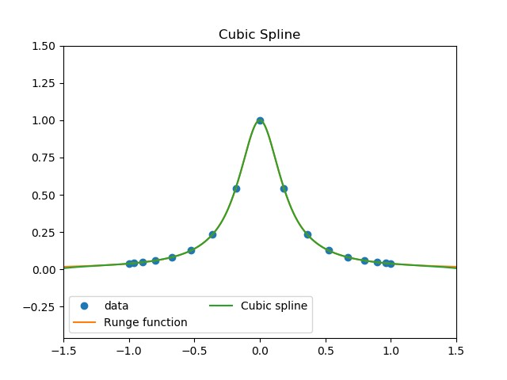
17/31
Solution

Slide 22
Solution
18/31
”Recompute the interpolating polynomial of degree 16 with the interpolation
points 𝑥 = 𝑐𝑜𝑠(
(𝑖+0.5)𝜋
) for 𝑖 = 0, ..., 16”
𝑖
17
▶
Use 𝑥_{𝑐ℎ𝑒𝑏} and 𝑦_{𝑐ℎ𝑒𝑏} in stead of 𝑥_{𝑒𝑞} and 𝑦
𝑒𝑞

Slide 23
Solution
18/31
”Recompute the interpolating polynomial of degree 16 with the interpolation
points 𝑥 = 𝑐𝑜𝑠(
(𝑖+0.5)𝜋
) for 𝑖 = 0, ..., 16”
𝑖
17
▶
Use 𝑥_{𝑐ℎ𝑒𝑏} and 𝑦_{𝑐ℎ𝑒𝑏} in stead of 𝑥 and 𝑦
𝑒𝑞
𝑒𝑞
▶
𝑠𝑐𝑖𝑝𝑦.𝑖𝑛𝑡𝑒𝑟𝑝𝑜𝑙𝑎𝑡𝑖𝑜𝑛.𝑙𝑎𝑛𝑔𝑟𝑎𝑛𝑔𝑒(𝑥, 𝑦)

Slide 24
Solution
18/31
”Recompute the interpolating polynomial of degree 16 with the interpolation
points 𝑥 = 𝑐𝑜𝑠(
(𝑖+0.5)𝜋
) for 𝑖 = 0, ..., 16”
𝑖
17
▶
Use 𝑥_{𝑐ℎ𝑒𝑏} and 𝑦_{𝑐ℎ𝑒𝑏} in stead of 𝑥 and 𝑦
𝑒𝑞
𝑒𝑞
▶
𝑠𝑐𝑖𝑝𝑦.𝑖𝑛𝑡𝑒𝑟𝑝𝑜𝑙𝑎𝑡𝑖𝑜𝑛.𝑙𝑎𝑛𝑔𝑟𝑎𝑛𝑔𝑒(𝑥, 𝑦)
▶ Monomial representation

Slide 25
Solution
19/31
▶ 4^{L}₈^{𝑐}_{.5}^{ℎ}6₅^{𝑒𝑏}8₉⁽5₁^{𝑥}8₉⁾5₇₂4⁼_{7.}8₉₄5₄⁸0₉^{.9}7₆₇⁵8₆₉⁶8₁₃⁰0₆₅³2₇₂²_{𝑒3}⁰₋¹⁴1₃₁⁶2₈₁²𝑥_{6𝑥}²¹₁⁷⁵₃⁷−⁶₊^{𝑒}3₁₆⁺._{1.}8_{8𝑥}4⁰₁2₄1^{𝑥}₇3¹₃7⁶₄₆7₃⁺3₄₂4₅₀2₇₂7₈₄3₄₆1₈₆3₉₉5₈₅𝑒_{2𝑒9}+₊₈₀03𝑥₈₂₈ ¹⁴_{𝑒 +}+
₀0₃3_{𝑥}𝑥₈¹⁰ − 1₀.0₂⁵6₃²9₀3₀668₆1₉7₂⁸3⁴18₃9₄5⁶1𝑒 − 10𝑥₇¹⁹₋¹+⁻₁3..5₂2₂9₄3₈647₁1₅465₈7₅0₁2₇6𝑒 +
_{01𝑥4}⁶ ₋− ₂3..₂3₀7₂68₀5₄4₉3₂5₅1₁6₀9₀9₁87₄6𝑒 − ₁1₃2_{𝑥}𝑥₃⁵ ₋+ ₁2..₉0₁1₉0₂1₀7₂9₆2₃4₅1₇1₇2₀4₄3₆8₆2_{𝑒}𝑒 ₊+
² + 3.047475466422256𝑒 − 15𝑥 + 1.000000000000000𝑒 + 00

Slide 26
Solution
20/31
”Plot the interpolants again and compare them with both the interpolating polynomial through the equidistant points and the natural cubic spline”

Slide 27
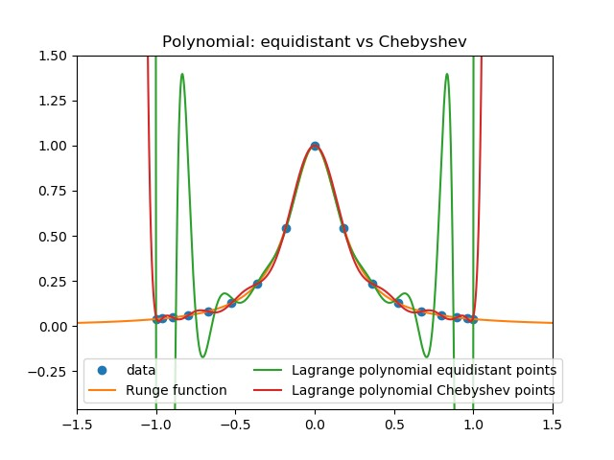
21/31
Solution

Slide 28
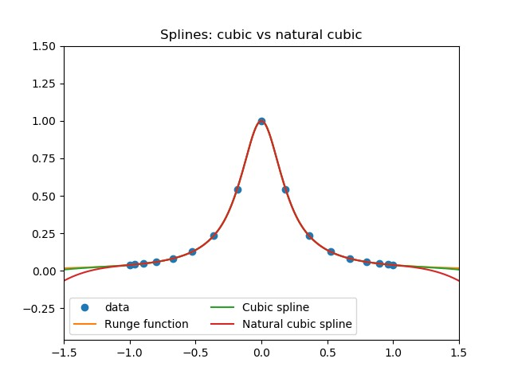
22/31
Solution

Slide 29
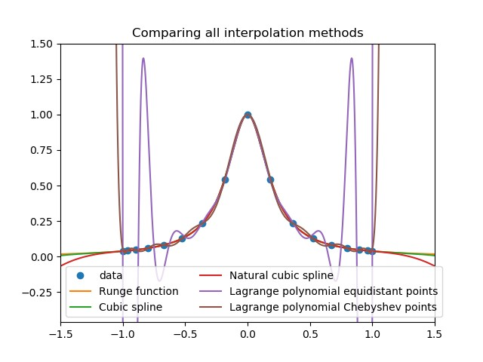
23/31
Solution

Slide 30
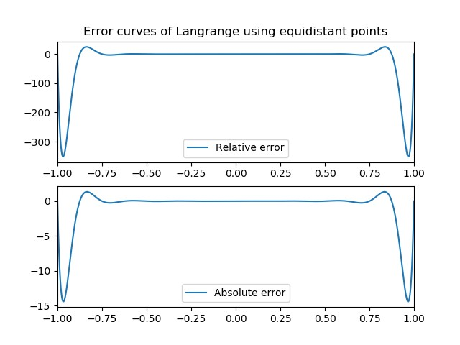
24/31
Solution

Slide 31
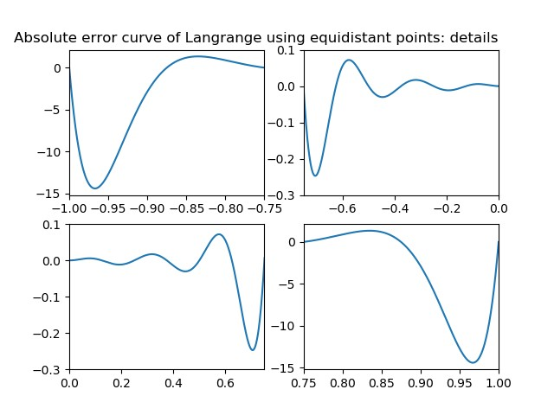
25/31
Solution

Slide 32
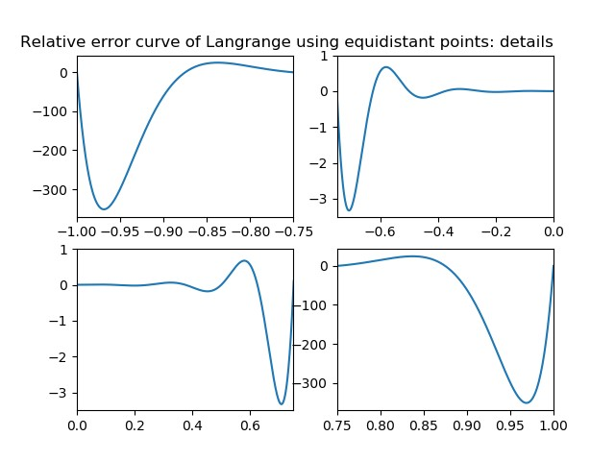
26/31
Solution

Slide 33
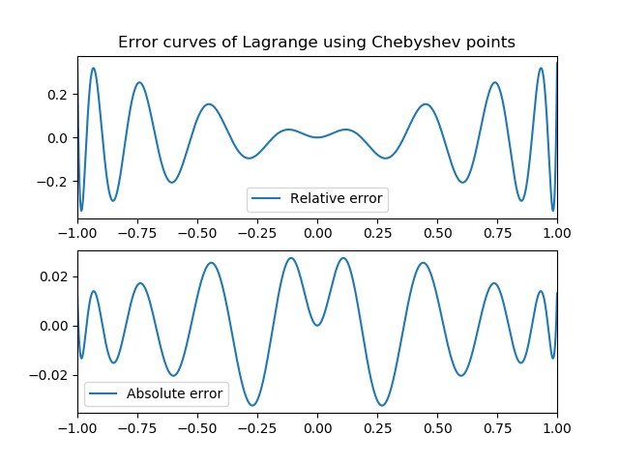
27/31
Solution

Slide 34
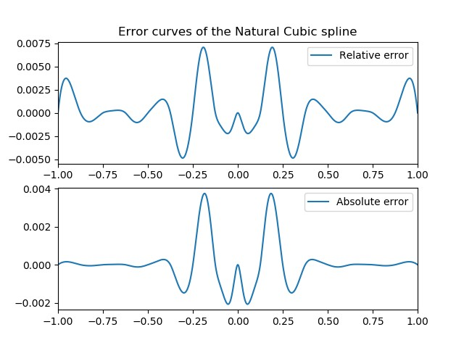
28/31
Solution

Slide 35
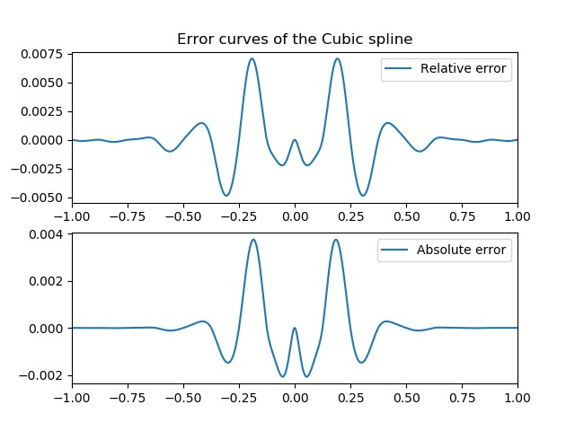
29/31
Solution

Slide 36
30/31
Conclusion
▶ Many possibilities

Slide 37
30/31
Conclusion
Many possibilities Lagrange is ok...
▶

Slide 38
Conclusion
30/31
Many possibilities Lagrange is ok...
... but splines are better for many points
▶
▶

Slide 39
Conclusion
30/31
Many possibilities Lagrange is ok...
▶
▶
... but splines are better for many points
▶
If you know more than just points → cubic spline

Slide 40
Conclusion
30/31
Many possibilities Lagrange is ok...
▶
▶
... but splines are better for many points
If you know more than just points → cubic spline
▶
If you only know points → natural cubic spline

Slide 41
Conclusion
31/31
▶ Concerning errors
▶
... but splines are better for many points
▶
If you know more than just points → cubic spline
▶
If you only know points → natural cubic spline

Slide 42
Conclusion
31/31
Concerning errors Lagrange is ok...
▶
▶
... but splines are better for many points
If you know more than just points → cubic spline
▶
If you only know points → natural cubic spline

