Slide 1
Striders
Mathias Ooms, Stan Schepers, Andrei Bondarenko & Laurens Van Damme

Slide 2
Overview
Daycare & Preschool
Data formats
Demographic Profile
Size class for company staff
Visualization
Simulation of Belgium

Slide 3
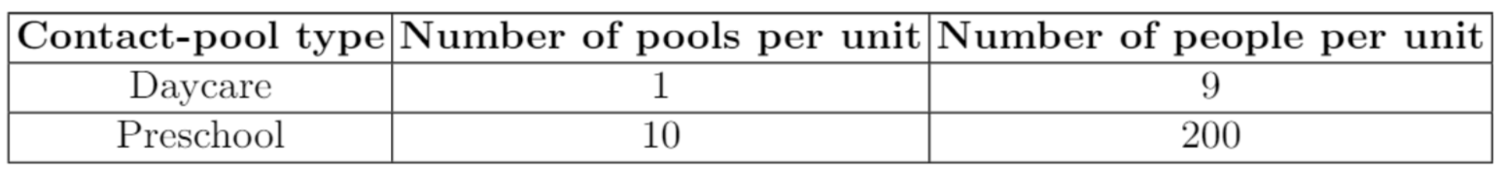
Daycare & Preschool

Slide 4
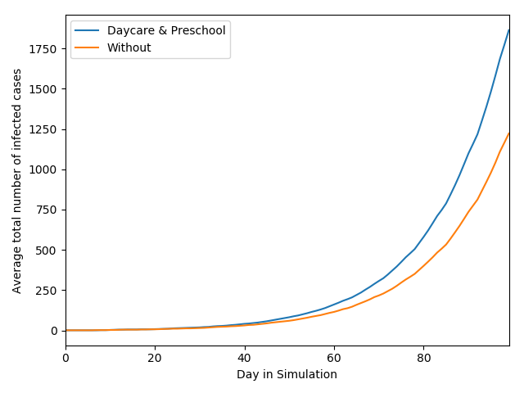
Daycare & Preschool

Slide 5
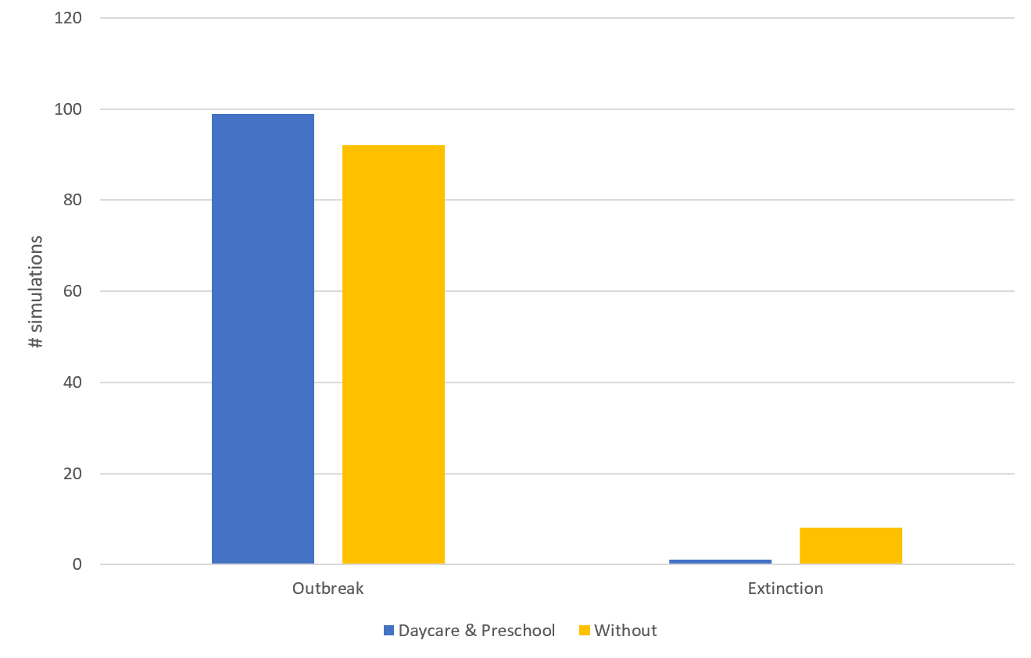
Daycare & Preschool

Slide 6
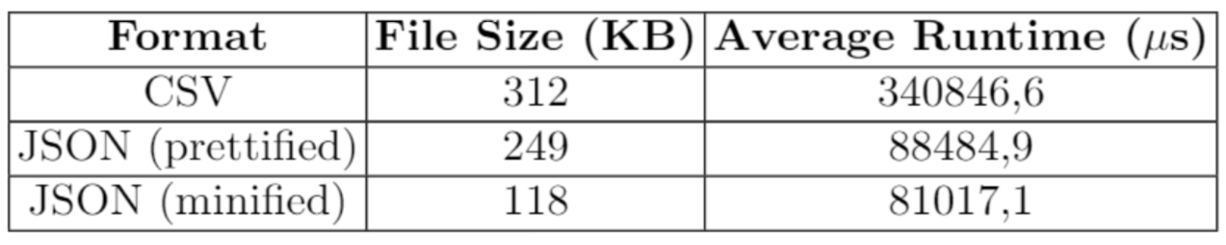
Data formats
Households

Slide 7
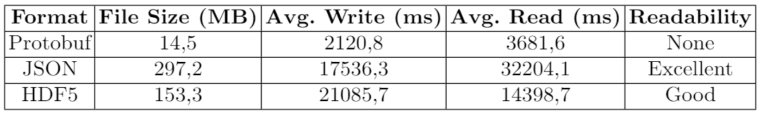
Data formats
GeoGrid

Slide 8
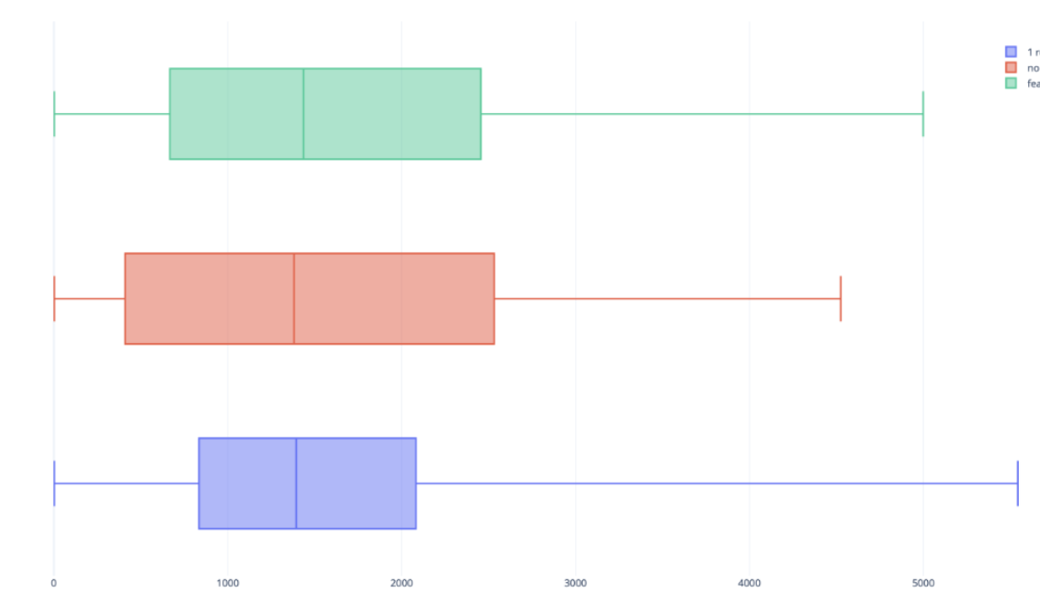
Demographic Profile
Different Reference Households
For each Location
Doesn’t affect simulation on average
Generated from household_flanders.xml
1 Reference Households
Multiple Reference Households
Multiple Reference Households + Generation Schools ~ Y/O fraction

Slide 9
Demographic Profile
Schools ~ Y/O Fraction
# daycares, preschools, k12 schools remain same
Likelihood generation in location increases with Y/O fraction of location

Slide 10
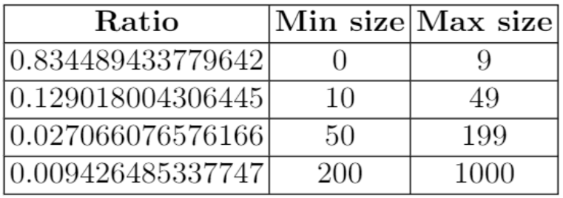

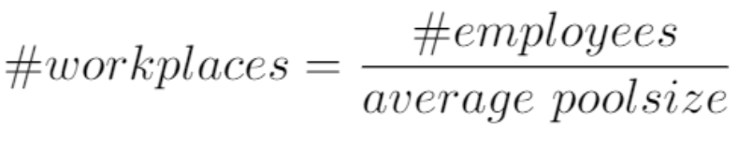
Size class for company staff

Slide 11
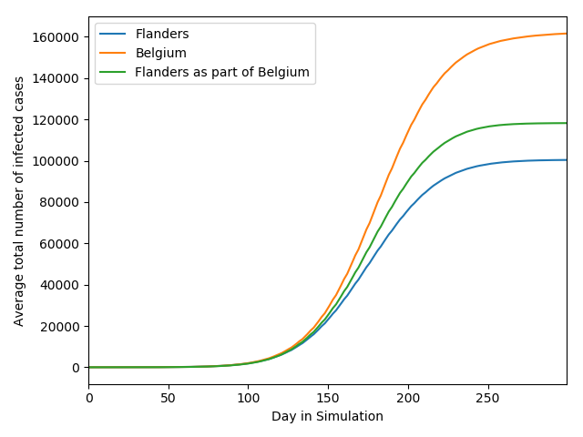
Simulation of Belgium

Slide 12
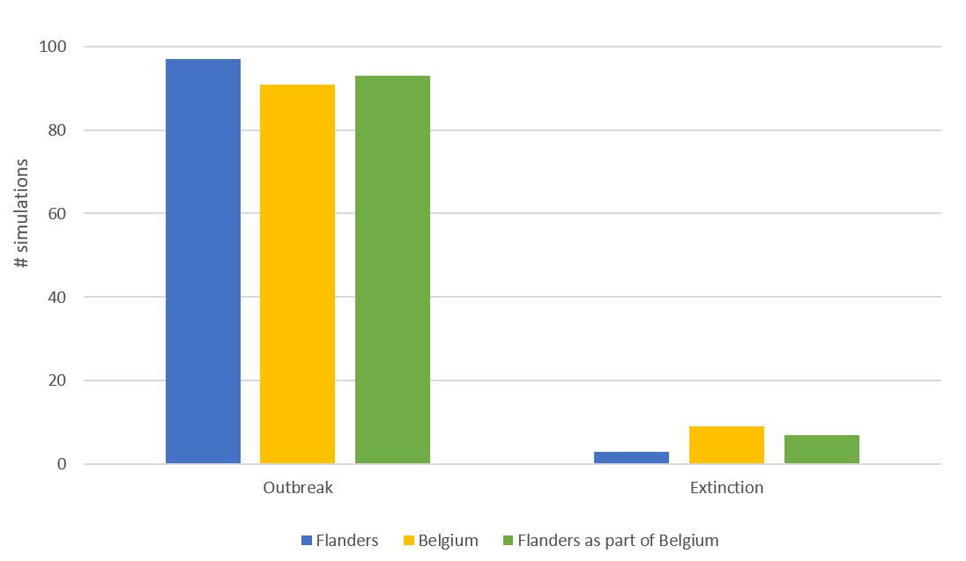
Simulation of Belgium

Slide 13

Visualizer

Slide 14
Conclusion
Implemented features introduce more finetuning
Visualizer adds functional and interesting views on complex simulations

