Slide 1
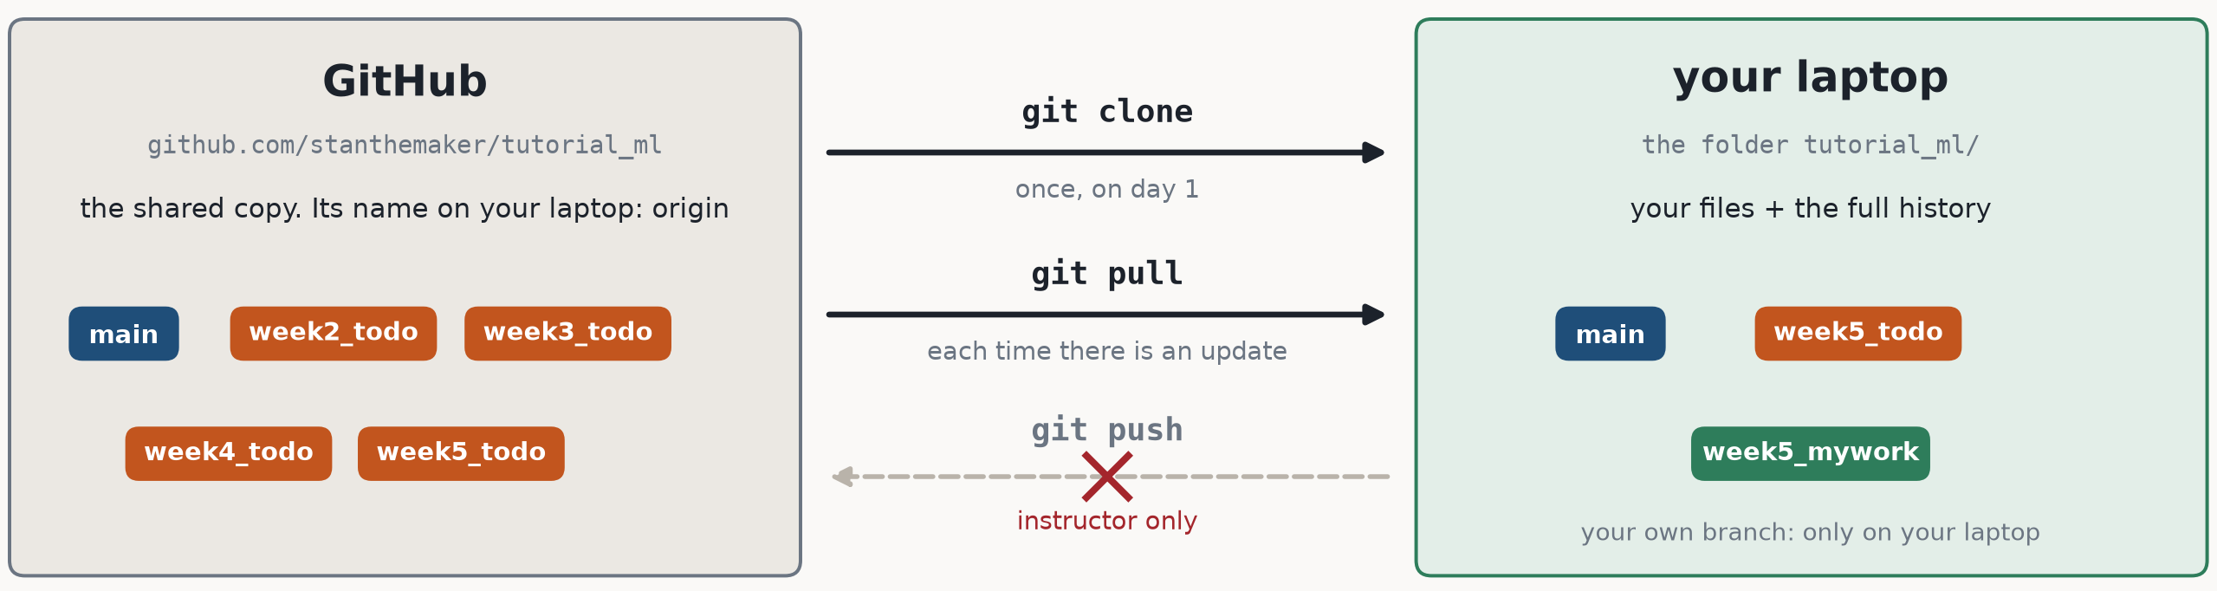
GIT AND GITHUB
Git keeps the history; GitHub keeps a shared copy
Git is a program on your laptop. It records versions of a folder, so you can go back, compare two versions, and combine work.
GitHub is a website that keeps a copy of the folder and its history, so everyone can download it.
In this course you only download: clone once, then pull each update. You never push.
Your answers stay on your laptop, on a branch of your own (slide 7).

Slide 2
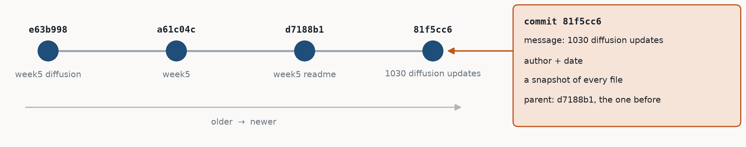
THE BASICS
A commit is a saved snapshot of the whole folder
$ git log --oneline -4 81f5cc6 # newest first
81f5cc6 1030 diffusion updates
d7188b1 week5 readme
a61c04c week5
e63b998 week5 diffusion
$ git show --stat 81f5cc6 # what it changed
...
55 files changed, 837 insertions(+), 131 deletions(-)
A commit = a snapshot of every file + a message + who and when + a link to the commit before it.
Its id (81f5cc6…) is computed from the contents, so every commit has its own. The first 7 characters are enough to name it.
Commits are never edited. New work is a new commit on top.

Slide 3
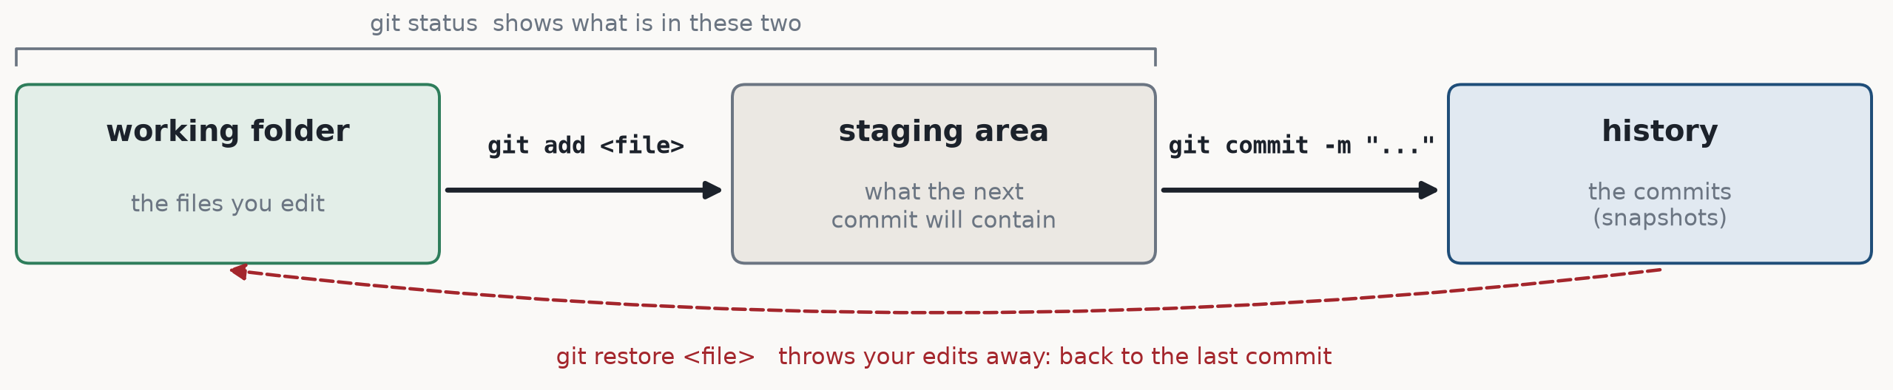
THE BASICS
Three places a change can be
$ git status
On branch week5_mywork
Changes not staged for commit:
modified: week5_diffusion/part1_unet_diffusion.py
$ git add week5_diffusion/part1_unet_diffusion.py
$ git status
On branch week5_mywork
Changes to be committed:
modified: week5_diffusion/part1_unet_diffusion.py
git status is always safe: it only reads. Run it before add, commit, checkout and merge.
Why a staging area: you choose which edits go into the next commit.
The first line, On branch …, says where your next commit will go.

Slide 4
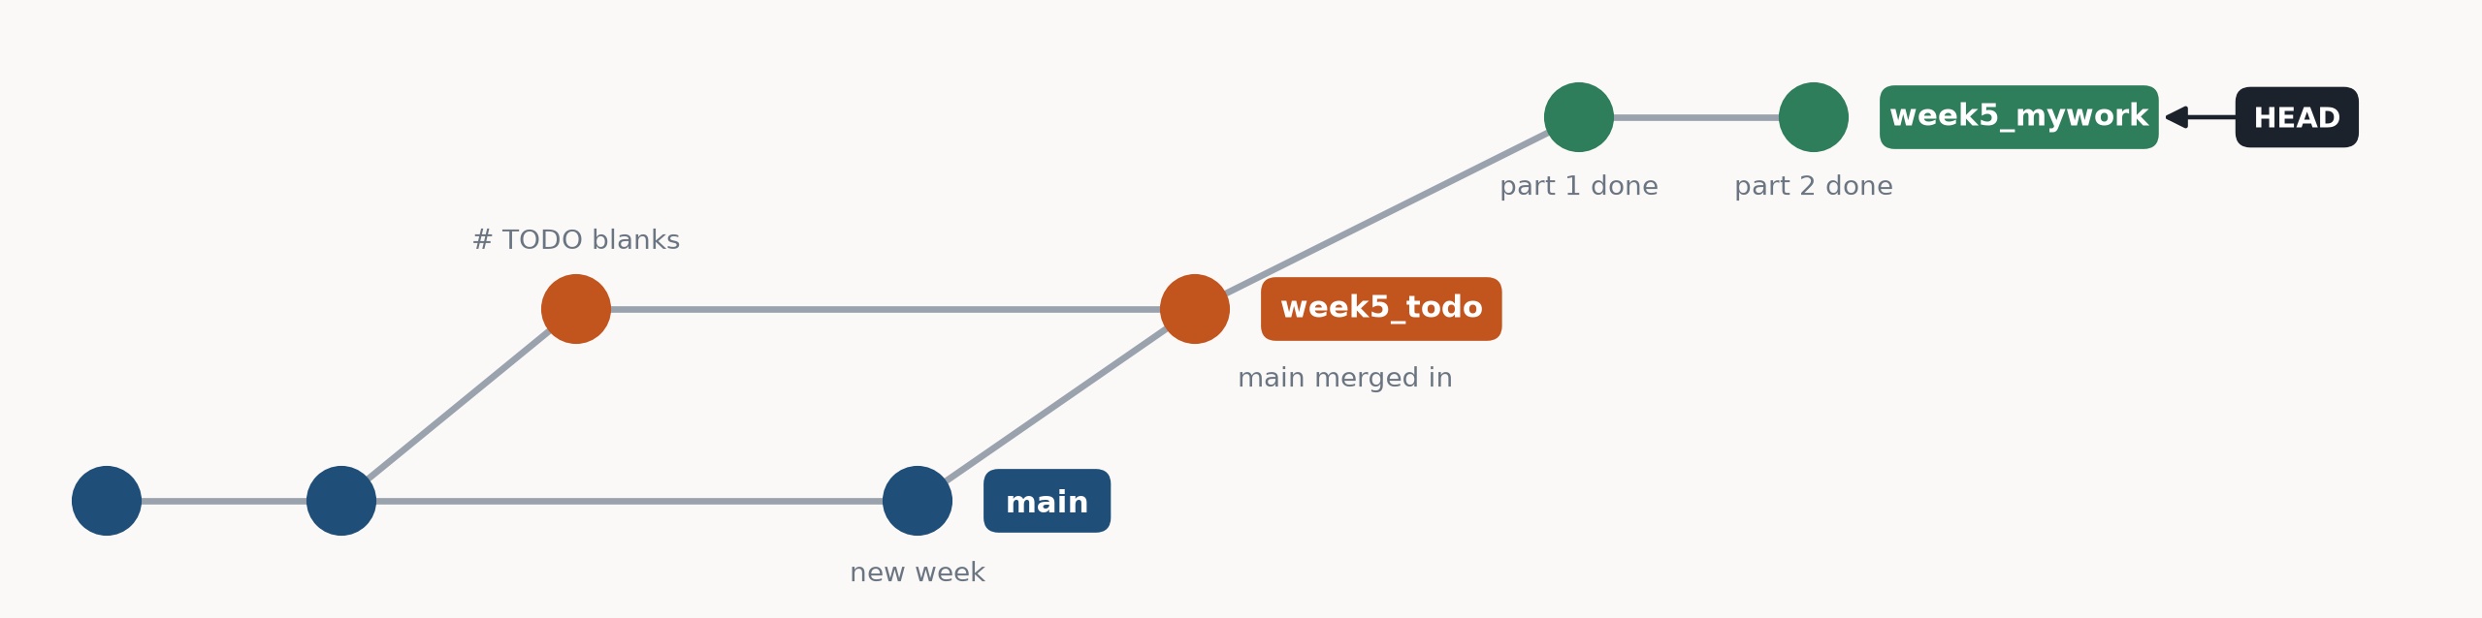
BRANCHES
A branch is a label that points at a commit
$ git branch # * = where you are
main
* week5_mywork
week5_todo
main the complete code: the answers.
week5_todo the same code with key lines blanked out (# TODO). One per week.
week5_mywork yours: you make it, and your commits go here.
A new commit moves only the label you are on (HEAD). git checkout <branch> swaps the files in your folder to that branch's commit.

Slide 5
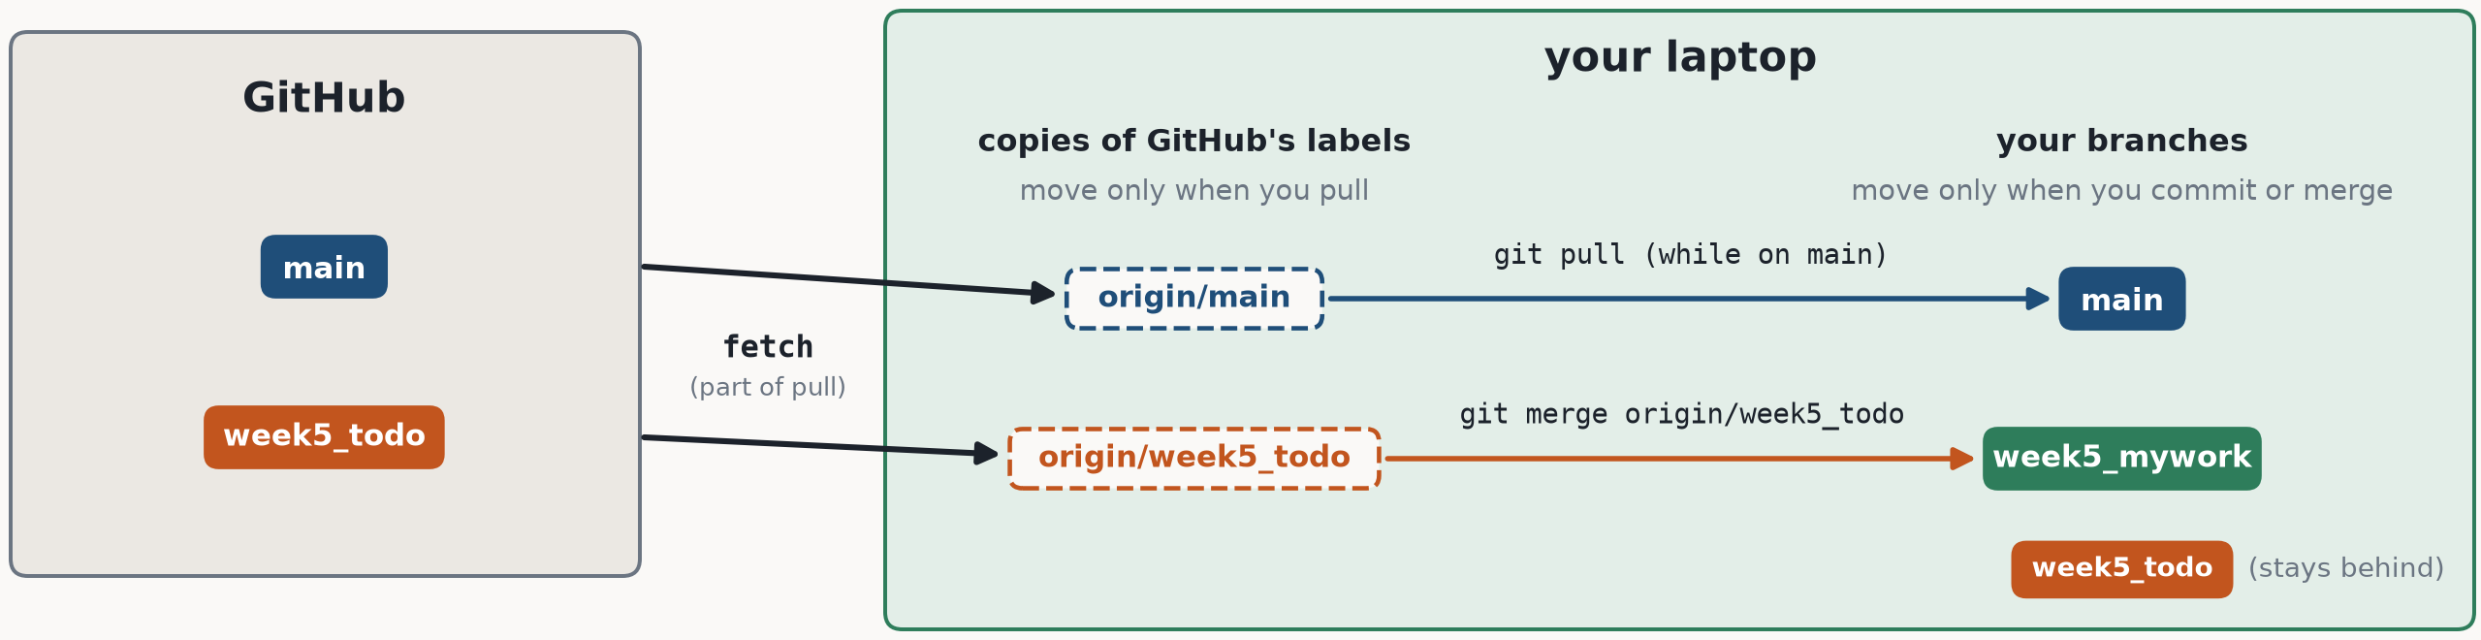
BRANCHES
GitHub's labels and yours are separate
$ git checkout main
$ git pull
From https://github.com/stanthemaker/tutorial_ml
83108d3..567d339 week5_todo -> origin/week5_todo
Already up to date.
origin/week5_todo is your copy of GitHub's week5_todo. Here GitHub had new TODO commits, so it moved; main had nothing new.
Your own labels never move by themselves. Bringing an update into your work is a merge (slide 9).

Slide 6
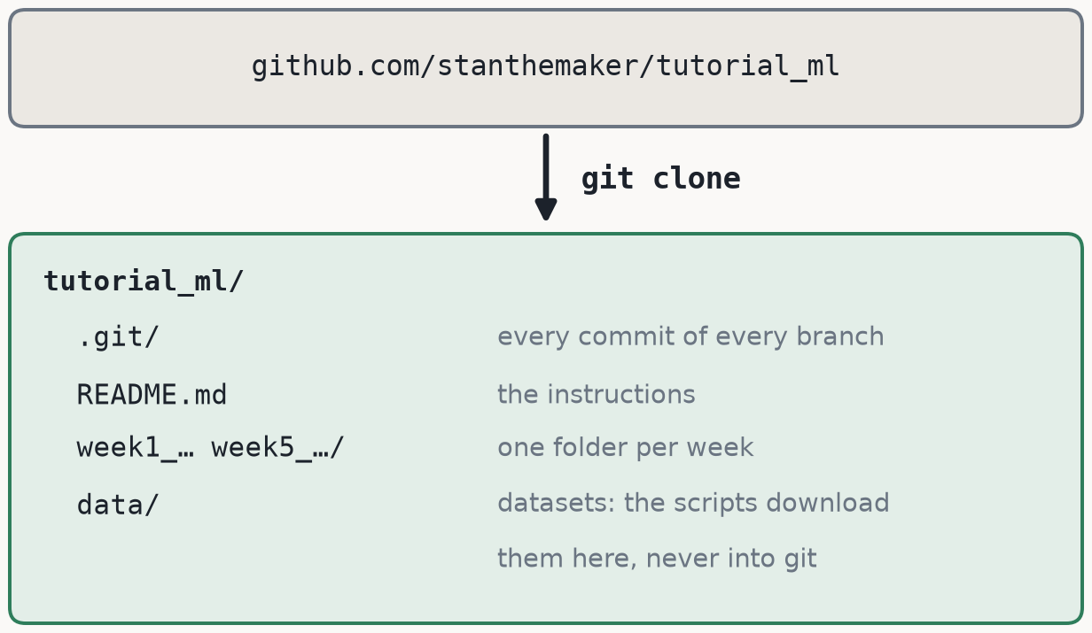
THE COURSE WORKFLOW
Day 1: download the repository
$ git clone https://github.com/stanthemaker/tutorial_ml.git
Cloning into 'tutorial_ml'...
$ cd tutorial_ml
$ git branch -a # every branch
* main
remotes/origin/HEAD -> origin/main
remotes/origin/main
remotes/origin/week2_todo
remotes/origin/week3_todo
remotes/origin/week4_todo
remotes/origin/week5_todo
Public repository: no account or login needed to clone or pull.
Windows: each week's data entry is a link to the shared data/ folder, and git on Windows saves it as a small text file instead. Run every script from the tutorial_ml folder, e.g. python week2_mlp/part3_mlp_mnist.py, not from inside week2_mlp/.

Slide 7
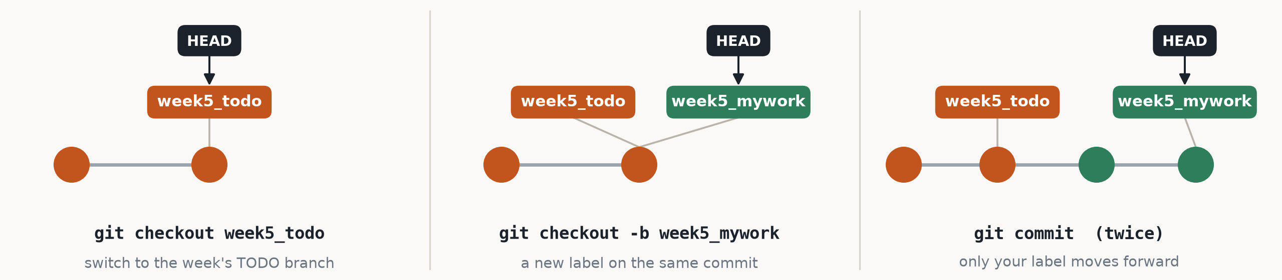
THE COURSE WORKFLOW
Starting a week: make a branch of your own
$ git checkout week5_todo
Switched to a new branch 'week5_todo'
branch 'week5_todo' set up to track 'origin/week5_todo'.
$ git checkout -b week5_mywork # -b: create, then switch
Switched to a new branch 'week5_mywork'
Never write answers on week5_todo or main. Updates arrive on week5_todo. With your work on week5_mywork, an update never overwrites it: git combines the two when you merge (slide 9).
Same every week: week2_todo → week2_mywork, week3_todo → week3_mywork, …

Slide 8
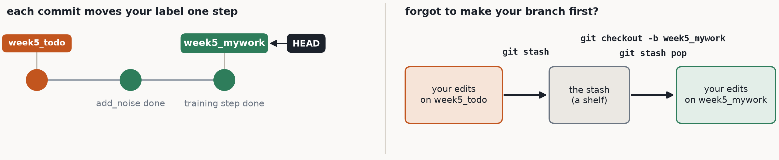
THE COURSE WORKFLOW
Saving your work: commit small and often
$ git add week5_diffusion/part1_unet_diffusion.py
$ git commit -m "week5: training step done"
[week5_mywork 0f95f08] week5: training step done
1 file changed, 3 insertions(+), 5 deletions(-)
$ git stash # put the edits aside
Saved working directory and index state WIP on week5_todo
$ git checkout -b week5_mywork
$ git stash pop # bring them back
A good message says what you did: "week5: training step done", not "update". Windows may print LF will be replaced by CRLF: harmless, it is about line endings.

Slide 9
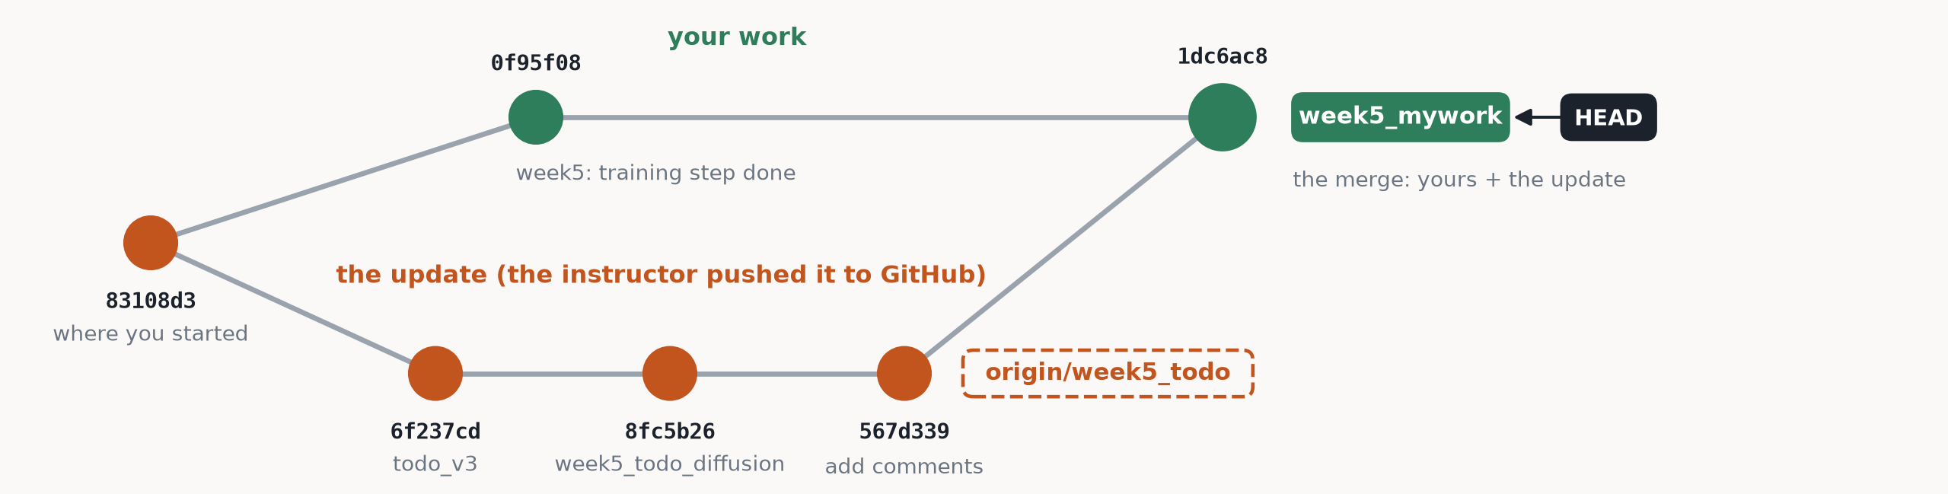
THE COURSE WORKFLOW
Getting updates: pull, then merge into your branch
$ git checkout main
$ git pull # download every branch's news
83108d3..567d339 week5_todo -> origin/week5_todo
$ git checkout week5_mywork
$ git merge origin/week5_todo # the update -> your work
Commit first. Git refuses to switch branch if that would overwrite unsaved edits (slide 13).
The merge is a new commit with two parents. Nothing of yours is lost.
Usually git combines the two by itself. When both changed the same lines, it stops: next slide.

Slide 10
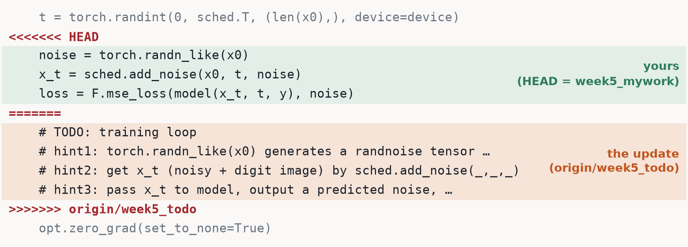
THE COURSE WORKFLOW
Merge conflict: both sides changed the same lines
$ git merge origin/week5_todo
CONFLICT (content): Merge conflict in week5_diffusion/part1_unet_diffusion.py
Automatic merge failed; fix conflicts and then commit the result.
To finish the merge
1. Edit the file: keep the lines you want (here: your 3 lines) and delete the marker lines <<<<<<< ======= >>>>>>>
2. git add <the file>
3. git commit (git writes the message)
Changed your mind?
git merge --abort goes back to before the merge.
This happened for real. On Oct 30 the hints for the training step on week5_todo were rewritten (commit 8fc5b26). Anyone who had already filled in those lines got exactly this conflict. Keep your 3 lines: they are what the hints describe.

Slide 11
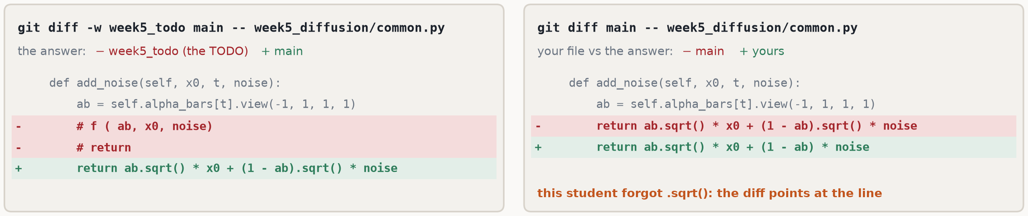
THE COURSE WORKFLOW
Checking your answer against main
$ git diff -w week5_todo main -- <file> # the answer
$ git diff main -- <file> # your file vs the answer
$ git checkout main # see everything (commit first)
$ git checkout week5_mywork # back to your work
− lines come from the first name, + lines from the second.
-w ignores changes in spacing. The TODO branch was also reformatted, so some lines differ only in layout: the answer is where the # TODO was.

Slide 12

GITHUB.COM
Reading the repository in the browser
add to github.com/stanthemaker/tutorial_ml
what you see
the same with git
/tree/week5_todo
the files on one branch
git checkout week5_todo
/commits/main
the list of commits
git log main
/commit/81f5cc6
what one commit changed
git show 81f5cc6
/compare/main...week5_todo
what week5_todo changed: answers out, TODOs in
git diff main...week5_todo
Code → Download ZIP gives only the files: no history, no branches, no git pull. Use git clone (slide 6).

Slide 13
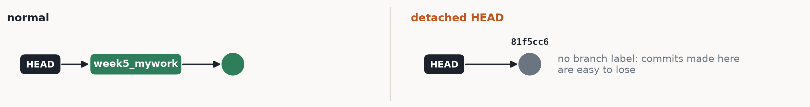
WHEN THINGS GO WRONG
Four situations, and what to do
what you see
what it means
what to do
error: Your local changes to the following files would be overwritten by checkout
You have unsaved edits, and the branch you are switching to has another version of that file.
commit them (slide 8), or git stash, switch, git stash pop
You are in 'detached HEAD' state.
You checked out a commit, not a branch. Fine for looking around.
git checkout week5_mywork
On branch week5_todo … and you already committed there
You forgot git checkout -b. Give your commits their own name, then take a fresh week5_todo from GitHub.
git branch -m week5_todo week5_mywork
git checkout week5_todo
a file never shows up in git status
It matches .gitignore: datasets (data/) and weights (*.pt) are never saved in git.
nothing to fix; git check-ignore -v <file> names the rule

Slide 14
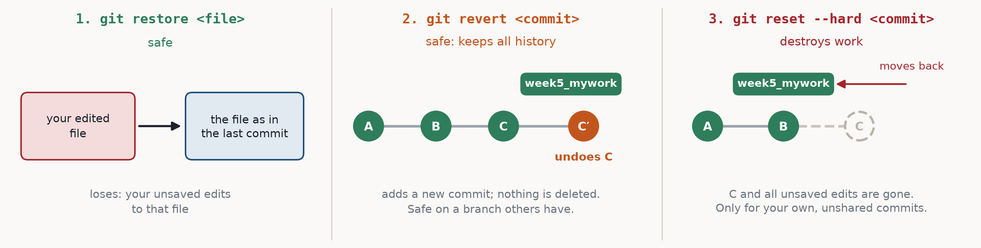
WHEN THINGS GO WRONG
Undo, from safe to destructive
$ git restore <file>
$ git status --short
(nothing: the edit is gone)
$ git revert 0f95f08
[week5_mywork 0e62e7d]
Revert "week5: training step done"
$ git reset --hard HEAD~1 # 1 back
HEAD is now at 0f95f08
week5: training step done
Before anything risky, keep a backup label: git branch backup_week5. It costs nothing, and git checkout backup_week5 gets your commits back.

Slide 15
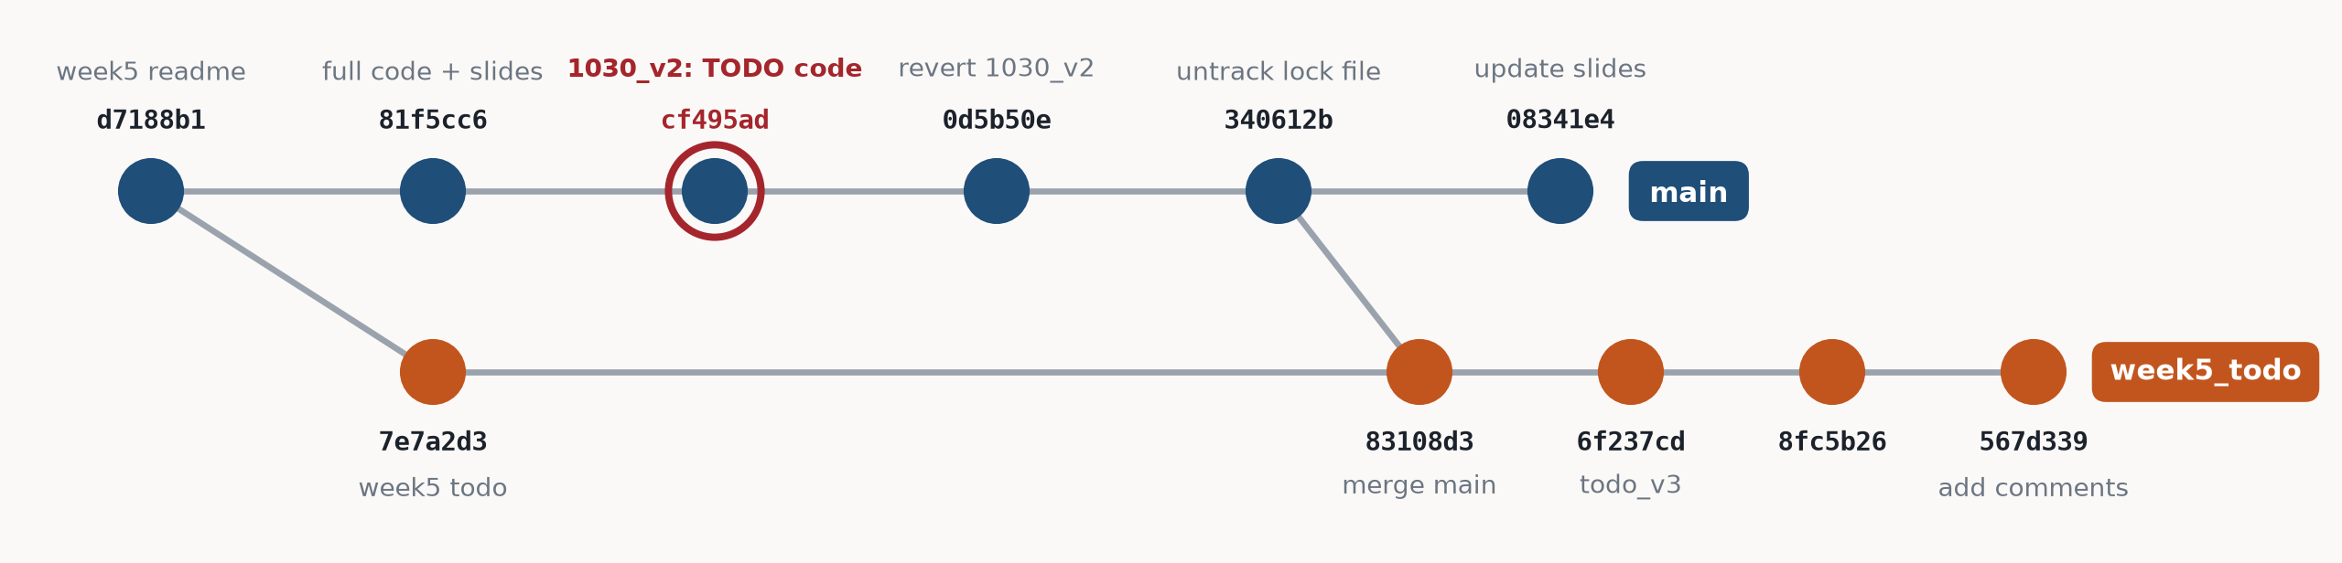
A REAL EXAMPLE
Oct 30: the TODO code landed on main
What happened
1030_v2 was committed on main, but it held the TODO version of the files: main lost its answers. It was already on GitHub.
Why not just delete it
git reset could remove it, but only with a force-push to GitHub, which rewrites history that others had already pulled.
The fix: two new commits
$ git checkout main
$ git revert cf495ad
$ git checkout week5_todo
$ git merge main
Lesson: read the first line of git status, On branch …, before every commit.

Slide 16
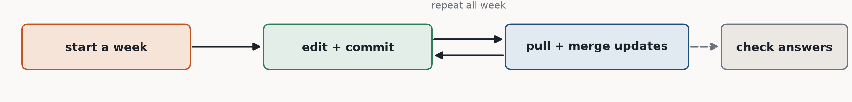
CHEAT SHEET
The commands of this course
Start a week
git checkout weekN_todo
git checkout -b weekN_mywork
Save
git status
git add <file>
git commit -m "what you did"
Get updates
git checkout main
git pull
git checkout weekN_mywork
git merge origin/weekN_todo
Look (always safe)
git status
git log --oneline --graph
git branch -a
Check answers
git diff -w weekN_todo main -- <file>
git diff main -- <file>
Fix and undo
git stash / git stash pop
git merge --abort
git restore <file>
git revert <commit>

