Slide 1
WEEK 3 · PARTS 7 AND 8
From 73% to 91%
Six rungs on CIFAR-10, one change at a time.
Every number measured on the same 5,000 validation images.

Slide 2
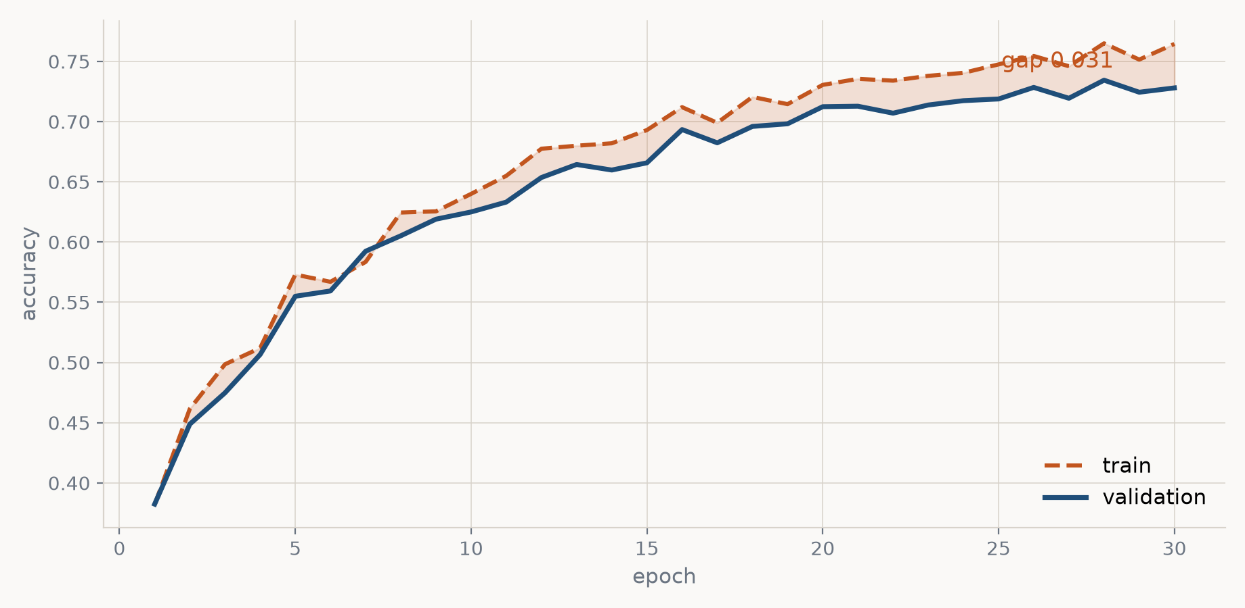
THE STARTING POINT
Part 6 ended here: 73%, and stuck
Rung 0 — part 6's config D. train 0.765, val 0.734, test 0.732, gap 0.031.

Slide 3
DIAGNOSIS
Read the training accuracy first
A 3-point gap is not an overfitting problem.
train 0.765 — the model cannot fit the images it was trained on.
val 0.734 — and it is only 3 points behind.
Overfitting = train high, val far below. Fix: regularise, add data.
Underfitting = train itself is low. Fix: more data, better optimisation, more capacity.
Part 6 regularised an overfitting model until it underfit. Parts 7 and 8 raise the ceiling back up.

Slide 4
METHOD
Three rules, and they matter more than the rungs
ONE CHANGE PER RUNG
Each rung differs from the one above it in exactly one respect, so each gain has exactly one cause.
ONE FIXED YARDSTICK
Every run — every rung, every sweep, every control — is scored on the same 5,000 validation images. The test set is opened once, at the end.
MEASURE THE CONFOUND
When a change drags a second change along with it, run the control that separates them.

Slide 5
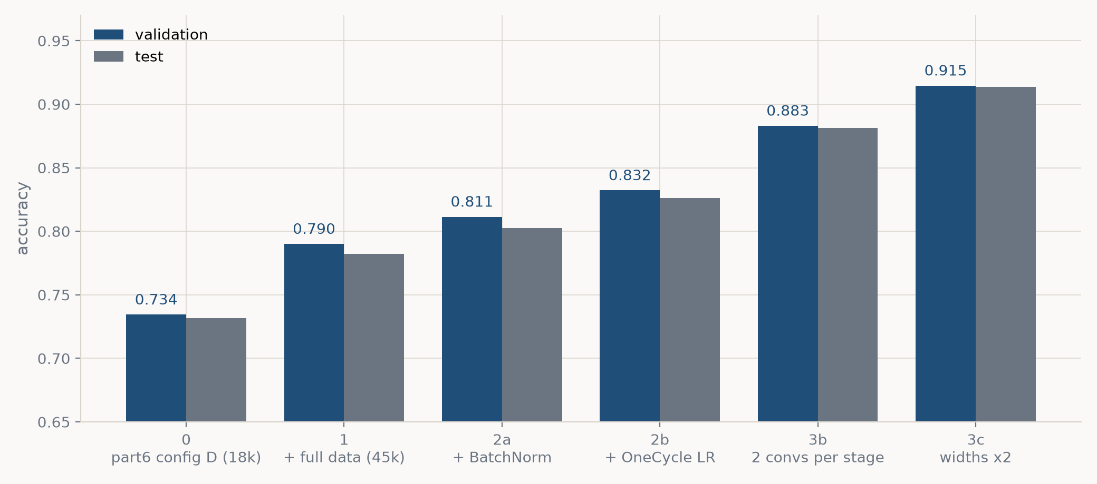
THE WHOLE STORY ON ONE SLIDE
Six rungs, 73% → 91%
Validation and test move together throughout — the validation split is doing its job.

Slide 6
THE WHOLE STORY ON ONE SLIDE
The same six rungs, as numbers
rung
params
min
train
val
test
gap
0: part6 config D (18k)
188,810
2.0
0.765
0.734
0.732
0.031
1: + full data (45k)
188,810
4.5
0.812
0.790
0.782
0.022
2a: + BatchNorm
188,970
4.8
0.835
0.811
0.802
0.024
2b: + OneCycle LR
188,970
4.9
0.867
0.832
0.826
0.034
3b: 2 convs per stage
272,234
6.9
0.934
0.883
0.881
0.051
3c: widths x2
1,672,010
11.4
0.986
0.915
0.914
0.071
M1 Pro, 30 epochs each, best-validation epoch. The rest of the deck unpacks one rung at a time: the idea, the maths, why it should help, then what it actually did.

Slide 7
PART 7
Make it fit
The model is not the bottleneck yet. Three rungs that cost almost no parameters: the data we already own, and how we train.

Slide 8
RUNG 1 · FULL DATA · THE IDEA
The cheapest capacity is data you already have
Part 6 trained on 18,000 of the 45,000 images available.
That was a habit from wanting fast iterations, not a decision about the model. CIFAR-10 ships 50,000 training images; we hold 5,000 back as validation and had been ignoring 27,000 of the rest.
Augmentation re-uses the same 18,000 pictures with random crops and flips. New images carry information augmentation cannot manufacture.
Rung 1: n_train 18,000 → 45,000. Nothing else moves.

Slide 9

RUNG 1 · FULL DATA · THE MATHS
More data drags a confound along
An epoch is a pass over the training set, so the number of gradient updates depends on how big that set is:
So 'more data' is really two changes at once: 2.5x the images AND 2.5x the gradient updates. Either could explain a gain.
The control: train on the same 18,000 images for 75 epochs — matching the update count with no new pictures. If the updates were doing the work, it should catch up.

Slide 10
RUNG 1 · FULL DATA · WHY IT SHOULD HELP
Two sources of error, and data only shrinks one
What the network gets wrong splits in two:
· what the architecture cannot represent at all — a ceiling that more data will not move;
· what it cannot pin down from the sample it saw — 18,000 examples leave many hypotheses consistent with the data.
More distinct images shrink the second term. The signature of that working is specific, and worth watching for:
>> accuracy goes up AND the train/val gap gets SMALLER.
If a change raised accuracy by widening the gap, it bought capacity, not generalisation.

Slide 11
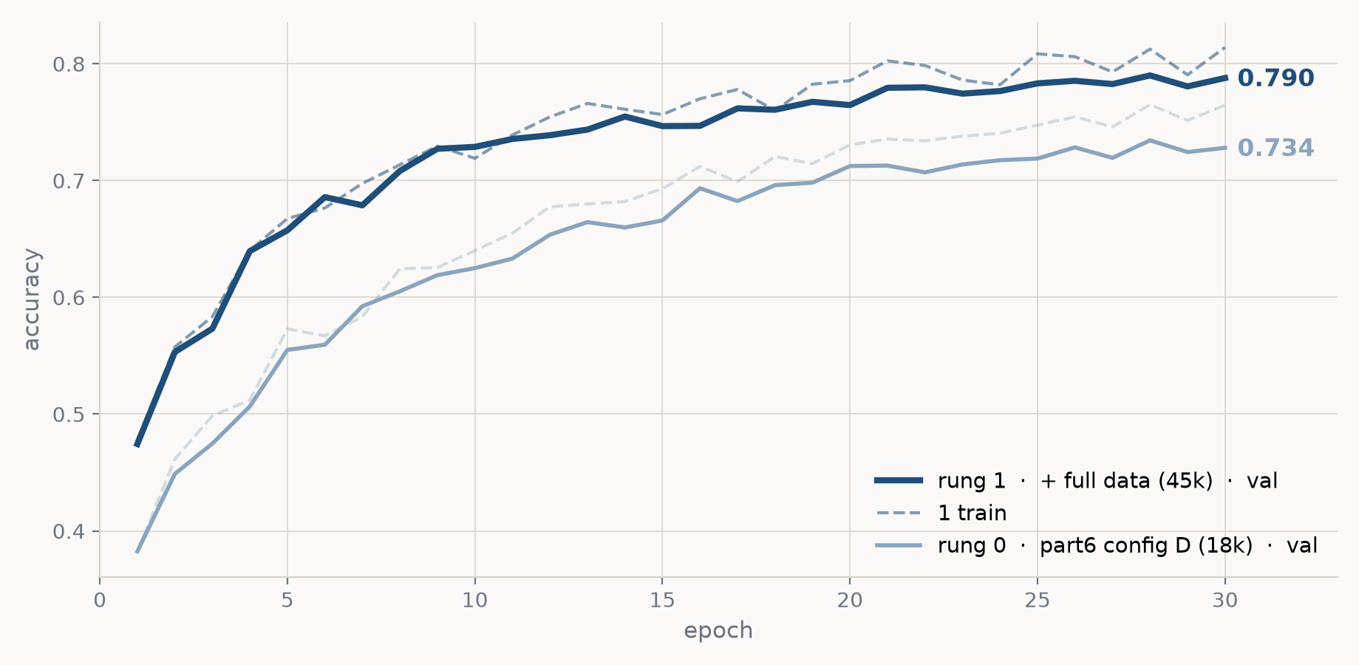
RUNG 1 · FULL DATA · THE EVIDENCE
val 0.734 → 0.790 (+5.6 points), and the gap narrows
gap 0.031 → 0.022 — exactly the data-limited signature. The equal-steps control on 18k images landed well short, so it is the images, not the updates.

Slide 12
RUNG 1 · FULL DATA · THE CODE
One argument, threaded through
part7_improving_cnn.py · make_splits()
N_POOL, N_VAL = 50000, 5000
N_FULL = N_POOL - N_VAL # 45,000
order = torch.randperm(N_POOL, generator=g.manual_seed(0))
train_idx = order[:n_train].tolist() # <- the only knob
val_idx = order[N_FULL:].tolist() # never moves
return (Subset(augmented, train_idx), # training, augmented
Subset(clean, val_idx), # validation, clean
Subset(clean, train_idx[:2000])) # probe
The validation slice is taken from the END of a fixed shuffle, so it is identical whatever n_train is — that is what makes rung 0 and rung 1 comparable. And because train_idx is a prefix, the 18,000 images are a subset of the 45,000: rung 1 adds data, it does not swap it.

Slide 13
RUNG 2A · BATCHNORM · THE IDEA
Every layer is aiming at a moving target
Layer 3 learns a mapping from what layer 2 sends it. Then layer 2's weights change, and the scale of that input shifts underneath layer 3.
The whole stack is doing this to itself, simultaneously, every step. The deeper the network, the worse it gets: a small change early is amplified by everything above it.
BatchNorm pins the distribution. After every conv, normalise each channel across the batch, then let the network learn the scale and offset it actually wants.
Rung 2a: Conv → ReLU → Pool becomes Conv → BatchNorm → ReLU → Pool.

Slide 14



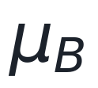
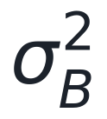


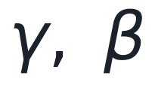

RUNG 2A · BATCHNORM · THE MATHS (1 OF 3)
Every symbol, before any formula
one mini-batch — the examples used for a single gradient step.
how many examples are in it. In our runs, m = 128.
one scalar value being normalised, at position i.
the empirical MEAN — empirical because it is measured on this batch, not known in advance.
the empirical VARIANCE of those same values.
a tiny constant so we never divide by zero (PyTorch: 1e-5).
the normalised value: mean 0, variance 1 across the batch.
LEARNED scale and shift — the network's chance to undo the normalisation if it wants to.
which dimension gets its own statistics. The one that trips people up — see 3 of 3.
Only γ and β are learned. μ, σ² and x̂ are recomputed from scratch on every batch.

Slide 15
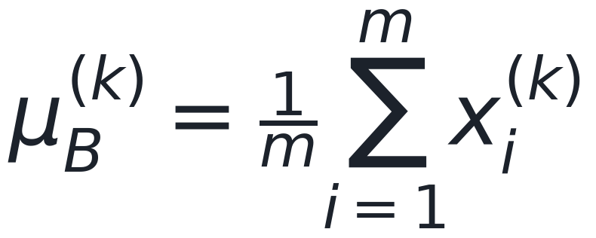
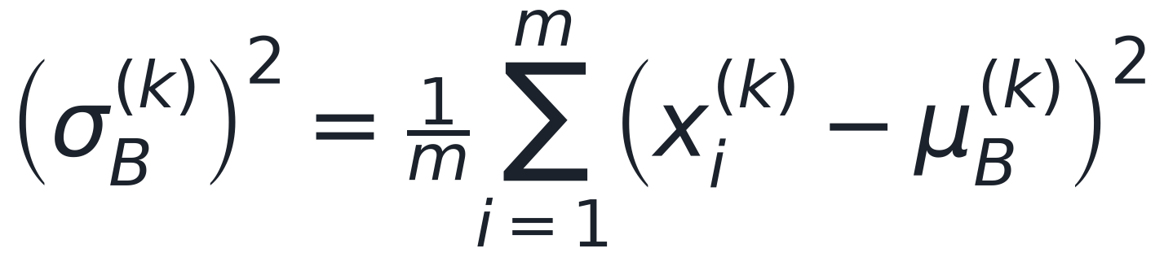
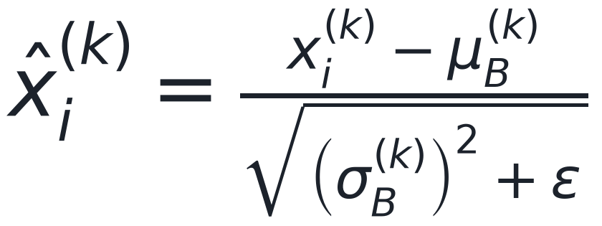
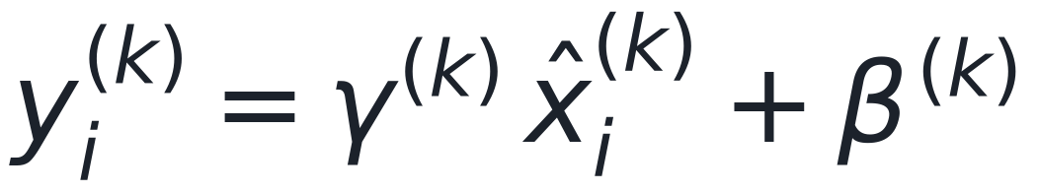
RUNG 2A · BATCHNORM · THE MATHS (2 OF 3)
The three equations
1. MEASURE the batch, separately for each dimension k
2. NORMALISE — subtract the mean, divide by the standard deviation
3. RESTORE a scale the network chooses for itself
Step 2 throws information away; step 3 hands the control back as two learned numbers. If the best thing really is the original scale, the network can recover it.

Slide 16
RUNG 2A · BATCHNORM · THE MATHS (3 OF 3)
What k is in a convolutional layer
Take stage 1 of our network: Conv2d(3 -> 32) on a batch of 128 CIFAR images. Its output is a 4-D tensor.
k indexes C, the CHANNELS — not pixels, not images. So d = 32 separate normalisations, one per channel.
Each channel is one learned filter, so this asks: across every image and every position, what scale does this filter output? That is the quantity worth pinning down.
Consequence: the statistics depend on the other images in the batch. That is why BatchNorm behaves differently in train() and eval() — and why tiny batches hurt it.

Slide 17
RUNG 2A · BATCHNORM · THE MATHS
And the whole thing costs 160 parameters
stage
channels
γ + β added
conv biases removed
net
1: Conv(3 → 32)
32
64
−32
+32
2: Conv(32 → 64)
64
128
−64
+64
3: Conv(64 → 64)
64
128
−64
+64
total
320
−160
+160
γ and β are 2 parameters per channel. The conv biases go because BatchNorm subtracts any constant the conv adds — β does that job now, so bias=False is bookkeeping, not a trick. 188,810 → 188,970: whatever BatchNorm buys, it does not buy it with capacity.

Slide 18
RUNG 2A · BATCHNORM · WHY IT SHOULD HELP
The real prize is not accuracy — it is a usable learning rate
A gradient step of size lr means something different at every layer when their activations live on different scales.
Normalising puts every layer on the same footing, which conditions the loss surface: one learning rate is now roughly the right size everywhere. Raise it, and the network no longer blows up.
So expect a modest accuracy gain at the same learning rate — and a much wider range of learning rates that still train.
>> That is what makes rung 2b possible. The rungs compound.

Slide 19
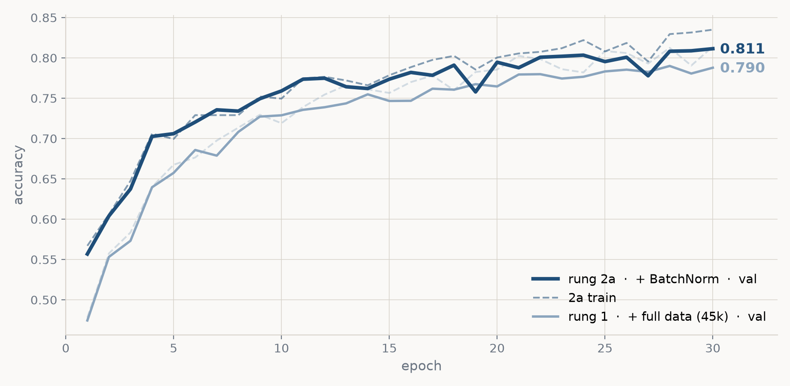
RUNG 2A · BATCHNORM · THE EVIDENCE
val 0.790 → 0.811 (+2.1 points) for 160 parameters
Same data, same learning rate, same 30 epochs. We also swept the learning rate: without BatchNorm the high end broke training; with it, 3e-3 trained cleanly.

Slide 20
RUNG 2A · BATCHNORM · THE CODE
Three lines in the block builder
part7_improving_cnn.py · build_model(bn=...)
def block(c_in, c_out):
layers = [nn.Conv2d(c_in, c_out, 3, padding=1, bias=not bn)]
if bn:
layers.append(nn.BatchNorm2d(c_out))
return layers + [nn.ReLU(), nn.MaxPool2d(2)]
layers = block(3, 32) + block(32, 64) + block(64, 64) + [nn.Flatten()]
bias=not bn is the parameter bookkeeping from the maths slide: with BatchNorm the conv bias cannot affect the output, so we do not allocate it. Note BatchNorm2d goes BEFORE the ReLU — it normalises the pre-activations, which is exactly what the activation probe measures.

Slide 21
RUNG 2B · ONECYCLE · THE IDEA
One learning rate for all 30 epochs is a compromise
A constant learning rate has to be two things at once:
· small enough that the first steps, from a random initialisation, do not wreck the network;
· small enough at the end that the weights can settle instead of bouncing around the minimum.
Whatever single value satisfies both is too small for the middle of training, where you want to cover ground.
Rung 2b: warm up to a high learning rate, then anneal it to nearly zero. Same optimiser, same everything else.

Slide 22
RUNG 2B · ONECYCLE · THE MATHS
Two cosine halves, joined at the peak
Let p be the fraction of training completed, and pct_start = 0.25 the fraction spent warming up. Both phases are cosines:
PyTorch derives the endpoints from the peak: η₀ = η_max / 25 and η_min = η₀ / 10⁴.
scheduler.step() runs after every BATCH — 10,560 times, not 30 — so the curve is smooth. cycle_momentum=False, because cycling AdamW's β₁ would be a second change riding along with the first.

Slide 23
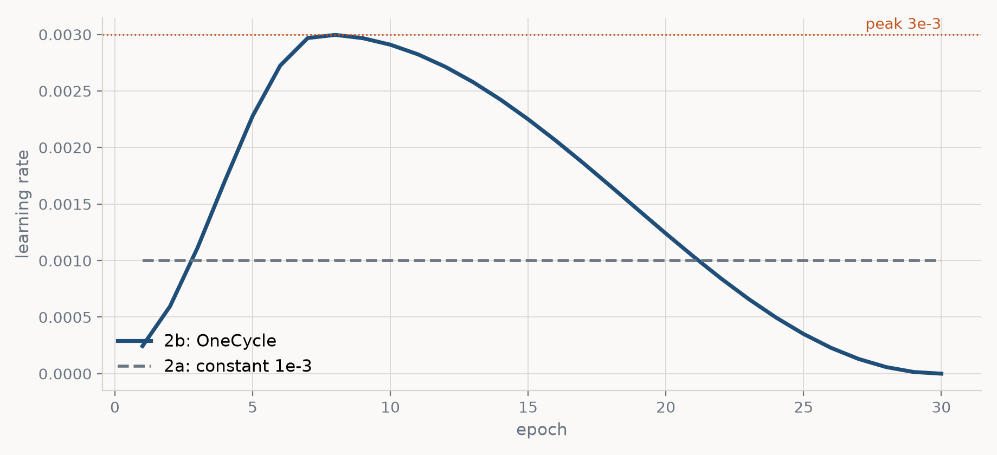
RUNG 2B · ONECYCLE · THE MATHS
What that looks like over 30 epochs
Sampled once per epoch, so the peak reads at epoch 8 rather than 7.5. Against rung 2a's flat 1e-3: OneCycle spends the middle of training well above it, and the end far below.

Slide 24
RUNG 2B · ONECYCLE · WHY IT SHOULD HELP
Each phase of the cycle does a different job
WARM-UP — a random network produces large, badly-aimed gradients. Starting small keeps the first few hundred steps from destroying the initialisation.
HIGH MIDDLE — big steps cover distance fast, and the noise they add acts as a mild regulariser: the weights cannot settle into a sharp, narrow minimum.
ANNEAL TO ZERO — once it is in the right basin, shrinking the step lets it walk down to the bottom instead of rattling across it.
Only safe at a peak of 3e-3 because BatchNorm is already there.

Slide 25
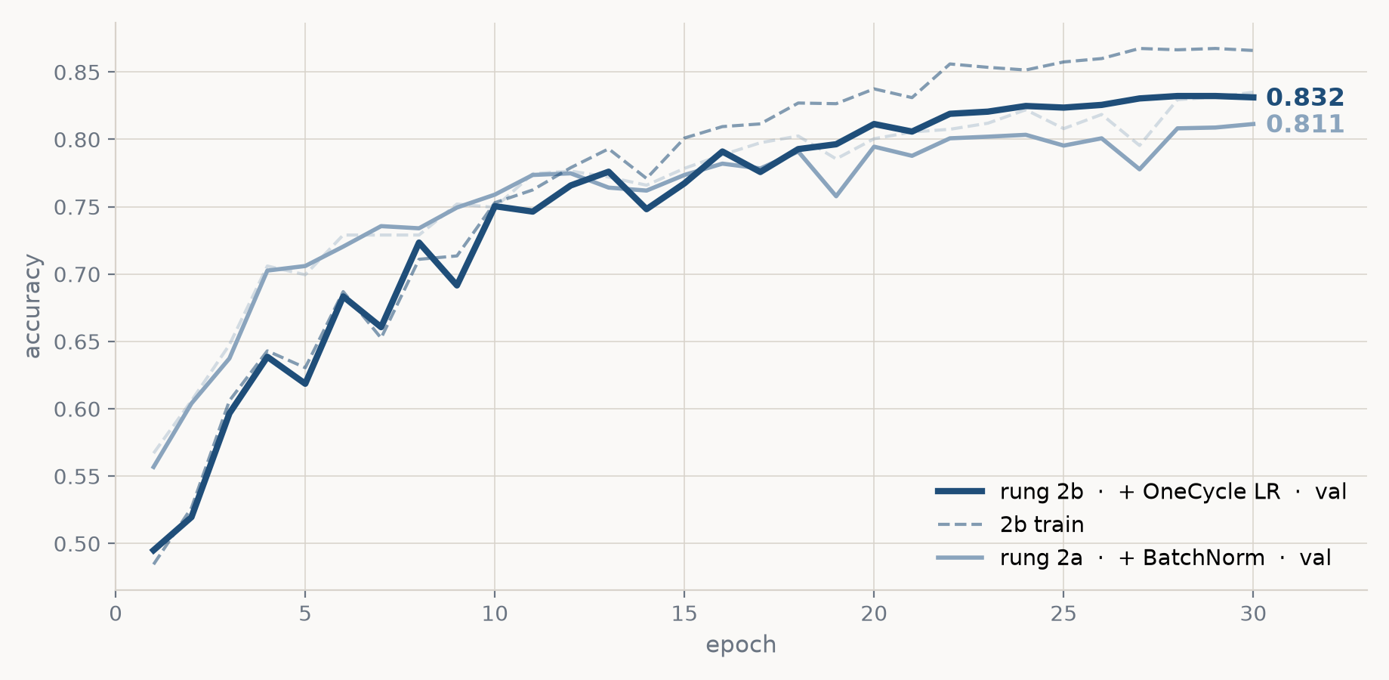
RUNG 2B · ONECYCLE · THE EVIDENCE
val 0.811 → 0.832 (+2.1 points) for zero parameters
Same architecture, same data, same 30 epochs. Only the learning-rate schedule moved. We swept the peak; 3e-3 and 1e-2 landed within noise of each other, so we kept 3e-3.

Slide 26
RUNG 2B · ONECYCLE · THE CODE
Build it once, step it every batch
part7_improving_cnn.py · train()
optimizer = torch.optim.AdamW(model.parameters(), lr=lr, weight_decay=5e-4)
scheduler = torch.optim.lr_scheduler.OneCycleLR(
optimizer, max_lr=lr, epochs=epochs,
steps_per_epoch=len(train_loader), # -> 352
pct_start=0.25, cycle_momentum=False)
for images, labels in train_loader:
...
optimizer.step()
scheduler.step() # every BATCH, not every epoch
steps_per_epoch x epochs is how OneCycle knows the length of the cycle; get it wrong and the schedule ends in the wrong place. cycle_momentum=False stops it also cycling AdamW's beta1 — that would be a second change riding along with the first.

Slide 27
CHECKPOINT
Still a ceiling — so the model is next
After three rungs: train 0.867, val 0.832, gap 0.034.
The gap is 3 points. The model still cannot fit its own training images, so this is the same diagnosis as part 6 — a ceiling, not overfitting.
But the two cheap fixes are spent: all 45,000 images are in use, and training is healthy. What is left is the model itself.
Part 6's architecture: three conv layers, at most 64 channels, and 70% of its weights sitting in a fully-connected head.

Slide 28
PART 8
Capacity
Same rules, same validation split, same recipe. Only the architecture moves — first deeper, then wider.

Slide 29
RUNG 3B · DEEPER · THE IDEA
The network does see the whole image. Look at where.
The final feature map is 64 channels on a 4×4 grid — a coarse, low-frequency summary of the entire picture. Coverage is not the problem.
But each of those 16 positions summarises only a 22×22 patch. Nothing in the convolutional stack ever relates two things more than 22 px apart. All longer-range structure is left to one dense layer:
Linear(1024 → 128) = 131,200 parameters = 70% of the network
That layer has no weight sharing — a dog's head top-left and the same head bottom-right are separate weights — and it combines the 16 positions in a single linear step, with no nonlinearity between them.
Rung 3b: two convs per stage. Widths unchanged, head unchanged.

Slide 30
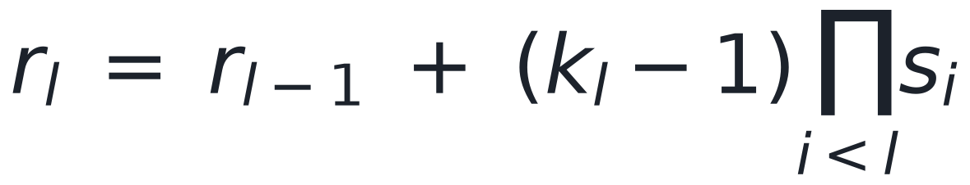
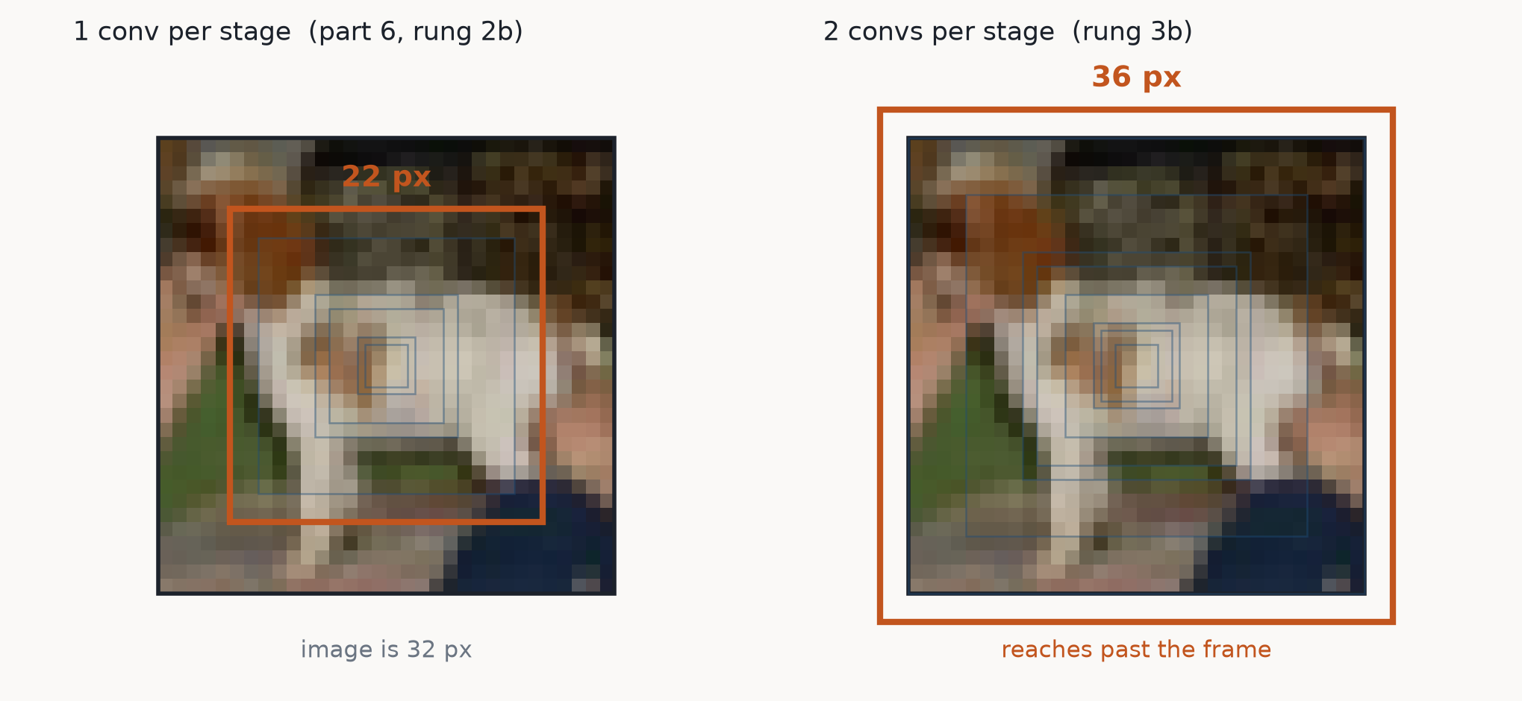
RUNG 3B · DEEPER · THE MATHS
What one unit in the last stage sees
Each layer widens the patch a unit responds to. The product is why pooling dominates: every 2×2 pool doubles the stride, so a 3×3 conv above one pool adds 4 px, above two pools 8 px.
Blue: the receptive field after each layer. Orange: the final one. Two convs per stage is the first point at which a single unit integrates the whole frame.

Slide 31
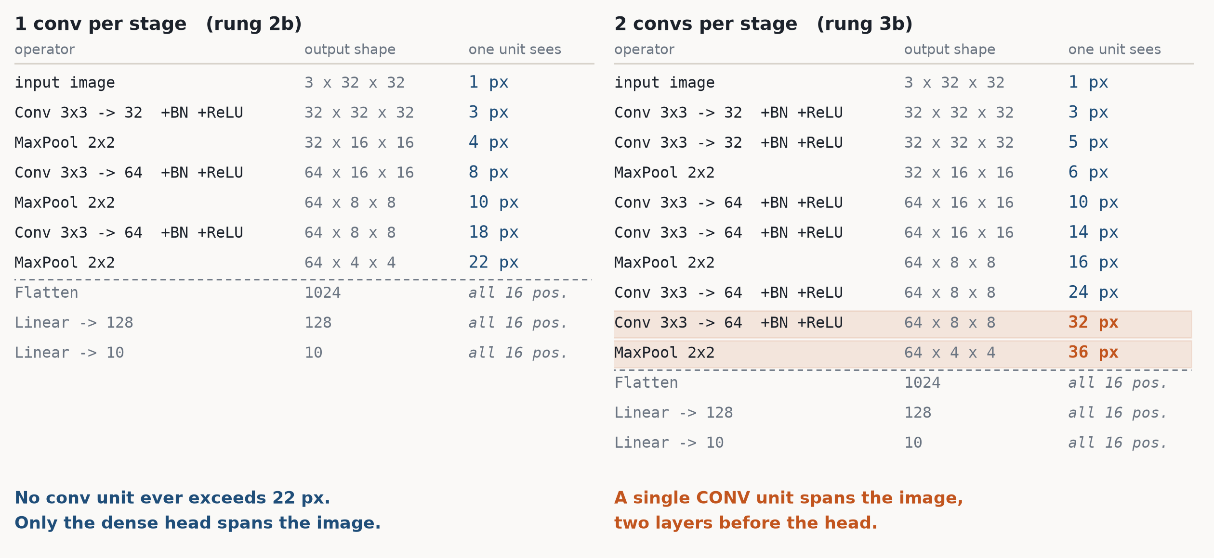
RUNG 3B · DEEPER · THE MATHS
Operator by operator — the shapes match, the reach does not
Generated by walking both networks, so these are the shapes PyTorch actually produces.

Slide 32
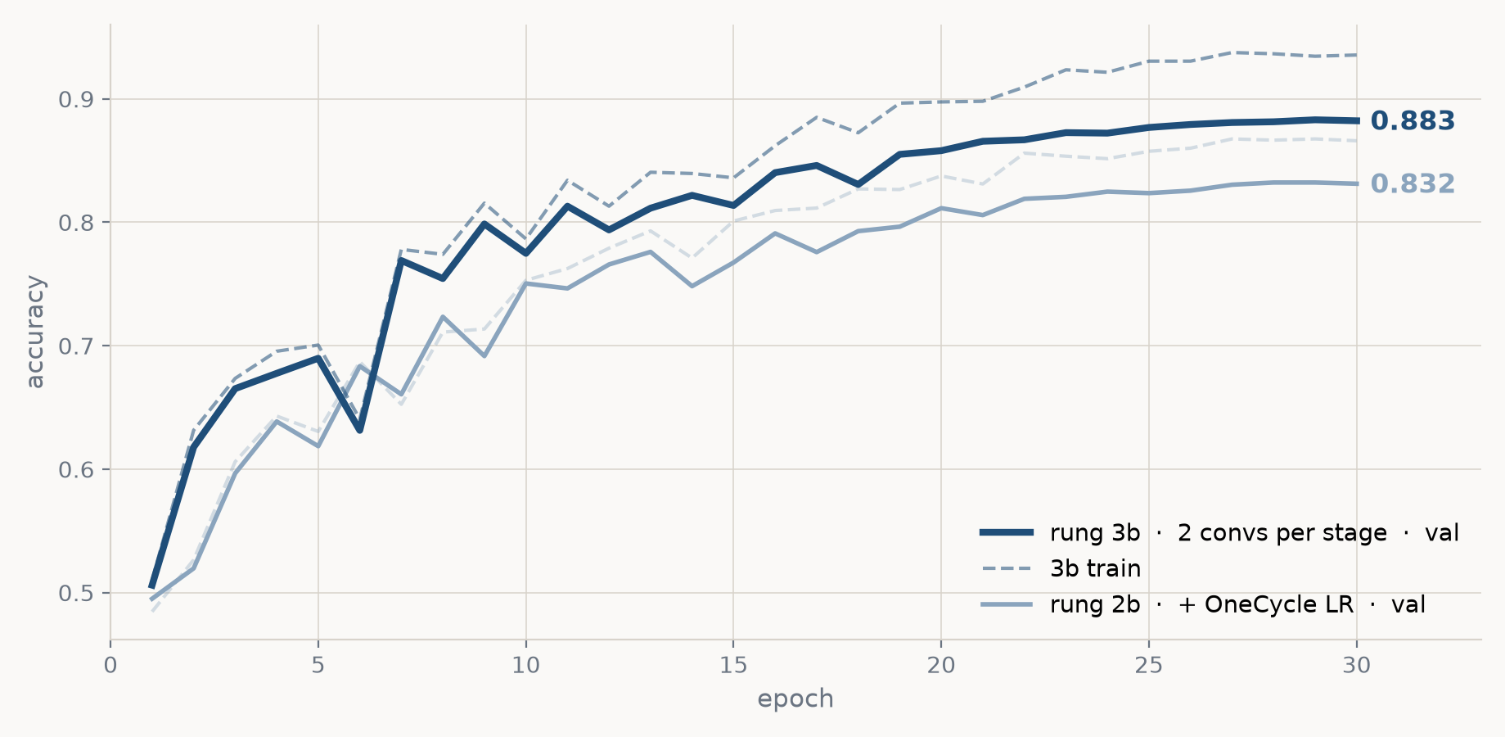
RUNG 3B · DEEPER · THE EVIDENCE
val 0.832 → 0.883 (+5.1 points) for 83k parameters
train 0.867 → 0.934: the ceiling lifts. gap 0.034 → 0.051 — the first sign of the other problem coming back.

Slide 33
RUNG 3B · DEEPER · THE CODE
The architecture becomes two loops
part8_bigger_cnn.py · build_model(widths, convs)
layers, c_in = [], 3
for width in widths: # widths = (32, 64, 64)
for _ in range(convs): # convs = 2 <- rung 3b
layers += [nn.Conv2d(c_in, width, 3, padding=1, bias=False),
nn.BatchNorm2d(width), nn.ReLU()]
c_in = width
layers.append(nn.MaxPool2d(2)) # one pool per STAGE
layers += [nn.Flatten(), nn.Dropout(0.5),
nn.Linear(c_in * 4 * 4, 128), nn.ReLU(), nn.Linear(128, 10)]
The pool stays outside the inner loop, so depth grows without changing the spatial sizes — the head still sees 4x4. With convs=1 and the default widths this rebuilds rung 2b layer for layer, which is what makes the comparison fair.

Slide 34
RUNG 3C · WIDER · THE IDEA
Depth is composition; width is vocabulary
Depth decides how many times features get combined. Width decides how many different features each level can hold at all.
Part 6's widths were 32, 64, 64 — and that last stage, 64 channels on a 4×4 grid, is what the entire classifier head has to work from. 1,024 numbers to describe an image.
Notice the third stage does not even widen over the second. There was no reason for that; it was a starter architecture.
Rung 3c: widths 32-64-64 → 64-128-256. Depth stays at two convs per stage.

Slide 35
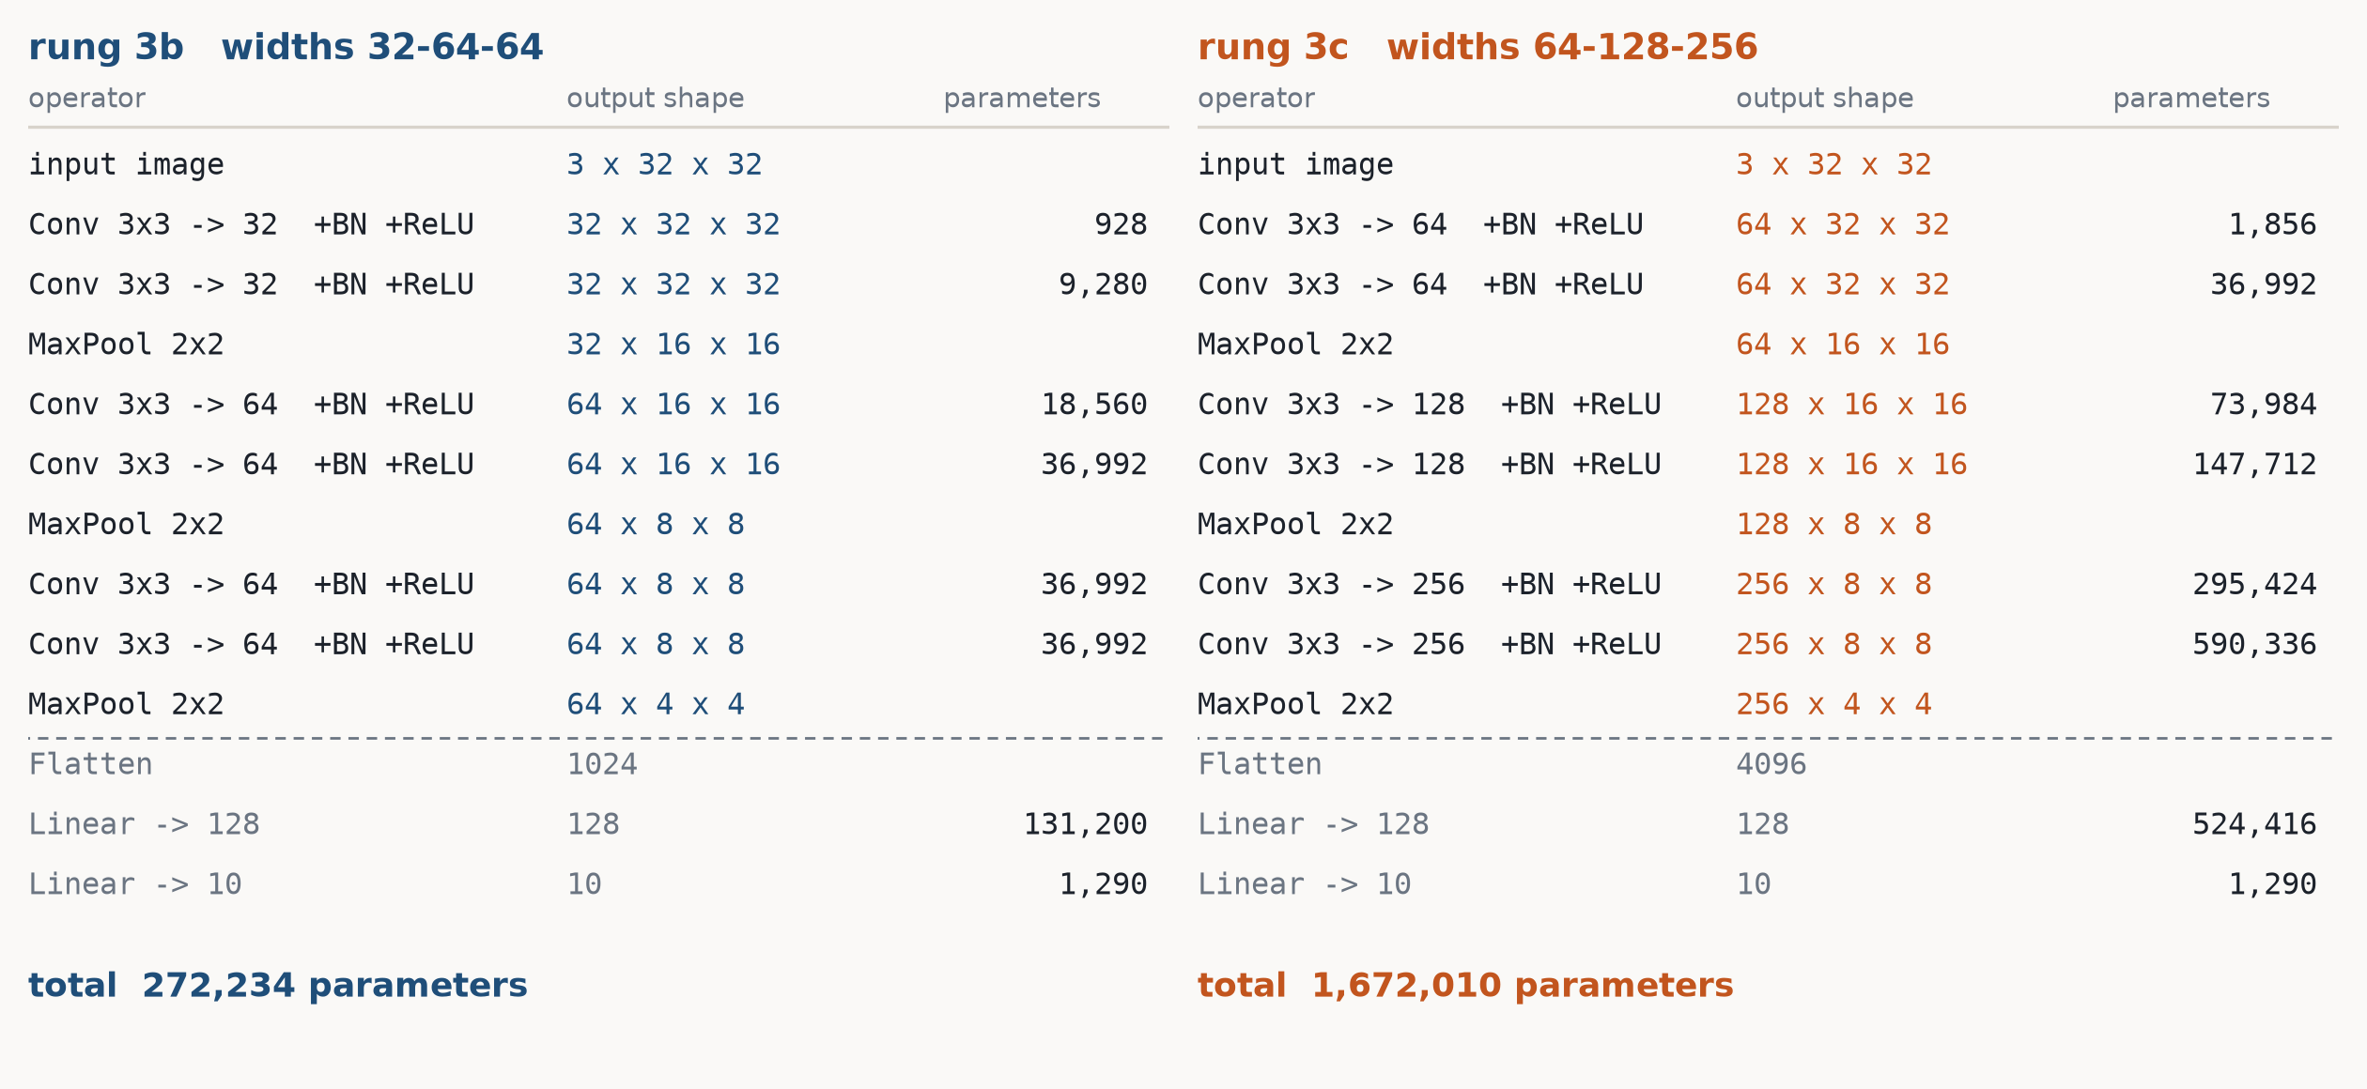
RUNG 3C · WIDER · THE MATHS
Same depth, same sizes — only the number of features moves

Slide 36
RUNG 3C · WIDER · WHY IT SHOULD HELP
Read the shape column: that is what ‘more features’ means
Every spatial position carries a vector of feature values, one per channel. Widening lengthens that vector.
stage 1 32 → 64 features per position, over a 32×32 grid
stage 3 64 → 256 features per position, over a 4×4 grid
head in 1,024 → 4,096 numbers describing the image
The last stage was the bottleneck: 64 numbers per position is a narrow pipe, and everything the classifier is allowed to use has to fit through it. More channels means more edge orientations held early and more object parts held late.
And expect the train/val gap to widen. Capacity is exactly what overfitting is made of.

Slide 37
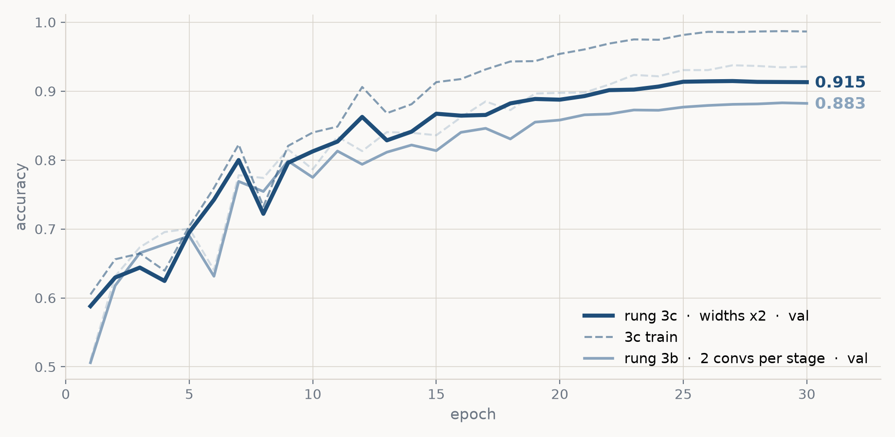
RUNG 3C · WIDER · THE EVIDENCE
val 0.883 → 0.915 (+3.2 points) for 6× the parameters
train 0.934 → 0.986. The ceiling is gone — the model now fits its training set almost perfectly. gap 0.051 → 0.071.

Slide 38
RUNG 3C · WIDER · THE CODE
Same builder, one tuple changed
part8_bigger_cnn.py · LADDER
LADDER = [
arch_spec("3b_deeper", "3b: 2 convs per stage", convs=2),
arch_spec("3c_wider", "3c: widths x2", convs=2,
widths=(64, 128, 256)),
]
def arch_spec(name, label, widths=(32, 64, 64), convs=1, epochs=30):
s = spec(name, label, n_train=45000, bn=True,
onecycle=True, lr=3e-3, epochs=epochs)
s.update(widths=list(widths), convs=convs)
return s
Every rung is a dict, and the dict is what gets logged to trackio as the run config. One change per rung is enforced by the fact that arch_spec carries rung 2b's entire recipe and only the named argument differs.

Slide 39
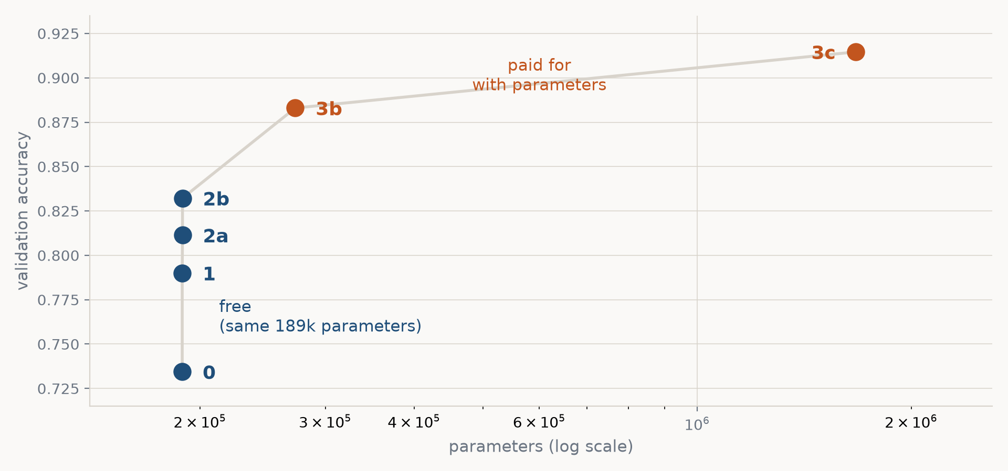
DEPTH VS WIDTH
Accuracy per parameter, across all six rungs
Rungs 0 → 2b gained 10 points at constant size. 3b bought 5 points for 44% more parameters; 3c bought 3 points for 6×.

Slide 40
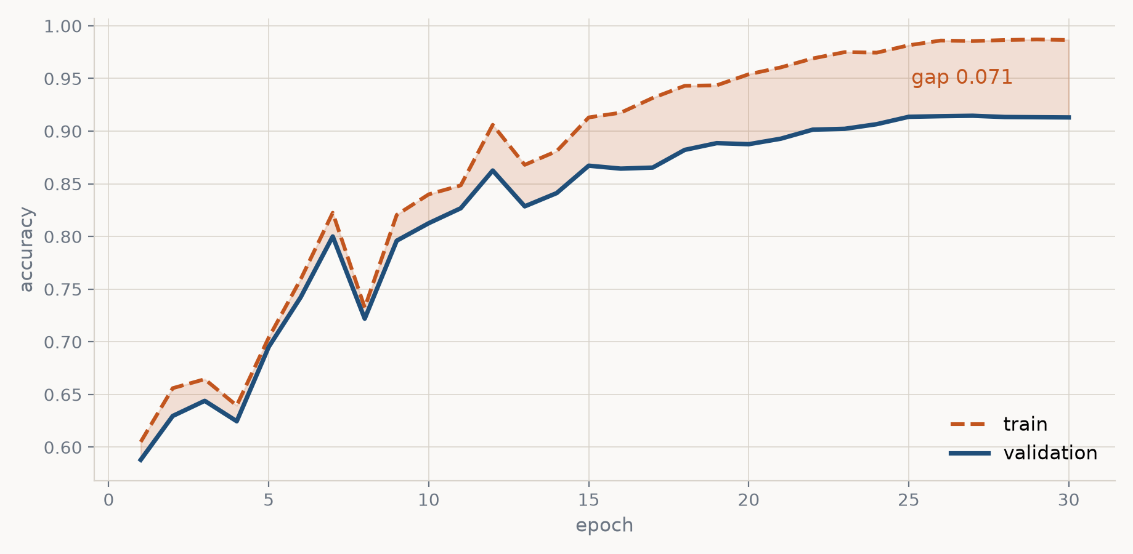
WHERE WE ARE
The ceiling is gone. The gap is back.
Rung 3c: train 0.986, val 0.915, test 0.914. A 7-point gap — the same problem part 6 opened with, on a much better model.

Slide 41
THE ARC OF WEEK 3
We have been here before
part
what happened
train
val
diagnosis
6 (no dropout)
plain CNN, 18k images
0.98
0.72
overfitting
6 (config D)
dropout + augmentation
0.765
0.734
underfitting
7
data, BatchNorm, OneCycle
0.867
0.832
still a ceiling
8
deeper, then wider
0.986
0.915
overfitting again
Every fix creates the next problem. That is not a failure of the method — it is the method: diagnose, apply the matching tool, re-diagnose.

Slide 42
YOUR TURN
Close a 7-point gap — you already know how
Rung 3c leaves 7 points on the table. Part 6's toolbox is the right toolbox; the model is now big enough to survive it.
LONGER 60 epochs instead of 30 — OneCycle rewards it
DECAY weight decay 5e-4 → 1e-2 (it is inactive today)
SMOOTHING label_smoothing=0.1 in CrossEntropyLoss
CUTOUT RandomErasing on top of crop + flip
POLICIES AutoAugment / TrivialAugmentWide
MIXUP blend image pairs and their labels
TTA average predictions over an image and its mirror
One change at a time. Same 5,000 validation images. Target: 93–94%.

Slide 43
BACKUP
The instruments
Accuracy tells you where you ended up. These four tell you what happened on the way, and they are all logged to trackio.

Slide 44
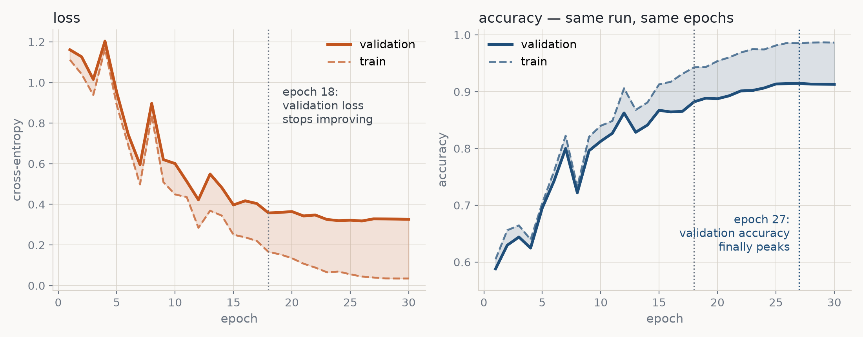
BACKUP · INSTRUMENT 1
Validation loss sees it coming. Accuracy does not.
Rung 3c. From epoch 18 validation loss is flat while training loss keeps falling — 0.17 to 0.04, nearly 5×. Validation accuracy went on creeping up for 9 more epochs, so accuracy alone says 'still improving'.

Slide 45
BACKUP · INSTRUMENT 1
What that gap actually means
Accuracy only asks whether the top-scoring class was right. Loss asks how confident the model was.
After epoch 18 the extra training is not fixing validation images — it is making the model more certain about training images it already had right. That is overfitting in progress, and the accuracy curve cannot see it.
loss gap epoch 18 0.19 → epoch 30 0.29
accuracy gap epoch 18 0.061 → epoch 30 0.074
Worth being precise: in none of our six runs did validation loss actually turn back UP within 30 epochs, so early stopping never fired. It flattens. Train for 60 epochs — the first item on your menu — and you will see the turn.

Slide 46
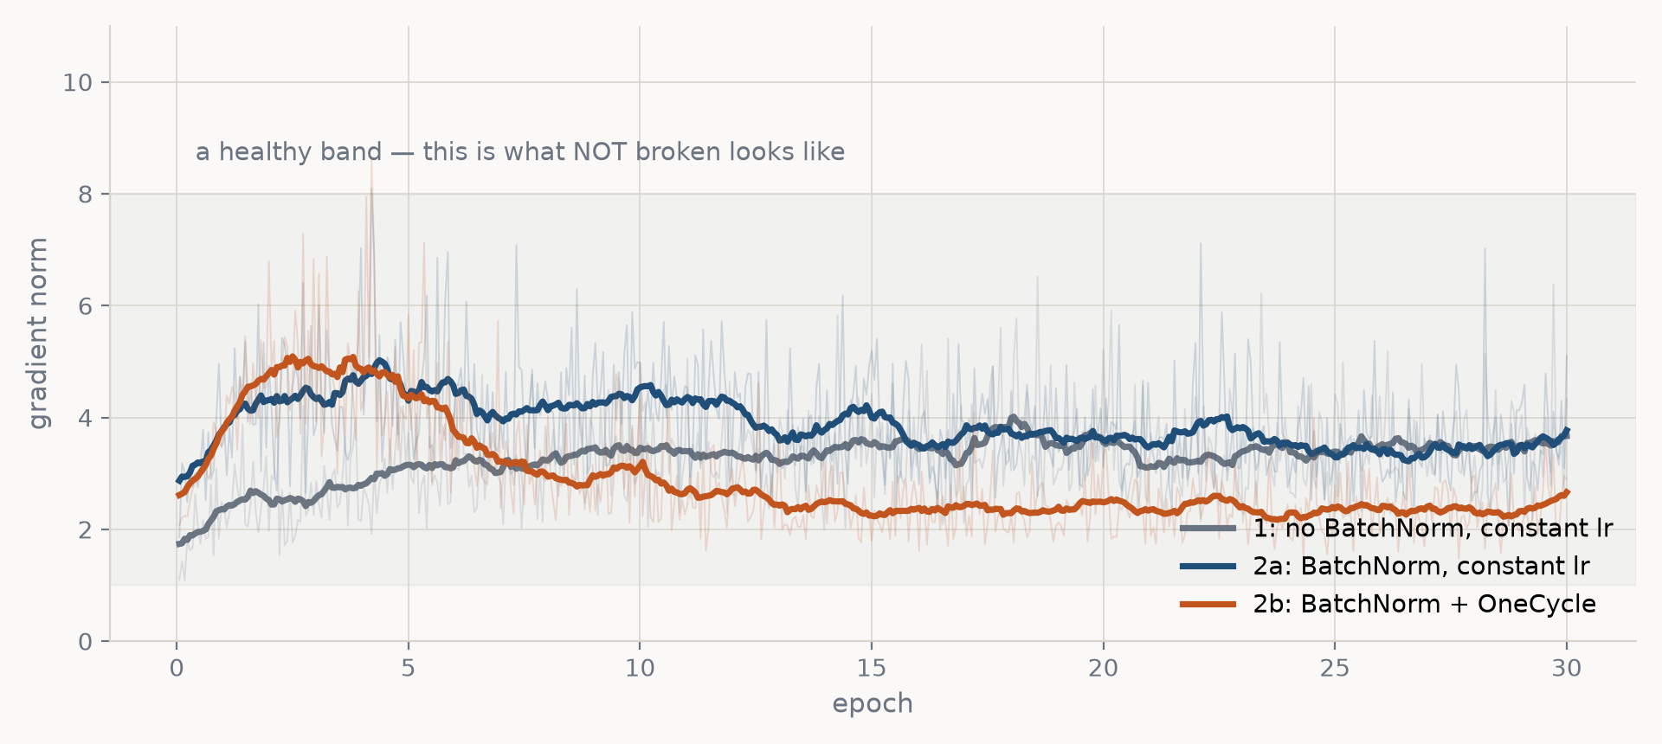
BACKUP · INSTRUMENT 2
Gradient norm — the dying-network light
Logged every 20 batches; faint lines are raw, bold is a rolling mean. None of our runs broke, so read this as the healthy baseline: steady, order 1–8, and falling at the end of 2b as OneCycle anneals.

Slide 47
BACKUP · INSTRUMENT 2
What a broken run looks like instead
This is a warning light, not a score. It is worth nothing on a good run and everything on a bad one.
→ 0 dead ReLUs, or vanishing gradients in a deep stack.
The network has stopped learning; loss goes flat.
→ huge the learning rate is too high, or a bad batch.
Usually followed by NaN loss a few steps later.
Both show up in the gradient norm well before they show up in validation accuracy — which is the whole reason to log it.
This is also how you would debug a OneCycle peak set too high: the norm blows up during warm-up, not at the end.

Slide 48
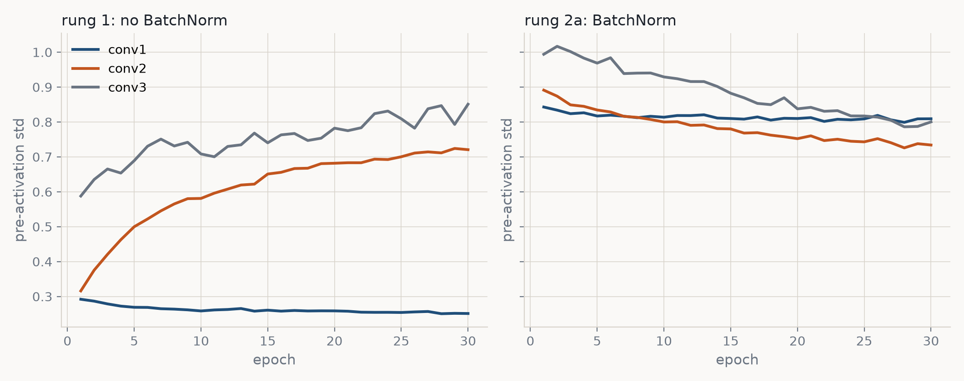
BACKUP · INSTRUMENT 3
Activation scale — what BatchNorm actually fixes
Pre-activation standard deviation per conv stage, measured on a fixed probe batch each epoch. Without BatchNorm the scales drift apart as training moves the weights; with it they hold.

Slide 49
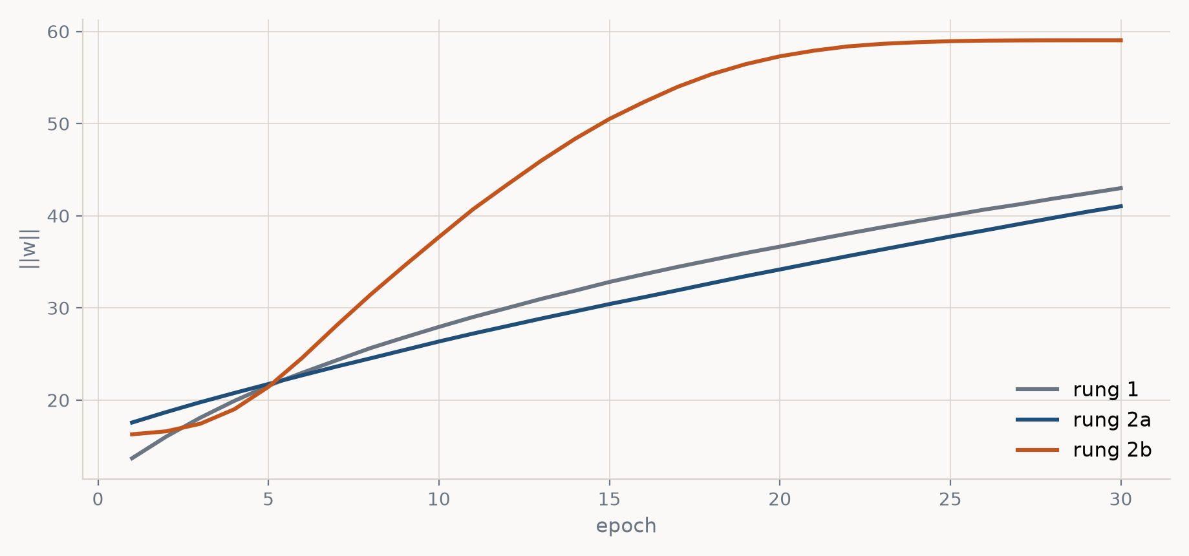
BACKUP · INSTRUMENT 4
Weight norm — is weight decay doing anything?
||w|| over all parameters. It climbs steadily, which tells us the 5e-4 weight decay is effectively inactive at these learning rates — which is why 'raise the decay' is on the menu for you to try.

Slide 50
BACKUP
Running it yourself
cd week3_cnn
python part7_improving_cnn.py --ladder # rungs 0 → 2b, ~15 min
python part8_bigger_cnn.py --ladder # rungs 3b, 3c, ~18 min
python part8_bigger_cnn.py --story # the staircase, from results/
python part7_improving_cnn.py --data-curve # rung 1 in depth
python part7_improving_cnn.py --lr-sweep # rung 2a in depth
trackio show --project "week3-cnn" # every curve, live
Each run writes checkpoints/<rung>.pt and results/<rung>.json. --story redraws the whole ladder from those JSONs without retraining.

