Slide 1
WEEK 4 · SEGMENTATION
One label per pixel
From a classifier to a U-Net, one change at a time.
Oxford-IIIT Pet at 96x96. Every number measured on the same 1000 test images.

Slide 2
THE TASK
Week 3 predicted one label. This week predicts 9,216.
Same photo in. A different shape out.
week 3 image -> 1 label (which of 10 classes)
week 4 image -> 96 x 96 labels (9,216 of them, one per pixel)
Every pixel gets its own answer: 0 = pet, 1 = background, 2 = border. The labels ship with the dataset as a trimap — a human painted them.
That one change to the output shape forces everything else in this session. Nothing here is a new kind of network; it is the same convolutions, the same loss, and the same training loop from Week 3.

Slide 3
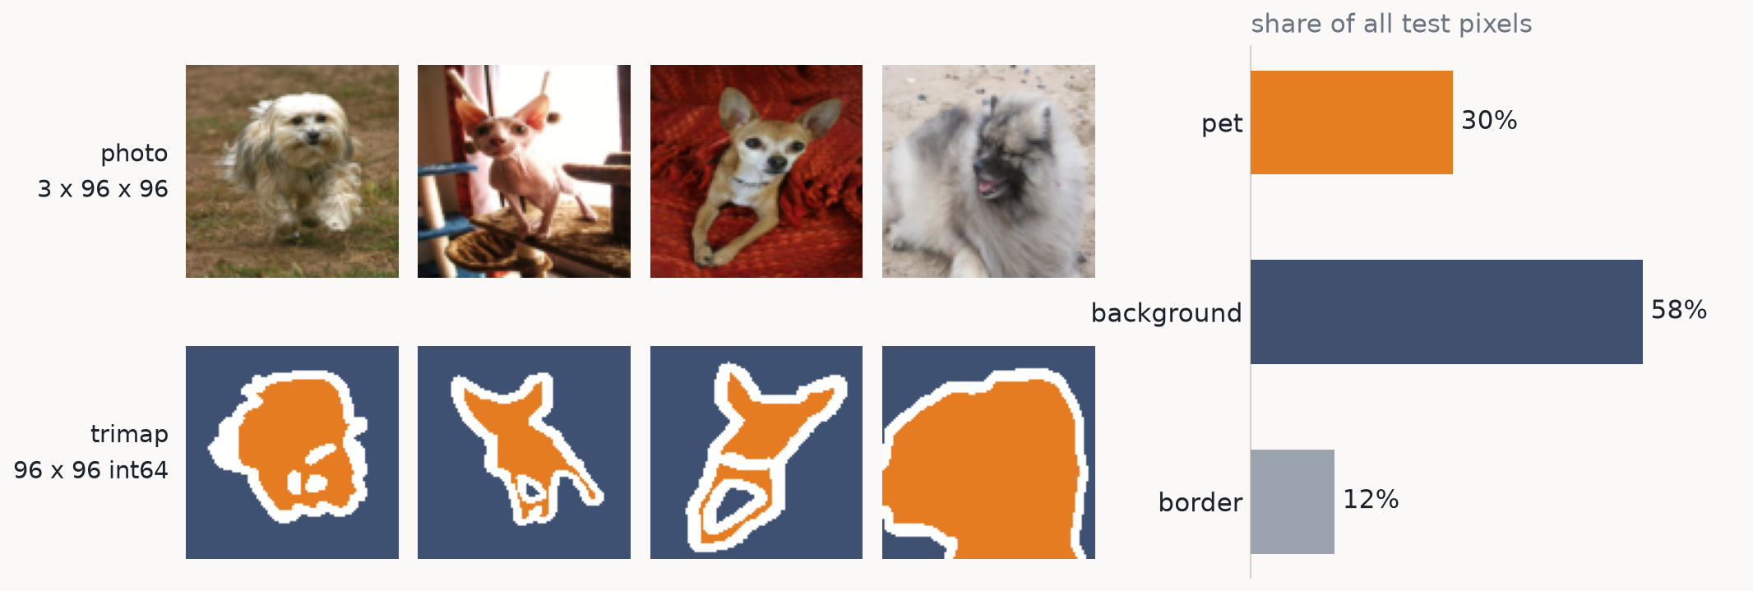
THE TASK
The data: a photo, and a label for every one of its pixels
Background is 58% of all pixels and the border ring is only 12%. Hold on to those two numbers — they decide which metric we are allowed to use.

Slide 4
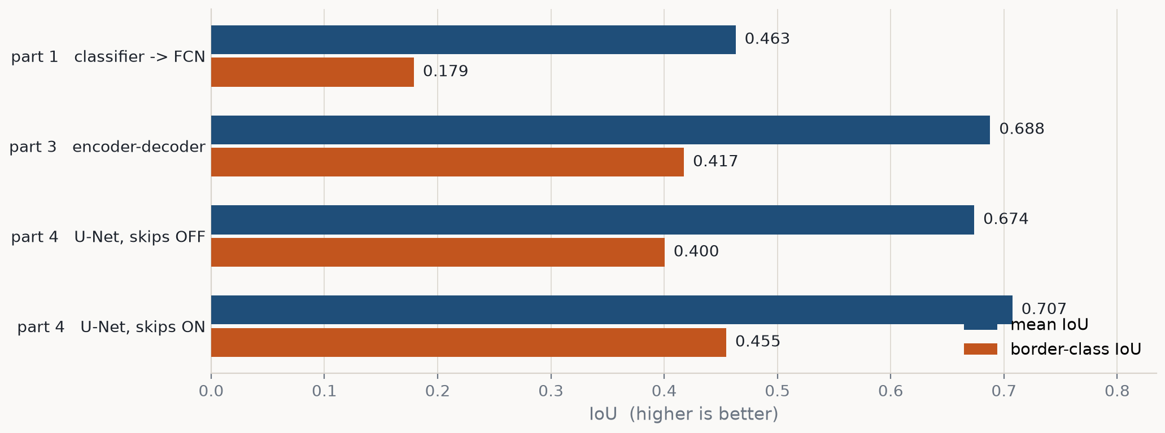
THE WHOLE SESSION ON ONE SLIDE
Four models, one test set
Each bar is the model of one part. The blue bar is the headline number; the orange bar is the border class, where the argument of this session actually lives.

Slide 5
THE WHOLE SESSION ON ONE SLIDE
The same four models, as numbers
model
params
acc
mIoU
pet
bg
border
part1 FCN
94,083
0.746
0.463
0.490
0.720
0.179
encoder-decoder
1,734,947
0.878
0.688
0.774
0.872
0.417
U-Net, skips OFF
1,928,483
0.870
0.674
0.761
0.859
0.400
U-Net, skips ON
1,928,483
0.887
0.707
0.787
0.881
0.455
All four trained for 15 epochs at lr 1e-3 on all 3,680 labelled images, and scored here on 1000 held-out test images. The rest of the deck unpacks one row at a time: the problem, the idea, the maths, then the evidence.

Slide 6
PART 1
A classifier is almost a segmenter
The problem: a classifier's head throws away WHERE. Delete it, and what is left already does the job.

Slide 7
PART 1 · THE PROBLEM
What exactly is incompatible?
Week 3's CNN ended: Conv stack -> Flatten -> Linear(1024->128) -> Linear(128->10).
Flatten is the layer that is wrong for this task, and it is wrong in a specific way: after it, 'ear-shaped thing' and 'ear-shaped thing in the top-left corner' are the same 1,024 numbers in a different order. The position is still in there, but only as an arbitrary index — and the Linear that follows has no reason to treat neighbouring indices as neighbouring pixels.
It also fixes the input size forever: Linear(1024 -> 128) needs exactly 1,024 numbers, so the network only accepts 32x32 images.
>> Everything else a classifier does — convolutions, pooling, BatchNorm, the loss — is already what a segmenter wants.

Slide 8
PART 1 · THE IDEA
Four lines of diff, and it is a segmentation model
week 3 part 6 classifier -> part1_classifier_to_segmenter.py
Conv -> BN -> ReLU -> MaxPool Conv -> BN -> ReLU -> MaxPool x3
Flatten (deleted)
Linear(1024 -> 128) -> ReLU (deleted)
Linear(128 -> 10) Conv1x1(128 -> 3)
(nothing) Upsample(x8)
CrossEntropyLoss on (N, 10) CrossEntropyLoss on (N, 3, H, W)
The trunk is untouched. Even the loss is untouched — nn.CrossEntropyLoss already accepts (N, C, H, W) logits against (N, H, W) integer targets. This is the 'fully convolutional' idea, and in 2015 it was a paper.

Slide 9
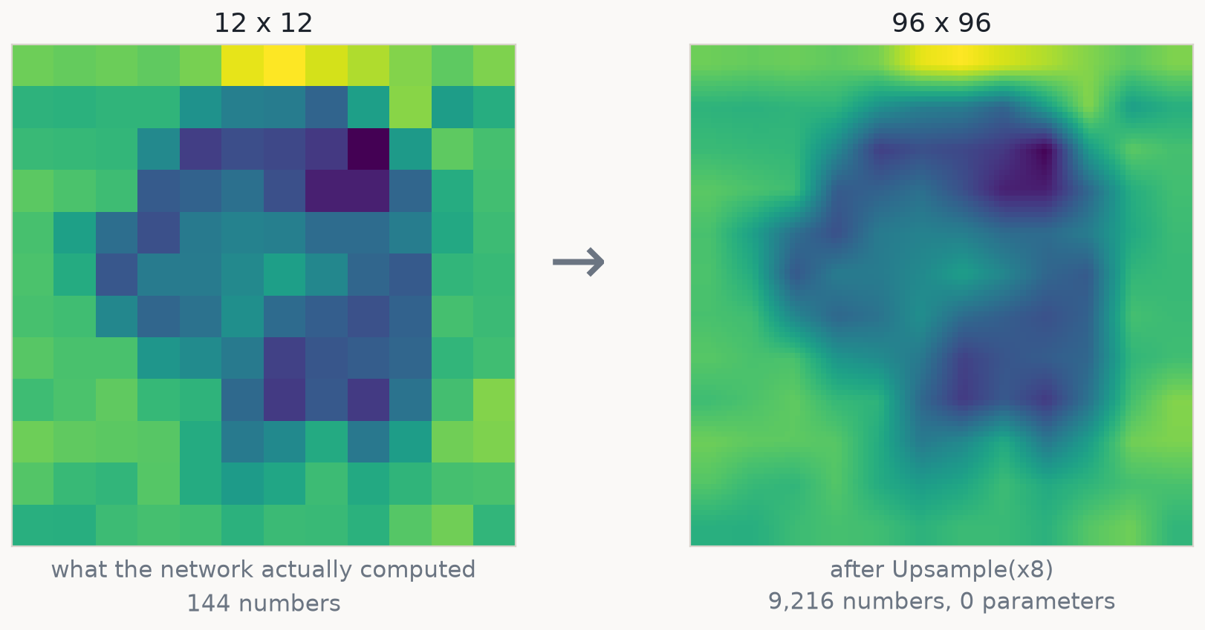
PART 1 · THE IDEA
And what is that Upsample line, exactly?
One channel of the real network's output, before and after its last layer. Upsample resizes: every one of the 9,216 numbers on the right is a weighted average of the 144 on the left. Bigger, smoother, and not one bit more detailed.

Slide 10
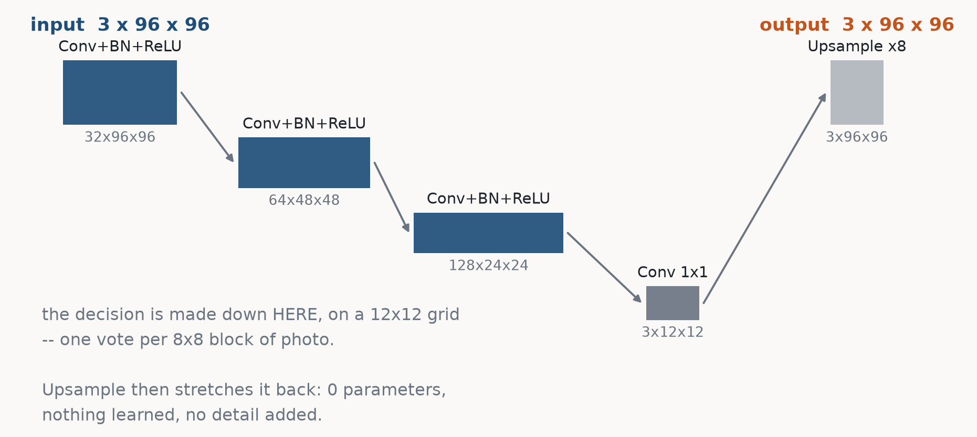
PART 1 · THE MODEL
The shapes, from a real forward pass
Box height is spatial size, box width is channel count. Three poolings take 96 down to 12; the 1x1 conv labels that 12x12 grid; Upsample stretches it back.

Slide 11
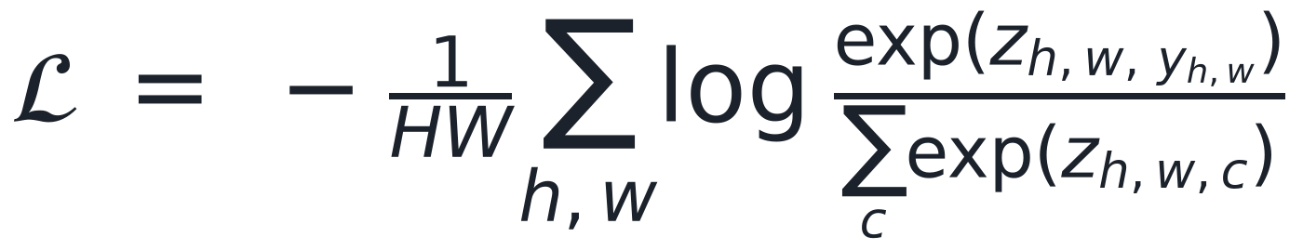
PART 1 · THE MATHS
A 1x1 convolution IS the Linear head, applied everywhere
A Linear layer maps one vector to another. A 1x1 convolution does exactly that, once per spatial position, with the SAME weights at every position:
So it costs 128 x 3 + 3 = 387 parameters, against the 131,200 in the Linear layer it replaced — and unlike that layer, it does not care how many positions there are.
The loss needs no change either. Cross-entropy is applied at each pixel independently and averaged:
Week 2's formula, inside a sum over pixels. Segmentation is classification run 9,216 times per image — with the whole picture available as context.

Slide 12
PART 1 · THE METRIC
Pixel accuracy is a trap, so we retire it here
58% of the pixels are background. A model that predicts 'background' everywhere and never looks at the image scores 0.579 pixel accuracy.
Worse, the border class — the thin ring where every interesting error lives — is 12% of the pixels. A model can ignore it completely and lose almost nothing on accuracy.
always 'background' acc 0.579 mIoU 0.193
Intersection over union scores each class on its own, so a class the model never predicts scores zero no matter how rare it is.

Slide 13
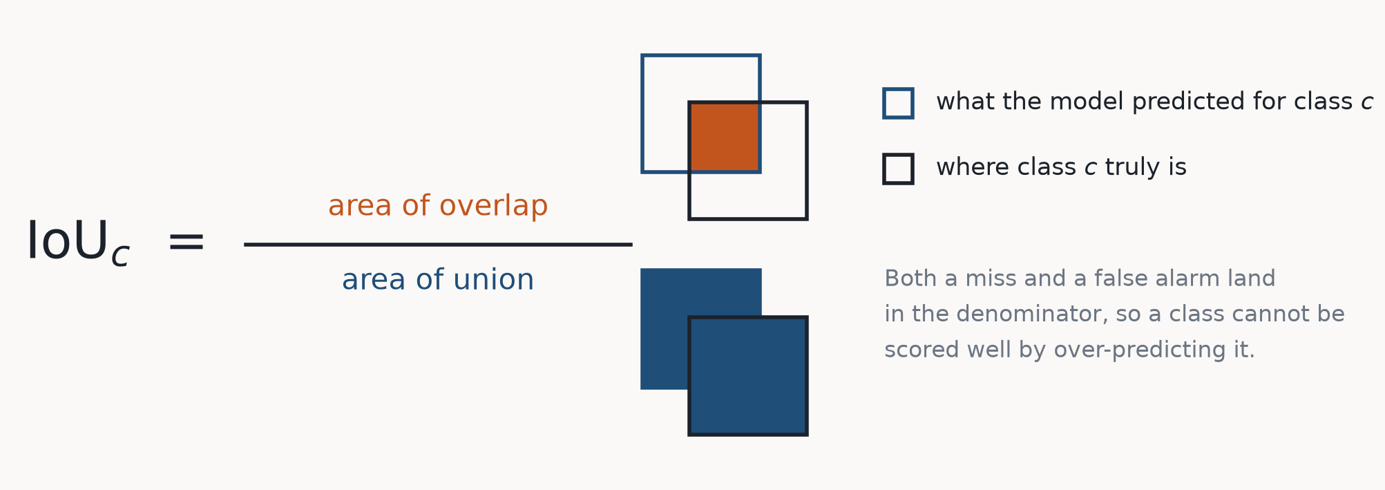
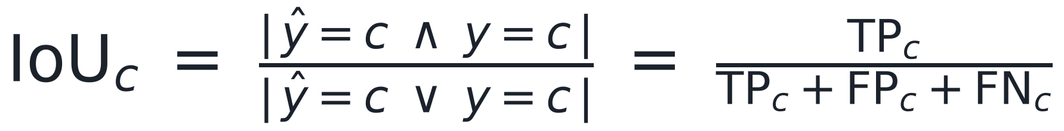
PART 1 · THE MATHS
Intersection over union
c is a CLASS INDEX. There is no single IoU: there is one per class, and the whole calculation is run once with 'pet' held up as the positive class, once with 'background', once with 'border'.

Slide 14
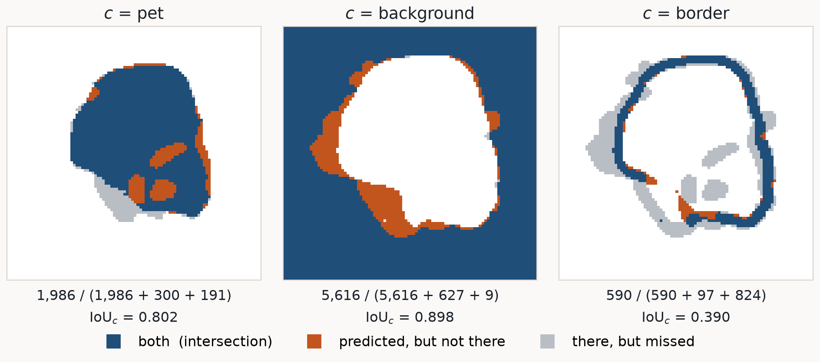

PART 1 · THE MATHS
Three classes, three IoUs, and then the mean
Unweighted, so the 12% class counts as much as the 58% one -- which is the whole reason we changed metric. Read the border panel: the same prediction that looks excellent on 'background' is mediocre there. Computed from ONE confusion matrix over the whole test set, never by averaging per-batch IoUs.

Slide 15
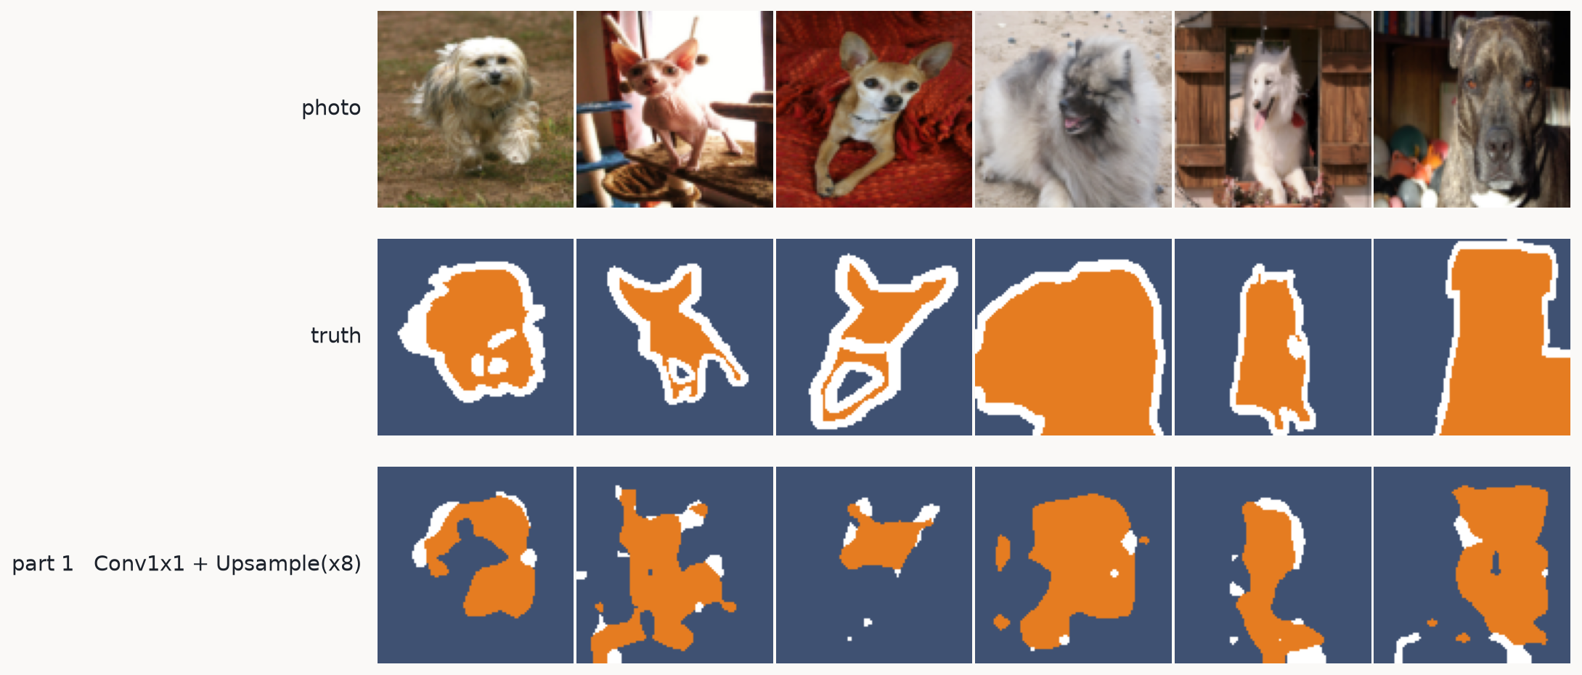
PART 1 · THE EVIDENCE
mIoU 0.193 -> 0.463 for 94,083 parameters
It finds the animal. Read the number against the 0.193 floor, not against pixel accuracy: +0.270 mIoU from deleting two layers.

Slide 16
PART 1 · THE LIMIT
Now look at the pictures, not the number
Ear tips round off. Thin legs fade out. Holes open in the middle of an animal. Nothing in the output is finer than about 8 pixels.
The reason is the one thing we did not replace. Three poolings take 96x96 down to 12x12, and that is where the decision is made — one vote per 8x8 block of photo. Upsample has no parameters: it can make the map bigger, it cannot make it more detailed.
And we cannot simply pool less. Pooling is what gives this model its context: at 12x12 a 3x3 kernel covers a quarter of the photo, which is how it knows it is looking at an animal at all rather than at a brown patch.
>> Context and resolution pull in opposite directions. The rest of the session is one idea for having both.

Slide 17
PART 2
Learn the way back up
The problem: Upsample stretches, it does not sharpen. Build a decoder instead — on the easiest possible target, no labels at all.

Slide 18
PART 2 · THE IDEA
Make the way up learned, and train it without labels
Replace the fixed stretch with convolutions that have weights, and train them on a task where the answer is free: the photo is its own target.
encoder 3 x 96 x 96 -> 256 x 12 x 12 (three poolings, as in part 1)
decoder 256 x 12 x 12 -> 3 x 96 x 96 (three upsamplings, new)
loss MSELoss(reconstruction, original)
That is an autoencoder, and we are here for exactly two reasons: it is the shortest path to understanding the decoder half, and its failure mode is the whole argument of part 4.
The training loop does not change — Week 1 Part 3's four steps, with loss_fn(model(x), y) where y happens to be x. This is the first time in the course that no label file is involved anywhere.

Slide 19
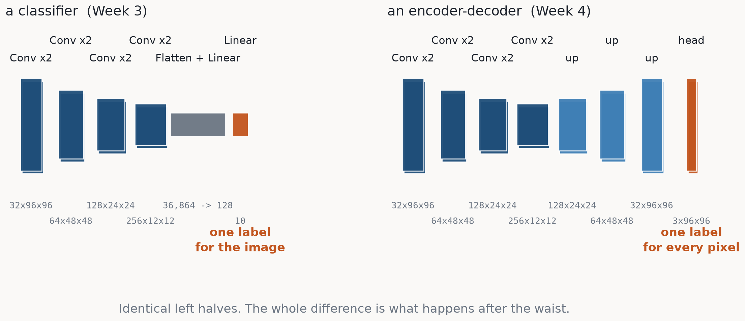
PART 2 · THE MODEL
The half you already have, and the half that is new
A VGG-style classifier and an encoder-decoder, drawn at the same scale. Box height is spatial size, box width is channel count. The encoders are the same network; a classifier then collapses the grid into one vector, and an encoder-decoder builds it back up.

Slide 20
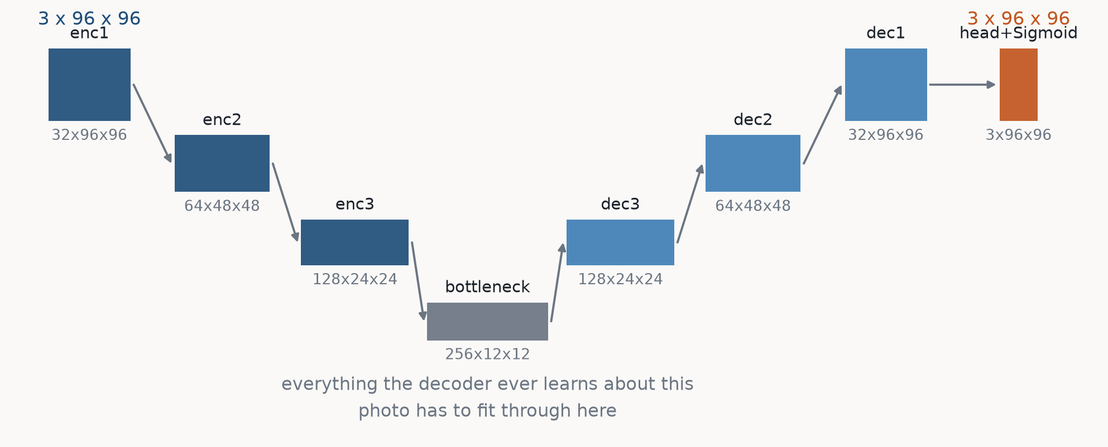
PART 2 · THE MODEL
Symmetric: every pooling on the left has an upsampling on the right
Shapes from a real forward pass. Remember this picture — part 4 changes three lines of it and nothing else.

Slide 21
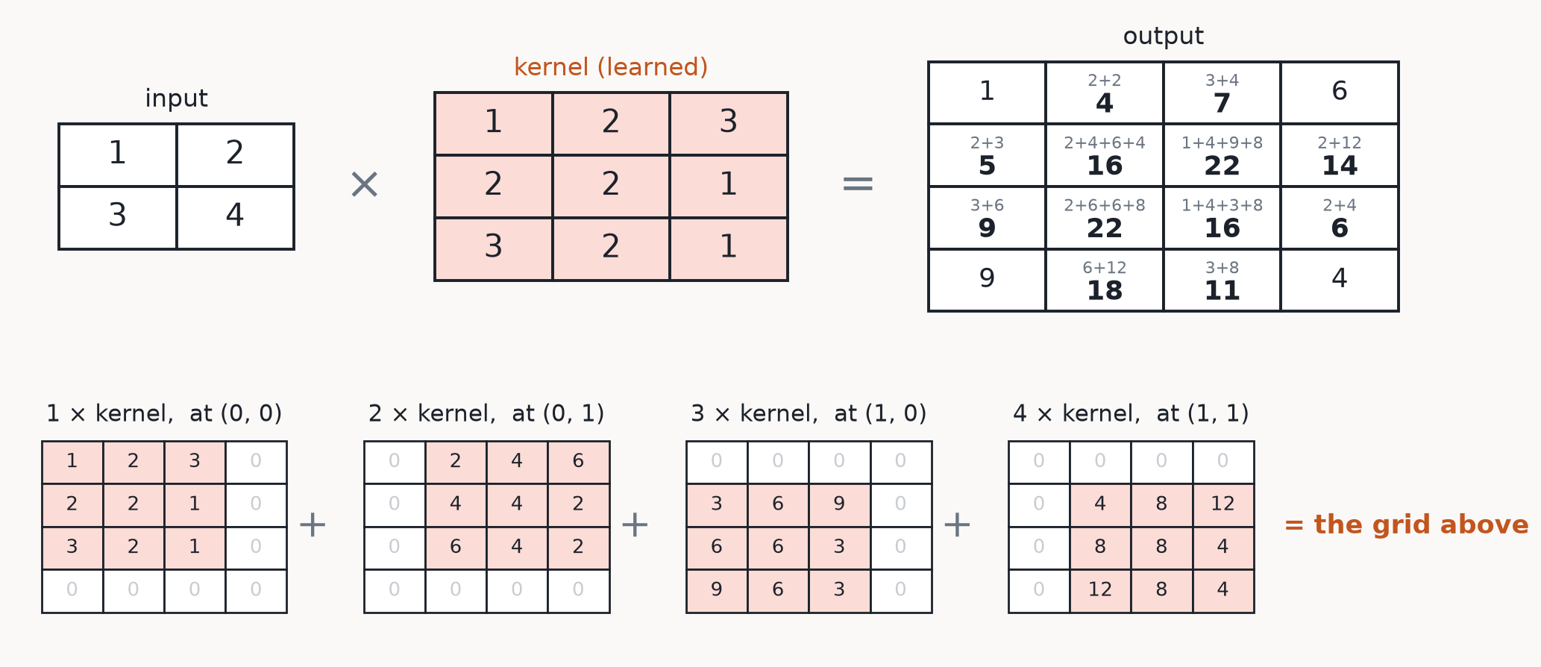
PART 2 · THE MATHS
ConvTranspose2d: what it actually computes
A 2x2 input, a 3x3 kernel. Every input value scales the WHOLE kernel and stamps it at that value's own offset; where the stamps overlap, they add. Run it backwards in your head and you have ordinary convolution -- which is exactly where the name comes from.

Slide 22
PART 2 · THE MATHS
What a learned upsampler buys over a fixed one
Compare that against Part 1's Upsample(x8), which had no kernel at all.
IT HAS WEIGHTS interpolation can only average the numbers
already there. A learned kernel can be trained
to sharpen, to fill in, to invert the blur.
ONE KERNEL PER a different patch for every (in, out) channel
CHANNEL PAIR pair: a crisp edge for one feature, a smooth
wash for another, decided by training.
ONE OPERATION it resizes and recombines features in a single
step -- the resize route needs a conv after it
anyway to do anything useful.
And the catch, which the next slide measures: overlapping stamps mean some output pixels collect more terms than their neighbours whenever the stride does not divide the kernel size.

Slide 23
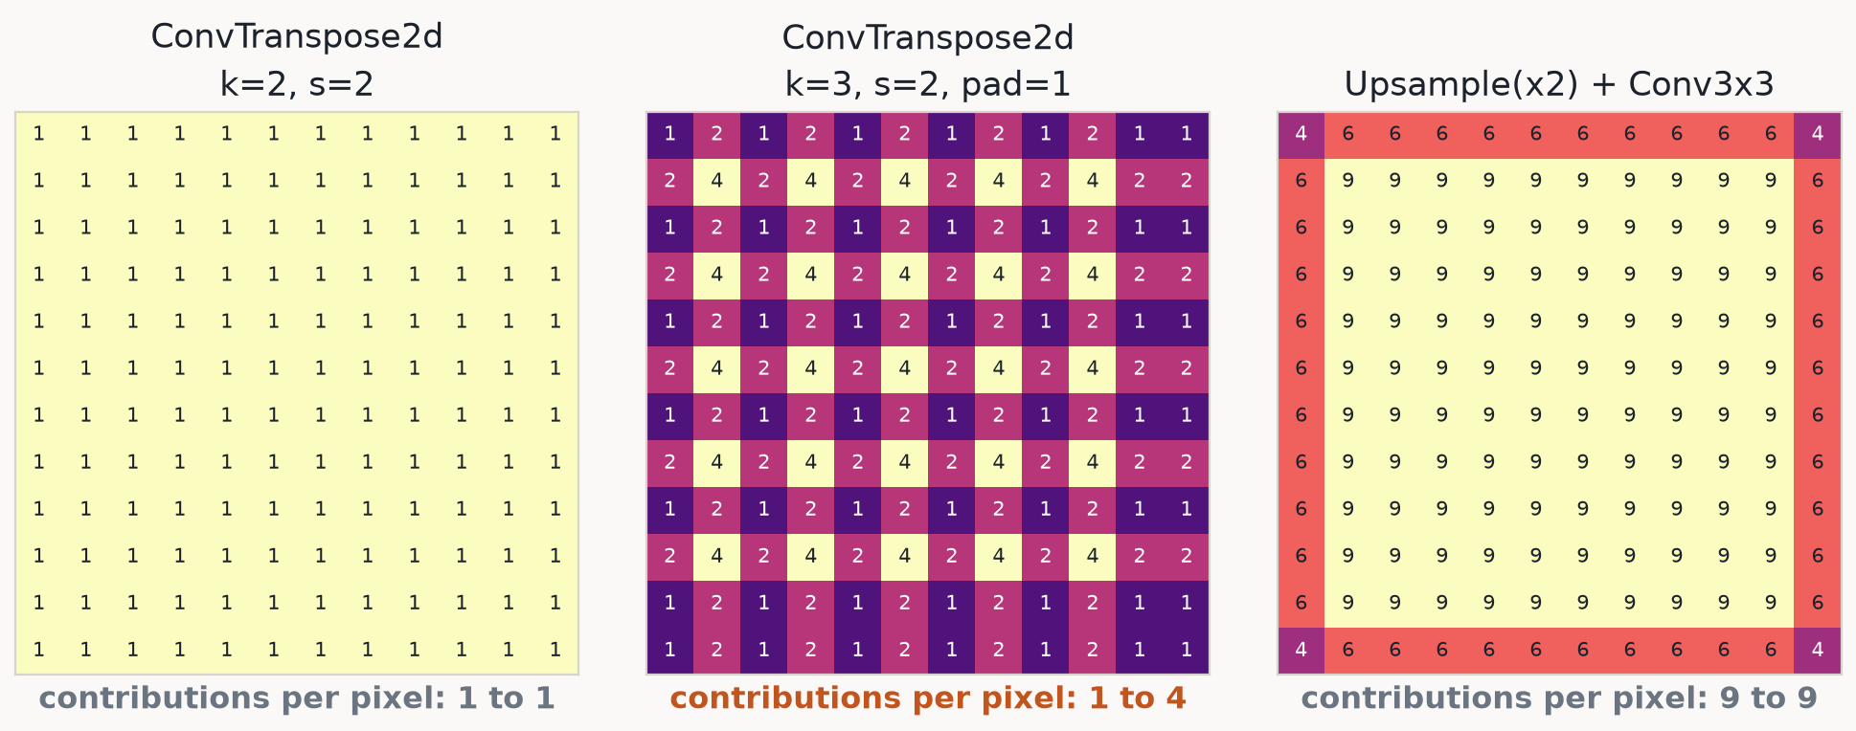
PART 2 · THE MATHS
Set every weight to 1, and count
Feed an image of ones through each upsampler with all weights set to 1: every output pixel then reports how many input cells reached it. The rule is simple — the stamps tile evenly only when the stride divides the kernel size. k=3 with s=2 does not, and there is the checkerboard, visible in the architecture itself before any training has happened.

Slide 24
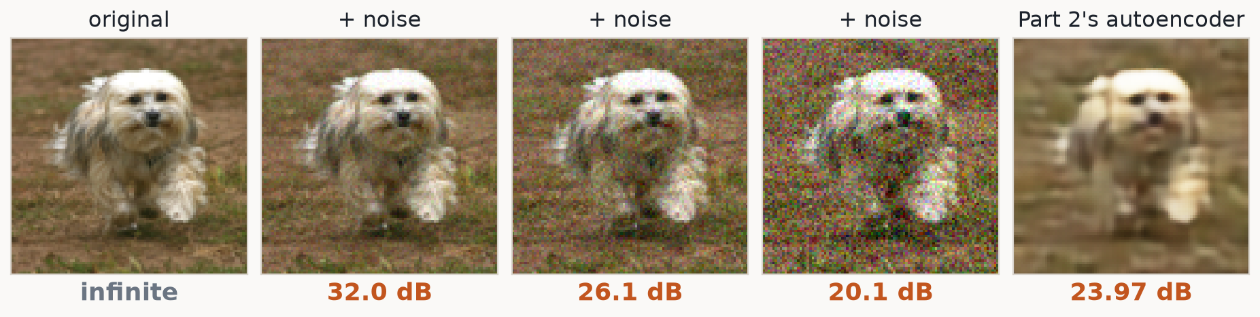
PART 2 · THE MATHS
PSNR: the same MSE, on a log scale
MAX is the largest possible pixel value, which is 1 here because our images live in [0, 1] — so the ratio is just 1/MSE. It carries no information MSE did not, and it is worth having anyway: a ratio in decibels is easier to feel. +3 dB means the error energy HALVED; +10 dB means it fell to a tenth. And because it is a log, the same 1 dB is a much bigger visual change at 30 dB than at 20.
Same photo, degraded to order. And the sting in the tail: Part 2's autoencoder scores BELOW the visibly noisy 26 dB image while looking far cleaner — PSNR measures how big the error is, not what kind.

Slide 25
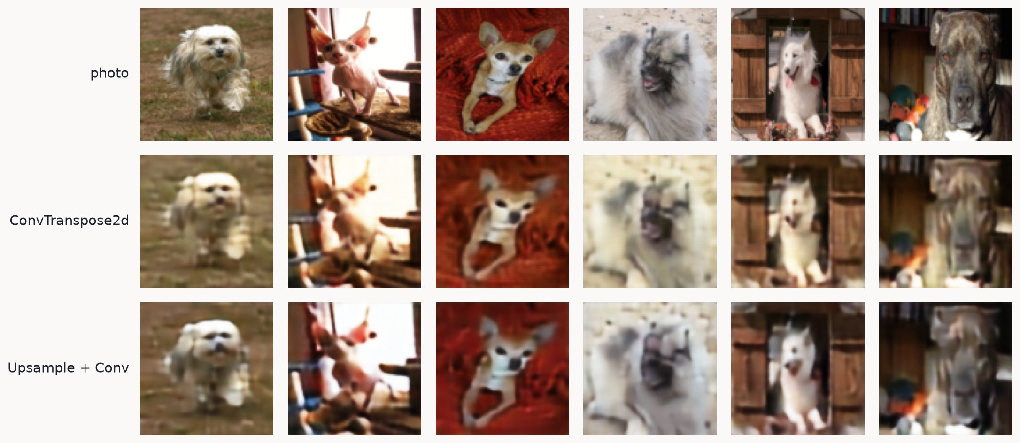
PART 2 · THE EVIDENCE
Both work. Both are blurry in exactly the same way.
ConvTranspose2d: 1,734,947 params, 23.97 dB. Upsample+Conv: 1,949,987 params, 25.22 dB. Worth having, and worth keeping in proportion — it is also the bigger model.

Slide 26
PART 2 · THE REAL PROBLEM
The waist is not a compression bottleneck
Count the numbers. The bottleneck holds MORE of them than the image does:
input 3 x 96 x 96 = 27,648 numbers
waist 256 x 12 x 12 = 36,864 numbers (1.3x MORE)
So whatever is being lost, it is not capacity and it is not count. It is WHERE: 144 positions have to describe 9,216 pixels, so each one speaks for an 8x8 block. Everything finer than that block — a whisker, the exact edge of an ear — has no representation left to live in.
If that diagnosis is right, then widening the waist should sharpen the picture even as the parameter count FALLS. That is a testable prediction, so let us test it.

Slide 27
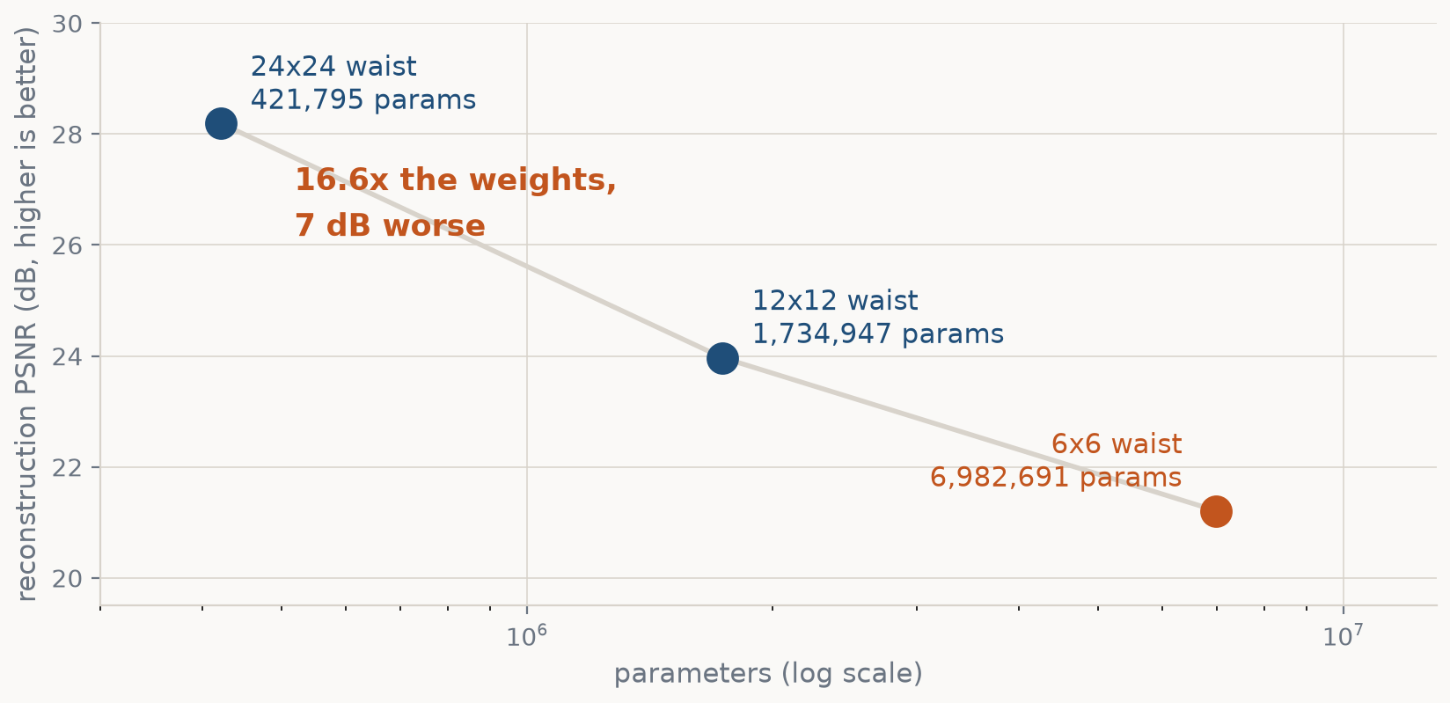
PART 2 · THE EVIDENCE
The control experiment: same model, three waists
Each extra pooling costs 2–4 dB and pays for it with four times the parameters. The prediction holds: the smallest waist has the most weights and the worst picture.

Slide 28
PART 2 · THE EVIDENCE
Resolution is what is missing, not capacity
poolings
waist
params
MSE
PSNR (dB)
2
24x24
421,795
0.0015
28.19
3
12x12
1,734,947
0.0040
23.97
4
6x6
6,982,691
0.0076
21.21
python part2b_waist_sweep.py (params recomputed live from the model). And we cannot just keep the 24x24 waist: part 1 showed we need the deep pooling for context. We need the deep waist AND the detail. Part 4 stops choosing.

Slide 29
PART 3
Point the decoder at the real task
Two lines change, and both follow from one fact: the output is now a class per pixel, not a colour per pixel.

Slide 30
PART 3 · THE IDEA
The same network, with its last layer re-read
part3_encoder_decoder.py · class SegAutoencoder(ConvAutoencoder)
class SegAutoencoder(ConvAutoencoder):
def __init__(self, n_classes=3, base=32, mode="convt"):
super().__init__(in_ch=3, out_ch=n_classes, base=base, ...)
# was: Sequential(Conv1x1(32 -> 3), Sigmoid)
self.head = nn.Conv2d(base, n_classes, kernel_size=1)
loss_fn = nn.CrossEntropyLoss() # was nn.MSELoss()
Subclassing rather than rewriting is the point: encoder, bottleneck, upsampling and decoder are character-for-character the network that was rebuilding cat photos a minute ago. The Sigmoid goes because those 3 numbers per pixel are now logits, and CrossEntropyLoss applies log_softmax itself — squashing them first is the commonest bug here.

Slide 31
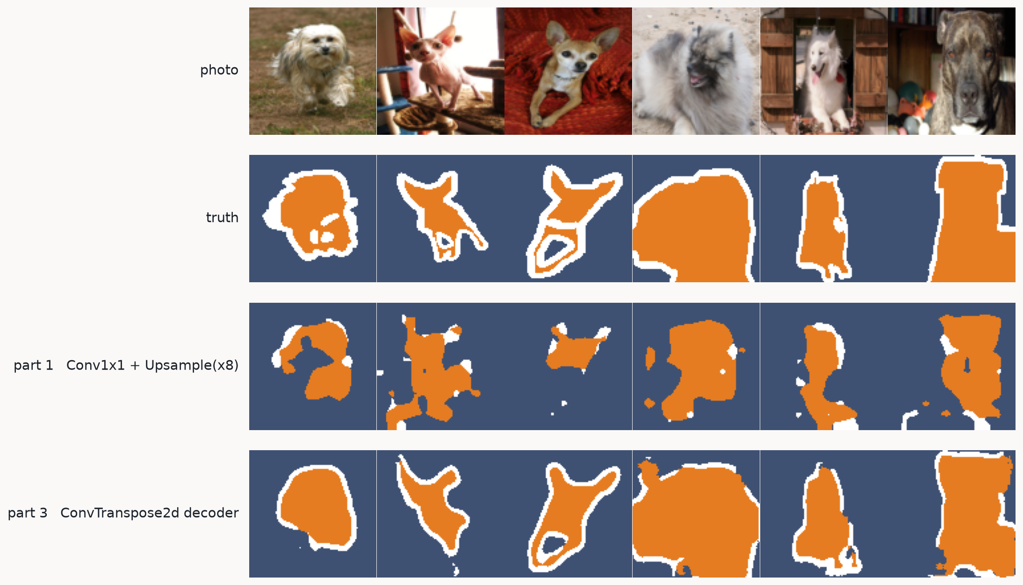
PART 3 · THE EVIDENCE
A learned decoder is worth +0.225 mIoU over stretching the logits
Part 1's fixed Upsample(x8) 0.463 -> Part 2's ConvTranspose2d decoder 0.688. Same encoder, same loss, same 15 epochs: the only thing that changed is whether the way back up has weights. The border class more than doubles, 0.179 -> 0.417.

Slide 32
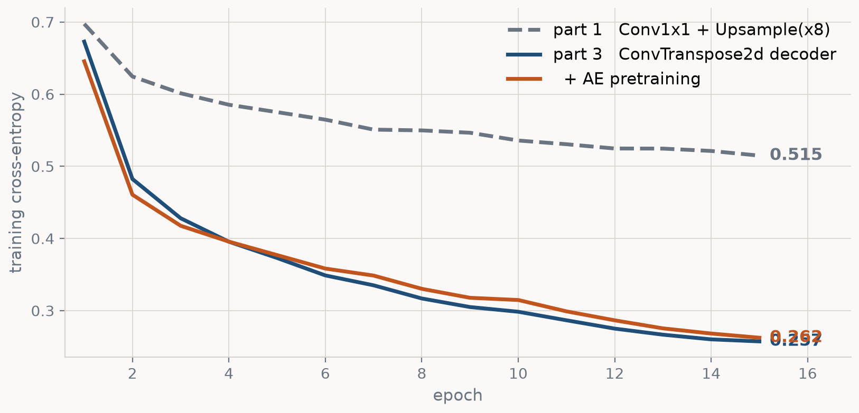
PART 3 · THE EVIDENCE
The same thing, seen during training
Training cross-entropy per epoch, from the runs that wrote the checkpoints. The fixed-Upsample model flattens out early and stays there — it is not short of epochs, it is short of resolution, and no amount of further training buys that back.

Slide 33
PART 3 · A FREE QUESTION
Part 2 trained this body with no labels. Why start from random?
Loading part 2's autoencoder weights transfers 104 of 106 tensors — everything except the head, which predicted colours and is no use here.
model.load_state_dict(torch.load("part2_ae_convt.pt"), strict=False)
strict=False is what makes it work: every encoder and decoder key matches, the head keys do not, so the body loads and the head stays random. Those weights already know what fur looks like and where edges are — nothing about that knowledge is specific to reconstruction.
This is self-supervised pretraining, and it is the reason anybody cares about autoencoders in practice. The unlabelled photo is free; the trimap a human painted by hand is not.

Slide 34
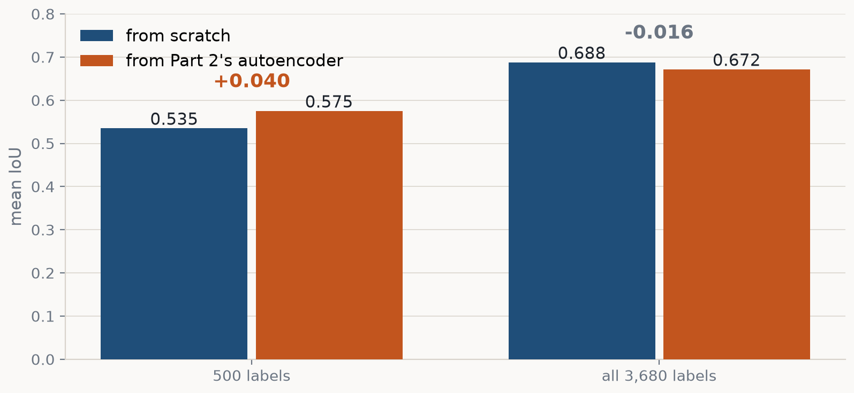
PART 3 · THE EVIDENCE
It buys nothing — until labels are scarce
What "500 labels" means, because it is the hinge of this chart:
A label here IS the ground-truth trimap — one mask a human painted, pixel by pixel, for one photo. --n-train 500 keeps a fixed random 500 of the 3,680 (photo, mask) pairs and simply never shows the model the other 3,180 masks.
The asymmetry is the point: Part 2's autoencoder still trained on all 3,680 PHOTOS, because it never needed a mask. So the orange bar is 500 masks + 3,680 unlabelled photos, against the blue bar's 500 masks alone — and that is the trade every real project faces. Photographs are free; the human's afternoon is not.

Slide 35
PART 3 · WHAT IS STILL WRONG
It knows where the boundary roughly is, and cannot commit
The border class is the worst of the three by a wide margin: 0.417, against 0.774 for the pet and 0.872 for the background.
It is the same complaint as part 2's blurry whiskers, in a different currency. There the lost detail cost us texture and looked soft; here it costs labelled pixels and is measurable.
And the cause has not changed: the information needed to place that boundary was destroyed at the 12x12 waist, before the decoder ever ran.
>> So stop destroying it.

Slide 36
PART 4
U-Net
On the way down, enc1 computed a 32 x 96 x 96 map that still had the whiskers in it. We pooled it, used it once, and threw it away.

Slide 37
PART 4 · THE IDEA
Hand the encoder's detail forward, across the gap
Keep every encoder feature map. When the decoder climbs back to that resolution, staple the saved map onto its own features before continuing.
x = self.up3(bottleneck) # 12x12 -> 24x24
x = torch.cat([x, skip3], dim=1) # <- the whole idea
The decoder now has two sources at every resolution:
from below, upsampled: coarse but semantically informed
"this is a cat, lying down, facing left"
from the side, skipped: sharp but naive
"there is a strong edge at exactly this pixel"
Its job shrinks from 'hallucinate the detail' to 'decide which of these sharp edges are real, given what I know about the scene'.

Slide 38
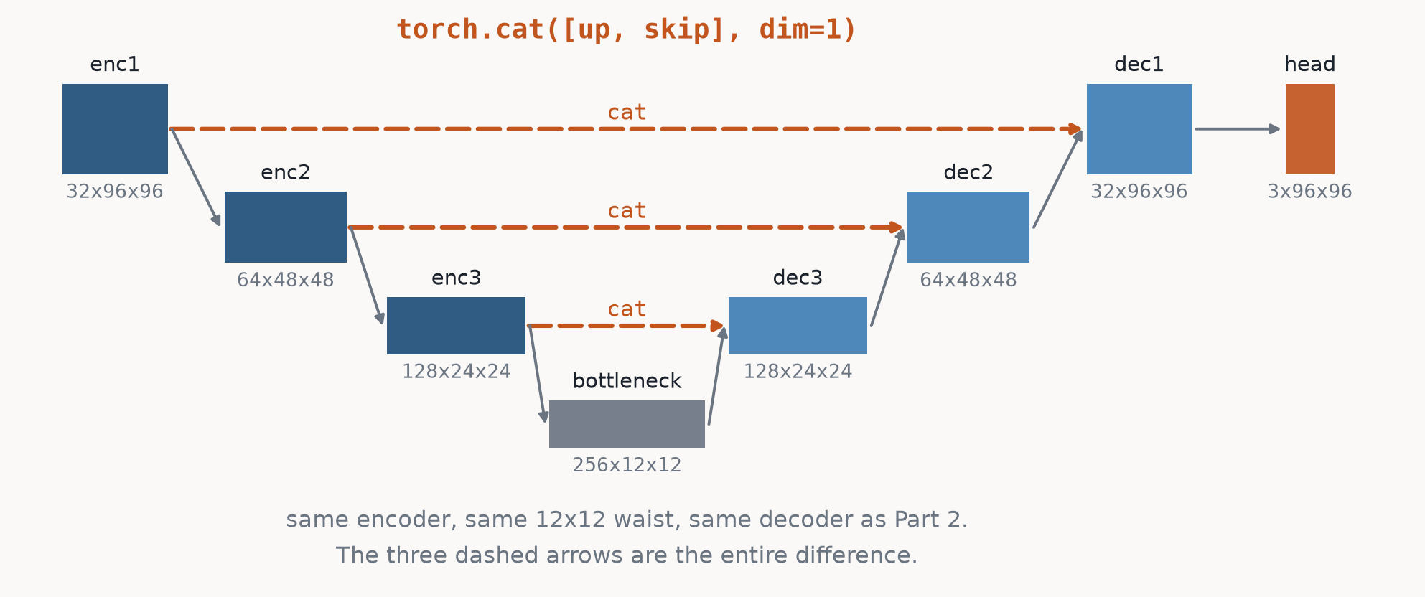
PART 4 · THE MODEL
Same left half, same waist, plus three arrows
The U is not decoration: because padding=1 keeps sizes fixed between pools, encoder level k and decoder level k are guaranteed to have the same height and width. The symmetry IS the alignment guarantee.

Slide 39
PART 4 · THE MATHS
cat, not add — and what that does to the channel counts
Adding (the ResNet move) sums the two sources irreversibly. Concatenating keeps both, so the next convolution can learn how much to trust each one. Both designs exist; U-Net concatenates.
The consequence is the bug you are about to write: every decoder block's INPUT channel count doubles.
The error message is a channel mismatch inside Conv2d, which points at the conv — not at the cat that caused it.

Slide 40
PART 4 · WHY IT SHOULD HELP
There is now a path that never passes through the waist
Without skips, every route from input pixel to output pixel goes through the 12x12 bottleneck. The finest thing the output can express is an 8x8 block, and no amount of decoder capacity changes that — part 2's waist sweep measured exactly this.
With skips, enc1's 96x96 map reaches dec1 without ever being pooled. The network CAN represent a one-pixel edge, because there is a stride-1 path from the image to the answer.
>> So the prediction is specific, and that makes it falsifiable:
the gain should land on the BORDER class, not spread evenly
the gain should appear NEAR boundaries and vanish far from them
Both are testable. Part 5 tests the second one.

Slide 41
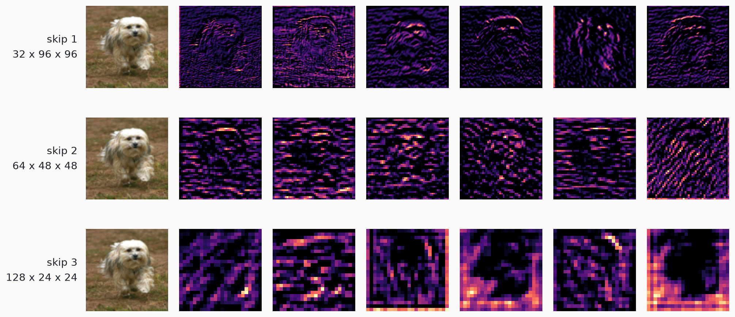
PART 4 · WHAT A SKIP CARRIES
The three tensors the decoder is handed
The six highest-variance channels at each level, from the trained model. Sharp edge and fur detectors at 96x96; at 24x24 they have stopped looking like the photo and started looking like regions.

Slide 42
PART 4 · THE EXPERIMENT
Making the comparison mean only one thing
--no-skips does not delete the skip connections. It replaces the skip half of every cat with zeros.
def _join(self, up, skip):
if not self.use_skips:
skip = torch.zeros_like(skip)
return torch.cat([up, skip], dim=1)
Same depth, same widths, same 12x12 bottleneck, and — as the table prints — exactly the same parameter count: 1,928,483 either way.
The skipless model has just as many weights to work with. It simply receives no information through them. So whatever the difference is, it is not capacity.

Slide 43
PART 4 · THE EVIDENCE
Read it twice
model
params
acc
mIoU
pet
bg
border
encoder-decoder
1,734,947
0.878
0.688
0.774
0.872
0.417
U-Net, skips OFF
1,928,483
0.870
0.674
0.761
0.859
0.400
U-Net, skips ON
1,928,483
0.887
0.707
0.787
0.881
0.455
1. skips ON vs OFF: identical parameter count, +0.034 mIoU, and the largest per-class gain is the border at +0.054 — the one class defined by sitting on an edge. 2. skips OFF vs part 3: 194k MORE parameters, -0.014 mIoU. Below the waist, capacity cannot buy back resolution that was already discarded. Only a path around it can.

Slide 44
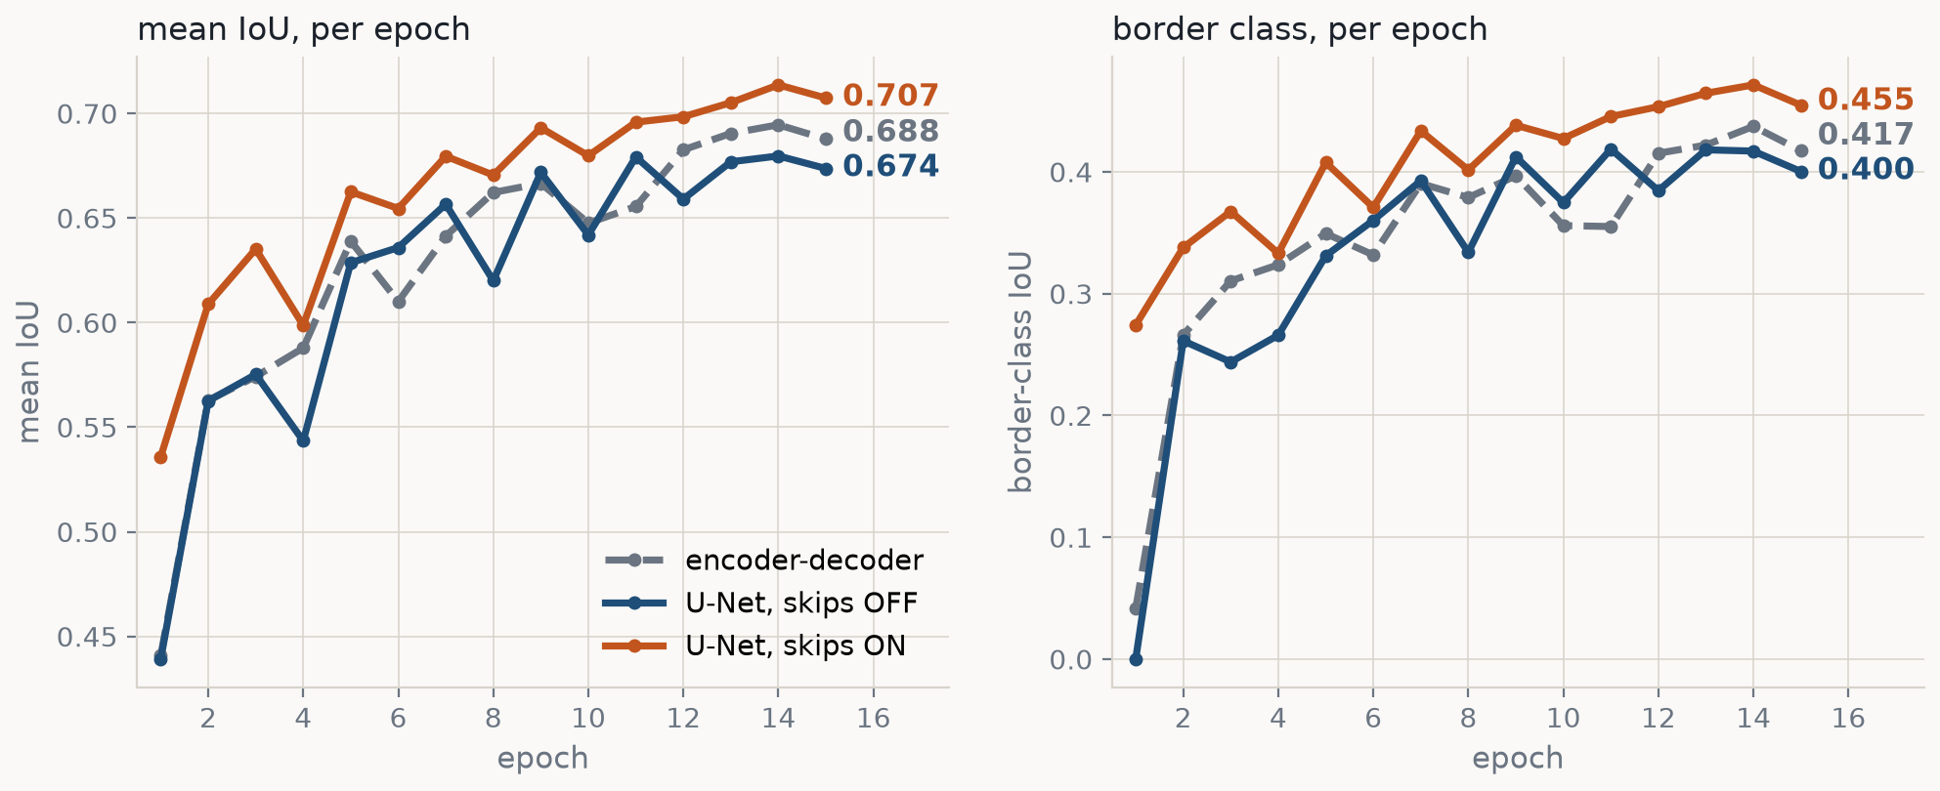
PART 4 · THE EVIDENCE
The same three runs, watched epoch by epoch
Logged to trackio during training, so this is not a re-measurement -- it is the run itself. The skips are ahead from the first epoch and stay ahead, and the right-hand panel is where the gap lives.

Slide 45
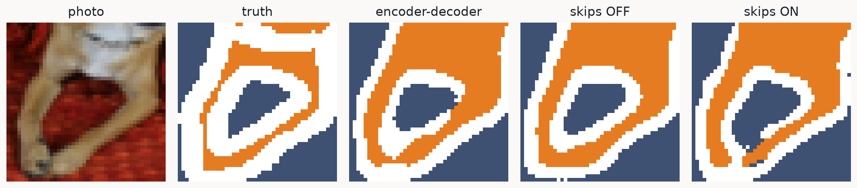
PART 4 · THE EVIDENCE
The busiest boundary in the batch, magnified
At thumbnail size every segmentation looks fine, so we go and find the crop with the most border pixels in it. This is what 0.033 mIoU looks like where it is spent.

Slide 46
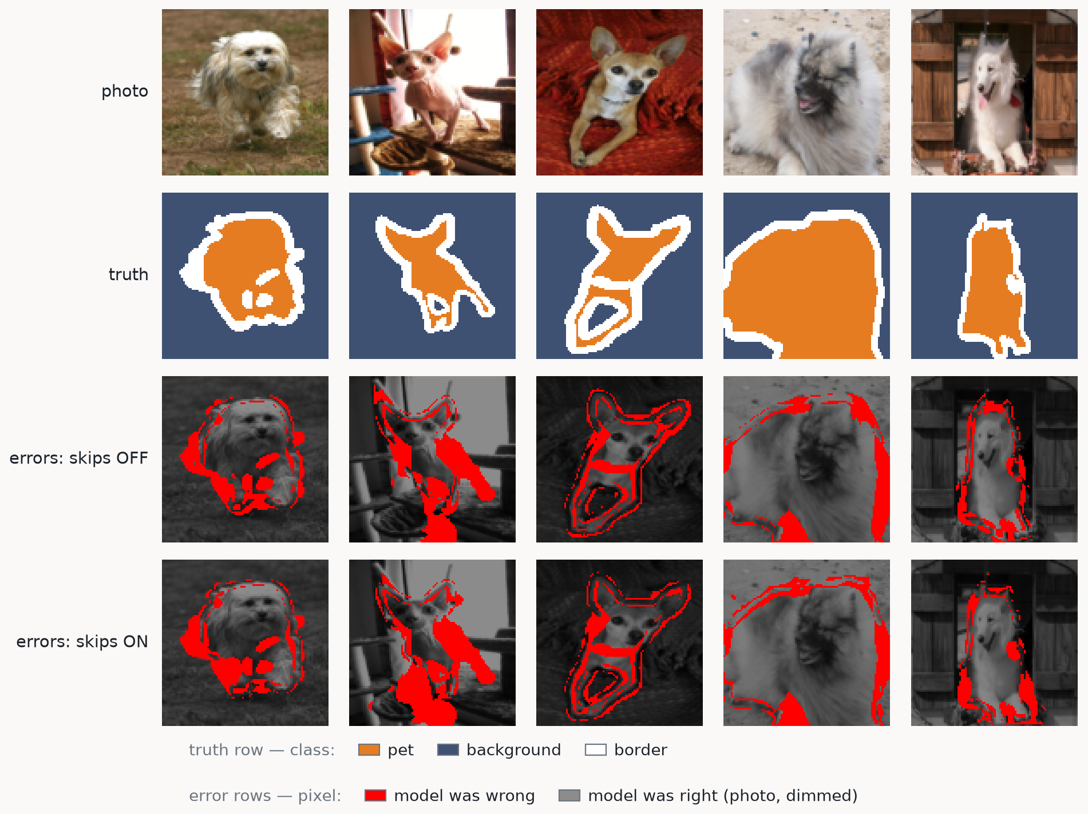
PART 4 · THE EVIDENCE
Every model's errors, in red
Two colour schemes, both named in the key. Row 2 is a class map. Rows 3-4 are not: they are the photo in grey at 55% brightness with every wrong pixel painted red, so red means 'argmax ≠ label' and says nothing about which class was guessed. Both models draw the same picture — a red outline tracing the animal, because that is where errors live. Skips ON draws it thinner.

Slide 47
PART 4 · ON THE SIZE OF THAT WIN
0.033 mIoU is real, and it is smaller than U-Net's reputation
Worth saying out loud, because a modest number is exactly the kind you should not take on trust.
Two reasons, and both are about this setup rather than about skip connections:
· the waist here is 12x12 — a gentle squeeze for a 96x96 image
· part 3's decoder is already good on its own (0.688)
Part 2's waist sweep says what to do about it: a 6x6 waist starts 7 dB worse, so the tighter the waist, the more there is for the skips to rescue. The 2015 paper went four levels deep on 572x572 microscope images, where the gap is not subtle.
>> So: a small effect. Does it appear where the mechanism says it should?

Slide 48
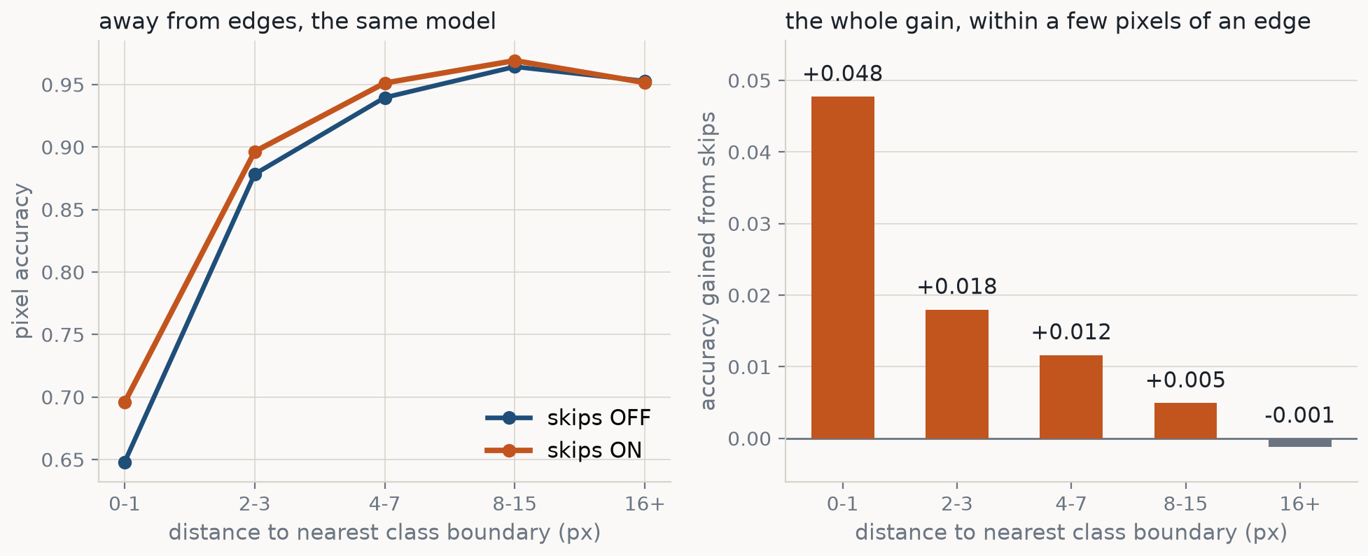
PART 5 · THE EVIDENCE
Accuracy against distance to the nearest boundary
16+ px from any boundary the two models are the same model to within noise (-0.001) — they share an encoder, so of course they are. The entire gain appears in the first few pixels and decays monotonically.

Slide 49
PART 5 · THE EVIDENCE
That is what turns a small number into a finding
A small effect that lands exactly where the mechanism predicts, and nowhere else, is a real effect.
distance (px) 0-1 2-3 4-7 8-15 16+
skips OFF 0.648 0.878 0.940 0.964 0.953
skips ON 0.696 0.896 0.951 0.969 0.952
gain +0.048 +0.018 +0.012 +0.005 -0.001
'Skip connections restore high-frequency detail' is a sentence. This is the same sentence with a y-axis.
Note also how hard the boundary is in absolute terms: even with skips, 30% of the pixels within 1px of a class boundary are wrong, against 5% out in the open. That is where the remaining headroom is.

Slide 50
THE ARC OF WEEK 4
Every part fixed what the previous one broke
part
the problem it faced
what changed
mIoU
1 FCN
a classifier throws away WHERE
Flatten+Linear -> Conv1x1
0.463
2 autoencoder
Upsample cannot add detail
a learned decoder
— (MSE)
3 encoder-decoder
the output is a class, not a colour
logits + CrossEntropy
0.688
4 U-Net
detail died at the waist
torch.cat(up, skip)
0.707
The tension that drives the whole session never actually goes away: pooling buys context and costs resolution. A U-Net does not resolve it — it routes around it.

Slide 51
WHERE THIS GOES
You have now built the standard answer for image-to-image
Swap the target, keep the network:
target = the clean image -> a denoiser
target = the masked-out region -> an inpainter
target = a depth map -> monocular depth
target = the noise that was added -> a diffusion model
That last one is not a joke: the network inside Stable Diffusion is a U-Net with attention blocks bolted on. It predicts the noise in a noisy image, and the encoder-decoder-with-skips shape is there for the reason you just measured — the output is an image, and it needs to be sharp.
Whenever the output has the same spatial shape as the input, this is the architecture to reach for first.

Slide 52
YOUR TURN · 1 OF 2
Where the next mIoU comes from, starting with the cheapest change
We stopped at mIoU 0.707. Four things to try before touching the architecture:
1 TRAIN LONGER --epochs 40, plus a cosine LR decay
nothing has converged: train loss is still falling at the last
epoch (0.259 -> 0.247) and test mIoU still trending up, noisily
(0.705, 0.714, 0.707 over the final three). We stopped for time.
2 AUGMENT MORE _PetSeg.__getitem__
a horizontal flip is all we do. Add random crop, scale, rotation.
Same rule as the flip: geometry hits the photo AND the mask.
3 AIM THE LOSS CrossEntropyLoss(weight=...), or a Dice loss
mIoU averages the classes unweighted, so the border is a third of
the score and the worst third: 0.455 vs 0.787 pet, 0.881 background.
4 MORE PIXELS IMAGE_SIZE = 192
one constant, 4x the compute. At 96x96 the border band runs 1.8 px
wide (median, 3 px at p75) — the worst class is half-buried in the
grid. The most direct attack on item 3.

Slide 53
YOUR TURN · 2 OF 2
And then the bigger swaps
Each of these changes what the network IS. One at a time, same test images:
5 WIDER, DEEPER base=64, or a fourth level
ours is 1,928,483 parameters, three pools, a 12x12 waist.
A fourth level buys context and costs resolution (part 2: a 6x6
waist starts 7 dB worse) — a bet on the skips covering the loss.
6 PRETRAINED ENCODER torchvision ResNet-34, fine-tuned
what production segmentation does: keep the U, start the encoder
from ImageNet instead of noise. Part 3 measured the small version —
our autoencoder bought +0.040 mIoU at 500 labels, -0.016 at 3,680.
Same bet, a million images behind it, and the same caveat: it pays
most when labels are scarce.
7 DIFFERENT DECODER dilated convs (DeepLab), or a ViT encoder
U-Net is 2015. Dilated convolutions widen the receptive field with
no pooling at all — attacking this session's tension at the root
instead of routing around it.

Slide 54
BACKUP
Running it yourself
Every figure in this deck is regenerated by the script that built it, from the checkpoints the parts wrote.

Slide 55
BACKUP
How to watch a run
trackio show --project "week4-unet"
Every part logs, per epoch: train_loss, test/acc, test/mIoU, and the three per-class IoUs. The run config carries the architecture, the parameter count, the learning rate and the training-set size, so the dashboard's run table sorts into a leaderboard on its own.
Two honest notes.
1. These per-epoch numbers are on the TEST set, so they are
monitoring, not selection: every part trains a fixed number of
epochs decided in advance and reports the last one. The moment
you want to CHOOSE something, carve a validation split out of
trainval first, the way Week 3 Part 7 does.
2. Measuring once per epoch changed the results, at first. See the
next slide -- it is a bug worth meeting once.

Slide 56
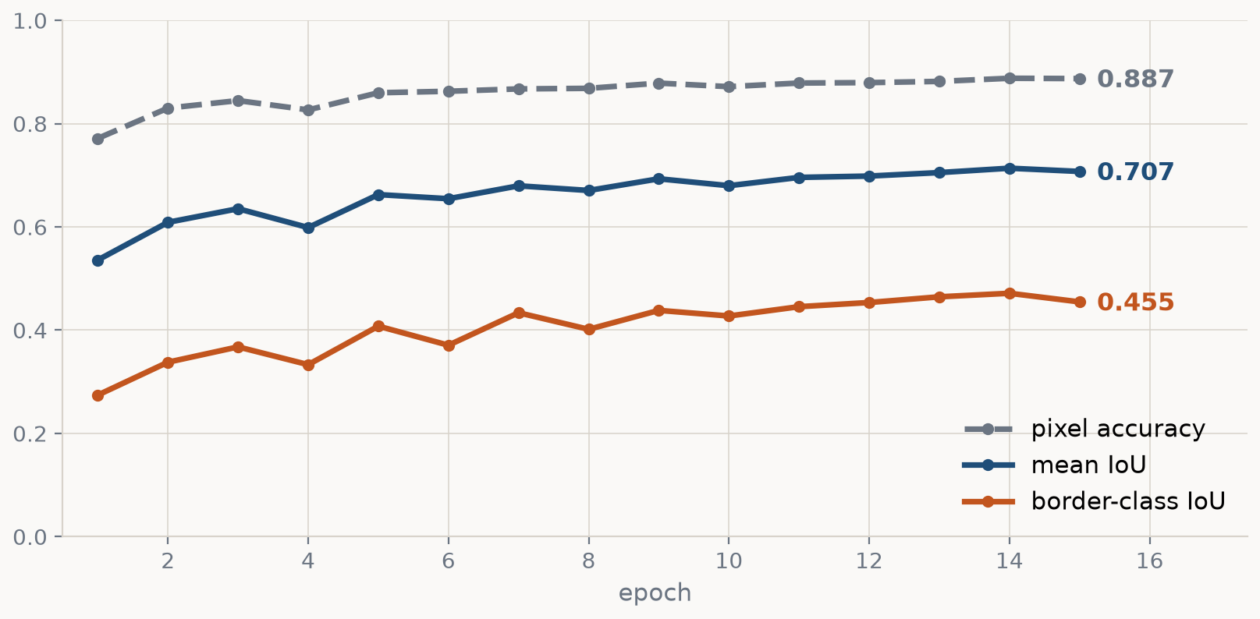
BACKUP · THE INSTRUMENT
Why the dashboard plots IoU and not accuracy
One run (U-Net, skips ON), three metrics, one axis. Accuracy opens at 0.771 -- barely above the 0.579 a model scores for predicting 'background' everywhere -- and gains 0.116 over 15 epochs. The border class opens at 0.274 and gains 0.180, and is still climbing at the end. Same run: one curve says 'nearly done', the other says 'keep going'.

Slide 57
BACKUP · THE INSTRUMENT
The bug that instrumentation introduced
Adding the per-epoch probe made the training runs stop reproducing.
epoch 1 loss 0.6974 <- identical to the un-instrumented run
epoch 2 loss 0.6268 <- and from here on, different
Nothing was wrong with the measurement. Creating a DataLoader ITERATOR draws a number from the global RNG, and our training loader shuffles from that same RNG — so evaluating once per epoch re-dealt the training order from epoch 2 onwards.
def undisturbed(fn): # common.py
state = torch.get_rng_state()
try: return fn(model)
finally: torch.set_rng_state(state)
The check that it worked: the per-epoch losses now match the runs from before any logging existed, to four decimals.

Slide 58
BACKUP
The files
cd week4_unet
python part1_classifier_to_segmenter.py # ~2 min
python part2a_cnn_autoencoder.py # ~9 min
python part2b_waist_sweep.py # ~11 min
python part3_encoder_decoder.py --pretrained # ~12 min
python part3_encoder_decoder.py --pretrained --n-train 500 --skip-baseline
python part4_unet.py # ~18 min
python part4_unet.py --shapes-only # shapes, no training
python part5_unet_visualize.py # take-home
python compare_parts.py # the summary figure
python slides/build_slides.py # this deck
Weights land in checkpoints/, figures in results/ (set WEEK4_SAVE_FIGS=1), loss curves in results/training_curves.json. The first run caches the dataset at 96x96, once, in about 23 seconds.

Slide 59
BACKUP
Where the numbers in this deck come from
Measured at build time, on 1000 held-out test images (mps):
· every mIoU, IoU and accuracy — by loading checkpoints/*.pt and running them here;
· every parameter count — count_params() on the model itself;
· every tensor shape in the architecture diagrams — forward hooks on a real forward pass;
· the class shares — counted off the test labels.
Read from results/training_curves.json, written by the parts:
· the training loss curves.
Transcribed by hand, because the runs that produced them saved no weights: part 2's waist sweep and the 500-label pretraining comparison. Both are marked in build_slides.py with the command that reproduces them, and the waist sweep's parameter counts are still recomputed live.

