Slide 1
THE PROBLEM
Generating has no single right answer
What we want: new images of a digit we choose -- not copies of the training set.
Weeks 3 and 4 had one correct answer per input (a class, a mask). We compared the output to it: that was the loss.
"Draw a 7" has millions of correct answers. There is nothing to compare the output to.
The idea: destroying an image is easy. Learn to undo it.
Add noise, a little at a time, until only noise is left. We know exactly which noise we added, so "find the noise" DOES have one right answer: an ordinary supervised problem.
To generate: start from pure noise and remove noise step by step until a digit is left.

Slide 2
ADDING NOISE (THE FORWARD PROCESS)
Any noise level in one formula
beta_t (beta): how much noise step t adds -- a fixed list of 1000 numbers, rising from 0.0001 to 0.02. alpha_t = 1 - beta_t: how much of the image that step keeps. alpha-bar_t: the product of all alphas up to t = how much of the original digit is left.
x_0: the clean digit, pixels in [-1, 1]. epsilon: random noise, one number per pixel drawn from a bell curve with mean 0 and spread 1. x_t: the digit at noise level t.
No loop: any level t is reached in one line. So training can pick a random t for every image in the batch.

Slide 3
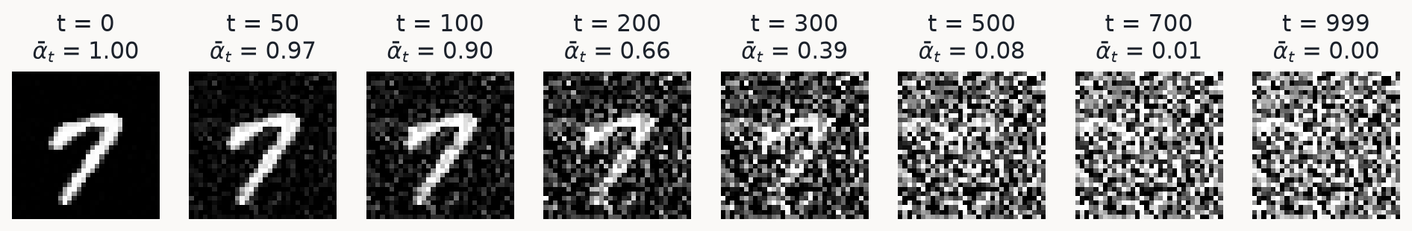
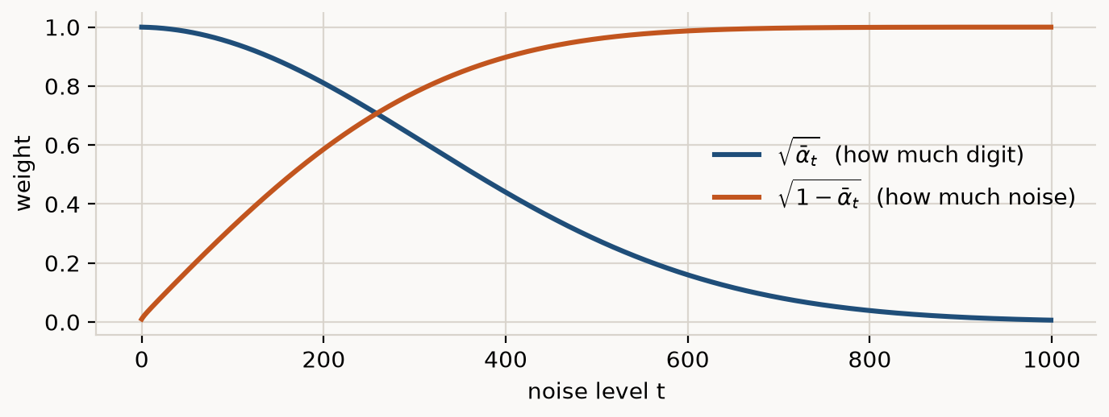
ADDING NOISE
A real training digit at eight noise levels
Top: x_t computed with the formula above. Bottom: the two weights in the formula. By t = 999 the digit is gone.

Slide 4
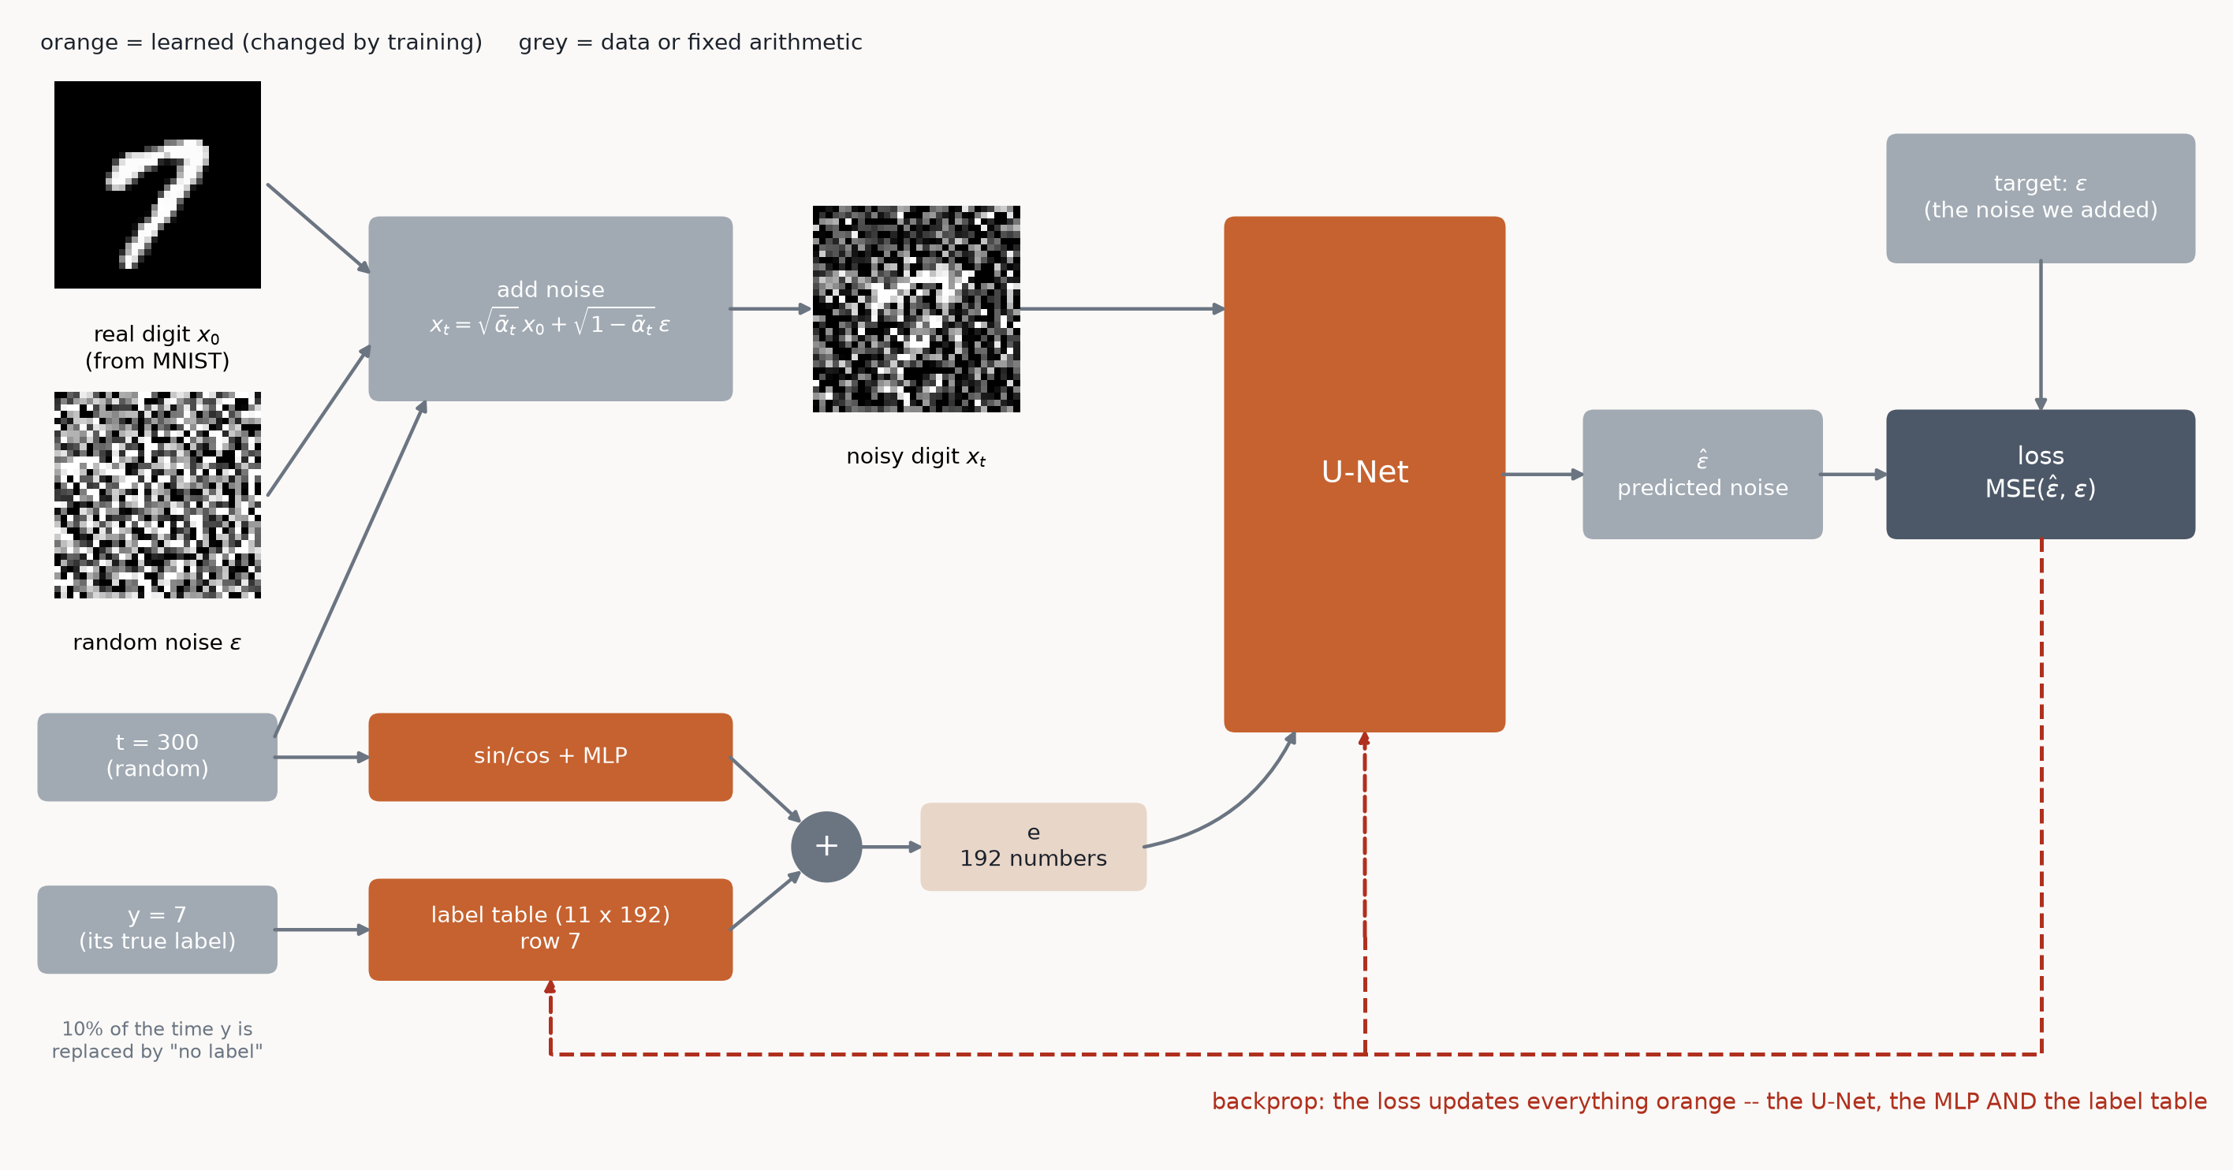
TRAINING
One training step: where each input comes from, and what learns
The label table is a weight like any other: backprop changes row 7 whenever the training digit is a 7.

Slide 5
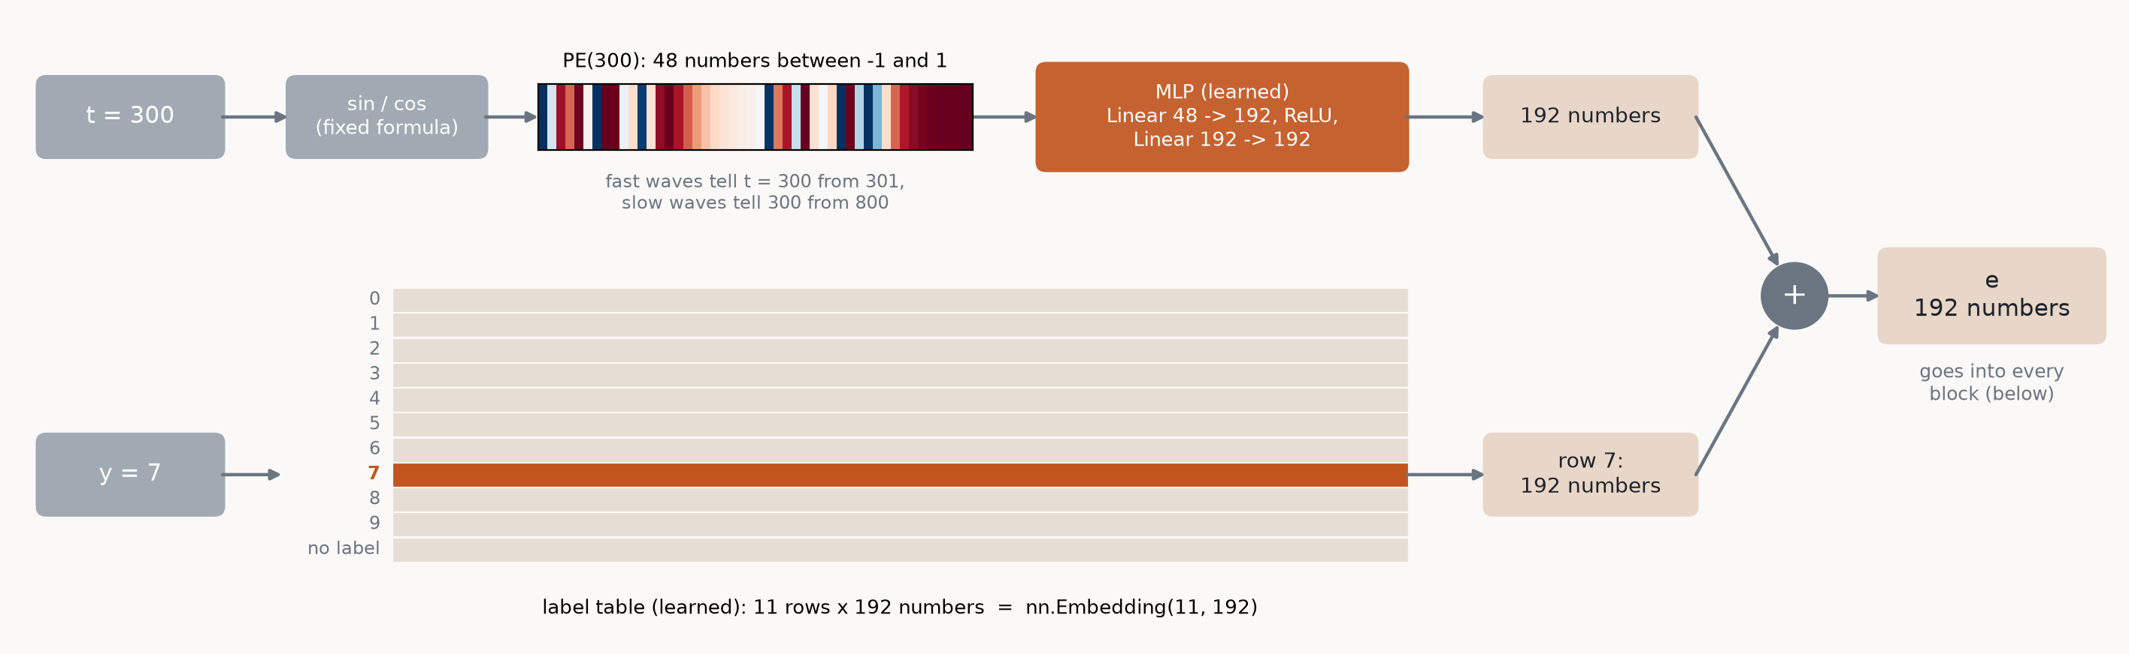
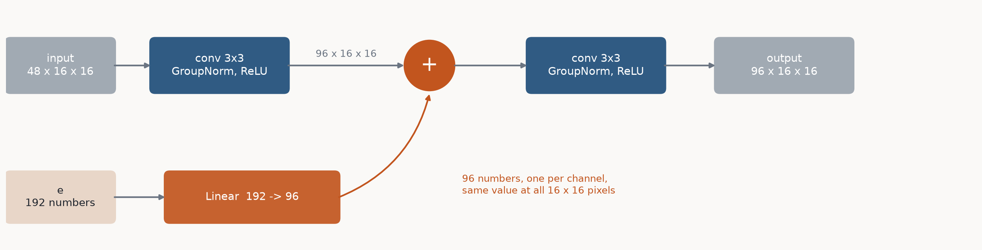
TRAINING
How t and y become e, and where e goes
Top: t -> sin/cos (fixed) -> MLP (learned); y -> its row of the table (learned). Their sum is e. Bottom: inside every block, a learned Linear turns e into one number per channel, added at every pixel.

Slide 6
THE LOSS
Predict the noise; the error is plain MSE
epsilon_theta: the U-Net (theta = its weights), taking the noisy digit, the level and the label. E[...]: the average over digits x_0, labels y, random levels t and random noise epsilon. ||...||^2: squared error over all 32 x 32 pixels -- MSE.
Why the noise and not the clean digit? The next two slides.

Slide 7
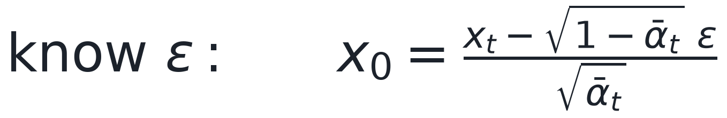
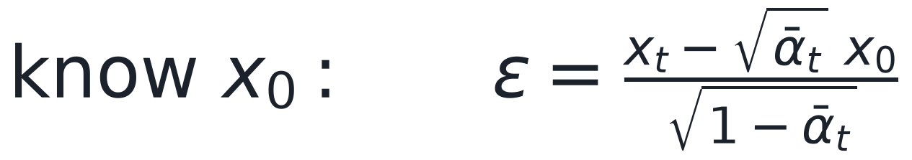
WHY PREDICT THE NOISE (1/2)
Knowing the noise = knowing the digit
The model already has x_t (its input) and t. That is one equation with two unknowns, x_0 and epsilon. Know one, and the other follows:
So a model that outputs the noise has also told us its guess for the digit. The two choices do not differ in what the model knows. They differ in what the loss punishes.

Slide 8
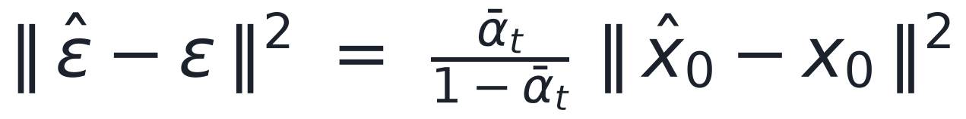
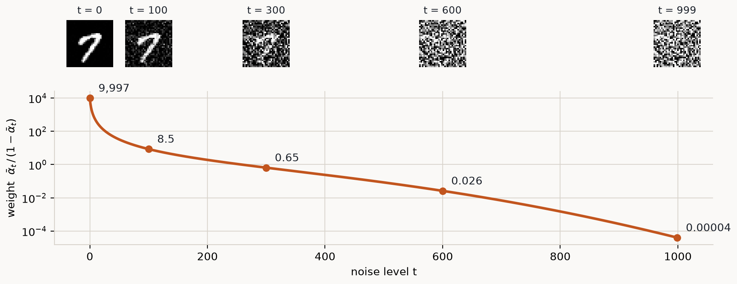
WHY PREDICT THE NOISE (2/2)
What the loss cares about
Predict the noise: a small mistake on a NEARLY CLEAN image costs a lot (left of the curve). The network spends its effort on fine details -- stroke edges, thickness, clean background.
Predict the digit: the same small mistake costs almost nothing. The loss is dominated by very noisy images, where the digit must be guessed from almost pure noise -- the best possible answer is a blurry average, and the loss keeps pushing on a task that cannot be solved.
Predicting the noise makes the loss care most about the details that decide how the final digit looks.

Slide 9
TRAINING
One training step: the whole algorithm
part1_unet_diffusion.py
t = torch.randint(0, sched.T, (len(x0),), device=device) # a random level per image
noise = torch.randn_like(x0) # random noise
x_t = sched.add_noise(x0, t, noise) # the forward formula
loss = F.mse_loss(model(x_t, t, y), noise) # find the noise
opt.zero_grad(set_to_none=True)
loss.backward()
opt.step()
Two extras, a few lines each: label dropout (10% of labels replaced by "no label", used later for guidance) and EMA, a second copy of the weights that is a slowly moving average of the trained ones. Its samples are cleaner; the checkpoint stores it.

Slide 10
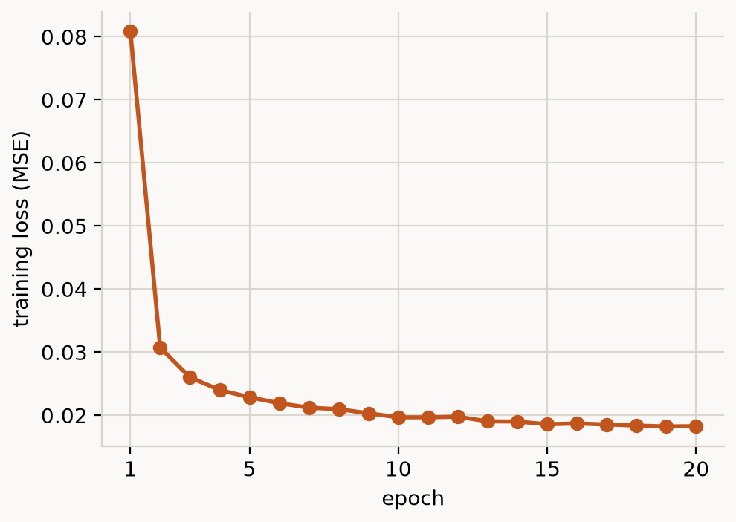
RESULTS: TRAINING
The loss falls, then flattens
20 epochs, 32 min on this Mac, 4,586,449 parameters. Live: trackio show --project week5-diffusion

Slide 11
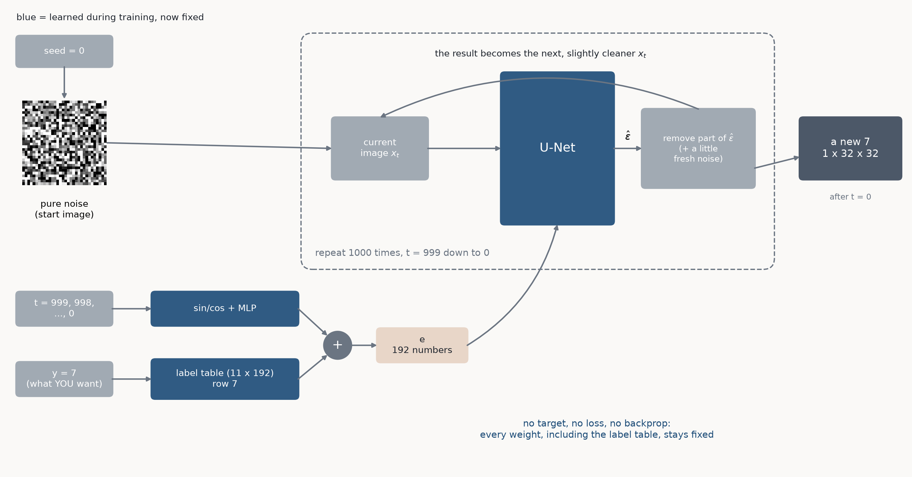
INFERENCE
Generating a 7: same network, run in a loop, nothing learns
The seed decides WHICH 7 (slant, thickness). The label decides THAT it is a 7. The model always runs forward; only t counts down.

Slide 12
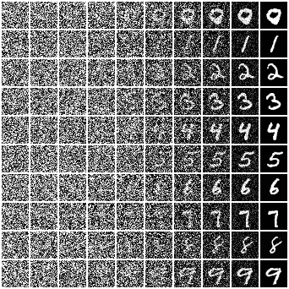
RESULTS: INFERENCE
Noise on the left, digit on the right
One row per requested digit, 0-9. Columns: 10 evenly spaced moments of the 1000-step loop from the previous slide.

Slide 13
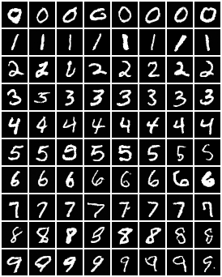
RESULTS: INFERENCE
Ask for each digit, get eight new ones
Row k: y = k, eight different seeds. Same trained model, 1000-step loop, nothing else. 80 digits x 1000 steps took 58 s.

Slide 14
PART 2
Swap the U-Net for a transformer
Same noise, same loss, same training loop, same samplers, same e. Only the network that predicts the noise changes -- sized to the same parameter count: 4,654,852 vs the U-Net's 4,586,449.

Slide 15
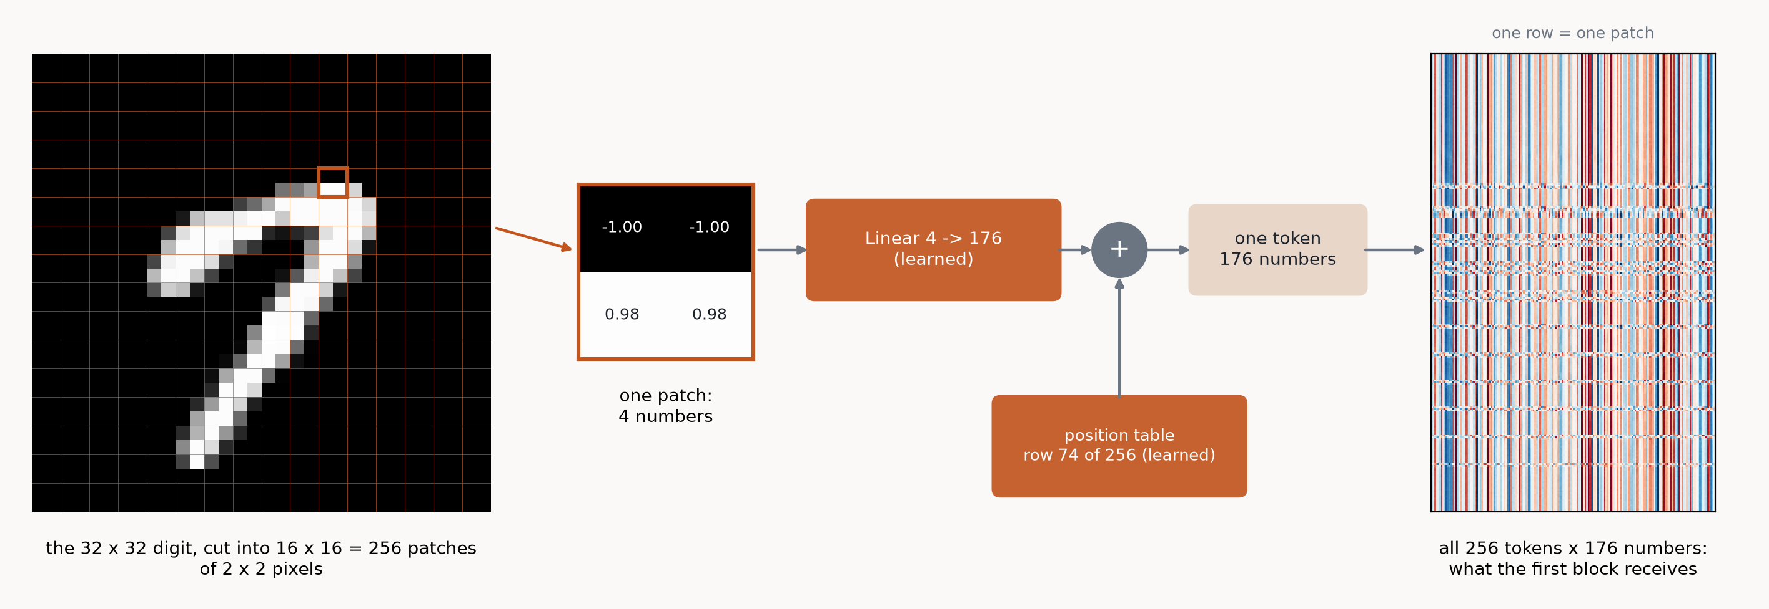
PART 2: THE MODEL
From an image to tokens
A token is one patch, described by numbers the network works with. The same Linear is used for every patch. The position table gives each patch its own learned row, so the network knows where the patch sits.

Slide 16
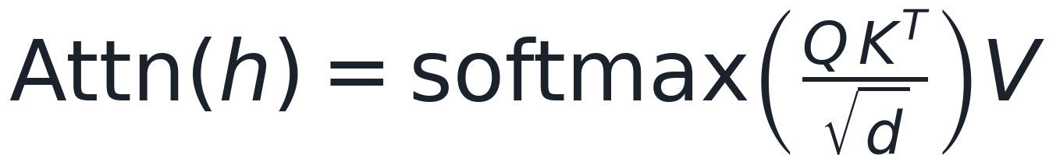
PART 2: ATTENTION (1/3)
Every token takes a weighted mix of all tokens
A transformer works on tokens: rows of d numbers, each describing one piece of the input (ours, later: one 2 x 2 patch of the image).
In attention, each token asks a question, every token offers an answer, and how well they match decides how much of each answer to take.
h: the N tokens, an N x d table. W_Q, W_K, W_V: learned d x d matrices, the same for every token. Q (query): what each token is looking for. K (key): what each token contains. V (value): what each token passes on when it is chosen.
Q K^T: an N x N table of match scores (dot products), one per pair of tokens. / sqrt(d): stops the scores growing with d, so softmax does not put all the weight on one token. softmax: each row becomes positive weights that sum to 1. x V: each token's output is a weighted average of all the tokens' values.
Unlike a convolution's fixed 3 x 3 window, attention decides from the input which tokens to mix.

Slide 17
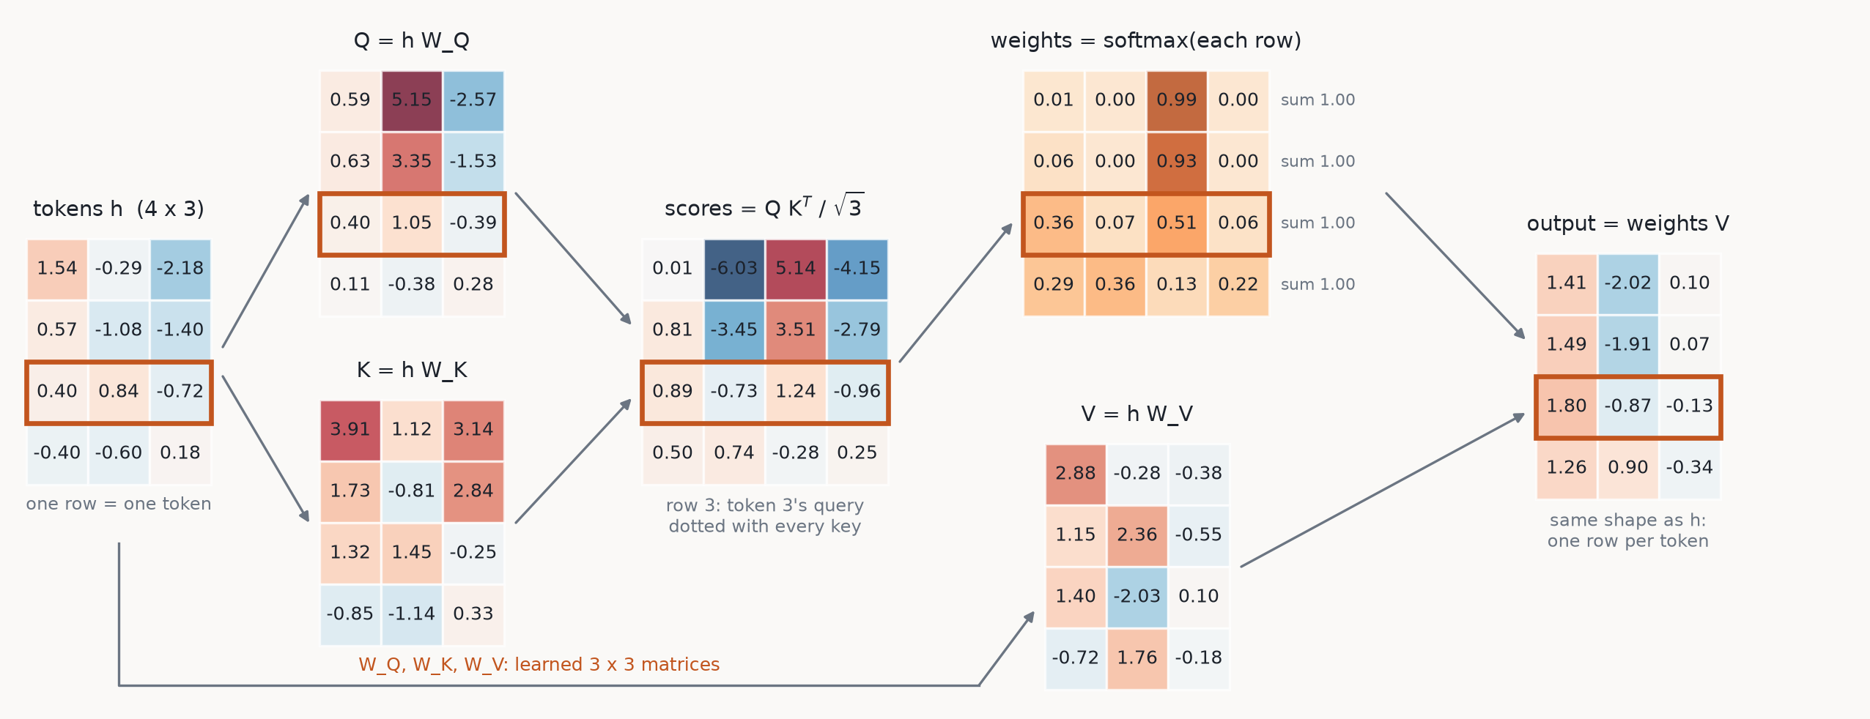
PART 2: ATTENTION (2/3)
The same formula, on 4 tokens of 3 numbers
Toy numbers: random tokens and random W_Q, W_K, W_V (seed 0). Token 3 (orange): output = 0.36 v1 + 0.07 v2 + 0.51 v3 + 0.06 v4 (v_j = row j of V). Each row of weights is different: every token decides for itself whom to listen to.

Slide 18
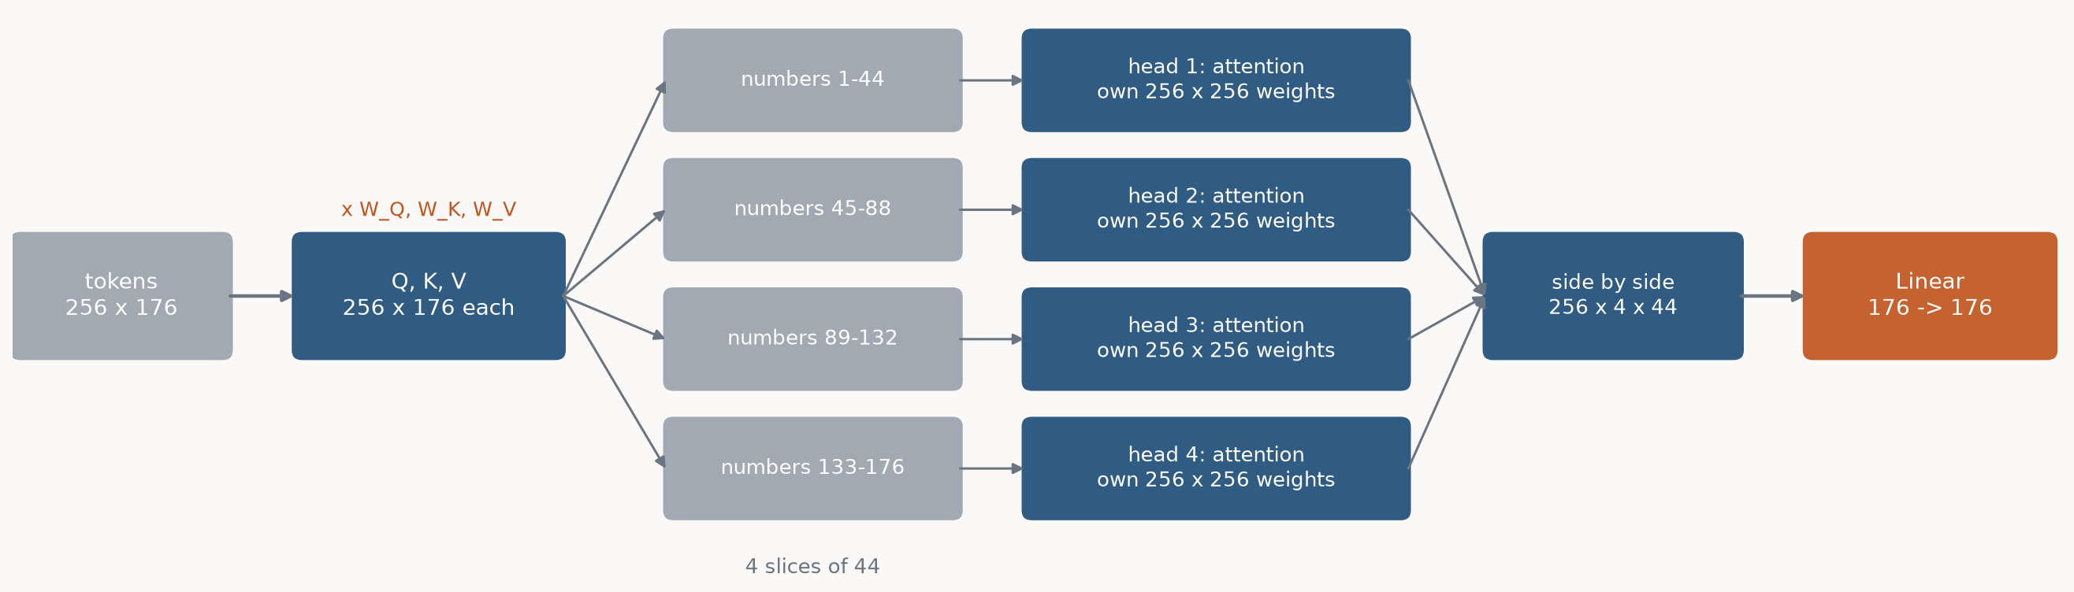
PART 2: ATTENTION (3/3)
Several heads, each with its own weights
Q, K and V are cut into 4 slices of 44 numbers. Each slice (a head) runs the formula on its own, so it gets its own 256 x 256 weights: one head can follow the stroke while another looks at the neighbours. The d in sqrt(d) is the slice size, 44. Same number of weights as one big head.
Cost: every head scores every pair of tokens, N x N. With our 256 tokens that is 65,536 scores per head per block. If every pixel were a token it would be 1,024 x 1,024 = 1,048,576. That is why the image is cut into 2 x 2 patches (next).

Slide 19
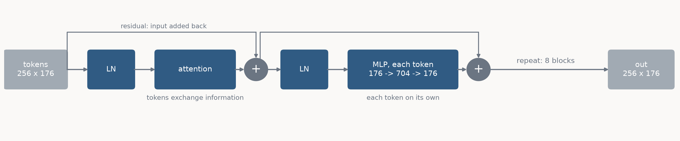
PART 2: THE MODEL
One transformer block: attention, then an MLP
LN (LayerNorm): rescales each token's 176 numbers to average 0, spread 1, so every block gets inputs in the same range.
Attention: the tokens exchange information (previous slides). MLP: two Linear layers with a GELU between them, applied to each token on its own, the same weights for all tokens.
Residual: each half's output is added onto its input, so a block only has to learn a change, and the gradient reaches early blocks directly.
Shape in = shape out, so blocks stack: the whole network is this block, repeated.

Slide 20
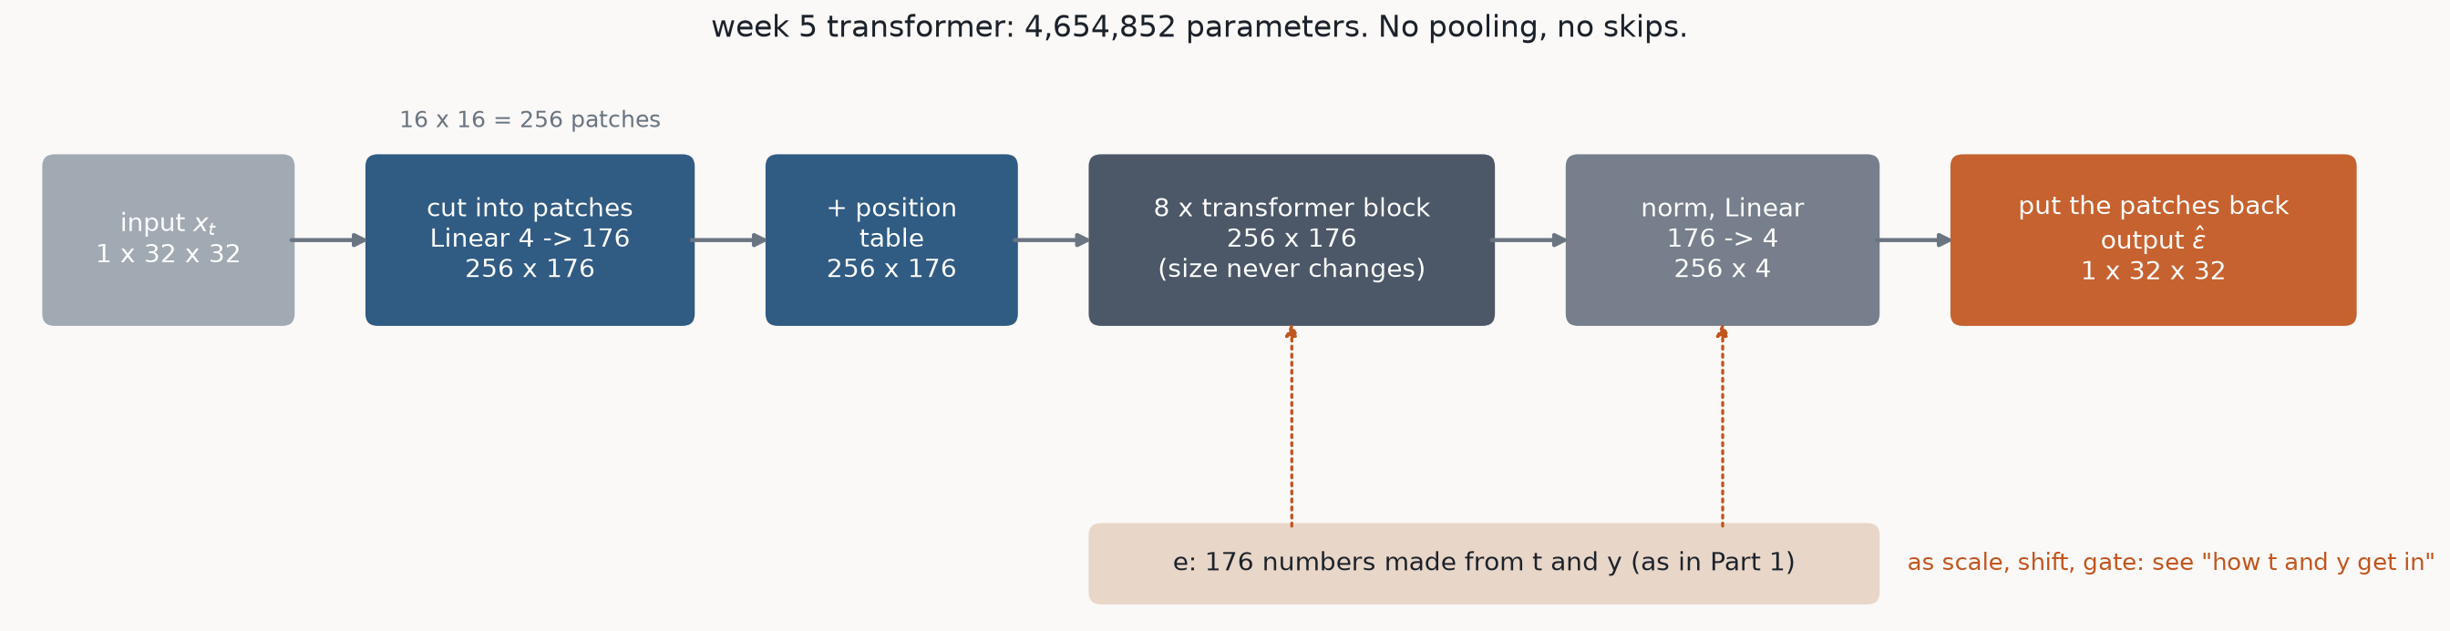
PART 2: THE MODEL
Tokens in, tokens out: the size never changes
The U-Net shrinks the image to 4 x 4 to see far, then grows it back with skips. The transformer keeps all 256 patches at full detail in every block; attention lets any patch use any other patch directly.

Slide 21
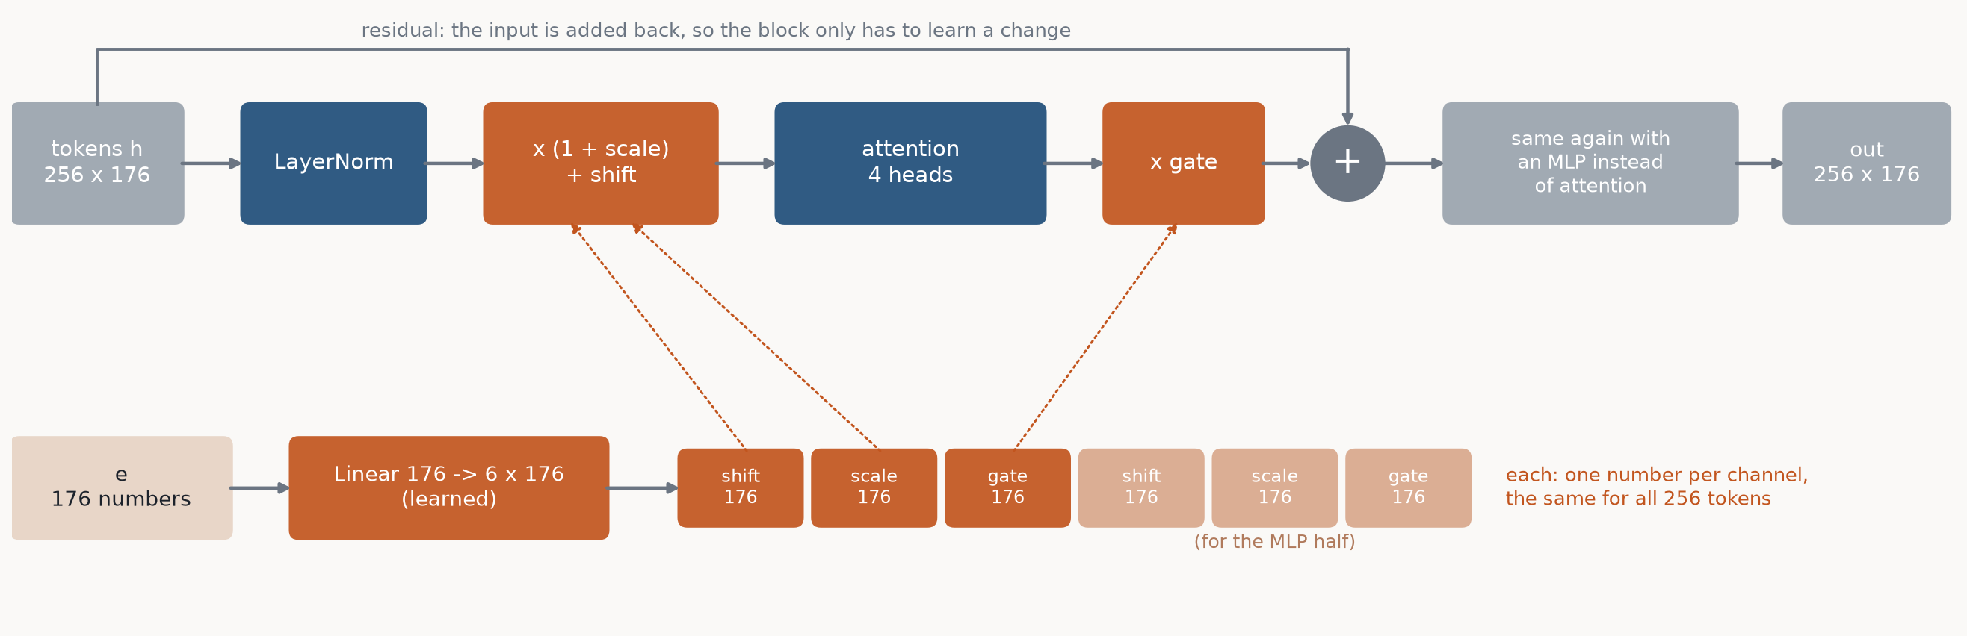
PART 2: HOW T AND Y GET IN
e scales, shifts and gates every block
The one change to the block on the previous slides. Circled dot: multiply number by number. shift, scale, gate: made from e by one learned Linear per block.
Part 1's U-Net block only ADDS e (a shift). Here e also scales, and gates how much each half changes the tokens. The gates start at 0, so every block starts as 'do nothing' and training switches it on. This is the DiT paper's recipe (Peebles & Xie, 2023), which beat adding e.

Slide 22
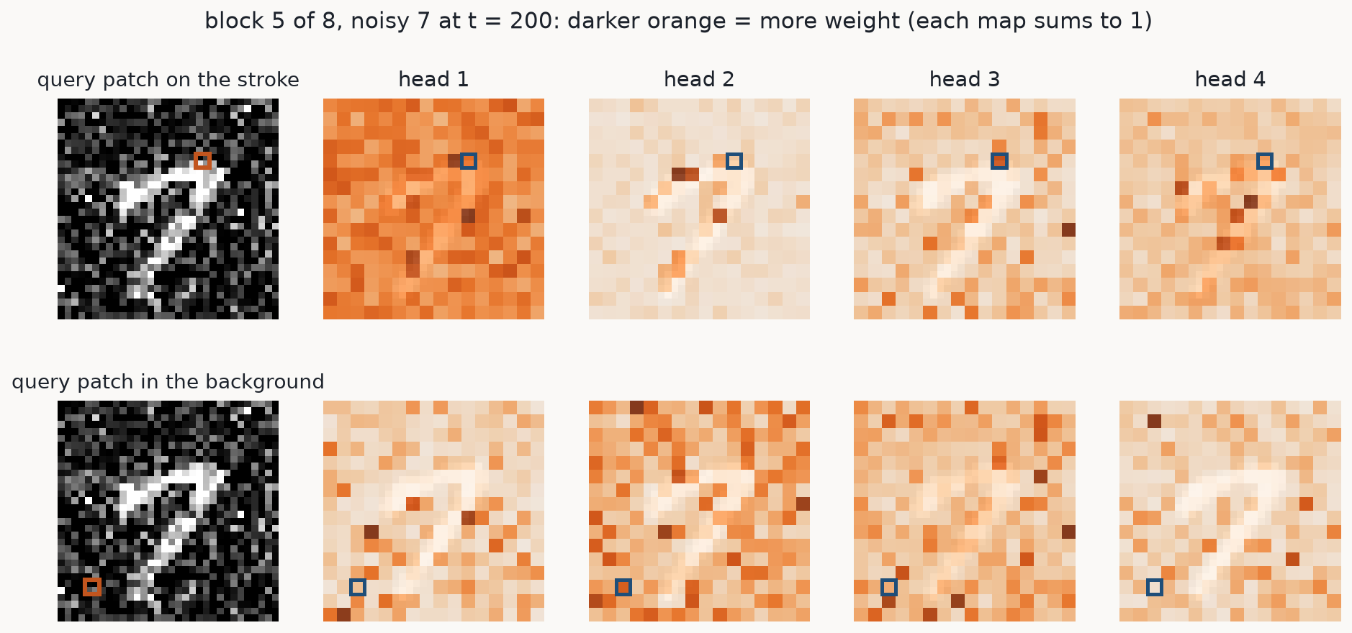
PART 2: ATTENTION IN THE TRAINED MODEL
Where one patch looks
Real attention weights from Part 2's checkpoint (after epoch 7). Left: the query patch (orange box). Right: how much weight it gives every patch, one map per head.

Slide 23
PART 2: THE COST
Same parameters, not the same compute
U-Net (Part 1)
transformer (Part 2)
parameters
4,586,449
4,654,852
compute per image, forward (GFLOPs)
0.65
1.53
seconds per training epoch (average)
96
414
minutes for 20 epochs
32
138 (projected)
GFLOPs: billions of multiplications and additions to process one image once, counted by PyTorch. Every transformer weight is used on all 256 tokens; the U-Net's widest layers only run on 4 x 4 = 16 positions. Attention is also slower per GFLOP than convolution on this Mac's GPU.

Slide 24
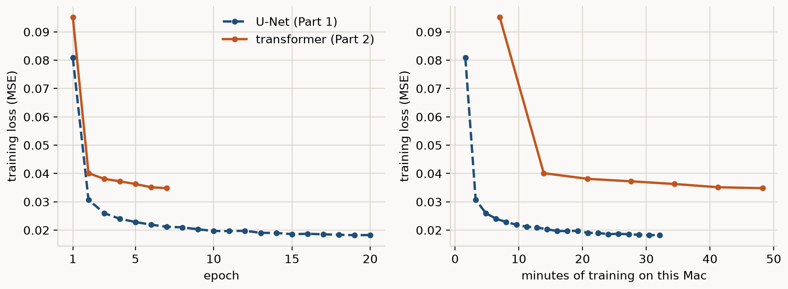
PART 2: RESULTS
Training loss: per epoch, and per minute
Transformer: 7 of 20 epochs so far (training still running), final loss 0.0348. U-Net: 20 epochs, final loss 0.0183. Same data, same loss, same recipe, so the numbers compare directly.

Slide 25
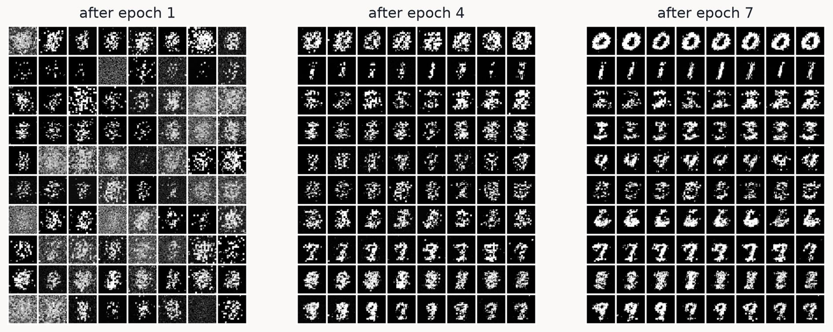
PART 2: RESULTS
The transformer's digits, epoch by epoch
Rows are digits 0-9, same starting noise after every epoch (50-step sampler with guidance w = 3).

Slide 26
PART 2: RESULTS
Same request, same seeds: U-Net vs transformer
Not run yet. The transformer's samples comes from:
python sample.py --run part2_transformer --sampler ddpm --guidance 1 --trajectory
Then rebuild the deck: python slides/build_slides.py

