Slide 1


CampusFix
Intelligent Facilities Management

Slide 2


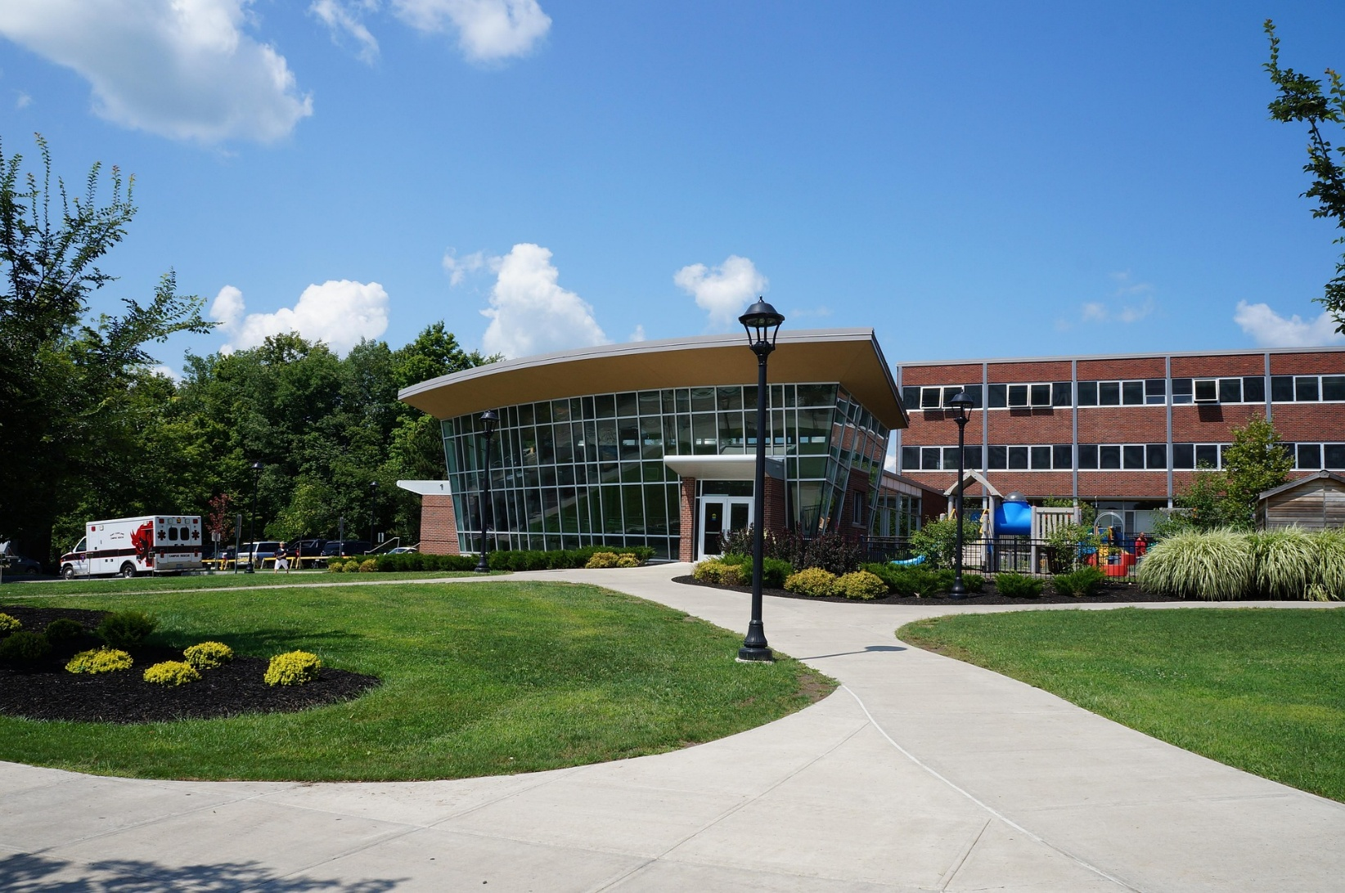
INTRODUCTION
CampusFix is a centralized, web-based facility maintenance management system designed to modernize how maintenance issues are reported, prioritized, and resolved. This project demonstrates the integration of database management, programming logic, web development, and project management skills.
The Team
Stanimir Todorov: Project Lead & Architect
Philip Polanco: Frontend Lead (Web Interface)
Mohamad Alkary: Backend Engineer (C++ Logic)
Kaleb Yang: Microservices Engineer (Java Notifications)

Slide 3
The Business Problem
The Situation:. Facilities departments receive 200–500 maintenance requests per week, overwhelming current manual processes.
The Pain Point: Requests are scattered across emails, phone calls, and handwritten notes, causing lost tickets and delayed responses.
The Critical Failure: There is no automated prioritization, meaning emergency issues compete with minor repairs.
Result: Increased safety risks, poor accountability, and slow service delivery.

Slide 4
The Solution
Mohamad and Kaleb
The Ecosystem:
A polyglot system (different components build using different technologies, programming languages, databases choosing the best that fits)centered around a shared MySQL Database.
1. Web Portal (HTML + PHP): Allows students to submit digital tickets instantly.
2. Priority Engine (C++): A background logic engine that automatically calculates urgency scores (Severity x Criticality).
3. Watchdog Service (Java): A standalone microservice that monitors the database 24/7.
Key Benefit: This creates a safety net. Even if the web server is busy, the Java Watchdog detects emergencies immediately.

Slide 5
Technology Architecture
Project Management: Framework - Hybrid Agile/Waterfall methodology with GitHub version control, MS Project planning (Gantt Charts), Teams.
Frontend Layer: HTML5, CSS3, Bootstrap 5. Responsive interface optimized for mobile ticket submission.
Backend Layer: PHP 8.2 (XAMPP environment). Handles ticket processing, validation, and system integration.
Advanced Logic Services: C++ priority algorithms for request ranking. Java notification services for automated alerts.
Database Layer: MySQL 8.0. Structured ticket storage and reporting.
Architecture designed for scalability, reliability, and future campus-wide deployment.

Slide 6
Project Timeline
Stan
Phase 1 (Planning): Complete. The system architecture is approved and the repository is live.
Phase 2 (Core Development): In Progress. We are currently building the middleware to connect the Web Frontend to the Database.
Phase 3 (Testing): Scheduled for early March.
Status: The project is on track for the Beta Release on March 13.

Slide 7
Next Steps & Roles
Stan
Milestone 2 Target: Functional Beta Version.
Team Assignments:
Philip: Finalize Dashboard UI and Form Validation.
Stanimir: Implement PHP Database connectivity and Security.
Mohamad: Finalize the C++ priority sorting algorithm.
Kaleb: Implement and test the Java Watchdog polling loop.
Documentation: Detailed task plans are available on our GitHub repository.

Slide 8
THANKS FOR YOUR ATTENTION!

