Slide 1
Data Modeling for Bank Telemarketing

Slide 2
AGENDA
1
2
3
4
5
BUSINESS UNDERSTANDING
DATA UNDERSTANDING
MODELING
EVALUATION &
DEPLOYMENT
DATA PREPARATION

Slide 3
01
BUSINESS
UNDERSTANDING

Slide 4
Business Understanding
Background
Problem
Solution
A Portuguese banking institution is using direct marketing campaigns to promote a bank term deposit product to potential clients
The telemarketing campaigns are based on phone calls
Facing challenges to increase the effectiveness of its direct marketing campaigns and increase the number of successful subscriptions to the banks term deposit product
Improve the efficiency and effectiveness of its direct marketing efforts by leveraging data mining techniques to gain insights into the factors that influence the success of its marketing campaigns
Predict if a customer will subscribe the bank term deposit product

Slide 5
02
DATA UNDERSTANDING

Slide 6
Data Exploration
The Bank Marketing Dataset
Related to direct marketing campaigns (phone calls) of a Portuguese Bank
41,188 observations on 10 categorical variables and 10 numerical variables
Target Variable - Term Deposit (Binary: Yes / No)
Only 11.27% out of 41,188 customers subscribe to the bank term deposit
Key Features
Job - Client’s occupation (Categorical)
Education - Client’s education level (Categorical)
Loan(personal) - Does the client have a personal loan? (Categorical)
Cons.price.idx - Consumer price index - monthly indicator (Numeric)
Euribor3m - Euribor 3 month rate - daily indicator (Numeric)
Source: UCI Machine Learning Library

Slide 7
03
DATA PREPARATION
Notes:
- Data Transformation/Cleaning
- Data Leakage

Slide 8
DATA PREPARATION
Dropping Variables with Data Leakage
Duration - Call duration is not known before making the call
Campaign - Number of contacts in the current campaign is not known before the campaign
Feature Engineering
Pdays - Convert it into a binary variable (IsContact) by assigning 1 to customers that were contacted before
Education - Combine four categories as “below_high_school” category
Month - Combine different months into quarters

Slide 9
DATA PREPARATION
Creating Dummy Variables
Convert Data Types from Object type to Categorical type
10 categorical variables result in 52 dummy variable columns in total
Handling Imbalanced Dataset
Imbalanced dataset with 11.26% YES & 88.74% NO in target variable
Oversample: Duplicate records from the minority class leading to a ratio of 2/3 (40% YES 60% NO)

Slide 10
04
MODELING

Slide 11
Modeling
Try different models:
  Decision Tree, Random Forest, Neural Network, GBM, XGBoost
Try with original data and oversampled data
Use grid search for hyperparameter tuning
Try stacking with different base models above

Slide 12
Pros and Cons of Models
 | Decision Tree | Random Forest | Neural Network | GBM | XGBoost
Pros | High Interpretability Handle numerical and categorical data | Work well with large datasets Handle numerical and categorical data | Handle complex relationships Work well with large datasets | Robust to outliers Works well with large datasets | Built-in regularization Works well with large datasets
Cons | Not suitable for large datasets | Low computing efficiency | Low Interpretability | Requires careful tuning | Low computing efficiency
Feature Importance Criteria | Information Gain Gini Index | Mean Decrease Impurity Mean Decrease Accuracy | Sensitivity analysis Weight Importance | Feature Contribution Gini Importance | Gain Importance Cover Importance

Slide 13
Hyper-parameter tuning
 | Decision Tree | Random Forest | Neural Network | GBM | XGBoost
Tuned parameters | Max depth Criterion Min samples split max leaf nodes | Max depth Criterion Min samples split | Activation function Batch size Epochs Early stopping Dropout Optimizers | N estimators Learning rate Max depth | N estimators Learning rate Max depth

Slide 14
05
EVALUATION & DEPLOYMENT

Slide 15
Models Comparison
 | Before Oversampling |  |  | After Oversampling
Models | Accuracy | F1-Score | AUC | Accuracy | F1-Score | AUC
Decision Tree | 90.12% | 0.39 | 0.78 | 77.75% | 0.68 | 0.79
Random Forest | 90.20% | 0.35 | 0.80 | 94.03% | 0.93 | 0.98
Neural Network | 90.18% | 0.34 | 0.79 | 79.81% | 0.72 | 0.86
GBM | 90.12% | 0.35 | 0.80 | 79.90% | 0.72 | 0.86
XGBoost | 90.10% | 0.38 | 0.79 | 93.76% | 0.93 | 0.97

Slide 16
Models Comparison (Stacking)
 | Before Oversampling |  |  | After Oversampling
Base Models | Random Forest + Neural Network + GBM |  |  | Random Forest + XGBoost
Accuracy | 90.19% |  |  | 94.03%
AUC | 0.63 |  |  | 0.96

Slide 17
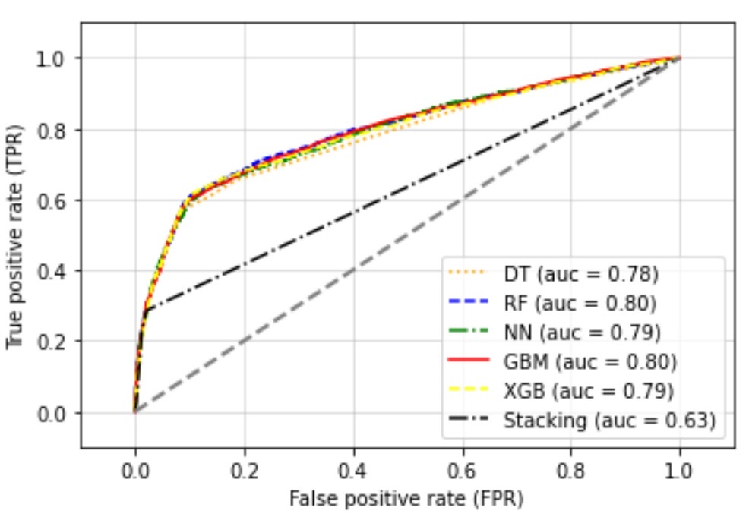
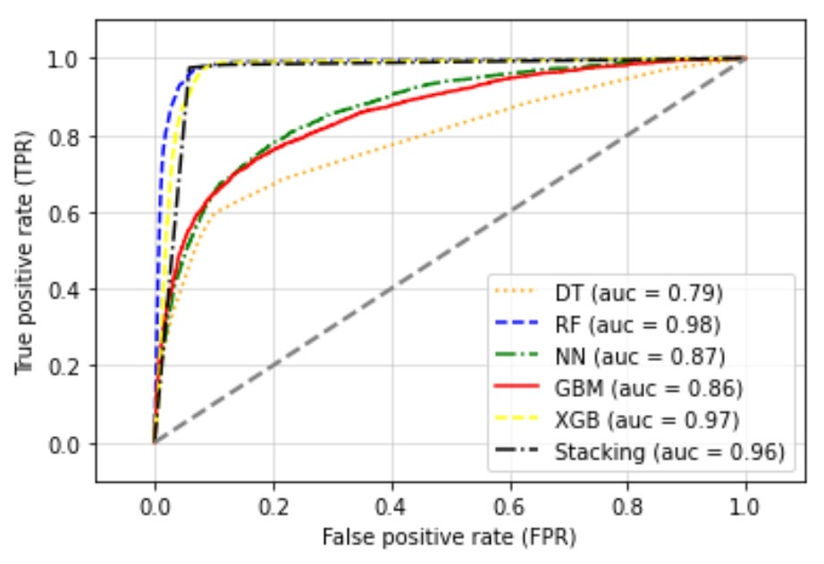
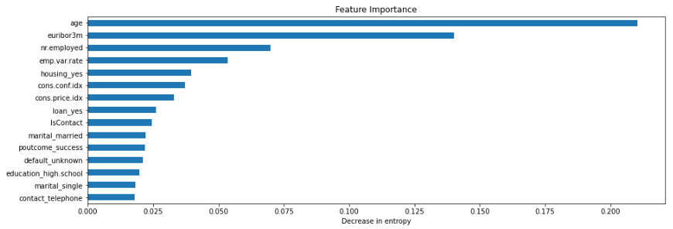
FINAL EVALUATION
Before Oversampling
After Oversampling
The higher AUC is, the better model predicts whether a customer will subscribe a deposit term in the bank
Random Forest after oversampling is the best performing model based on AUC, Accuracy, and F1 Score

Slide 18
COST-BENEFIT Analysis for the Best Model
Cost-Benefit Matrix
Confusion Matrix (for Random Forest optimized parameters)
Expected Value: ($200)*(39.16%)+($-20)*( 5.14%)+0+0=$77.29
 | Actual Positive | Actual Negative
Predicted Positive | 200 | -20
Predicted Negative | 0 | 0
 | Actual Positive | Actual Negative
Predicted Positive | 7157 (39.16%) | 939 (5.14%)
Predicted Negative | 152 (0.83%) | 10026 (54.86%)

Slide 19
MODEL DEPLOYMENT
Ways of Deploying Our Models
Integration with marketing campaign management system
Development of a recommendation engine
Potential Issues of Deploying Our Models
Integration with existing systems
Model accuracy
Bias and fairness
Mitigation of Risks
Integration risk - work closely with IT to develop custom integration solutions
Model Accuracy risk - regularly monitor the model accuracy and make updates
Bias and fairness risk - careful selection of training data and feature
Notes:
- allowing the model to automatically identify the clients who are most likely to subscribe to the bank term deposit and target them with personalized marketing messages.
using the predictive model to suggest personalized marketing messages to clients based on their predicted likelihood of subscribing to the bank term deposit.

Slide 20
QUESTIONS?
THANK YOU.

Slide 21
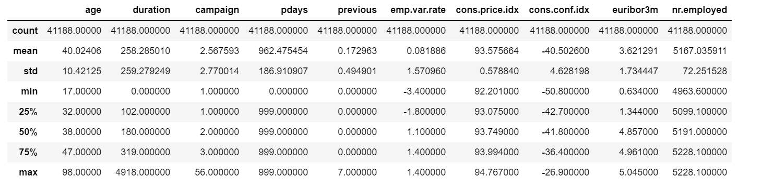
Appendix

Slide 22
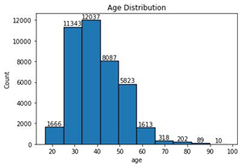
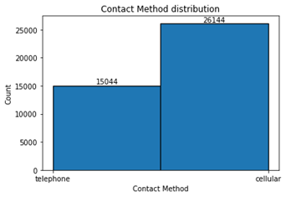
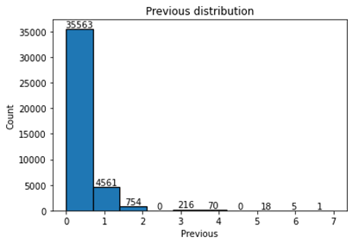
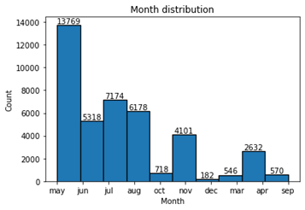
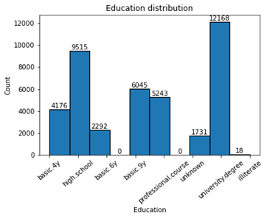
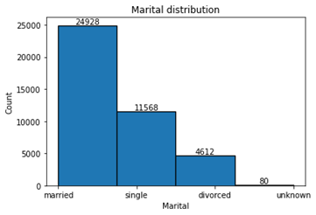
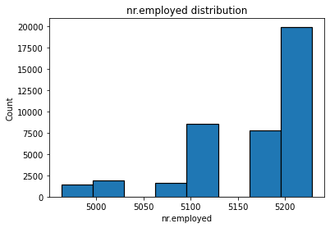
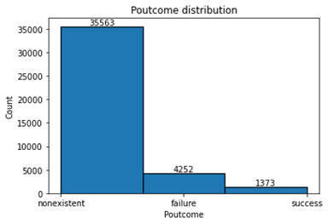
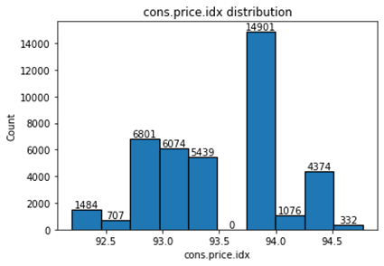
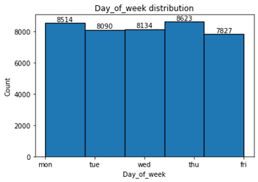
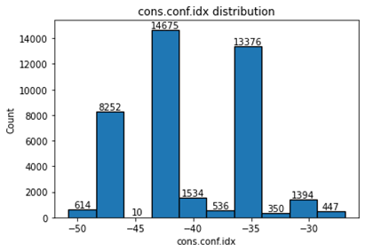
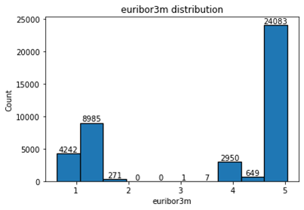
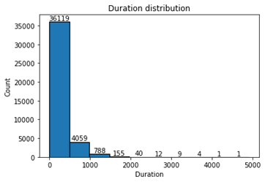
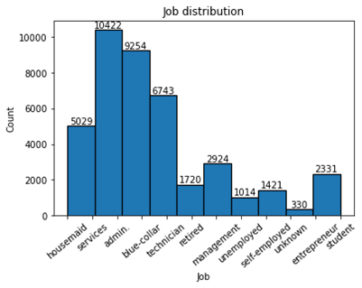
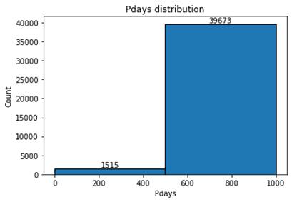
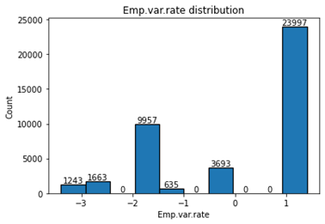
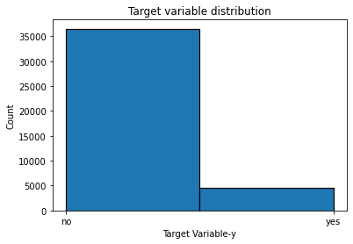
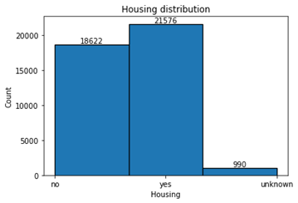
Appendix

