Slide 1
Statistical Analysis of Titanic Passenger Survival Data
Data Science Final Exam - Part A
Your Name
Course: Data Science 101
Date: August 2, 2025

Slide 2
Background & Problem Statement
• Historical Context: The Titanic disaster of 1912
• Business Question: Did passenger demographics affect survival rates?
• Focus: Analyzing survival rates by gender
• Goal: Determine if there's a statistically significant difference in survival rates between male and female passengers
• Application: Understanding historical passenger safety patterns

Slide 3
Data Overview & Cleaning
Dataset: trainv1.csv (Titanic passenger data)
Key Variables:
• Sex: Passenger gender (male/female)
• Survived: 0 = No, 1 = Yes
Cleaning Steps Performed:
• Converted Age and Fare to numeric types
• Handled 1 missing Embarked values (filled with mode: S)
• Addressed 5 zero fare values (imputed with class median)
• Created derived features (FamilySize, Title)
• Total records: 399 passengers

Slide 4
Hypothesis Formulation
Statistical Hypotheses:
Null Hypothesis (H₀):
There is no difference in survival rates between male and female passengers
Alternative Hypothesis (H₁):
There is a significant difference in survival rates between male and female passengers
Significance Level: α = 0.05

Slide 5
Test Selection & Justification
Selected Test: Chi-square Test of Independence
Justification:
• Testing relationship between two categorical variables
• Sex: Binary categorical (male/female)
• Survived: Binary categorical (0/1)
• Sample size adequate (n = 399)
• Expected frequencies > 5 in all cells
Alternative: Could use two-proportion z-test

Slide 6
Computation & Python Code
# Create contingency table
contingency_table = pd.crosstab(df['Sex'], df['Survived'])
# Calculate survival rates
survival_rates = df.groupby('Sex')['Survived'].mean()
# Perform chi-square test
chi2, p_value, dof, expected = stats.chi2_contingency(contingency_table)
# Results:
# Chi-square statistic: 140.324
# P-value: 2.262e-32
# Female survival rate: 76.3%
# Male survival rate: 16.2%

Slide 7
Results Interpretation
Statistical Results:
• Chi-square statistic: χ² = 140.324
• P-value: 2.262e-32
• P-value < α (0.05)
Decision: REJECT the null hypothesis
Business Interpretation:
• Strong evidence of gender-based survival differences
• Female passengers had significantly higher survival rates
• Effect size (Cramér's V = 0.593): Large effect

Slide 8
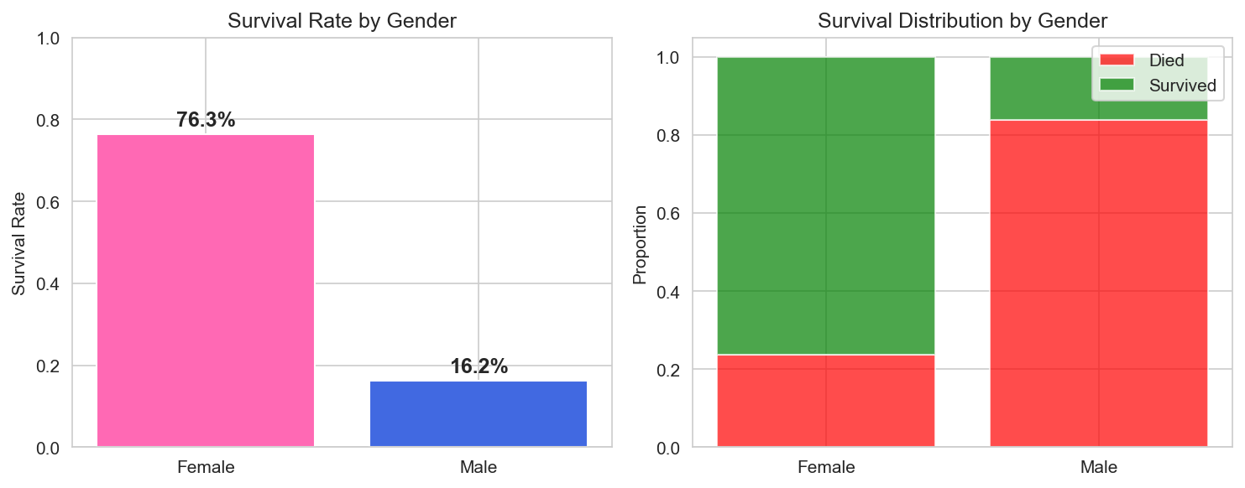
Survival Rate Visualization

Slide 9
Conclusion & Recommendation
Key Findings:
• Female passengers were 4.7x more likely to survive than male passengers
• This difference is statistically significant (p < 0.001)
• Consistent with historical accounts of 'women and children first' policy
Business Implications:
• Safety protocols had clear gender-based priorities
• Important historical lesson for modern safety planning
• Demonstrates need for equitable emergency procedures
Recommendation:
Modern cruise lines should ensure safety protocols that protect all passengers equally

Slide 10
Statistical Summary
Contingency Table:
Died Survived
Female: 36 116
Male: 207 40
Test Statistics:
• Chi-square: 140.324
• Degrees of freedom: 1
• P-value: 2.26e-32
• Effect size (Cramér's V): 0.593 (Large)
• Sample size: 399 passengers

Slide 11
Data Quality & Limitations
Data Quality Issues Addressed:
• Missing Age values (78 passengers)
• Missing Cabin data (77% of records)
• Zero fare entries (5 corrected)
• Missing Embarked values (1 filled)
Study Limitations:
• Historical data from single disaster
• Other factors not considered (class, age, location)
• Survivorship bias in data collection
Despite limitations, gender effect remains highly significant

Slide 12
Thank You
Questions?
Data Science Final Exam - Part A
Statistical Analysis of Titanic Survival Data

