Slide 1


Graphics Pipeline

Slide 2


Why do you care?
Either:
You want to be a graphics programmer.
You want to work with graphics programmers.

Slide 3

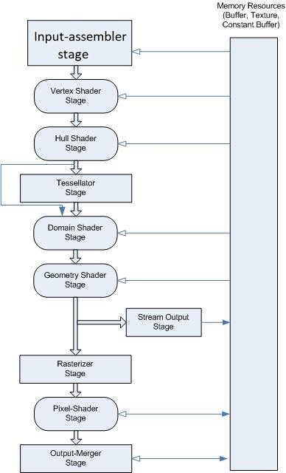
Abstract Pipeline
Fixed-Function Stages
Input Assembly
Tessellator
Rasterizer
Output-Merger
Programmable Stages
Shaders

Slide 4
Shaders
SIMT Programming Model
“Single Instruction Multiple Threads”
SIMD + Multithreading (sort of)
Execution Masking
“Waves”

Slide 5
Fragment Shaders & Texture Sampling
Problem: 2D Images demonstrate aliasing when downscaled.
Solution: Prefiltered mipmaps
Problem: How to pick mipmap level?
Solution: Local footprint of texture coordinates
Problem: How to compute footprint?
Solution: Quad derivatives
All fragment shading must run in 2x2 sample quads.

Slide 6
Early-Z
Officially, depth testing (Z-test) happens after fragment shading.
But fragment shading is expensive.
What if we could cheat?
Follow the rules:
No side effects.
No depth write modification.
Occurs immediately before fragment shading.

Slide 7
Reference / Recommendation
“A Trip Through The Graphics Pipeline”, Fabian Giesen
https://fgiesen.wordpress.com/2011/07/09/a-trip-through-the-graphics-pipeline-2011-index/
Deep dive into the real nitty-gritty (from a software perspective) of the GPU pipeline.
https://learn.microsoft.com/en-us/windows/win32/direct3d11/overviews-direct3d-11-graphics-pipeline
D3D11 Graphics Pipeline Overview

Slide 8
Questions / Discussion

