Slide 1
OPEN AGENT HACKATHON 2026 / TRACK 01
ReplyFlow
A SINGLE AI AGENT SERVING MULTIPLE BUSINESSES
CamTech Electronics
Autonomous AI customer operations
for modern businesses.
Retail • stock and price questions
Every customer deserves a reply.
DouaTech Solution Sarl
B2B services • scoping and leads
From public comments to qualified conversations—
with business-grounded answers and human escalation.
Designed & engineered by Douatech Solution
Stephen Njong • Founder / Lead Architect
A coordinated operations layer—not another chatbot.
01/08

Slide 2
02 / THE BUSINESS PROBLEM
The expensive part isn’t the inbox. It’s what slips through it.
Companies pay for people to watch channels—yet customers still wait, leads get buried, and public complaints linger.
THE SPARK: A REAL CUSTOMER FAILURE
01 / COST WITHOUT COVERAGE
02 / LEADS BURIED IN NOISE
48 hours!
No useful answer.
Human attention doesn’t scale
Every comment is not a lead
Teams are expected to monitor multiple channels, answer repeat questions, and chase internal data.
Campaigns mix emoji hype, genuine questions, complaints, and buying signals in the same feed.
I reported a SIM-related issue through a telecom provider’s WhatsApp support. The AI replied off-topic; I asked for an Ai to connect me with real staff and I got a repeated response. Two days later, the case was still unresolved. A second support ticket elsewhere also took over two days and I had to use my network to solve the issue..
03 / SLOW ANSWERS LOSE INTENT
04 / CONTEXT IS FRAGMENTED
Late can mean lost
The answer lives elsewhere
A prospect may choose a competitor before a human response arrives.
Stock may be in a warehouse sheet; service scope in a PDF; the conversation in a DM.
THE TARGET CUSTOMER
The insight: this isn’t only a model problem. It’s an operations problem.
Mid-market and enterprise teams with high-volume support, sales, and social channels—especially retail and B2B services.
REPLYFLOW • OPEN AGENT HACKATHON 2026
02/08

Slide 3
03 / WHY REPLYFLOW
ReplyFlow turns scattered messages into managed outcomes.
An AI operations layer that understands the request, grounds the answer, and knows when a human should take over.
01
02
03
04
05
CONNECT
›
TRIAGE
›
GROUND
›
GOVERN
›
ACT
WhatsApp, social
comments, web chat
Drop noise; detect
intent and urgency
Check approved business
catalogs and policies
Apply tenant rules;
flag risk and uncertainty
Reply, route privately,
or escalate to staff
FOR CUSTOMERS
FOR REVENUE TEAMS
FOR OPERATIONS
Relevant answers
Recover intent
Human control
Use business-approved information instead of generic, off-context replies.
Separate prospects from noise and carry promising conversations into a traceable inbox.
Escalation and staff takeover are already visible in the product UI.
Why it matters: automate the routine work; preserve human judgment for the exceptions
REPLYFLOW • OPEN AGENT HACKATHON 2026
03/08

Slide 4
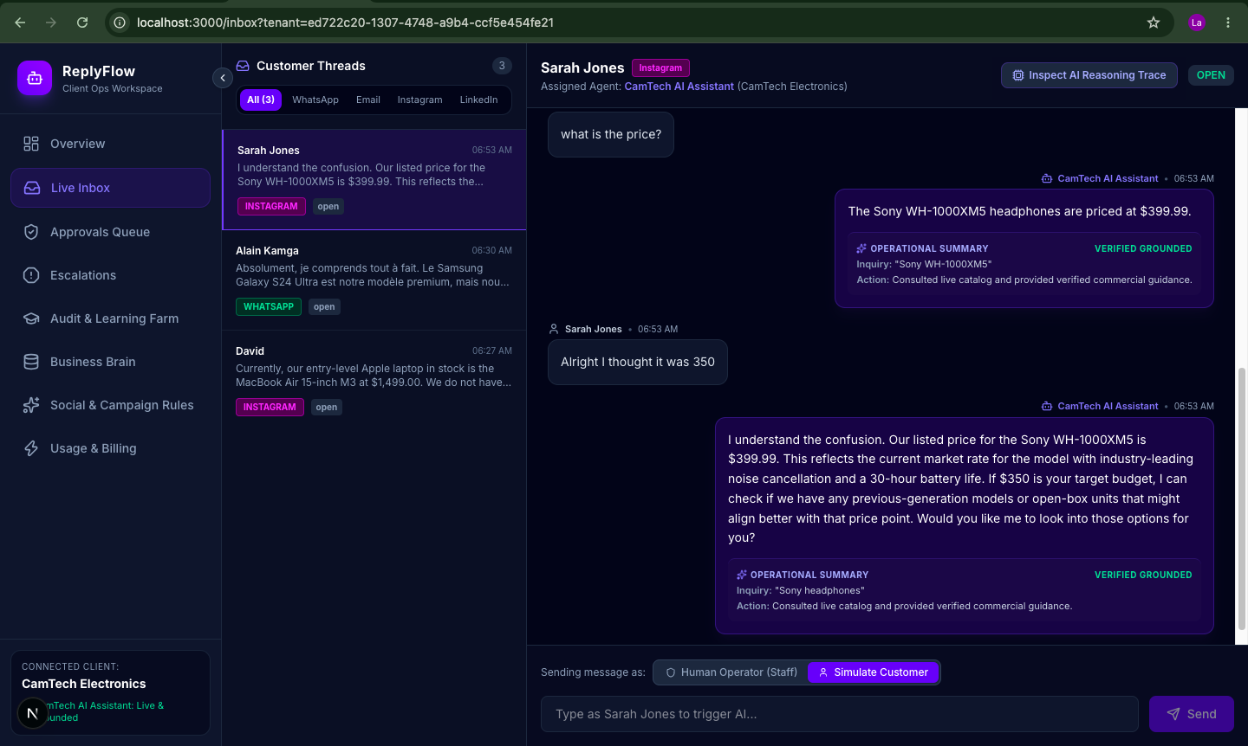
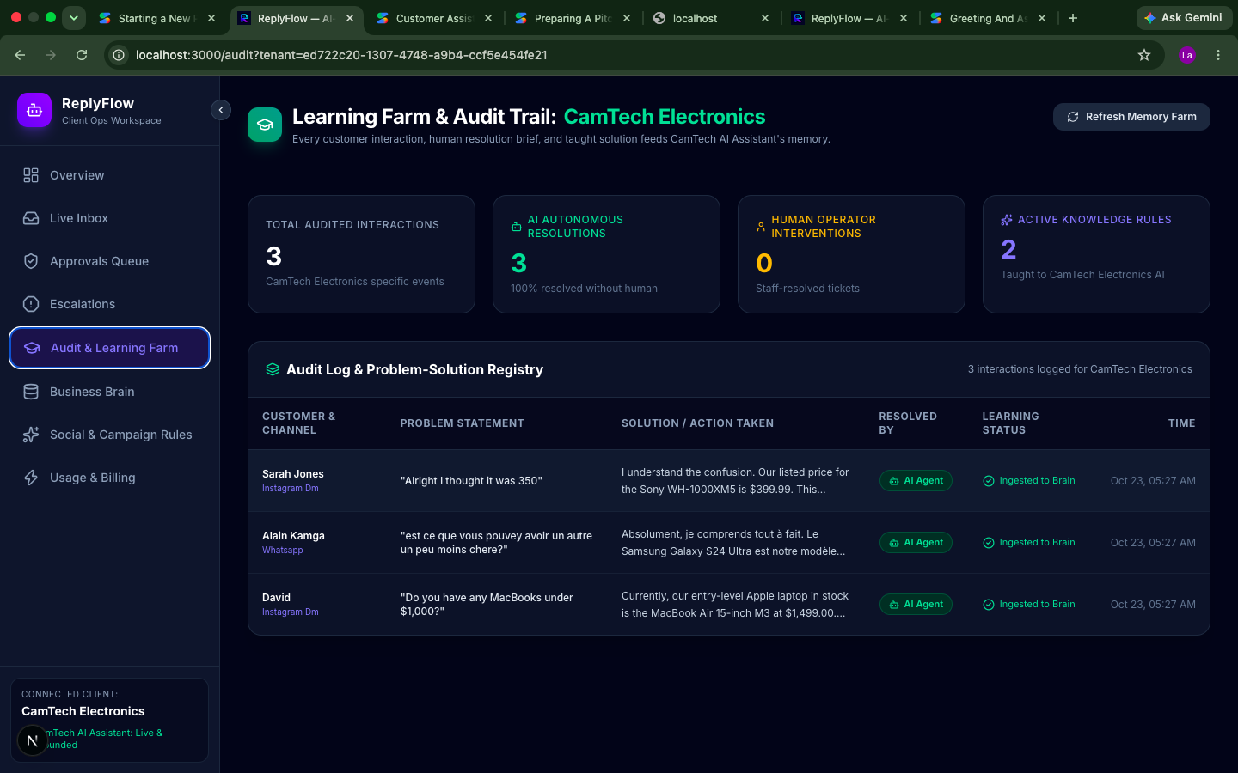
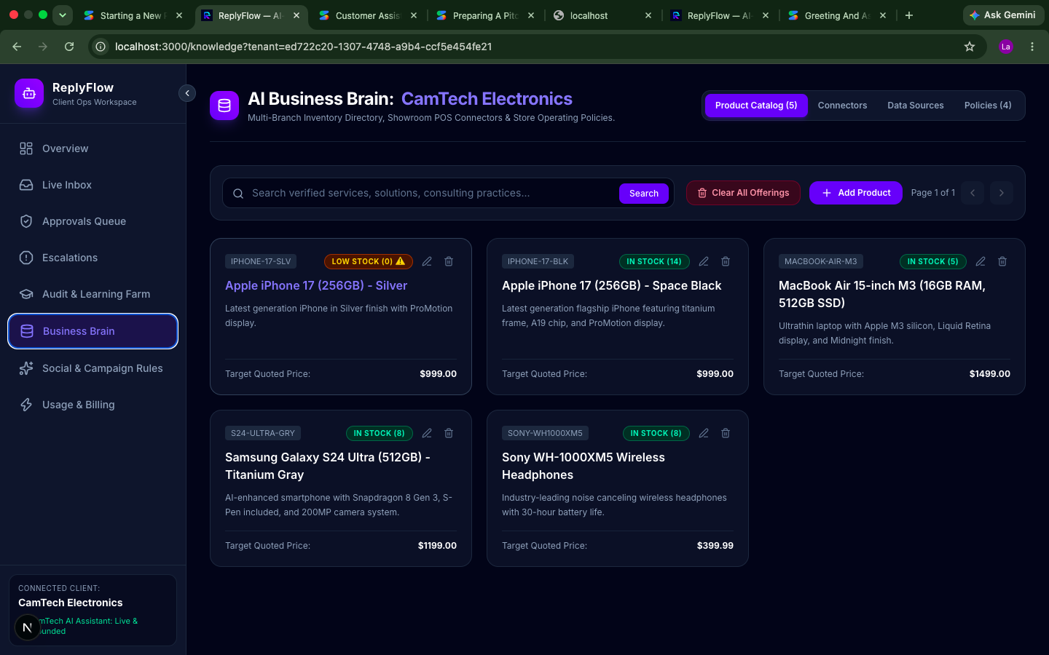
04 / PRODUCT PROOF
The product is visible: inbox, business context, and an audit trail.
Current UI evidence from the ReplyFlow workspace—not mockups of a future interface.
AUDIT & LEARNING FARM
LIVE INBOX
Channel-tagged threads, grounded AI replies, and human/operator controls.
BUSINESS BRAIN / VERIFIED CATALOG
REPLYFLOW • OPEN AGENT HACKATHON 2026
04/08

Slide 5
05 / AGENT WORKFLOW & TECHNICAL STACK
A governed workflow—not a single prompt.
The agent moves through explicit steps before a message or action leaves the system.
OMNICHANNEL GATEWAY
Inbound messages / comments • webhook ingress
TECHNICAL FOUNDATION
↓
API & orchestration
TENANT RESOLUTION
Business UUID context • PostgreSQL tenant scoping
Python 3.13 • FastAPI • LangGraph
Client portals
Next.js 16
↓
Persistence & isolation
LANGGRAPH AGENT PIPELINE
Intent → retrieve data → policy gate → response/action
PostgreSQL 16 • tenant-scoped queries / RLS
Business grounding
↓
Zetaris MCP data-fabric connector
DISPATCH OR ESCALATE
Send reply / route to private thread / staff takeover
Governance
Policy gate + human escalation
Usage controls
Meterless quota service integration scaffold
Key design principle: tenant context and policy checks must travel with the conversation.
REPLYFLOW • OPEN AGENT HACKATHON 2026
05/08

Slide 6
06 / SPONSOR TECHNOLOGY
Grounded data + governed autonomy.
Clear separation between integrated components and components still awaiting workshop credentials.
DATA FABRIC • INTEGRATED
TOKEN GOVERNANCE • SCAFFOLDED
Zetaris
Meterless
MCP-connected data access layer intended to query fragmented business sources without copying them into a new central store. Value: answers grounded in operational data.
Quota service and LLM-provider hooks are present; workshop credentials are still required to validate live metering end-to-end.
SAFETY • SCAFFOLDED
DEVELOPMENT TOOL • ACTIVE
NVIDIA
Cursor
Policy-gate integration points are present; live NIM / NeMo Guardrails behavior must be validated once the workshop key is available.
Partially used to accelerate full-stack implementation across FastAPI, Next.js, and database migrations; Continues with other tools when i ran out of credit.
Unique use: combine business-data grounding with per-tenant cost governance and a policy-controlled path to human review.
REPLYFLOW • OPEN AGENT HACKATHON 2026
06/08

Slide 7
07 / BUSINESS MODEL & DEPLOYMENT
Monetize recovered capacity—not AI replies
Initial wedge: two contrasting client workflows already represented in the product UI.
SAAS MODEL
PILOT PLAN: MEASURE BEFORE SCALING (Testing Clients)
Subscription by
business + usage tier
PILOT A • RETAIL
PILOT B • B2B SERVICES
CamTech Electronics
DouaTech Solution
Track stock/price accuracy, response time, qualified product inquiries, and escalation rate.
Track lead capture, service-scoping quality, discovery-call conversion, and staff time saved.
Proposed Pricing for now: $29–$499/month across four tiers.
COST CONTROL LEVERS
UNIT ECONOMICS HYPOTHESIS
Filter obvious noise before LLM calls
Bound usage per tenant
Escalate exceptions instead of automating everything
Reuse one platform across client workspaces
Revenue per tenant − model/API cost − messaging cost − support cost = contribution margin.
Pilot gates: validate channel reliability, data accuracy, safe escalation, cost per resolved interaction, and willingness to pay.
No claims on savings or ROI percentages until measured in pilot deployments.
REPLYFLOW • OPEN AGENT HACKATHON 2026
07/08

Slide 8
08 / WHY NOW • WHY US • WHY THIS SHOULD WIN
AI adoption is accelerating. Trustworthy execution is the gap.
ReplyFlow’s case is specific: a real founder pain, a customer-operations background, and a working product surface.
WHY NOW
WHY ME / WHY US
WHY REPLYFLOW SHOULD WIN
AI needs operations
Built from the frontline
A complete operating loop
Businesses are adding AI to customer-facing work—but generic answers without business context can create more friction.
Founder Stephen Njong brings 4+ years across frontline and back-office customer experience.
Triage → grounded data → policy check → action or human handoff, shown across retail and B2B client workspaces.
NEXT: PROVE IT IN REAL OPERATIONS
NOW
NEXT
THEN
Commercial pilots
Production monitoring
Regional expansion
CamTech + DouaTech
Reliability, accuracy, cost per resolution
More channels, clients, and business systems
ReplyFlow doesn’t promise that AI replaces every agent. It promises that fewer customers are lost in the gaps—and that people keep control when it matters.
REPLYFLOW • OPEN AGENT HACKATHON 2026
08/08

