Slide 1

Multimodal Demand Forecasting
Hybrid CNN-GRU, NLP and Computer Vision Fusion with Retrieval-Based Explanation
Soham Chatterjee
Avrrodeep Banerjee
Roll number: 2328128
Roll number: 2328158
Debarshi Karmakar
Supratik Maity
Roll number: 2328164
Roll number: 2328226
Guide: Dr. Bhaswati Sahoo · KIIT Deemed to be University, School of Computer Engineering, Bhubaneswar

Slide 2


The Problem
What's Missing in Today's Forecasting
⏱ 3-Day Lag
📸 Visual Early Warning
Demand forecasts rely on sales data alone — but reviews and product images signal shifts before sales move.
Reviews arrive 3 days after purchase — ahead of the sales dip
Images show quality degradation before any drop appears in sales figures
Sales-only models are always looking in the rearview mirror.
Unstructured Inputs
Missing Modalities
No Controlled Comparison
Text and images cannot be fed directly into classical forecasters
Any input may be absent; the system must still produce a forecast
No evidence on whether staged or joint fusion performs better

Slide 3





Objectives and Contributions
14-Day Forecast Per Product
Controlled Fusion Comparison
Leak-Free Evaluation
Control dataset confirms no information leakage from future data
Unified forecast from sales history, review text, and product images
Staged vs. joint fusion evaluated on identical data under the same conditions
Graceful Missing-Input Handling
Retrieval-Based Explanation
System remains operational when any modality is absent
Each forecast is backed by retrieved reviews for interpretability

Slide 4
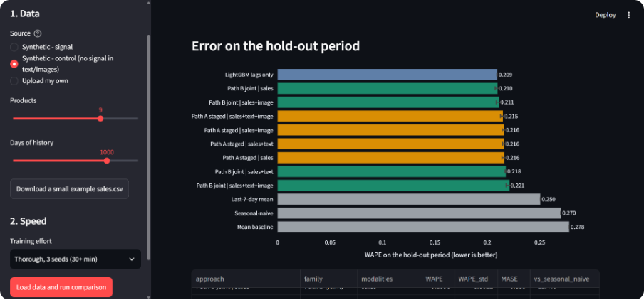
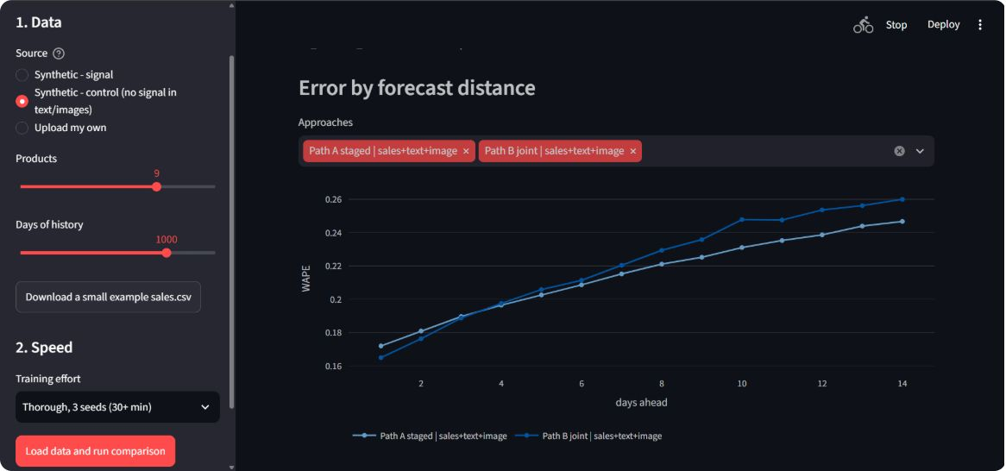
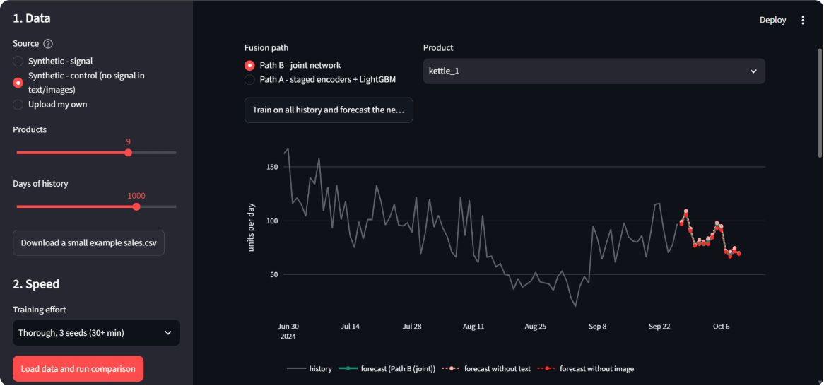
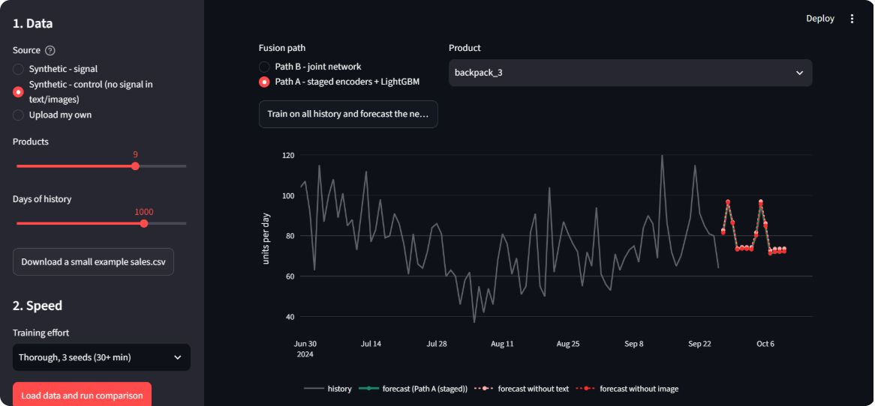
Working Application, Sample Run and Testing
Streamlit app: sidebar plus tabs Data check, Comparison, Forecast and explanation
Control data, 9 products, 1000 days: LightGBM 0.209, joint on sales 0.210, staged 0.215 to 0.216, joint all inputs 0.221, seasonal-naive 0.270
31 automated tests pass in two environments (122 s and 129 s)
Full benchmark on two-core CPU: 5.2 min (1 seed), 8.6 min (3 seeds)
Hold-out error ranking (Fig 4.9)
Path A vs Path B error by distance (Fig 4.11)
Path B kettle_1 (Fig 4.13)
Path A backpack_3 (Fig 4.15)

Slide 5
Related Work and the Gap
What Exists
The Gap This Work Fills
1
Gradient-Boosted Trees
No prior study provides a controlled, leak-free comparison of staged vs. joint fusion on products with complete sales history.
This project is the first to systematically answer: which fusion strategy wins, and by how much?
Won M5 retail competition using lag features — numeric only
2
Neural Forecasters
DeepAR, Temporal Fusion Transformer — numeric covariates only, no text or vision
3
Multimodal Forecasting
Existing work focuses on new products without sales history

Slide 6

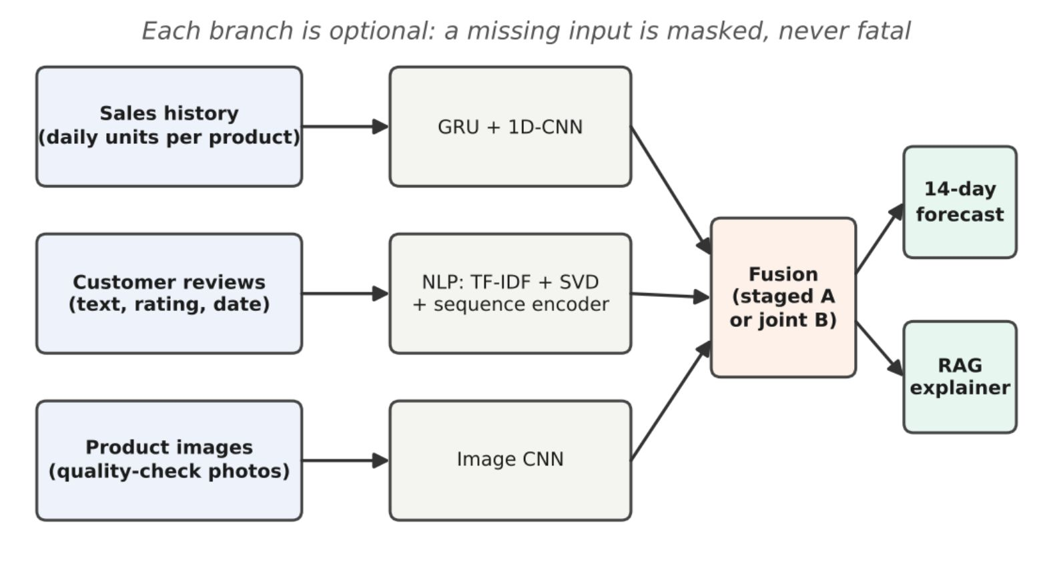

System Overview
Three Inputs → Two Fusion Paths → One Forecast
Sales History
Review Text
GRU + 1D-CNN encoder → 32-dim embedding
TF-IDF + LSA + RNN encoder → 16-dim embedding
Product Images
3-layer CNN encoder → 16-dim embedding
Path A
Path B
Staged fusion via LightGBM stacker
Joint fusion end-to-end with modality gate
Output: 14-day forecast + retrieval-based explanation

Slide 7
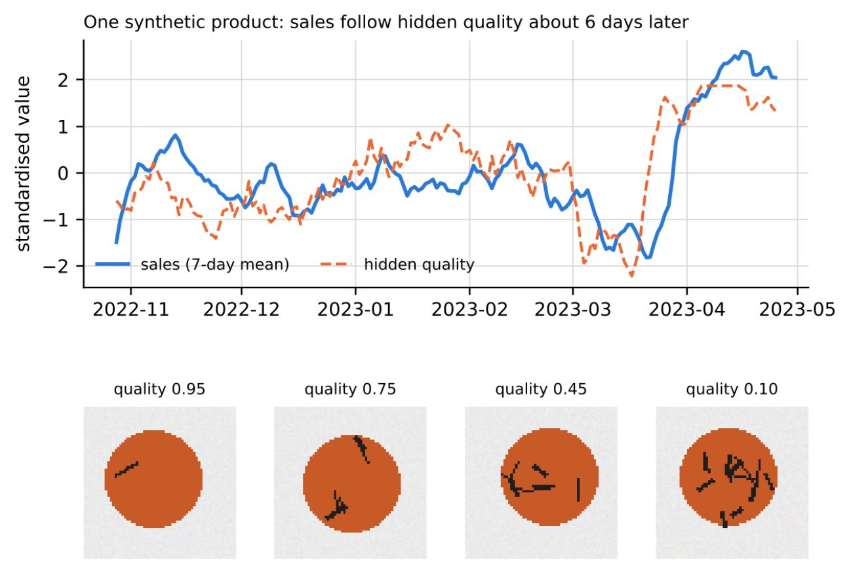
Dataset: Built from Scratch
No Public Dataset Qualified
No existing benchmark has aligned sales, reviews, and images. A synthetic generator was built.
6
25.3K
Products
Reviews
900 days each
Generated
Signal Mode
Control Mode
771
Reviews and images carry a 6-day leading demand signal
Reviews and images are independent — no information content
Images
Included

Slide 8

Robust Data Ingestion
Column Match
Gap Handling
Modality Gate
Upload Types
The pipeline accepts five upload configurations and always produces a valid forecast, even with incomplete inputs.

Slide 9

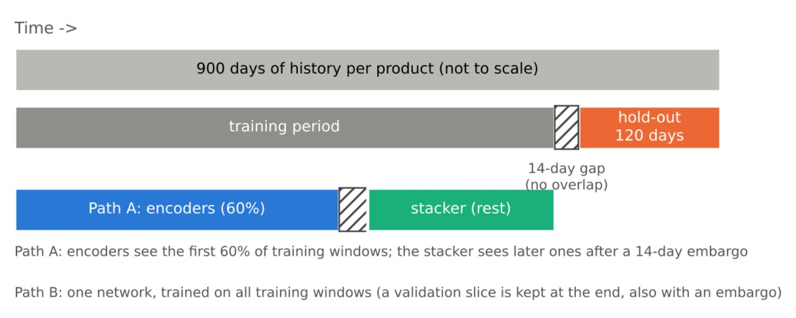


Leak-Free Evaluation Setup
Rigorous Hold-Out Design
1
2
56-Day Windows
14-Day Horizon
Sales context window per forecast origin
Forecast target — no overlap with training
3
4
120-Day Hold-Out
14-Day Gap
642 test origins for evaluation
Enforced between train end and test start to prevent leakage
Statistics fitted on training period only. Leakage tests overwrite all data after origin and verify inputs are unchanged.

Slide 10
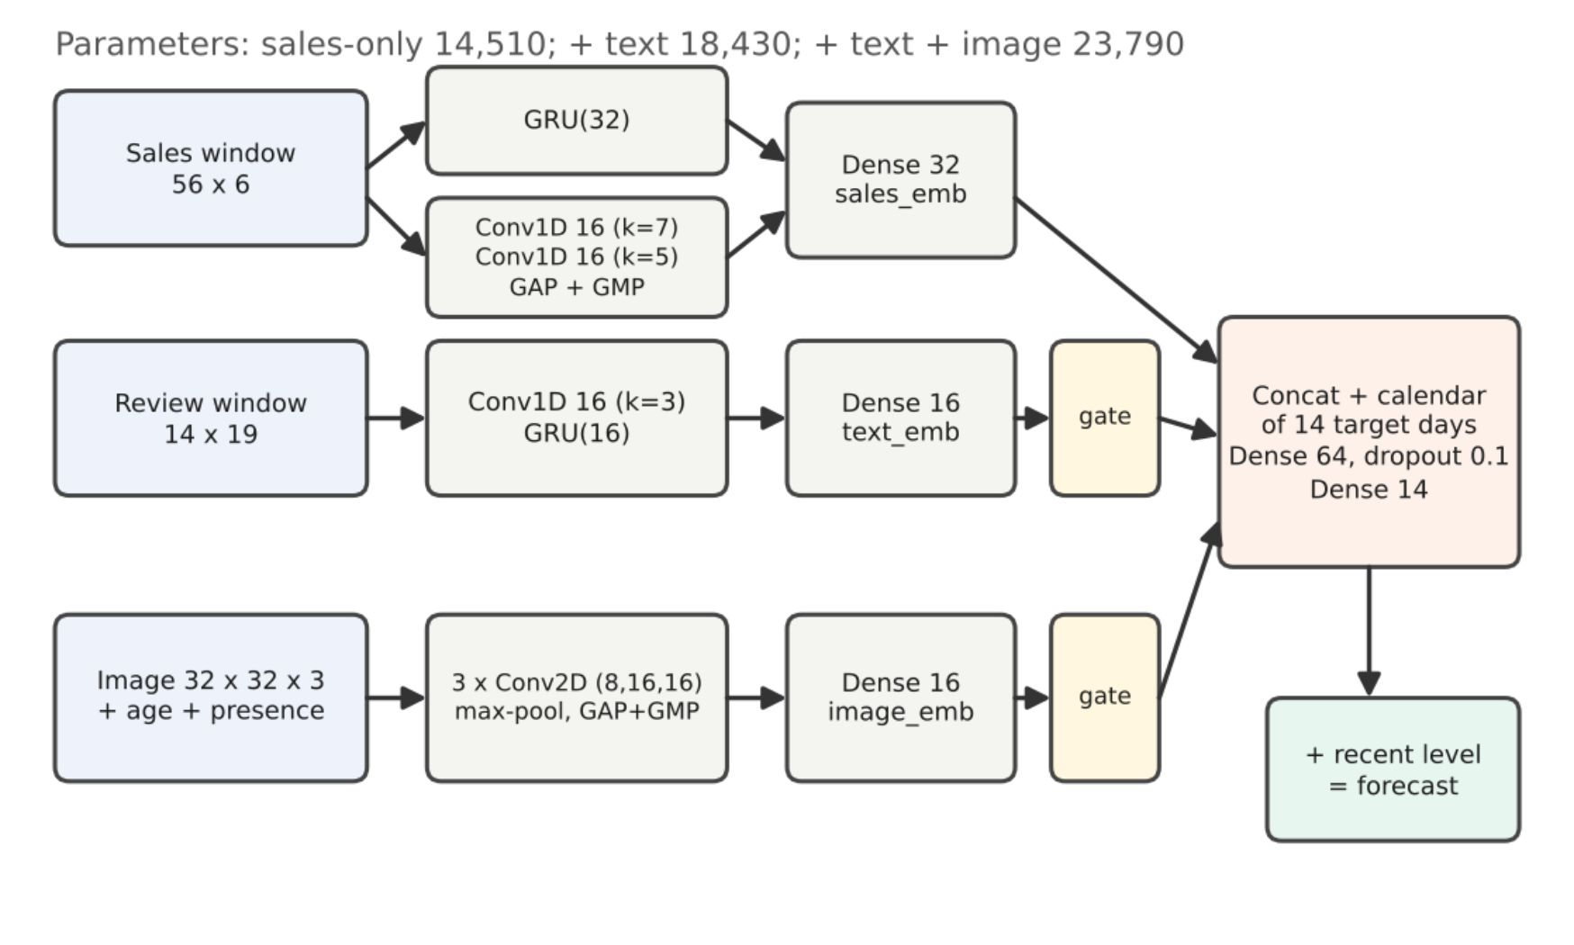
Encoders: Architecture Details
Shared Prediction Head
Concatenate all embeddings + calendar features
64-unit dense layer
Output: 14 daily change predictions
Sales Encoder
Text Encoder
Image Encoder
32-unit GRU + two 1D-CNNs (16 filters, kernels 7 & 5) → 32 numbers
TF-IDF + LSA (16 components) + 1D-CNN + 16-unit GRU → 16 numbers
Three 3×3 convolutions (8, 16, 16 filters) + pooling → 16 numbers

Slide 11
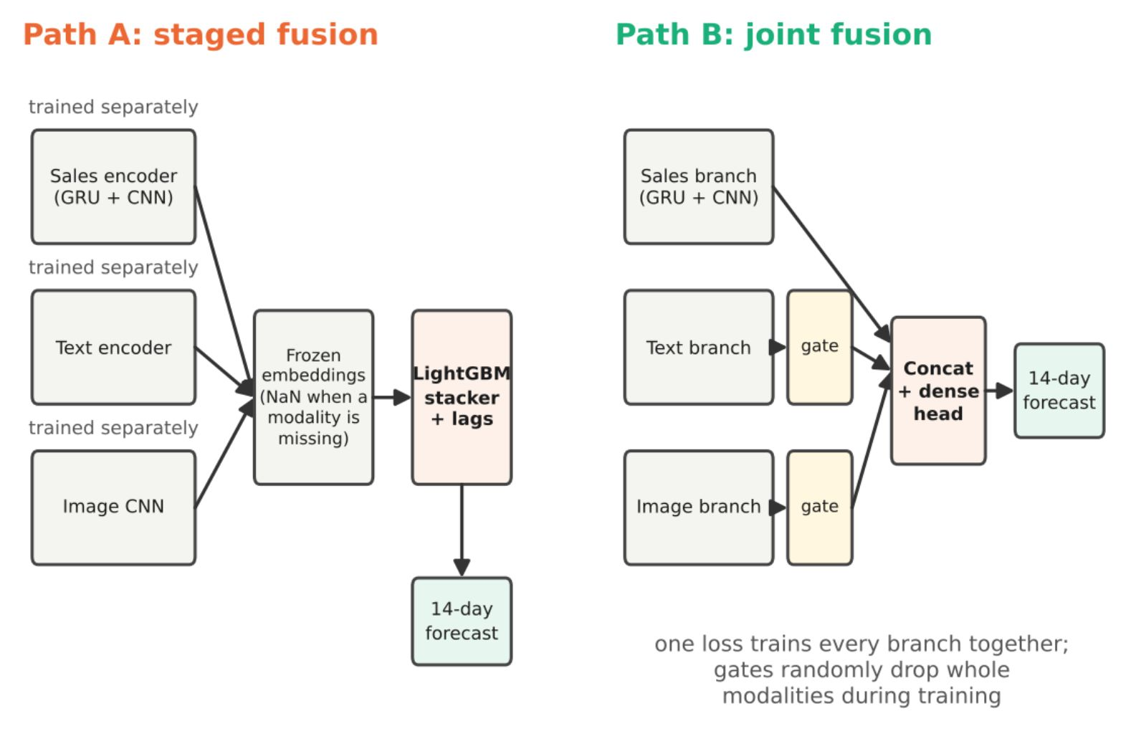
Path A (Staged) vs Path B (Joint)
Path A — Staged Fusion
Encoders trained separately on first 60% of training origins
Encoders frozen after pre-training
LightGBM stacker on embeddings + hand-built features
Missing inputs handled via LightGBM's native mechanism
Path B — Joint Fusion
Single network with modality gating
Modality dropout rate: 0.25 during training
One loss function trains all branches end-to-end
Missing inputs handled via learned gates
Both paths handle missing modalities by design — the key question is which fusion strategy yields lower WAPE on the hold-out set.

Slide 12
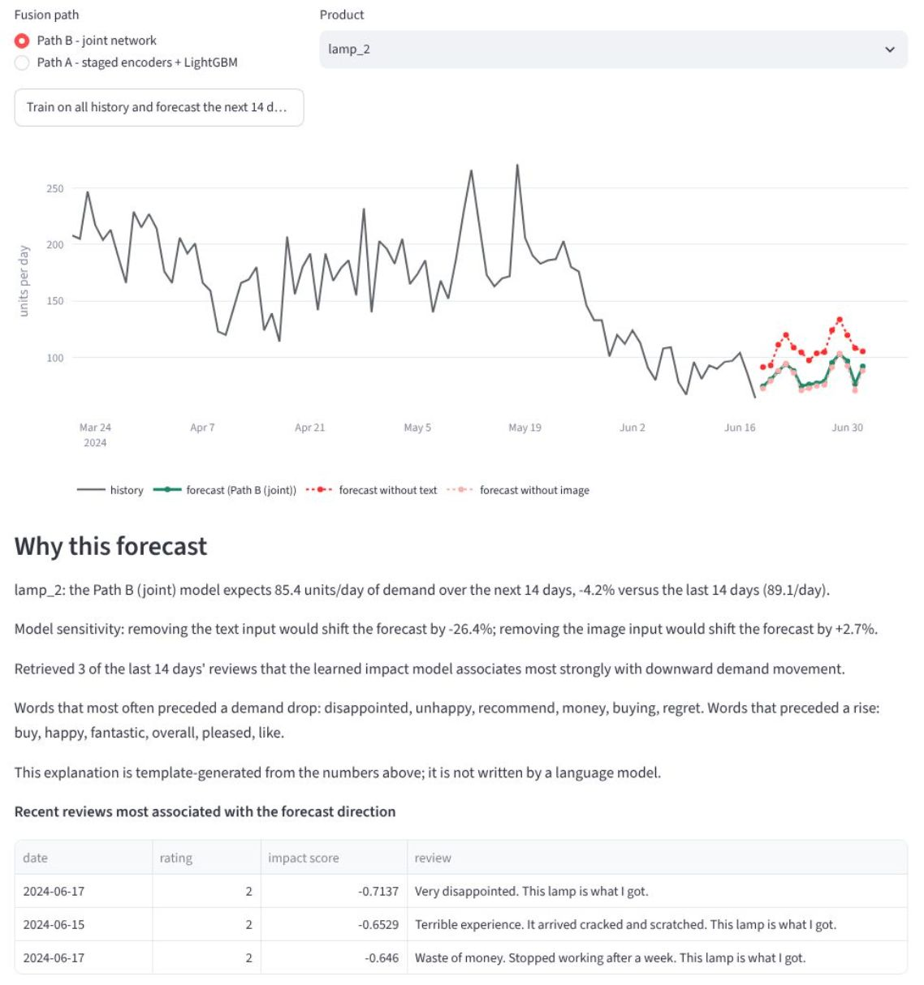
Explanation Module
Why This Forecast?
Review Impact Score: Retrieves the most relevant recent reviews, weighted by a learned impact score, to contextualize demand shifts.
Template-Based: Explanations are constructed using a fixed, interpretable template, not a black-box language model.
Sensitivity Analysis: Reveals how the forecast would change if specific input modalities (text, images) were unavailable or altered.

Slide 13

Evaluation Protocol
To ensure honest metrics and reproducible results, we implemented a rigorous evaluation protocol, including comprehensive metrics, a suite of baselines, and statistical validation.
Evaluation Metrics
Benchmark Baselines
Rigorous Experimentation
Statistical Significance
Performance is primarily assessed using WAPE (Weighted Average Percentage Error) and MASE (Mean Absolute Scaled Error) for robust error measurement.
Our model's performance is benchmarked against four standard baselines: mean, last-7-day mean, seasonal-naive, and LightGBM on lagged features.
We conduct ablation studies for every input combination, employ 3 random seeds for statistical confidence, and include dedicated robustness tests and a control dataset.
A performance difference is considered significant only if it exceeds twice the combined seed standard deviation (e.g., 0.01 WAPE for a single seed).
Experimental Configuration
Setting | Value | Setting | Value
Horizon | 14 days | Epochs / Patience | 40 / 6
Window (sales / text) | 56 / 14 days | Batch / Learning Rate | 128 / 0.002 (Adam [21])
Hold-out | 120 days | Modality Dropout | 0.25
Image Size / Max Age | 32 px / 21 days | Validation / Encoder Share | 15 % / 60 %
LSA Dimension | 16 | Seeds | 3 (mean ± sd)

Slide 14
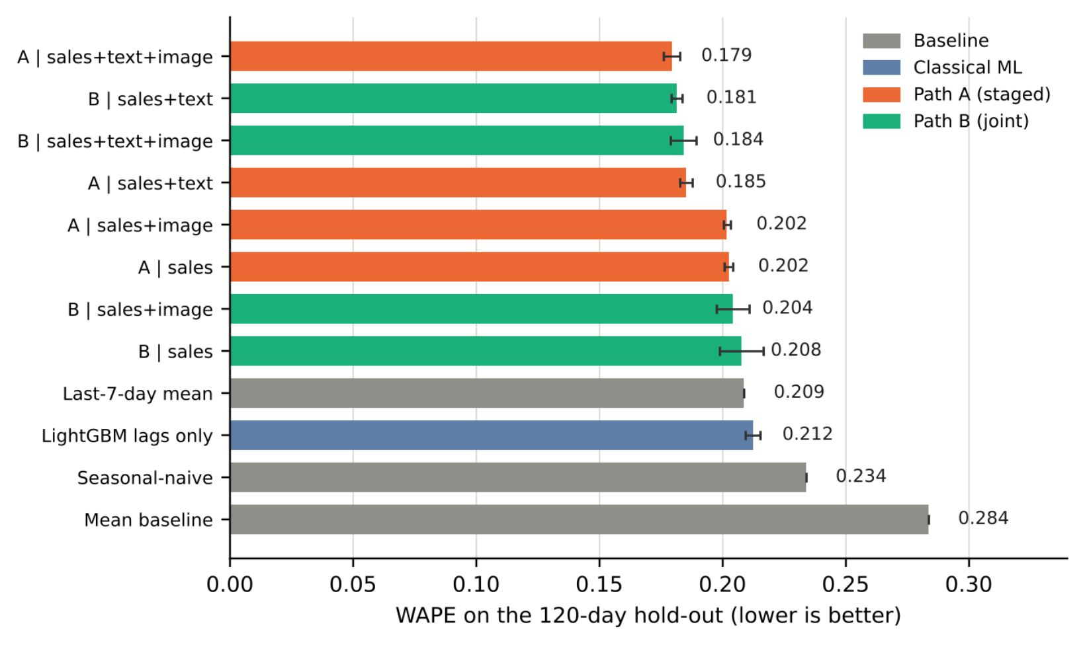
Results on Signal Data
Best: Path A with all inputs, WAPE 0.179 vs 0.234 seasonal-naive (23.3% better, MASE 0.869)
Text cuts error by about 0.02 WAPE on signal data
Images add little
Staged vs joint: no clear difference (0.179 vs 0.184, inside seed noise)

Slide 15
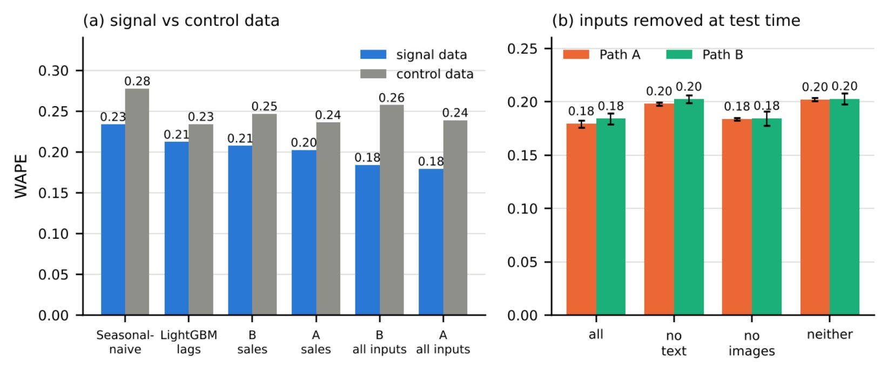
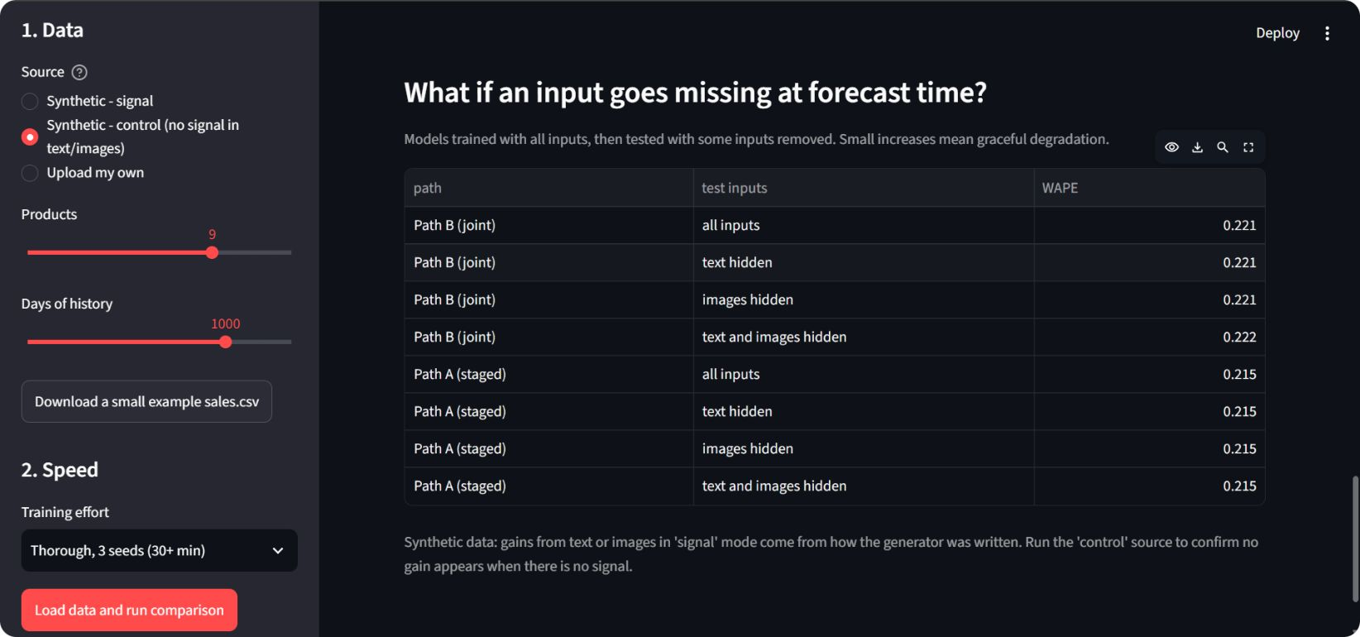
Control and Robustness: Both Paths Degrade Gracefully
Figure 4.6: Signal vs control data (left) and inputs removed at test time (right).
Control, one seed: joint about 0.01 WAPE worse (0.247 to 0.257); staged unaffected (0.236)
Signal: hiding text gives 0.198 (A) and 0.202 (B); hiding both gives 0.202 and 0.203
Our own run on control data: staged 0.215 in every row; joint 0.221 to 0.222

Slide 16
Key Takeaways & Future Directions
Text data helps when it carries a predictive signal. Staged (Path A) and joint (Path B) fusion both work and degrade gracefully when inputs are missing; neither consistently outperforms the other.
Current Limitations
Future Work
Synthetic Data Dependency: Gains so far come from our synthetic dataset, designed to isolate specific signals; real-world data may be more complex.
Custom Image Encoder: The small image CNN was trained from scratch; pre-trained models could extract more robust features.
Template-Based Explainer: The fixed template is interpretable but may miss nuanced patterns.
Seed Noise Sensitivity: Small sample-run differences can fall within random-seed noise, limiting definitive comparisons.
Real-World Data Application: Validate and extend the fusion models on diverse, large-scale real demand datasets.
Pre-trained Encoders: Integrate pre-trained language and vision models to improve feature learning and generalization.
Probabilistic Forecasts: Add uncertainty estimates alongside point predictions for better decision support.
Expanded Seed Evaluation: Run more random seeds to improve statistical confidence.

