Slide 1
Animal and Object Detection using YOLOv8
By: Star Yarbrough
Tier 1

Slide 2
The Problem
Problem: Identifying animal species from images can be time-consuming and requires expert knowledge.
Who cares: Wildlife researchers, conservationists, and biodiversity organizations.
Why it’s important: Automating animal and object recognition helps speed up wildlife monitoring and supports biodiversity research efforts.

Slide 3
My Solution
A YOLOv8 object detection system that analyzes uploaded images and identifies detected objects using bounding boxes and confidence scores.
How it works:
Image → YOLOv8 Model → Object Detection Results

Slide 4
Technical Approach
Computer Vision Technique: Object Detection
Model: YOLOv8 (pre-trained)
Framework: Ultralytics YOLO + Python
Justification:
Pre-trained YOLOv8 models provide fast and effective object detection for real-world image testing and analysis.

Slide 5
Data Plan
Source: Personal test images and publicly available animal images
Content: Real dogs, backyard cat, stuffed animal objects, decorative objects, and wildlife images
Purpose: Evaluate strengths and limitations of pretrained YOLOv8 object detection

Slide 6
System Diagram
[Input Image] → [YOLOv8 Model] → [Detection Results]

Slide 7
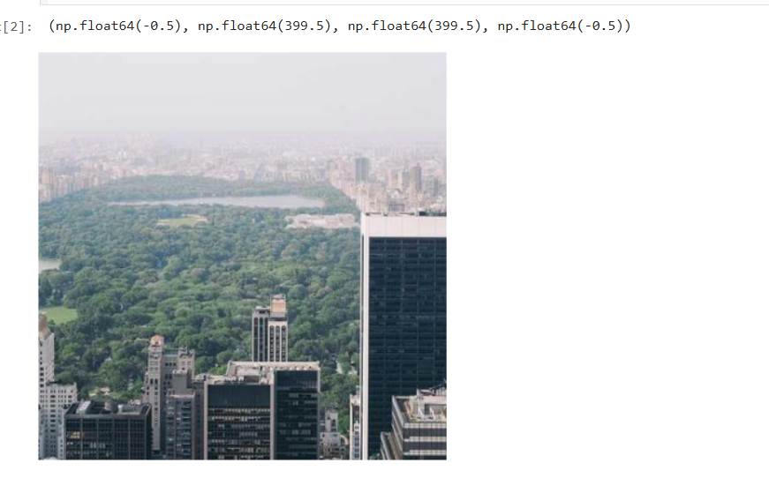
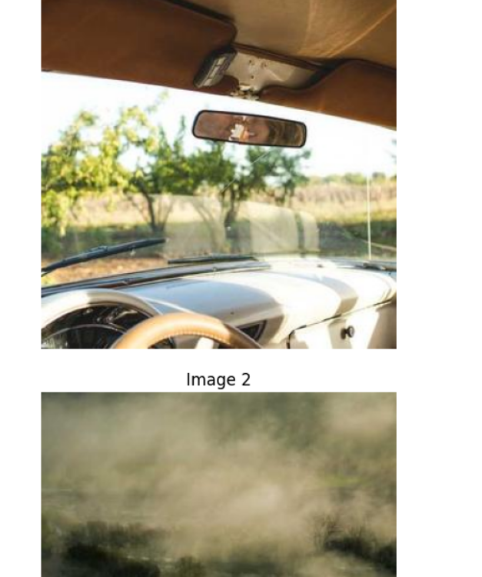
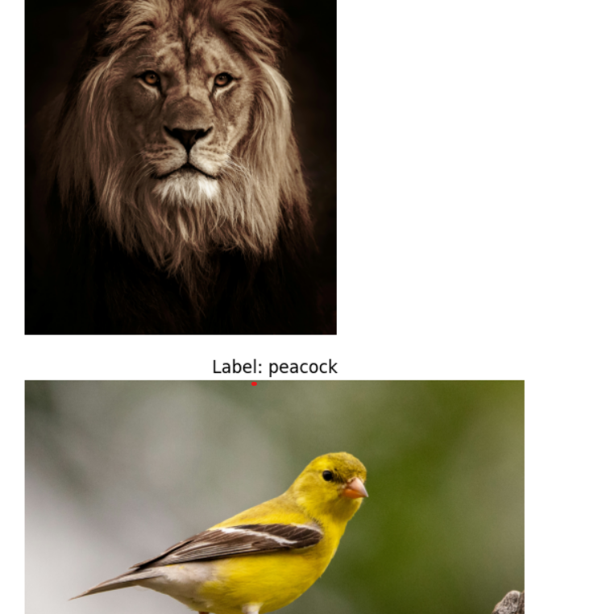
Initial Testing
Initial testing was performed using a variety of publicly available images to confirm the YOLOv8 model was functioning correctly before focused testing began.

Slide 8
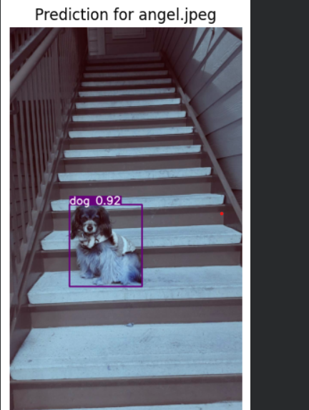
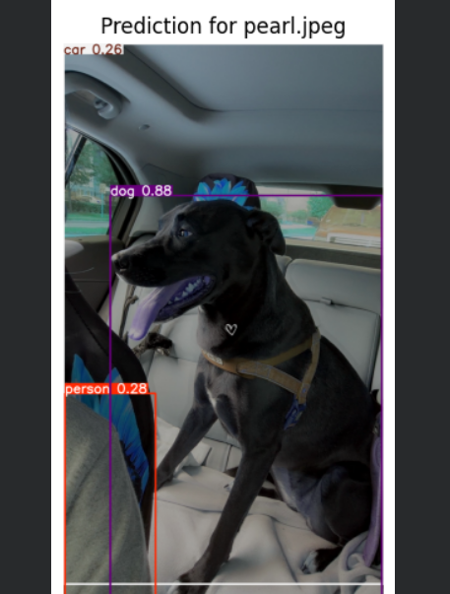
Successful Detections
YOLOv8 successfully detected real dogs in multiple test images

Slide 9
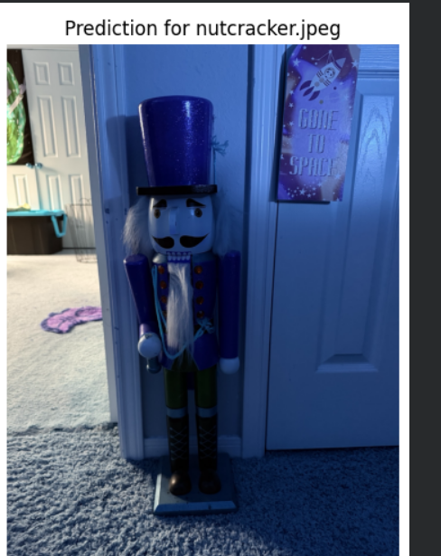
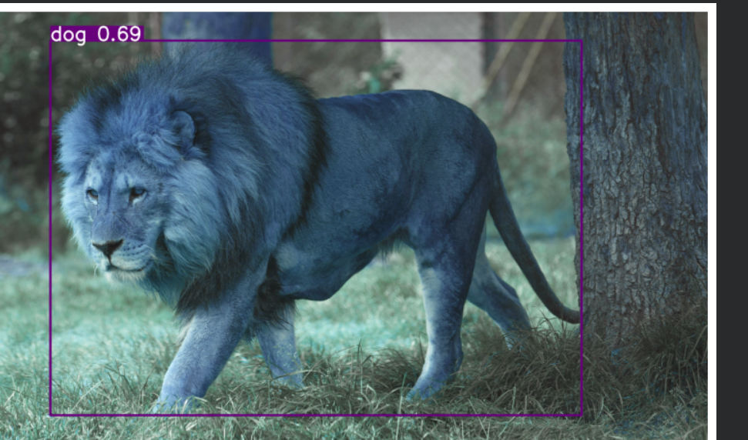
Incorrect/Failed Detections
The model showed limitations with species-level accuracy and unusual objects.

Slide 10
Observations and Findings
YOLOv8 successfully detected real dogs in multiple test images.
The model struggled with species-level accuracy in some cases.
A lion image was incorrectly classified as a dog.
Decorative and unusual objects were more difficult for the model to detect.
Pretrained object detection models perform well on common objects but may struggle with ambiguous inputs.

Slide 11
Success Metrics
Metric Type | Metric | Target
Primary | Successful object detection and analysis of model performance | Correctly identify common objects/animals in most test cases
Secondary | Inference Time | < 1 second per image

Slide 12
Challenges & Backup Plans
Challenge: Incorrect or failed detections
Plan B: Analyze model limitations and compare successful vs unsuccessful predictions
Challenge: Limited training/customization time
Plan B: Use pretrained YOLOv8 model for real-world testing and evaluation

Slide 13
Resources Needed
Resource | Personal and publicly available test images; GitHub repository
Compute | Google Colab (free GPU)
Frameworks | Ultralytics YOLOv8; Python
Estimated Cost | $0

