Slide 1

Analysis on 2013-2018 Accelerated Learning Cohorts
Benjamin Brown, Grace Rusth
The Office of Educational Partnerships and Outreach
Oregon Institute of Technology
Contact Benjamin: benjaminbrown.cpe@gmail.com

Slide 2
Project Goals
Data Analysis
Machine Learning Algorithm
Generate functional statistics to assist Oregon Tech’s Strategic Enrollment Management division in targeted recruitment of current high school non-degree seeking students
Find a usable machine learning prediction model that is reasonably accurate (greater than 75% prediction accuracy)
Emphasize accuracy with predicting who will matriculate over who will not matriculate

Slide 3
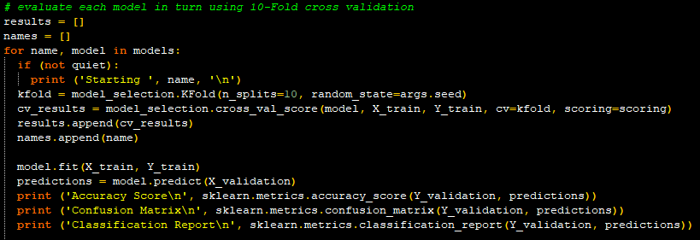
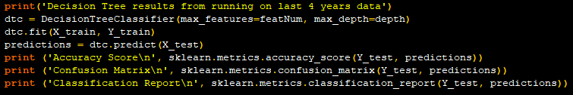
Overview
Data Analysis
Machine Learning Algorithm
Data gathered for the 2013-2018 cohorts
22716 samples with 12 provided features and 1 generated feature
The dataset includes students who have started the dual credit programs in the last 4 years but have not yet graduated
All students in the 2013-2015 cohorts should have graduated
Ran statistical analysis on the data provided by Oregon Tech’s Office of Institutional Research using Excel functions, charts, and graphs to aid in explanation
Programmed in Python using the scipy, numpy, pandas, sklearn, graphviz, and matplotlib modules
Ran five different machine learning algorithms to compare accuracies and determine best model for prediction

Slide 4
10-Fold CV Score Comparison
Logistic Regression:
Mean: 0.7705
Standard Deviation: 0.01706
Linear Discrimination Analysis
Mean: 0.7404
Standard Deviation: 0.01956
KNN (k = 5)
Mean: 0.7564
Standard Deviation: 0.01475
Support Vector Classification
Mean: 0.7803
Standard Deviation: 0.01984
Binary Decision Tree
Mean: 0.794
Standard Deviation: 0.01602

Slide 5
Methods
Data Analysis
Binary Decision Tree
By subject comparisons
By school comparisons
2013-2015 vs 2016-2018 cohort comparisons
Full dataset comparisons
Tree depth of 5 is optimal with this dataset to not over fit
Final model predicts 2016-2018 cohort matriculations off of a decision tree trained on the 2013-2015 cohort
Validated by splitting the 2013-2015 cohort before training the model
Notes:
Assumptions:
Matriculation can be predicted.
All of the included variables (12 given variables: Term, Prefix, Credits, Student Type, Gender, High School, Metro Area)can be used to assist in predicting matriculation.
2013-2015 Cohorts all have had ample time to graduate

Slide 6
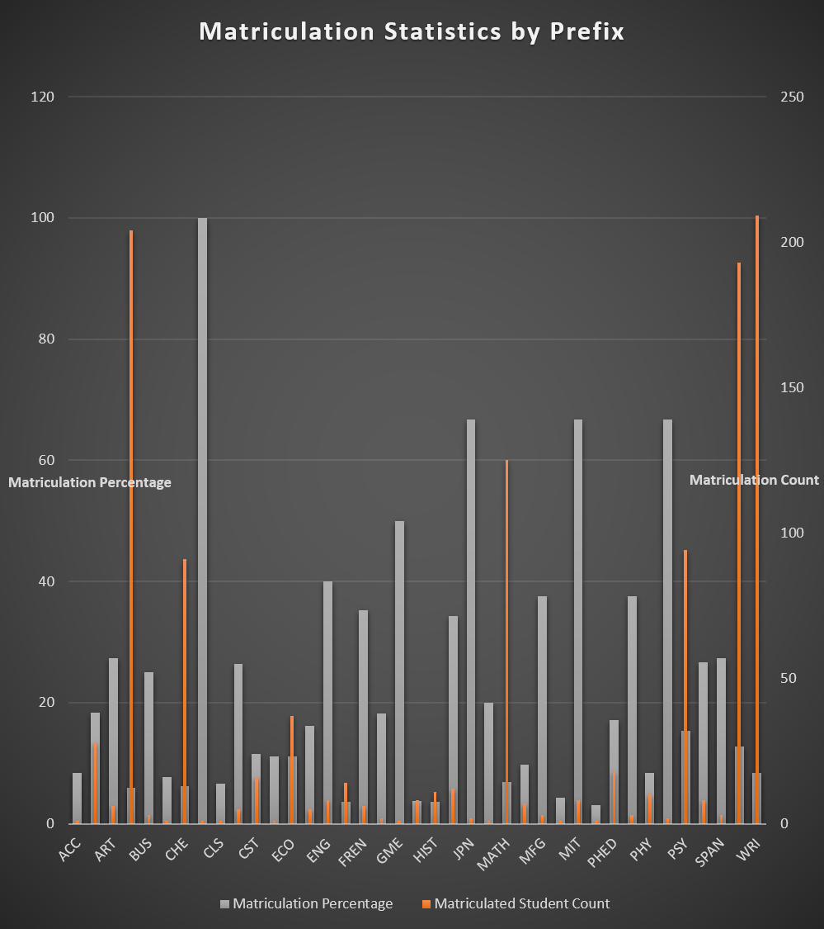
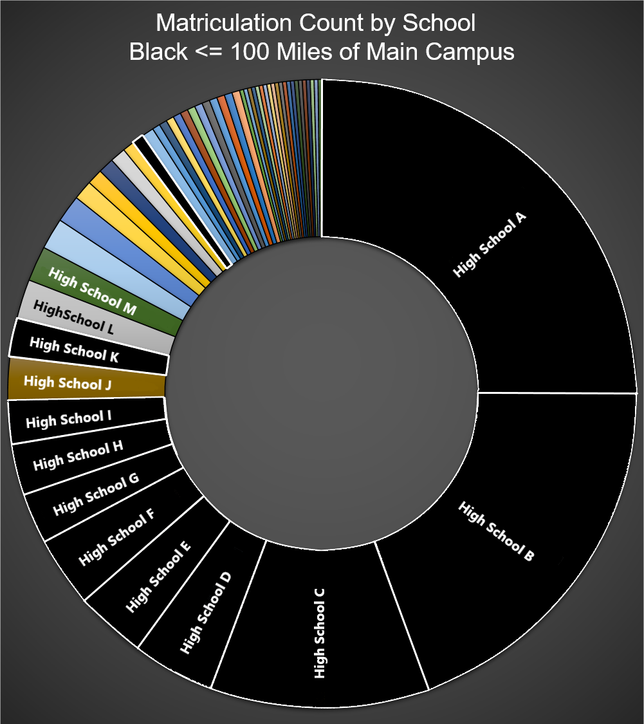

Slide 7
Machine Learning Results
Decision Tree Predictions
with Validation Set
10-Fold Cross Validation Accuracy
Accuracy score: 0.9156
Confusion matrix:
No Yes
No [[14634 947]
Yes [ 425 246]]
Classification report
Precision Recall F1-score Total
No 0.97 0.94 0.96 15581
Yes 0.21 0.37 0.26 671
Min: 0.7644
Max: 0.8173
Mean: 0.794
Standard Deviation: 0.01602
Notes:
Actual = Rows
Predicted = Columns
Precision: Correct/ total column (true predicted Yes/No / total predicted Yes/No)
Recall: Correct / total row (True predicted Yes/No / actual Yes/No)
F1: Harmonic mean of precision and recall (2*precision*recall/(precision+recall))

Slide 8
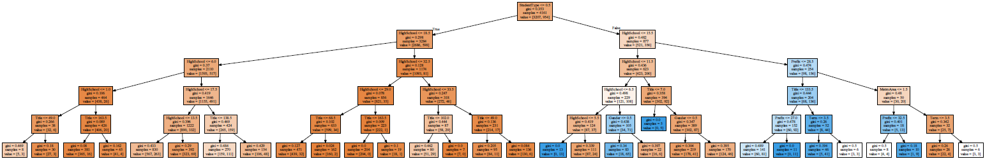
Final Decision Tree

Slide 9
Results
Data Analysis
Binary Decision Tree
Schools geographically close to Oregon Tech’s main campus have higher matriculation rates
Students who take more specialized classes are more likely to matriculate to Oregon Tech
Students who matriculate take more credits on average than those who do not
Determined matriculation can be predicted with acceptable accuracy using decision trees
Garnered interest from administrators for further applications of machine learning algorithms within Oregon Tech
Notes:
Geographically close = within ~106 miles
More specialized classes: CST/EE/MFG/etc. over MATH/ENG/WRI/etc.
More credits = +4 credits over non-Mat, on average.

Slide 10
References and Acknowledgements
Idea originated through collaboration between Grace Rusth and Benjamin Brown
Data retrieved by Oregon Tech’s Office of Institutional Research
Machine learning taught by Dr. Rosanna Overholser, Assistant Professor: Oregon Tech
Advice and support from Joseph Reid, Associate Professor, Oregon Tech

Slide 11
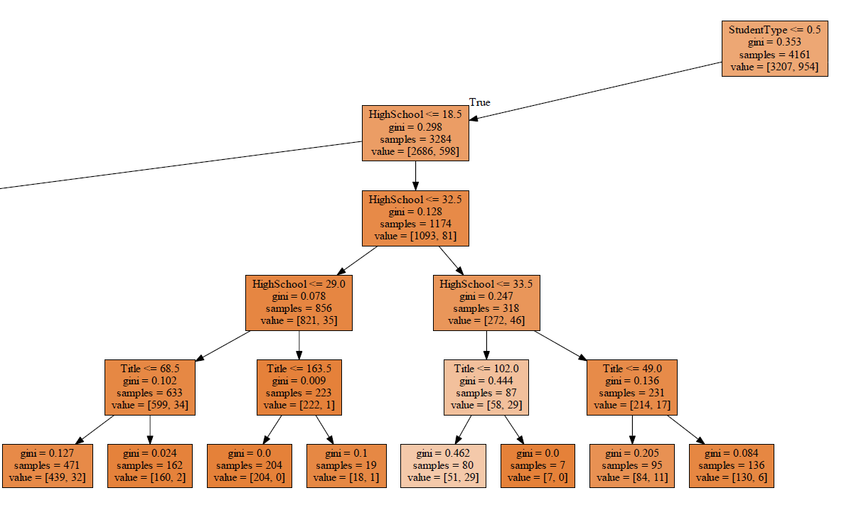

Slide 12
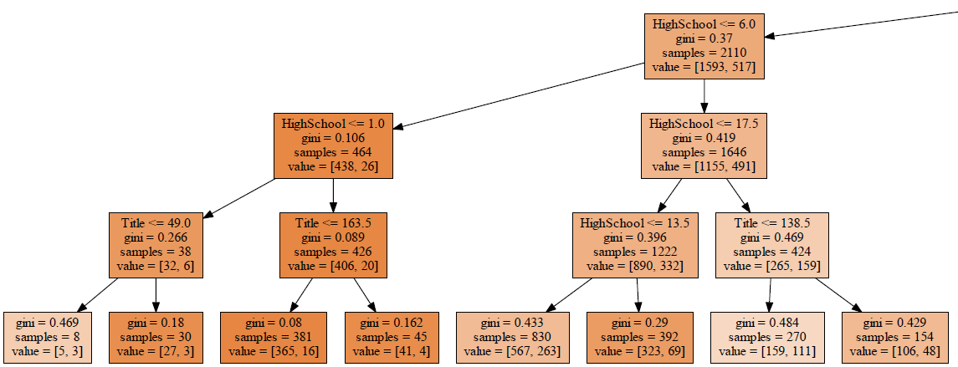

Slide 13
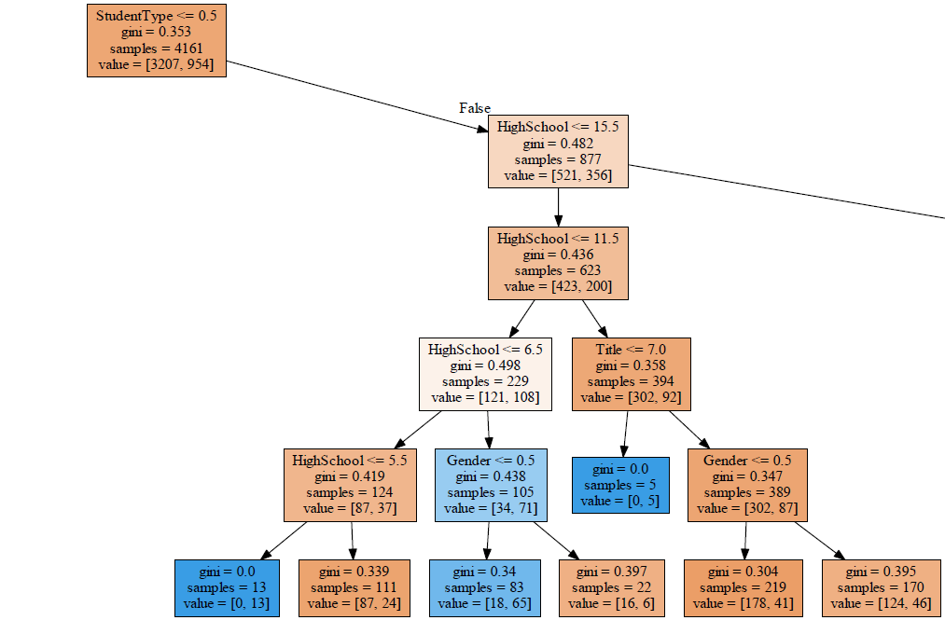

Slide 14
