Slide 1


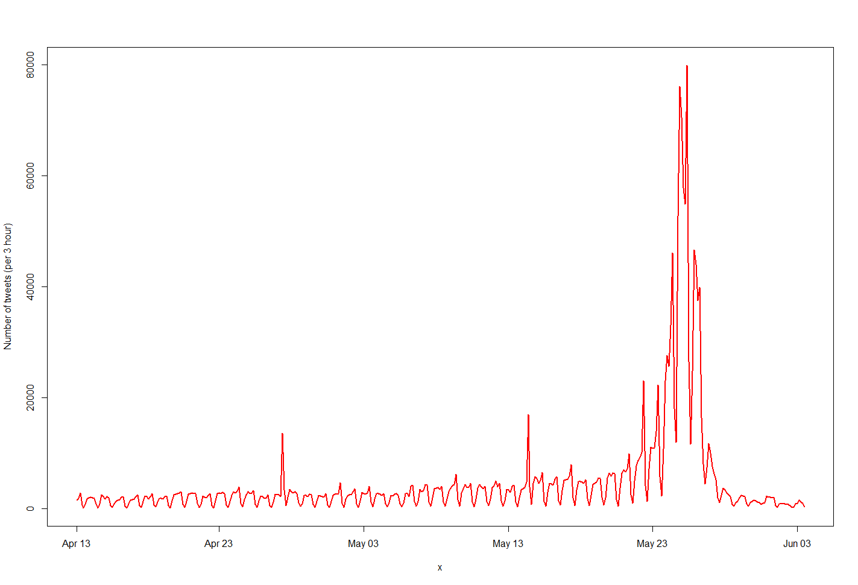
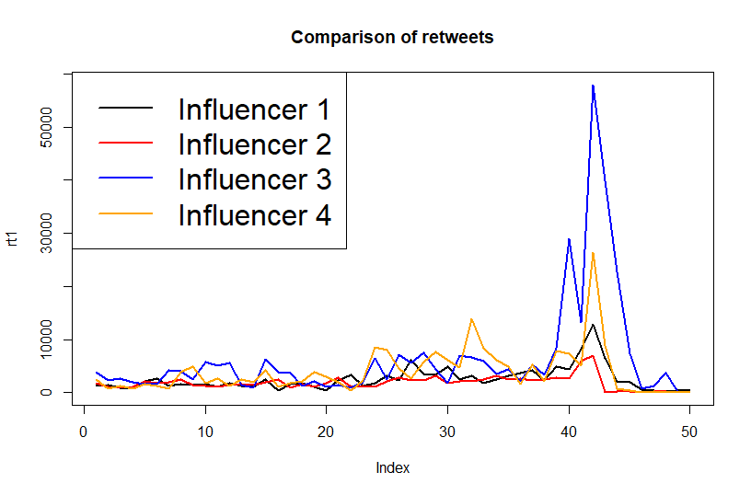

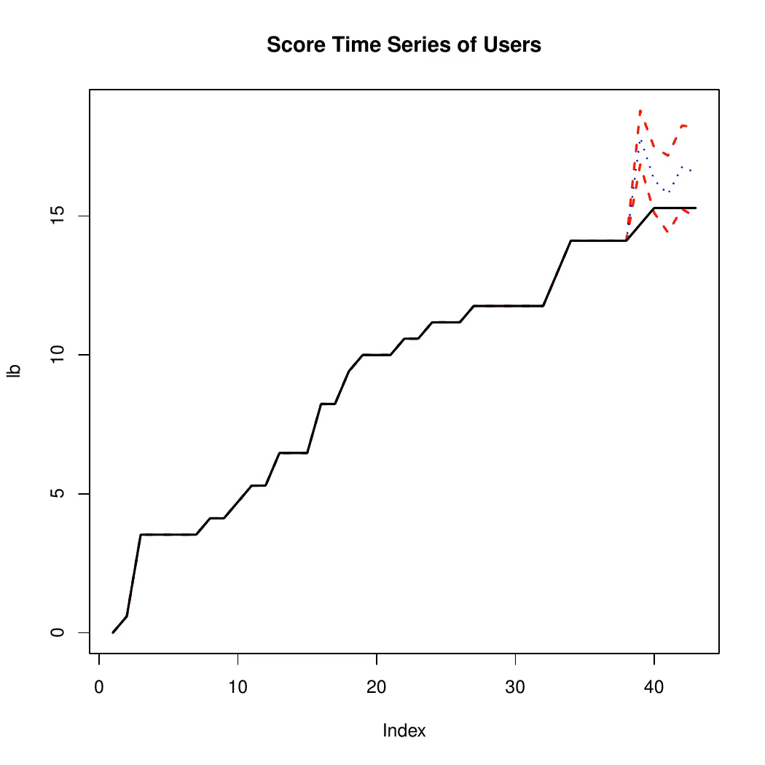
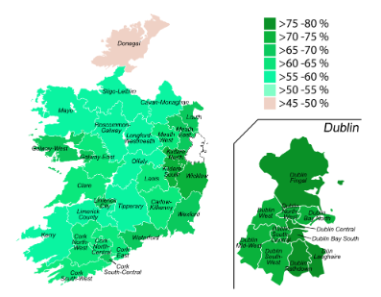
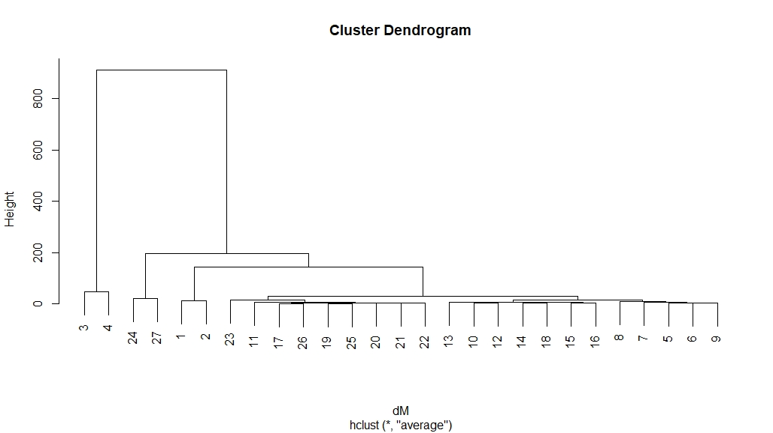

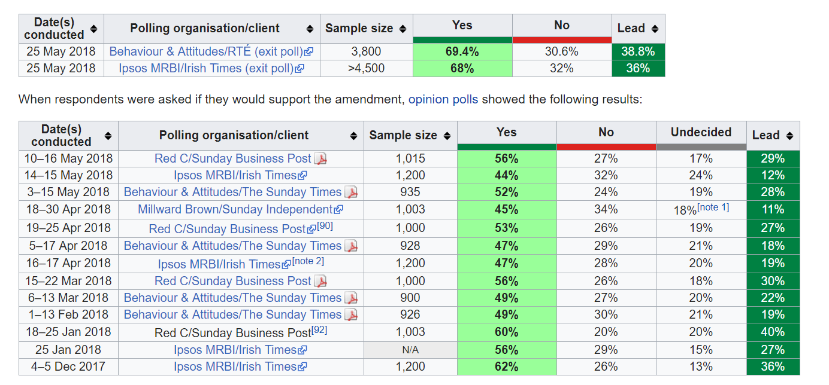


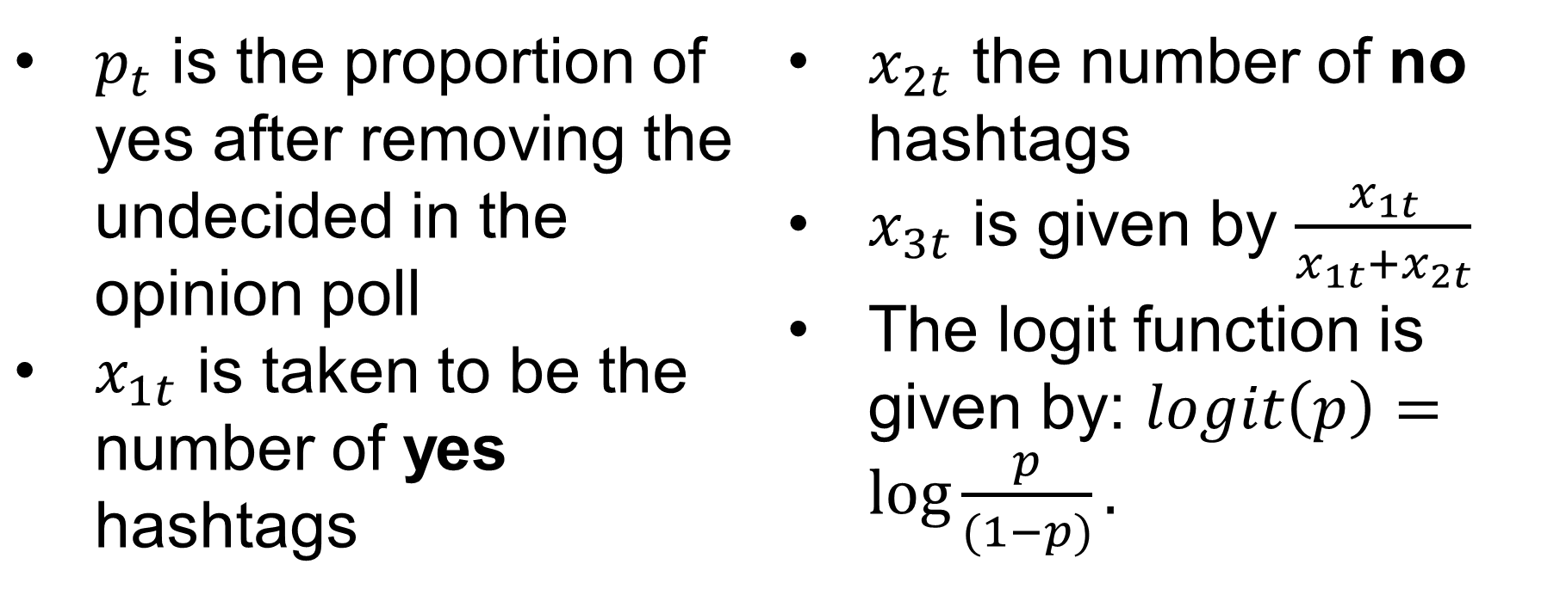

Analyzing Influence of Social Media Through Twitter
Dhrubajyoti Ghosh, James Robertson, Soumendra Lahiri, Rob Johnston, William Boettcher, Michelle Kolb
Objective
Tweet Times
Analyzing Influencers
Demonstrate the influence of Twitter on public through the data on The 36th Amendment of The Constitution of Ireland.
Analyze the growth of network in the Twitter Dataset.
Identifying and analyzing features that helps users become successful influencers.
The plot of the number of tweets per 3 hour indicates that there is a surge in number of tweets around May 25, the day of the vote.
A simple periodogram analysis suggests that there is a periodicity in the said time series, the period being one day.
The influencers from the yes campaign (3 and 4) seem to be having more influence than their no counterparts (1 and 2).
Tweet Summary
Plot of retweets for each of the four influencers
Top 50 influencers are selected from the network based on the number of retweets, and the number of retweets is regressed against five dynamic features extracted from the time series --
Length of Text
Number of Media
Predicting Outcomes
We built a model using the results of the opinion poll, and some features extracted from the Twitter data.
Number of URL
Number of Hashtags
Sentiment Score
Background
Model: $logit\left(p_{t}\right)=β_{0}+β_{1}x_{1t}+β_{2}x_{2t}+β_{3}x_{3t}+ε_{t}$
Analysis reveals that Number of hashtags plays a vital role in increasing number of retweets of most of the influencers over time.
Abortion has been subject to criminal penalty in Ireland since 1961.
The Eighth Amendment of the Constitution Act 1983 recognized the equal right to life of the pregnant woman and the unborn.
The introduction of the Protection of Life During Pregnancy Act 2013, which defined the circumstances and processes within which abortion in Ireland could be legally performed.
Repeal of the 8th amendment allowed the government to legislate on abortion.
The proposed legislation brought Ireland into line with the majority of European countries, allowing for abortion on request up to the 12th week of pregnancy (subject to medical regulation).
$p_{t}$ is the proportion of yes after removing the undecided in the opinion poll
$x_{1t}$ is taken to be the number of yes hashtags
$x_{2t}$ the number of no hashtags
$x_{3t}$ is given by $\frac{x_{1t}}{x_{1t}+x_{2t}}$
The logit function is given by: $logit\left(p\right)=\log{\frac{p}{(1−p)}}.$
Analyzing User Behavior
$af_{score}=20×\left(\frac{edge_{y}}{user_{y}} −\frac{edge_{no}}{user_{no}}\right)+10×\frac{edge_{neutral}}{user_{neutral}}$
A VAR model ($y_{t}=μ_{t}+βy_{t−1}+ε_t$) is fitted to get the predictions.
Adjusted$R^{2}$ shows that it is enough to take the data from the last 15 days
Fit gives similar results thereafter
Additionally, the prediction seems to be very close to the actual result, with a true value of 0.664 and a prediction of 0.6725
Available Data
Affinity Score of Users
Twitter Data: Some details about the data:
Source: https://www.docnow.io/catalog/
Duration: April 13, 2018 – June 4, 2018
Size of Dataset:2,279,396 (However, hydrator deleted some tweets, finally giving 1,933,397 tweets)
Network Analysis
Future Directions
The network contains 76,095 links (through retweets) and 21,153 users.
A reduced network is considered created by top 50 influencers.
An affinity score is assigned to each users, based on their twitter activity.
Classifying Type of Influencers, i.e. campaigner, bot or normal person.
Apply similar analysis to other real-life dataset, the Russian Troll Data, for example.
Examine the features which help an influencers gain vast number of retweets.
Tweet-specific analysis, i.e. analyzing what features play crucial roles in determining the popularity of individual tweets.
Examine spatial patterns in voting behavior.
Other Data: We also have the opinion polls conducted by four different sources, during the course of campaign.

