Slide 1

Teaching Upper Level Statistics Courses through a Shared/Hybrid Model
Jingchen (Monika) Hu
Vassar College
Symposium on Data Science & Statistics 2019

Slide 2
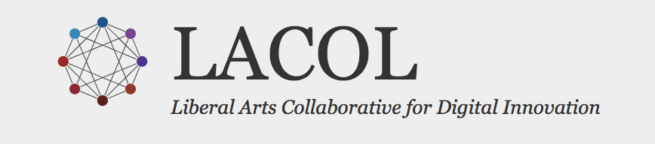
Course Sharing Project
Liberal Arts Collaborative for Digital Innovation
a 10-college consortium
share classes to supplement and keep small liberal arts flavor
 | 2016-2018 (pilot phase) | 2018-2019 | 2019-2020
Bayesian Statistics | Fall 2017 16 Vassar students + 1 Swarthmore student | Spring 2019 16 Vassar students + 1 Amherst + 1 Carleton + 4 Swarthmore students | Fall 2019 16 Vassar students + 1 Amherst + 1 Swarthmore students
Other courses | Spring 2017 Putnam Problem Solving (S. Miller, Williams College) Fall 2017 Advanced Real Analysis (S. Garcia, Pomona College) | Summer 2019 Intro to Data Science 5 instructors from 4 colleges 32 students from 4 colleges | Fall 2019 Operations Research (S. Miller, Williams College)

Slide 3
Vassar’s Bayesian Statistics
An upper-level Statistics course
Component | Focus | Challenge when shared/online
Inference | Theoretical and methodological derivations Reading research paper | High-quality video for board work Online and in-class discussion
Computation | Statistical programming Labs | High-quality video for programming demos Teaching programming online
Applications | Case studies, student projects | Online learning community Cross-campus group work

Slide 4
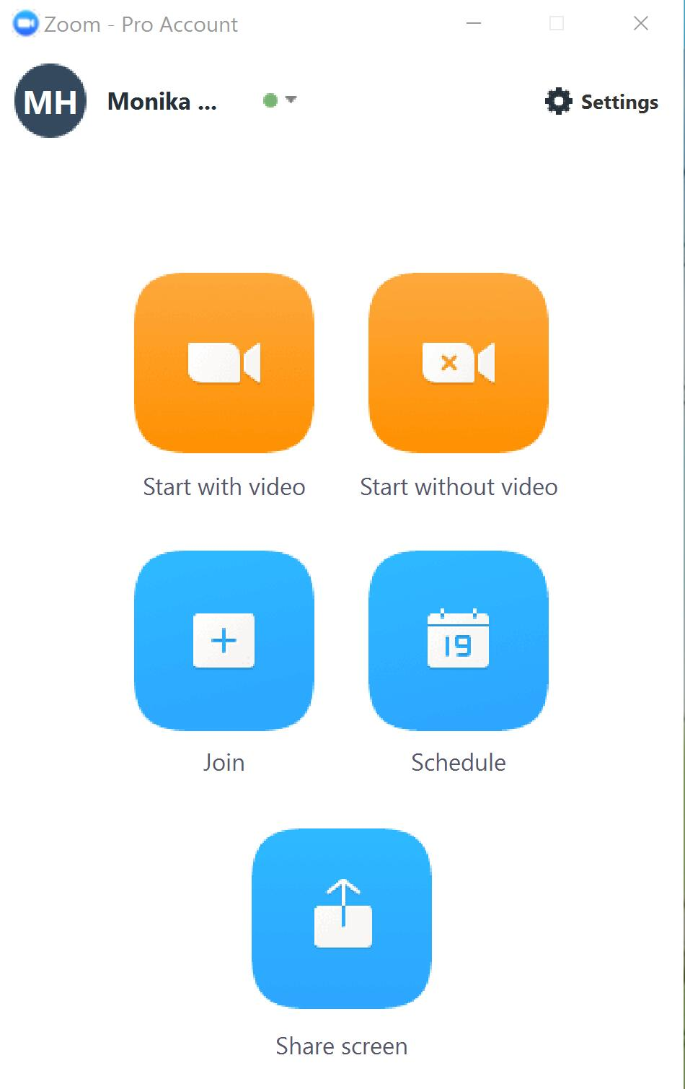
Course mechanics
Zoom meetings
zoom.us
Synchronized – remote students join lectures real time
Asynchronized – lectures are recorded and posted on YouTube playlist

Slide 5

Course mechanics
iPad Pro
Take control, bring up slides from Google Drive
Apple pencil
Write on slides and/or whiteboard on iPad
Laptop
Take control for R demonstration

Slide 6
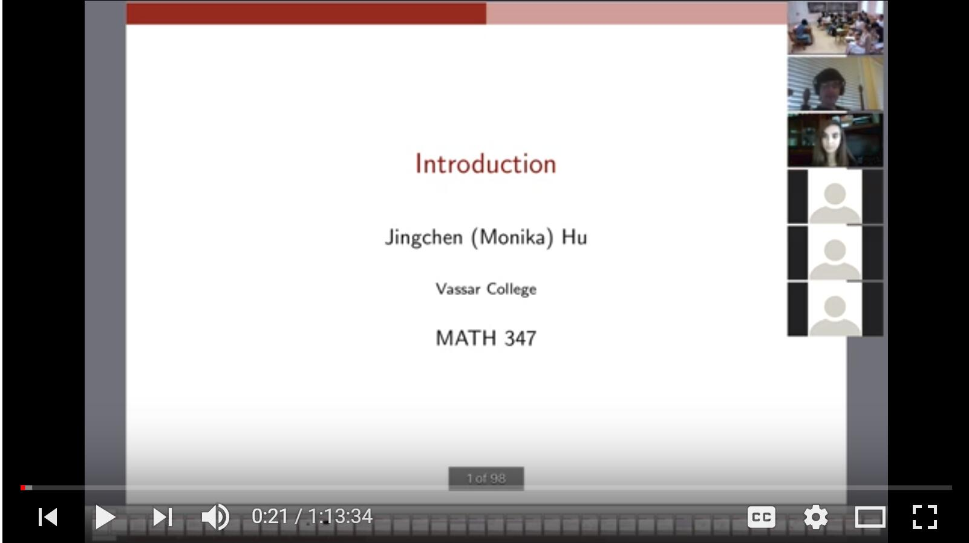
Course mechanics – lecture slides

Slide 7
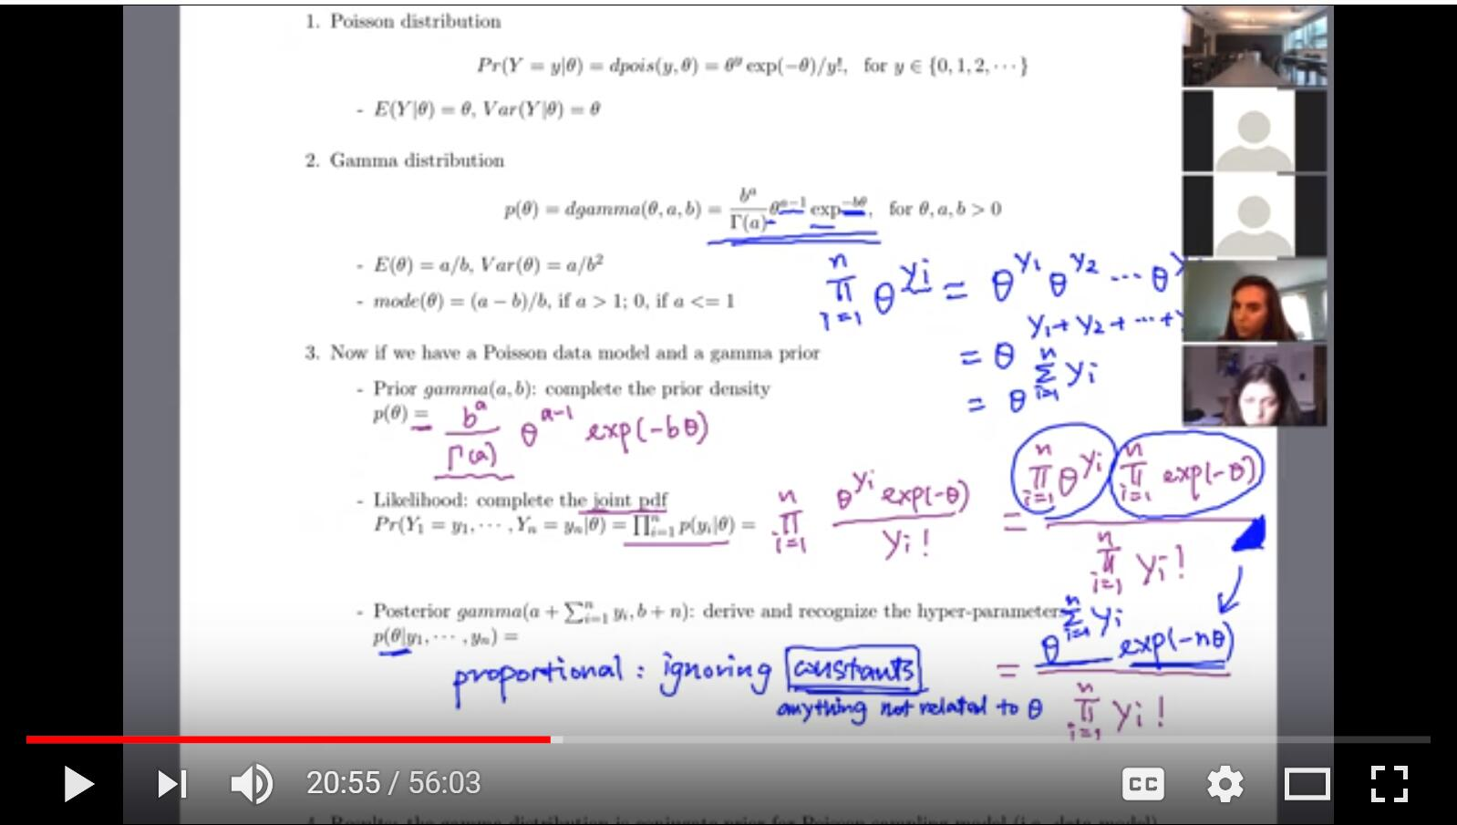
Course mechanics – write on slides

Slide 8
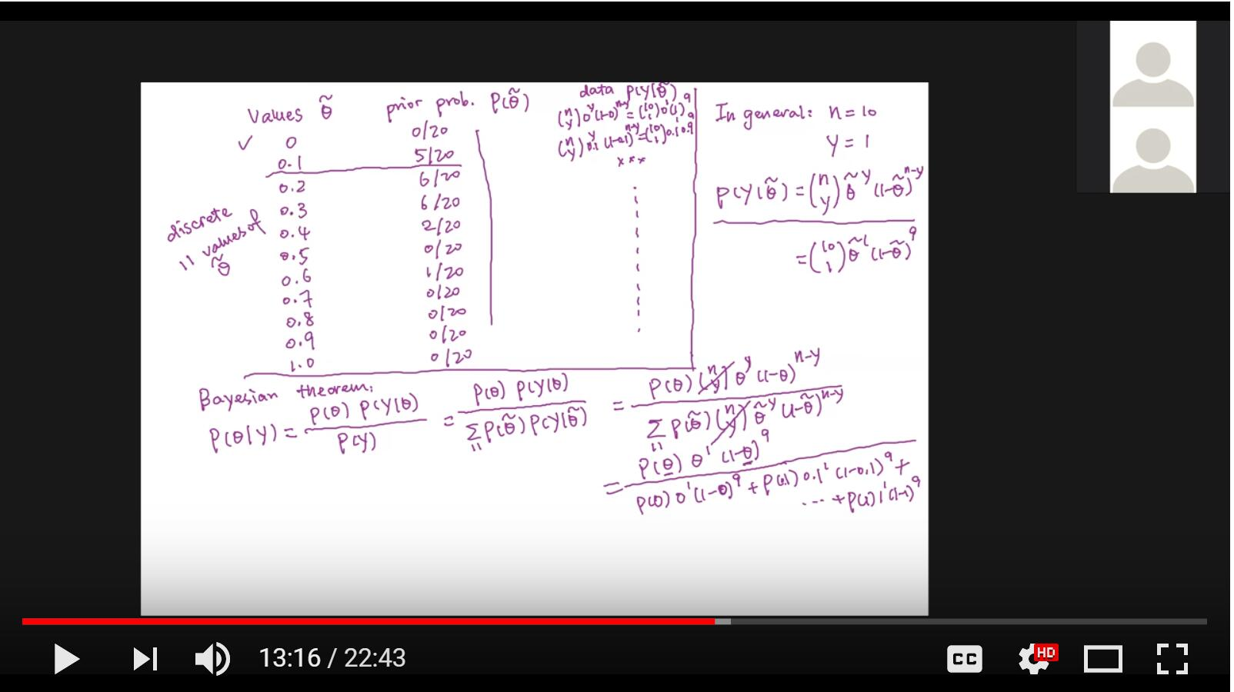
Course mechanics – write on whiteboard

Slide 9
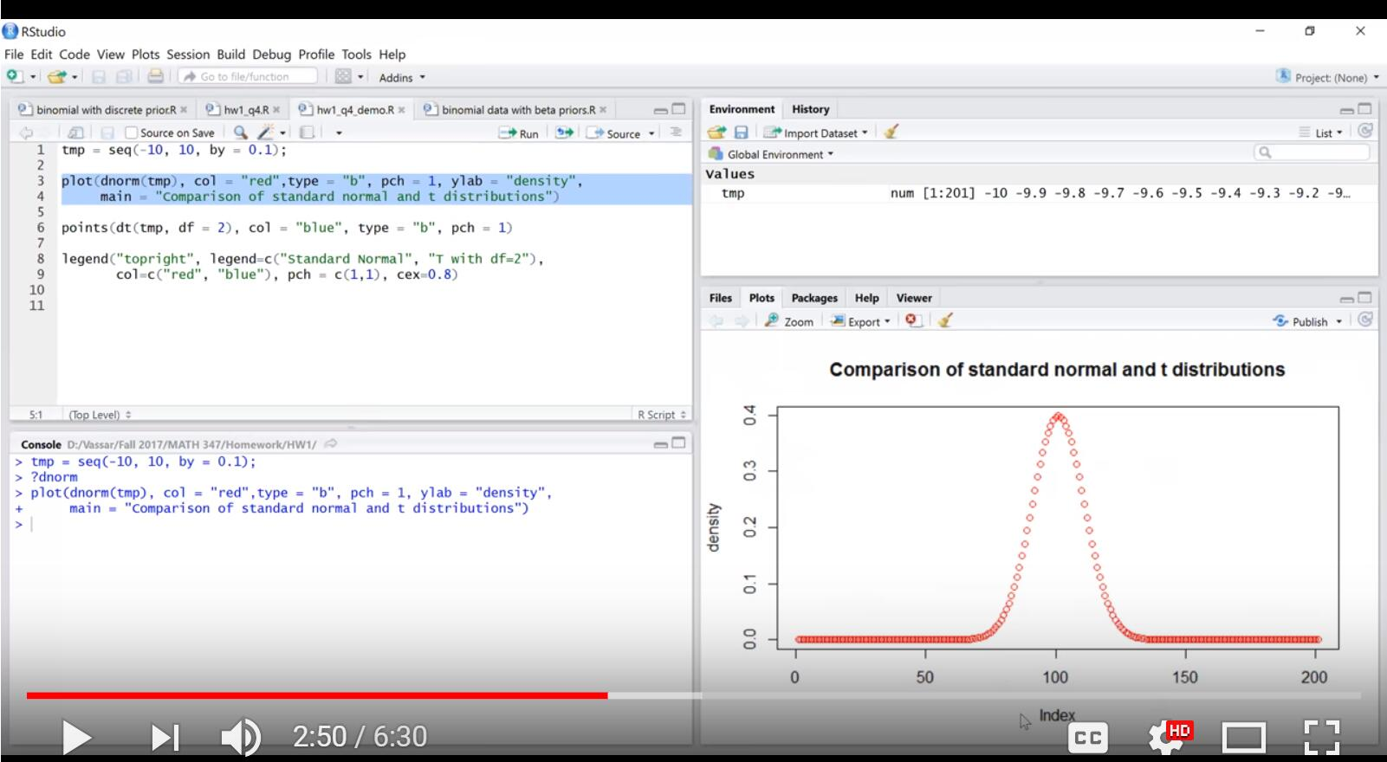
Course mechanics – R demo

Slide 10
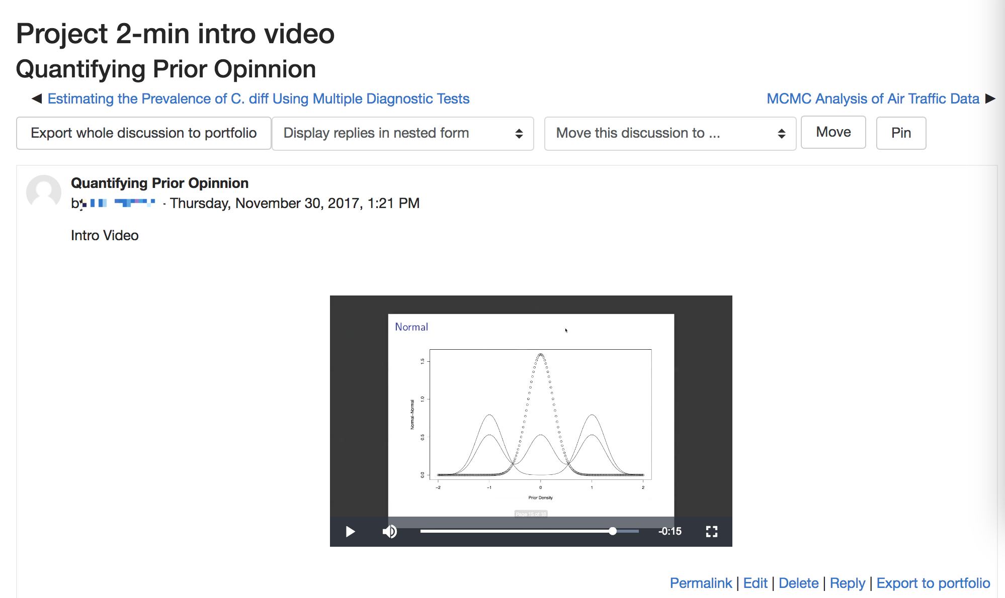
Online learning community: Example 1 – project intro videos
Useful for presenters Useful for audience

Slide 11
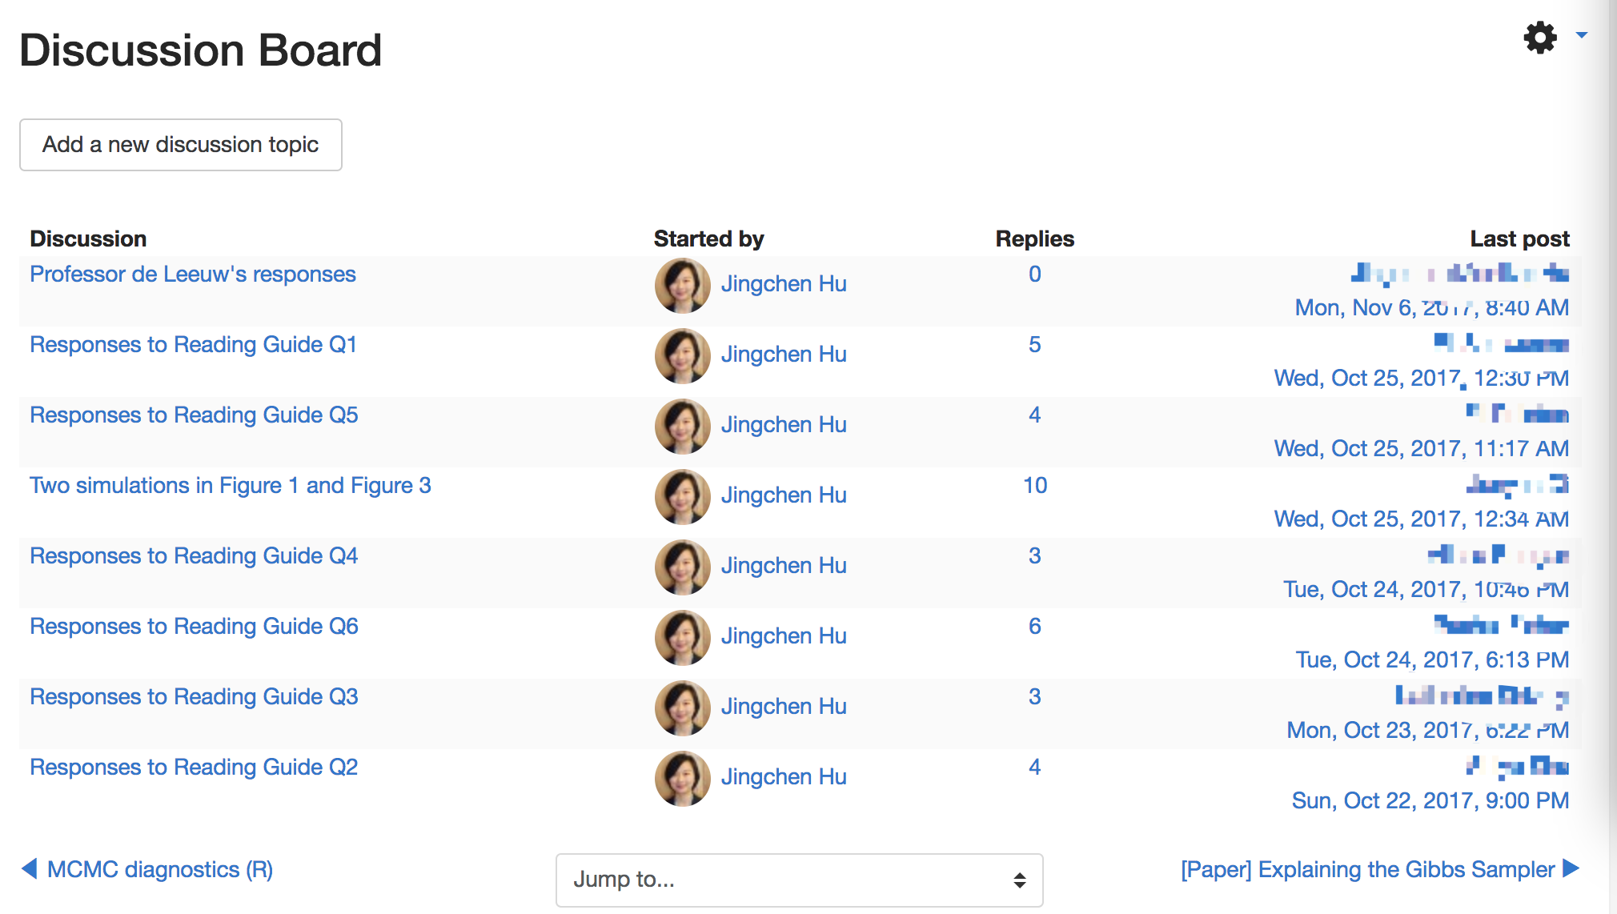
Online learning community: Example 2 – reading a research paper
Students accountability Higher level of engagement Few discussion topics started by students

Slide 12
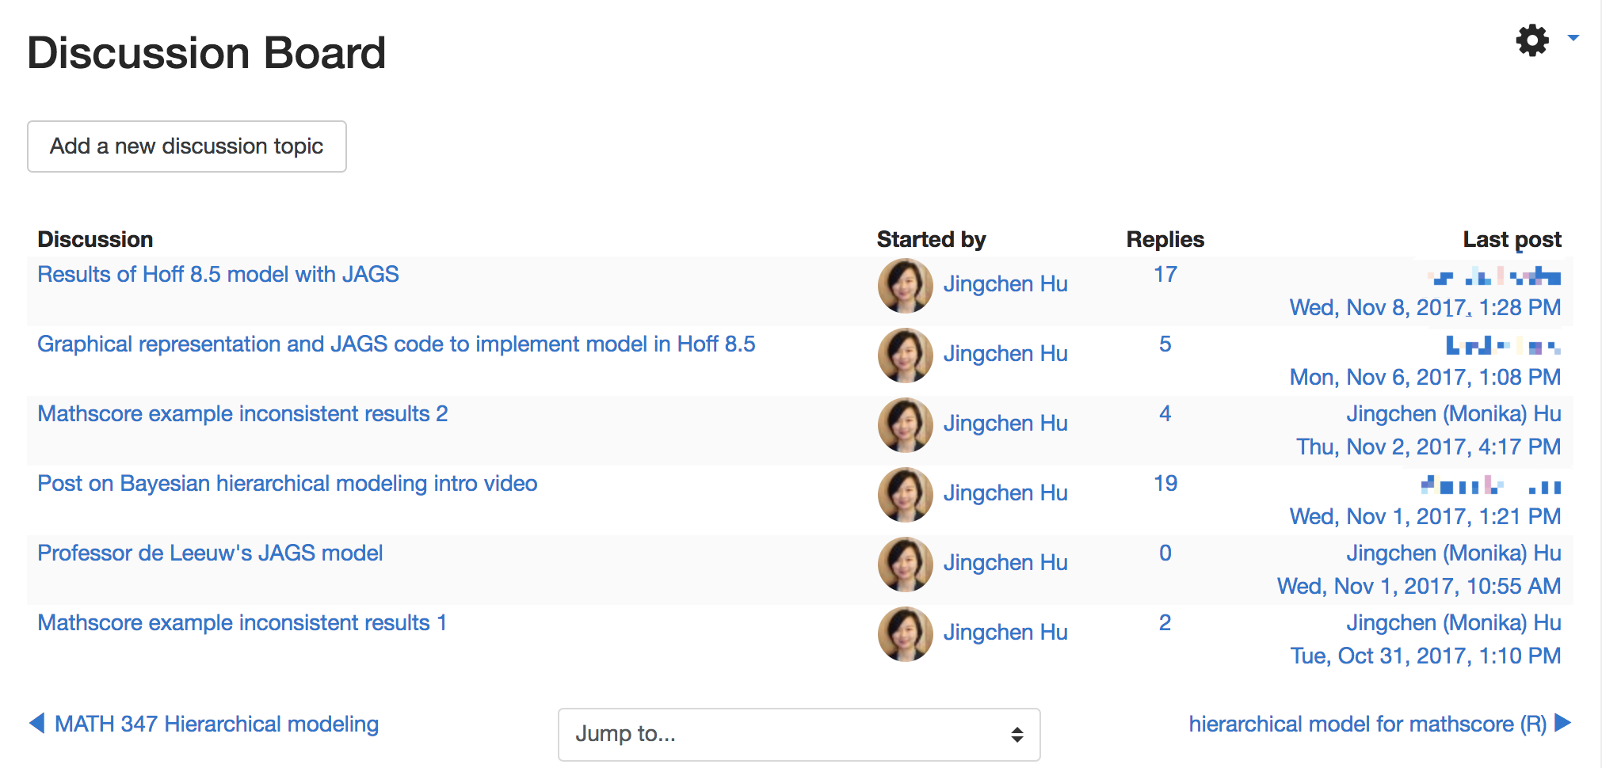
Online learning community: Example 3 – guest introductory videos
Students accountability -> higher level of engagement Post my own unsolved problems (learning together) -> some engagement

Slide 13

Thank you very much!
Jingchen (Monika) Hu
Mathematics and Statistics
Vassar College
Course Sharing Project
Liberal Arts Collaborative for Digital Innovation (LACOL)
jihu@vassar.edu

