Slide 1
Multiple-target Robust Design of a Coronary Stent with Multiple Functional Outputs
Jiang Fang Matthias HY Tan
School of Data Science, City University of Hong Kong

Slide 2
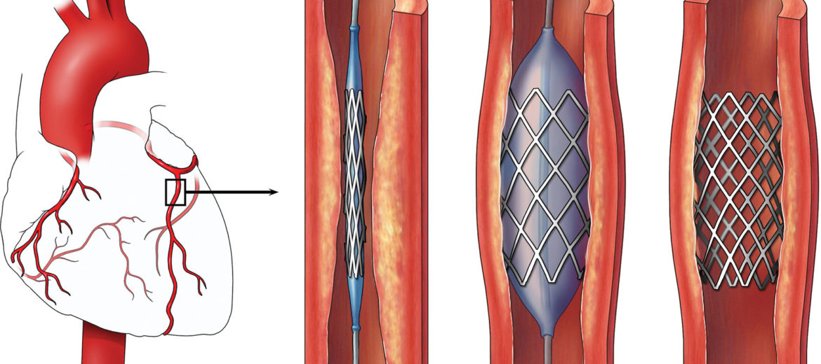
Background
Coronary stents are used to open narrowed arteries
Restenosis: the recurrence of narrowing of the artery, induced during the implantation of stent.
Multiple-target problem
Physical experiment Computer simulations using the finite element method
Costly
High computational burden

Slide 3
Background
Much of the published work: comparative studies (Lally et al., 2005, Wang et al., 2006, Lim et al., 2008).
Optimizing a number of scalar summaries of the expansion process (Li et al., 2009; Li and Wang 2013; Pant et al. 2012)
Few papers attempt to find a robust stent design
Robust parameter design (RPD)
Choose nominal values of design factors
Making systems insensitive to noise variation
Multiple-target system
Signal factor
accommodate different customer requirements
Joseph and Wu (2002): formulation of RPD for multiple-target scalar response systems
In the present work, a multi-output GP emulator is applied to predict the outputs of a finite element computer model at all simulation time-steps.
The Joseph-Wu formulation of the multi-target problem is solved using the emulator

Slide 4
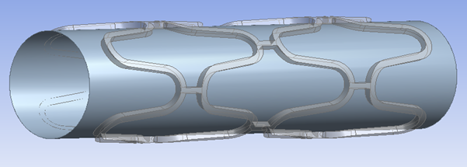
Finite element model
Finite element method is applied to simulate the expansion process of a stent-balloon system using ANSYS
Geometry of stent-balloon system
Under pressure from an expanding balloon, the stent expands to widen the arteries.
Stent expands until the balloon diameter reaches the target value.
The balloon is removed after loading , the slightly recoiled stent remains.
Radial displacement process of balloon
with maximum displacement (signal factor) of d=0.5 mm

Slide 5
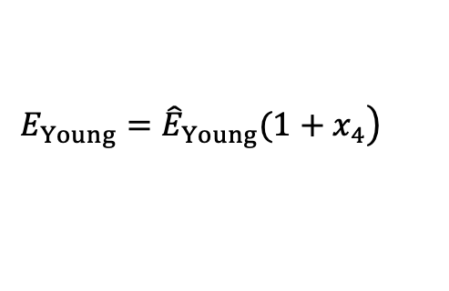

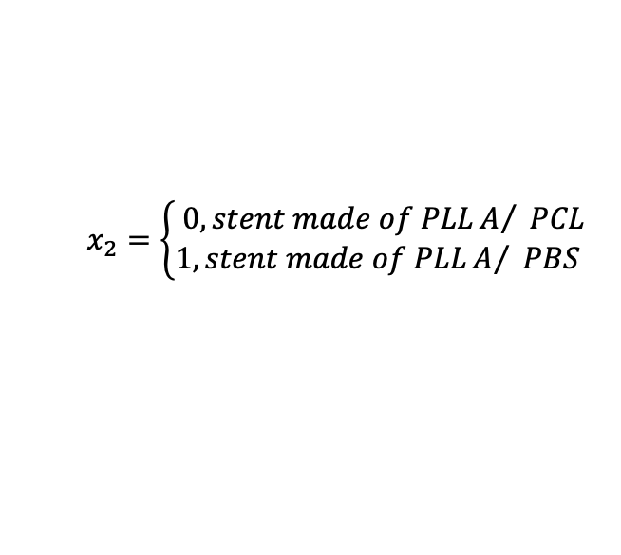
Control Factors and Noise Factors
To eliminate serious complications caused by permanent implant of metal stent, biodegradable stents have been proposed
Stents made of PLLA Blending with other polymers (PCL and PBS)
PLLA, PLLA/PBS, or PLLA/PCL blends ?
the percentage of PLLA?
Control factors: $x_{c}=(x_{1},x_{2})$, $x_{1}$: volume fraction of PLLA; $x_{2}$: type of blend
$$x_{2}=\left\{\begin{aligned}& 0,stent made of PLLA/ PCL \\ &1,stent made of PLLA/ PBS\end{aligned}\right.$$
$E_{blend}$ : properties of a composite material used in the computer model:
${\hat{E}}_{blend}=x_{1}E_{PLLA}+{x_{2}(1−x_{1})E}_{PBS}+{(1−x}_{2})\left(1−x_{1}\right)E_{PCL},$
Noise factors: $x_{e}=\left(x_{3},x_{4}\right),$fractional deviation of yield strength/Young’s modulus from their nominal values
$${E_{yield}=\hat{E}}_{yield}\left(1+x_{3}\right)$$
$$\left.{E_{Young}=\hat{E}}_{Young}(1+x_{4}\right)$$

Slide 6
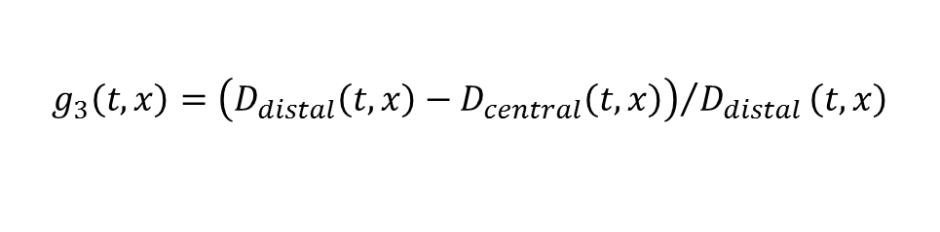
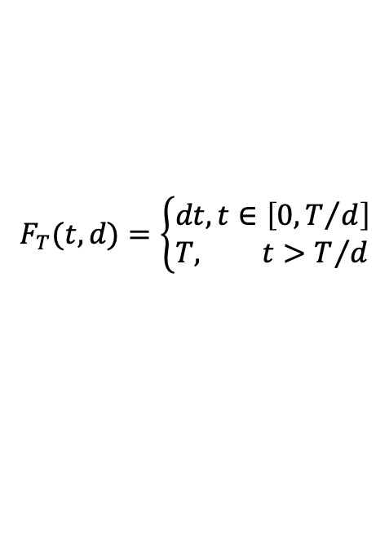


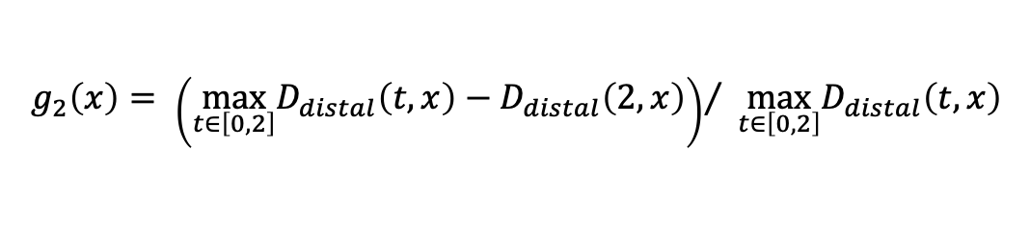
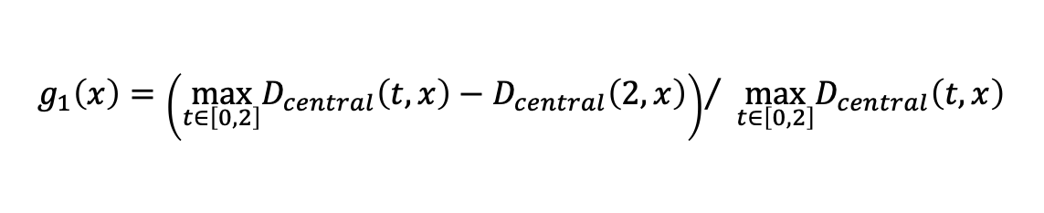
Target Function and Signal Factor
Signal factor: 𝑑, maximum radial displacement of the balloon
Target Function :
$$F_{T}(t,d)=\left\{\begin{aligned}&dt,t∈\left[0,T/d\right] \\ &T, t>T/d\end{aligned}\right.$$
$$T$$
: target radius
Outputs:
$D_{central}$ and $D_{distal}$
Summary measures of the stent expansion process
Central radial recoil : the difference between the maximum central radial displacement and the displacement after unloading
Distal radial recoil :
Dogboning : ends of the stent expand faster than its central portion
$$g_{1}\left(x\right)={\left(\max_{t∈\left[0,2\right]}D_{central}\left(t,x\right)−D_{central}\left(2,x\right)\right)}/ \max_{t∈\left[0,2\right]}D_{central}\left(t,x\right)$$
$$g_{2}\left(x\right)= {\left(\max_{t∈\left[0,2\right]}D_{distal}\left(t,x\right)−D_{distal}\left(2,x\right)\right)}/ \max_{t∈\left[0,2\right]}D_{distal}\left(t,x\right)$$
$$g_{3}\left(t,x\right)={\left(D_{distal}\left(t,x\right)−D_{central}\left(t,x\right)\right)}/{D_{distal}}\left(t,x\right)$$

Slide 7
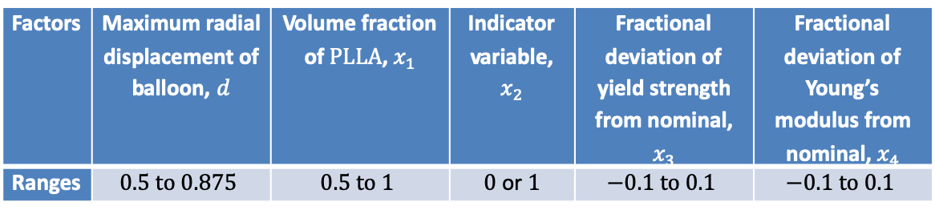
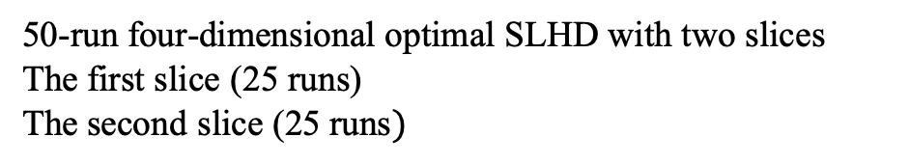
Design of computer experiment
Input setting: $x=({d,x}_{c},x_{e})$, where $x_{c}=\left(x_{1},x_{2}\right)$ and $x_{e}=\left(x_{3},x_{4}\right)$
Table 1: Factors and their ranges
Factors | Maximum radial displacement of balloon, $d$ | Volume fraction of $PLLA$, $x_{1}$ | Indicator variable, $x_{2}$ | Fractional deviation of yield strength from nominal, $x_{3}$ | Fractional deviation of Young’s modulus from nominal, $x_{4}$
Ranges | $$0.5 to 0.875$$ | $$0.5 to 1$$ | $0$ or $1$ | $$−0.1 to 0.1$$ | $$−0.1 to 0.1$$
Quantitative and qualitative factors
50-run four-dimensional optimal SLHD with two slices
The first slice (25 runs)
The second slice ($\text{25 }\text{runs})$
PLLA/PCL stents
PLLA/PBS stents

Slide 8
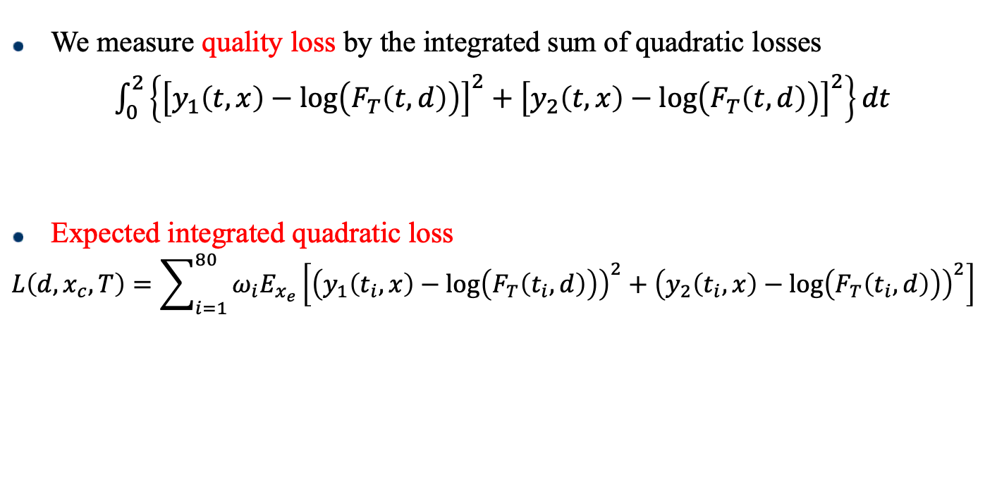
Performance Measure for Robust Stent Design
The severity of vessel damage is proportional to $\left(D_{central}−F_{T}\right)/F_{T}$ and $\left(D_{distal}−F_{T}\right)/F_{T}$
Approximated by
$\log\left(D_{central}\right)−\log\left(F_{T}\right)$ and $\log\left(D_{distal}\right)−\log\left(F_{T}\right)$
Log transform
$y_{1}\left(t,x\right)=\log\left(D_{central}\left(t,x\right)\right)$, $y_{2}\left(t,x\right)=log (D_{distal}\left(t,x\right))$.
We measure quality loss by the integrated sum of quadratic losses
$\int_{0}^{2}{\left\{{\left[y_{1}\left(t,x\right)−\log\left(F_{T}\left(t,d\right)\right)\right]}^{2}+{\left[y_{2}\left(t,x\right)−\log\left(F_{T}\left(t,d\right)\right)\right]}^{2}\right\}}dt$
Expected integrated quadratic loss
$$L\left(d,x_{c},T\right)=\sum_{i=1}^{80}{ω_{i}E_{x_{e}}\left[{\left(y_{1}\left(t_{i},x\right)−\log\left(F_{T}\left(t_{i},d\right)\right)\right)}^{2}+{\left(y_{2}\left(t_{i},x\right)−\log\left(F_{T}\left(t_{i},d\right)\right)\right)}^{2}\right]}$$
quadrature formula
$$\sum_{i=1}^{80}{ω_{i}\left[{\left(y_{1}\left(t_{i},x\right)−\log\left(F_{T}\left(t_{i},d\right)\right)\right)}^{2}+{\left(y_{2}\left(t_{i},x\right)−\log\left(F_{T}\left(t_{i},d\right)\right)\right)}^{2}\right]}$$

Slide 9

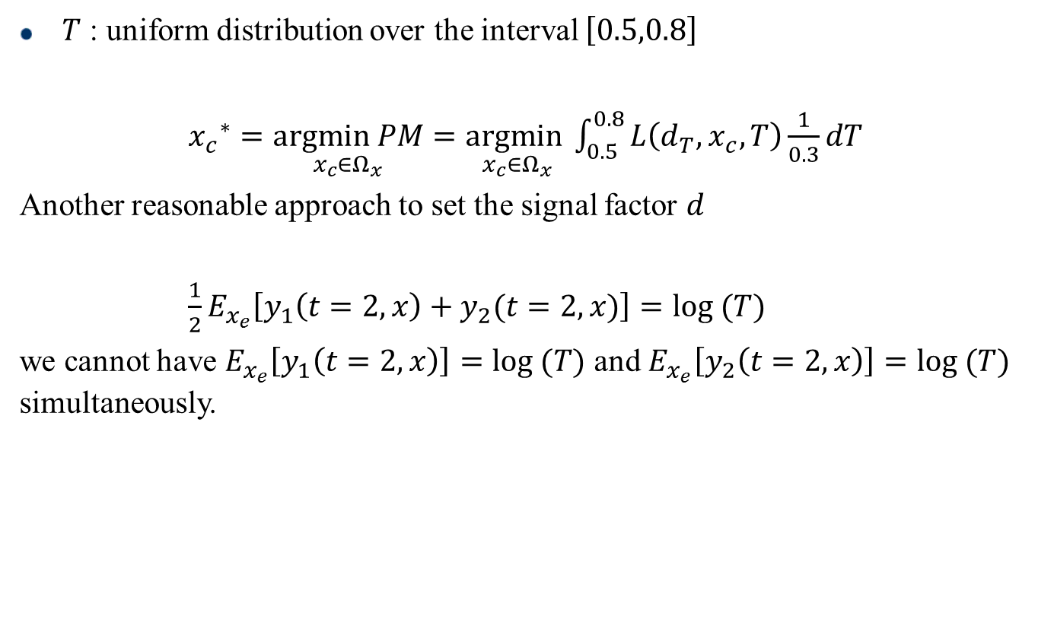
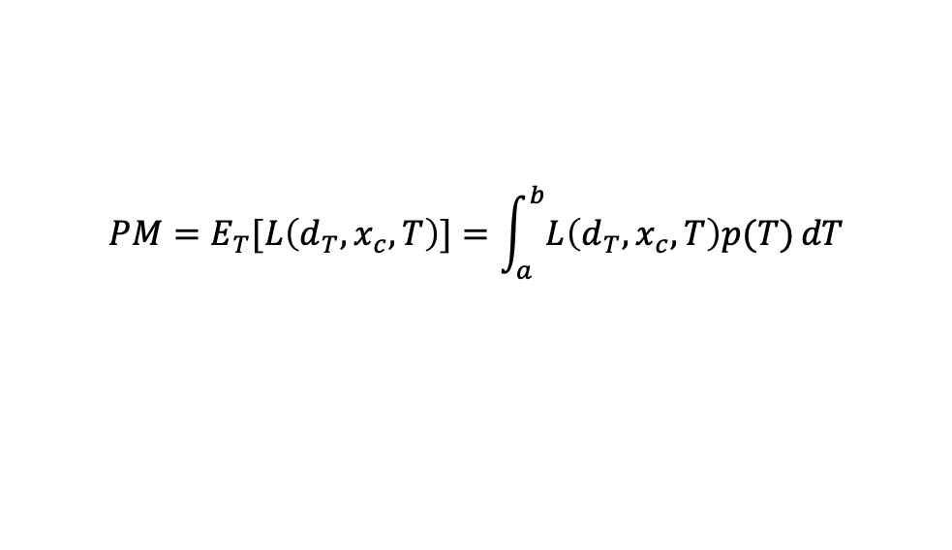
Performance Measure for Robust Stent Design
Signal factor
$$d_{T}=\underset{d∈Ω_{d}}{argmin}\left\{L\left(d,x_{c},T\right):d≥T\right\}$$
$$PM=E_{T}[L\left(d_{T},x_{c},T\right)]=\int_{a}^{b}{L\left(d_{T},x_{c},T\right)p(T)}dT$$
$T$ : uniform distribution over the interval $\left[0.5,0.8\right]$
${x_{c}}^{∗}=\underset{x_{c}∈Ω_{x}}{argmin PM}=\underset{x_{c}∈Ω_{x}}{argmin}\int_{0.5}^{0.8}{L\left(d_{T},x_{c},T\right)\frac{1}{0.3}}dT$
Another reasonable approach to set the signal factor $d$
$\frac{1}{2}E_{x_{e}}\left[y_{1}\left(t=2,x\right)+y_{2}(t=2,x)\right]=log (T)$
we cannot have $E_{x_{e}}\left[y_{1}\left(t=2,x\right)\right]=log (T)$ and $E_{x_{e}}\left[y_{2}\left(t=2,x\right)\right]=log (T)$ simultaneously.

Slide 10
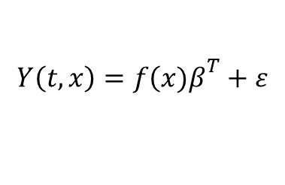
GP emulator
We employ a multi-functional output GP emulator to construct an emulator for the two functional outputs of the FE computer model.
We model the computer output vector as a stationary GP of the form:
$$Y\left(t,x\right)=f{\left(x)β\right.}^{T}+ε$$
where $f\left(x\right)$is a regression functions and $β$ is a $p×q$ matrix of regression coefficients. The residual $ε$ is a vector valued GP with zero mean and separable covariance function.
The functional outputs at each experiment run are $p$ functions observed at $T={\{t}_{1}, t_{2}, …, t_{m}\}$. We arrange all output data in a $mn×p$ matrix $Z$
$Z$ follows a matrix-normal distribution $N_{mn,p}\left(Fβ^{T},R,Σ\right)$
The maximum likelihood estimates of $β$ and $Σ$ are
$$\hat{β}=Z^{T}((R_{X}^{−1} F)⊗{(R}_{t}^{−1}1_{m})){{({ F}^{T}R}_{X}^{−1} F)}^{−1}{({{1_{m}}^{T}R}_{t}^{−1}1_{m})}^{−1}$$
$$\hat{Σ}=\frac{1}{mn}{\left(Z−(F⊗1_{m}){\hat{β}}^{T}\right) }^{T}(R_{X}^{−1}⊗R_{τ}^{−1})\left(Z−(F⊗1_{m}){\hat{β}}^{T}\right)$$

Slide 11

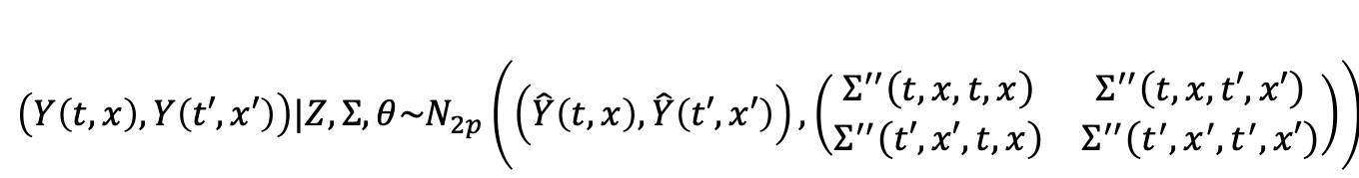
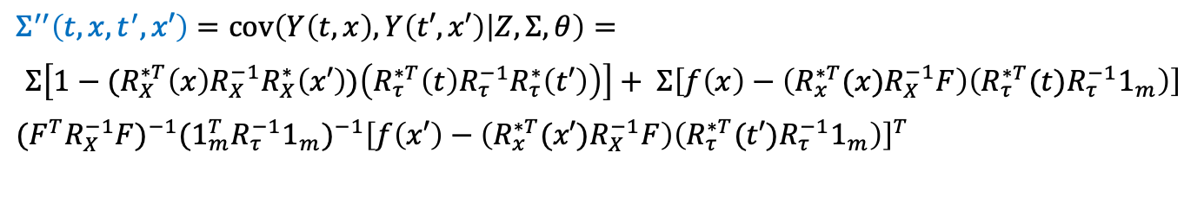
GP emulator
Suppose we want to predict $y\left(t,x\right),\text{the} \text{posterior} \text{predictive} \text{process} \text{conditional} \text{on} Σ \text{is} \text{given} \text{by}\text{:}$
$\left(Y\left(t,x\right),Y\left(t′,x′\right)\right)|Z,Σ,θ\sim N_{2p}\left(\left(\hat{Y}\left(t,x\right),\hat{Y}\left(t′,x′\right)\right),\left(\begin{matrix}Σ^{′′}\left(t,x,t,x\right) & Σ^{′′}\left(t,x,t′,x′\right) \\ Σ^{′′}\left(t′,x′,t,x\right) & Σ^{′′}\left(t^{′},x^{′},t^{′},x′\right)\end{matrix}\right)\right)$
The posterior mean function $\hat{Y}$ and the posterior covariance functions $Σ^{′′}$ are
$$\hat{Y}\left(t,x\right)=f(x){\hat{β}}^{T}+\left[\left(R_{X}^{∗T}(x)R_{X}^{−1}\right)⊗\left(R_{τ}^{∗T}(t)R_{τ}^{−1}\right)\right]\left(Z−(F⊗1_{m}){\hat{β}}^{T}\right)$$
$$Σ^{′′}\left(t,x,t^{′},x′\right)=cov\left(Y\left(t,x\right),Y\left(t′,x′\right) | Z,Σ,θ\right)=$$
$$Σ\left[1−(R_{X}^{∗T}\left(x\right)R_{X}^{−1}R_{X}^{∗}\left(x′\right))\left(R_{τ}^{∗T}\left(t\right)R_{τ}^{−1}R_{τ}^{∗}\left(t′\right)\right)\right]+ Σ\left[f\left(x\right)−\left(R_{x}^{∗T}(x)R_{X}^{−1}F\right)\left(R_{τ}^{∗T}(t)R_{τ}^{−1}1_{m}\right)\right]$$
$(F^{T}R_{X}^{−1}F{)^{−1}(1_{m}^{T}R}_{τ}^{−1}1_{m})^{−1}{\left[f\left(x′\right)−\left(R_{x}^{∗T}(x′)R_{X}^{−1}F\right)\left(R_{τ}^{∗T}(t′)R_{τ}^{−1}1_{m}\right)\right]}^{T}$

Slide 12
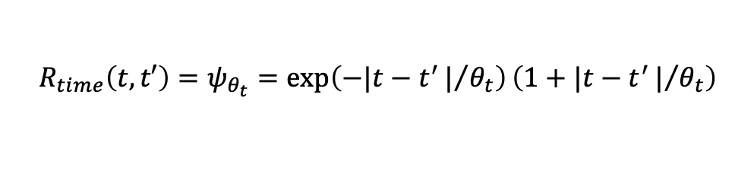
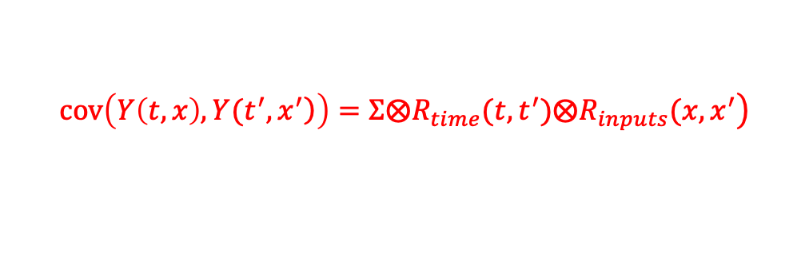
Analysis and Results
1. Comparison between the multi-functional output GP and independent GP emulators
Independent GP emulators (Spiller et al. 2014)
160 independent GP emulators: two outputs at 80 time points
Multi-functional output GP emulator VS independent GP emulators
25+25 computer simulation runs are conducted.
Randomly pick 20 out of 25 runs in each slice of the SLHD 30 times
30 training sets remaining ten runs : test points
A separable correlation function is used:
$$\left.cov\left(\left.Y\left(t,x\right),Y(t^{′},x^{′}\right)\right)=Σ⨂R_{time}(t, t^{′}){⨂R}_{inputs}(x, x^{′}\right)$$
Matérn correlation function with smoothness parameter $v=\frac{3}{2}:$
$$R_{time}\left(t,t′\right)=ψ_{θ_{t}}=\exp\left(−|t−t^{′}|/{θ_{t}}\right)\left(1+|t−t^{′}|/{θ_{t}}\right)$$
$$\left(w_{PCL},w_{PBS}\right)=\left(\left(1−x_{2}\right)\left(1−x_{1}\right),x_{2}\left(1−x_{1}\right)\right)$$
The correlation function for $\left(d,w_{PCL},w_{PBS},x_{3},x_{4}\right)$:
$$R_{inputs}\left(x,x′\right)=ψ_{θ_{d}}\left(d,d^{′}\right)ψ_{θ_{1}}\left(w_{PCL},w_{PCL}^{′}\right)ψ_{θ_{2}}\left(w_{PBS},w_{PBS}^{′}\right)ψ_{θ_{3}}\left(x_{3},x_{3}^{′}\right)ψ_{θ_{4}}\left(x_{4},x_{4}^{′}\right)$$

Slide 13
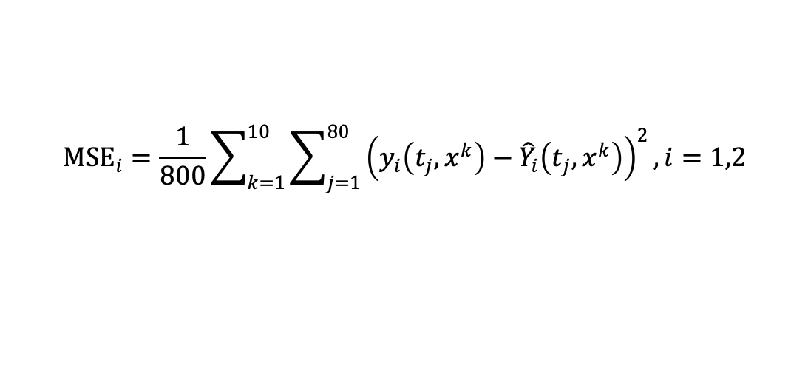
Analysis and Results
Boxplots of MSE for multi-functional output GP emulator and independent GP emulators
Mean squared error (MSE)
$${MSE}_{i}=\frac{1}{800}\sum_{k=1}^{10}{\sum_{j=1}^{80}{{\left(y_{i}\left(t_{j},x^{k}\right)−{\hat{Y}}_{i}\left(t_{j},x^{k}\right)\right)}^{2}}},i=1,2$$
Independent GP emulators give slightly better MSE than the multi-functional output GP emulator.

Slide 14
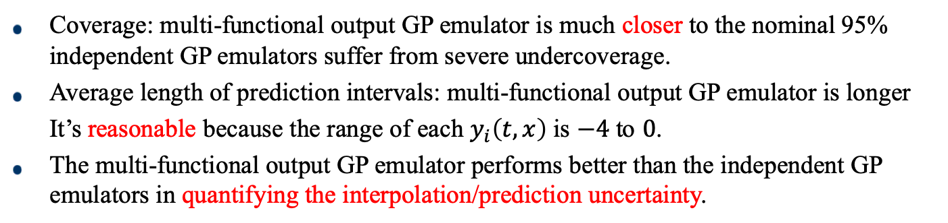
Analysis and Results
Boxplots of coverage of nominal 95% prediction intervals and average length of the prediction intervals for multi-functional output GP emulator and independent GP emulators
Coverage: multi-functional output GP emulator is much closer to the nominal 95% independent GP emulators suffer from severe undercoverage.
Average length of prediction intervals: multi-functional output GP emulator is longer
It’s reasonable because the range of each $y_{i}\left(t,x\right)$ is $−4$ to $0$.
The multi-functional output GP emulator performs better than the independent GP emulators in quantifying the interpolation/prediction uncertainty.

Slide 15
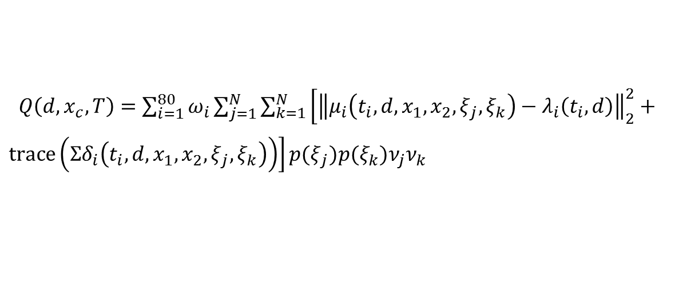
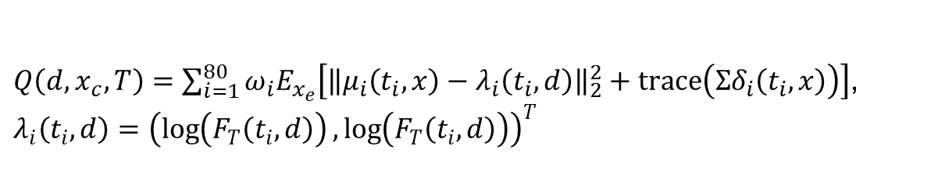
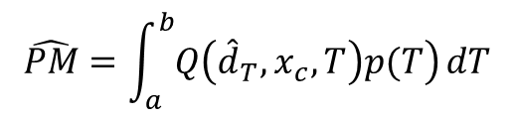

Analysis and Results
2. Robust Optimization of Stent Based on the Multi-functional Output GP Emulator
Fit the GP emulator using data from all 50 design points
Posterior expected integrated quadratic loss
$Q\left(d,x_{c},T\right)=\sum_{i=1}^{80}{ω_{i}E_{x_{e}}\left[{\left\|μ_{i}\left(t_{i},x\right)−λ_{i}\left(t_{i},d\right)\right\|}_{2}^{2}+trace\left(Σδ_{i}\left(t_{i},x\right)\right)\right]}$,
$$λ_{i}\left(t_{i},d\right)={\left(\log\left(F_{T}\left(t_{i},d\right)\right),\log\left(F_{T}\left(t_{i},d\right)\right)\right)}^{T}$$
Gauss-Legendre quadrature
$Q\left(d,x_{c},T\right)=\sum_{i=1}^{80}{ω_{i}\sum_{j=1}^{N}{\sum_{k=1}^{N}{\left[{\left\|μ_{i}\left(t_{i},d,x_{1},x_{2},ξ_{j},ξ_{k}\right)−λ_{i}\left(t_{i},d\right)\right\|}_{2}^{2}+\right.}}}$
$\left.trace\left(Σδ_{i}\left(t_{i},d,x_{1},x_{2},ξ_{j},ξ_{k}\right)\right)\right]p(ξ_{j})p(ξ_{k})ν_{j}ν_{k}$
Signal factor
$${\hat{d}}_{T}=\underset{d∈Ω_{d}}{argmin}\left\{Q\left(d,x_{c},T\right):d≥T\right\}$$
$$\hat{PM}=\int_{a}^{b}{\left.Q\left({\hat{d}}_{T},x_{c},T\right)p(T\right)}dT$$
Performance Measure

Slide 16

Analysis and Results
Plot of performance measure versus volume fraction of PLLA for the two types of stents
$x_{1}={x_{1}}^{∗}=1$ $(\text{stent} \text{made} \text{of} \text{PLLA}$) minimize $\hat{PM}$ for both stent materials
$PM$ is estimated with little uncertainty by $\hat{PM}$

Slide 17


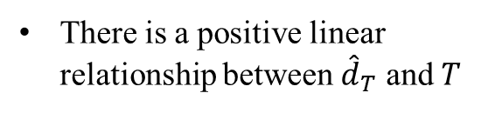
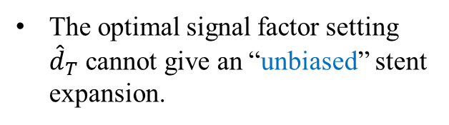
Analysis and Results
The signal factor setting $d_{T,2}$ :
$\frac{1}{2}{\hat{E}}_{x_{e}}\left\{E_{Y\left(∙\right)}\left[Y_{1}\left(t=2,x\right)\right]+E_{Y\left(∙\right)}\left[Y_{2}(t=2,x)\right]\right\}=log(T)$
There is a positive linear relationship between ${\hat{d}}_{T}$ and $T$
${\hat{d}}_{T,2}$ is larger than ${\hat{d}}_{T}$ for fixed $T$
The optimal signal factor setting ${\hat{d}}_{T}$ cannot give an “unbiased” stent expansion.

Slide 18
Summary and conclusions
We apply the theoretical formulation proposed by Joseph and Wu (2002) for robust design of multiple-target systems to design a coronary stent with a multi-functional output Gaussian process model
Contributions:
Computer model of a coronary stent yields multivariate time series outputs and takes a long time to run. The multi-functional output Gaussian process model significantly expedites the process of stent design.
There is no existing work on multiple functional output and multiple functional target robust design problems based on a time-consuming computer model

Slide 19
Reference
Joseph, V. R., & Wu, C. J. 2002. Robust parameter design of multiple-target systems. Technometrics, 44(4), 338-346.
Li, N., Zhang, H., & Ouyang, H. 2009. Shape optimization of coronary artery stent based on a parametric model. Finite Elements in Analysis and Design, 45(6): 468-475.
Sacks, J., Welch, W. J., Mitchell, T. J., & Wynn, H. P. 1989. Design and analysis of computer experiments. Statistical science: 409-423.
Santner, T. J., Williams, B. J., & Notz, W. I. 2003. The design and analysis of computer experiments. Springer Science & Business Media.
Li, H., & Wang, X. 2013. Design optimization of balloon-expandable coronary stent. Structural and Multidisciplinary Optimization, 48(4): 837-847.
Conti, S., Gosling, J. P., Oakley, J. E., & O'Hagan, A. 2009. Gaussian process emulation of dynamic computer codes. Biometrika, 96(3): 663-676.
Spiller, E. T., Bayarri, M. J., Berger, J. O., Calder, E. S., Patra, A. K., Pitman, E. B., & Wolpert, R. L. 2014. Automating emulator construction for geophysical hazard maps. SIAM/ASA Journal on Uncertainty Quantification, 2(1): 126-152.

Slide 20
Thank you!

