Slide 1
GREIN: An Interactive Web Platform for Re-analyzing GEO RNA-seq Data
Naim Al Mahi
Division of Biostatistics and Bioinformatics
Department of Environmental Health
University of Cincinnati College of Medicine, Cincinnati, OH

Slide 2
Definitions
RNA-seq: High throughput sequencing technology that tells us which genes are active and how much they are transcribed.
GEO: Gene Expression Omnibus (GEO) is a public database repository of raw gene expression data.

Slide 3
Motivation
Reuse of GEO RNA-seq data is made difficult by the complexity of the processing protocols and analytical tools.
Lack of open-source user-friendly tools with comprehensive analytical toolbox for re-analysis of public RNA-seq data.

Slide 4
What is GREIN?
GREIN (GEO RNA-seq Experiments Interactive Navigator) is an interactive web-application with access to >12,000 uniformly processed human, mouse, and rat Gene Expression Omnibus (GEO) RNA-seq data and >400,000 samples.
User-friendly interfaces to manipulate and analyze GEO RNA-seq data

Slide 5
Overview of RNA-seq
Sample of interest
Extract total RNA
mRNA fragments
Convert to cDNA
Align reads to reference genome
Sequenced reads
Sequencing
machine
Add adapters
Gene A
Gene B

Slide 6
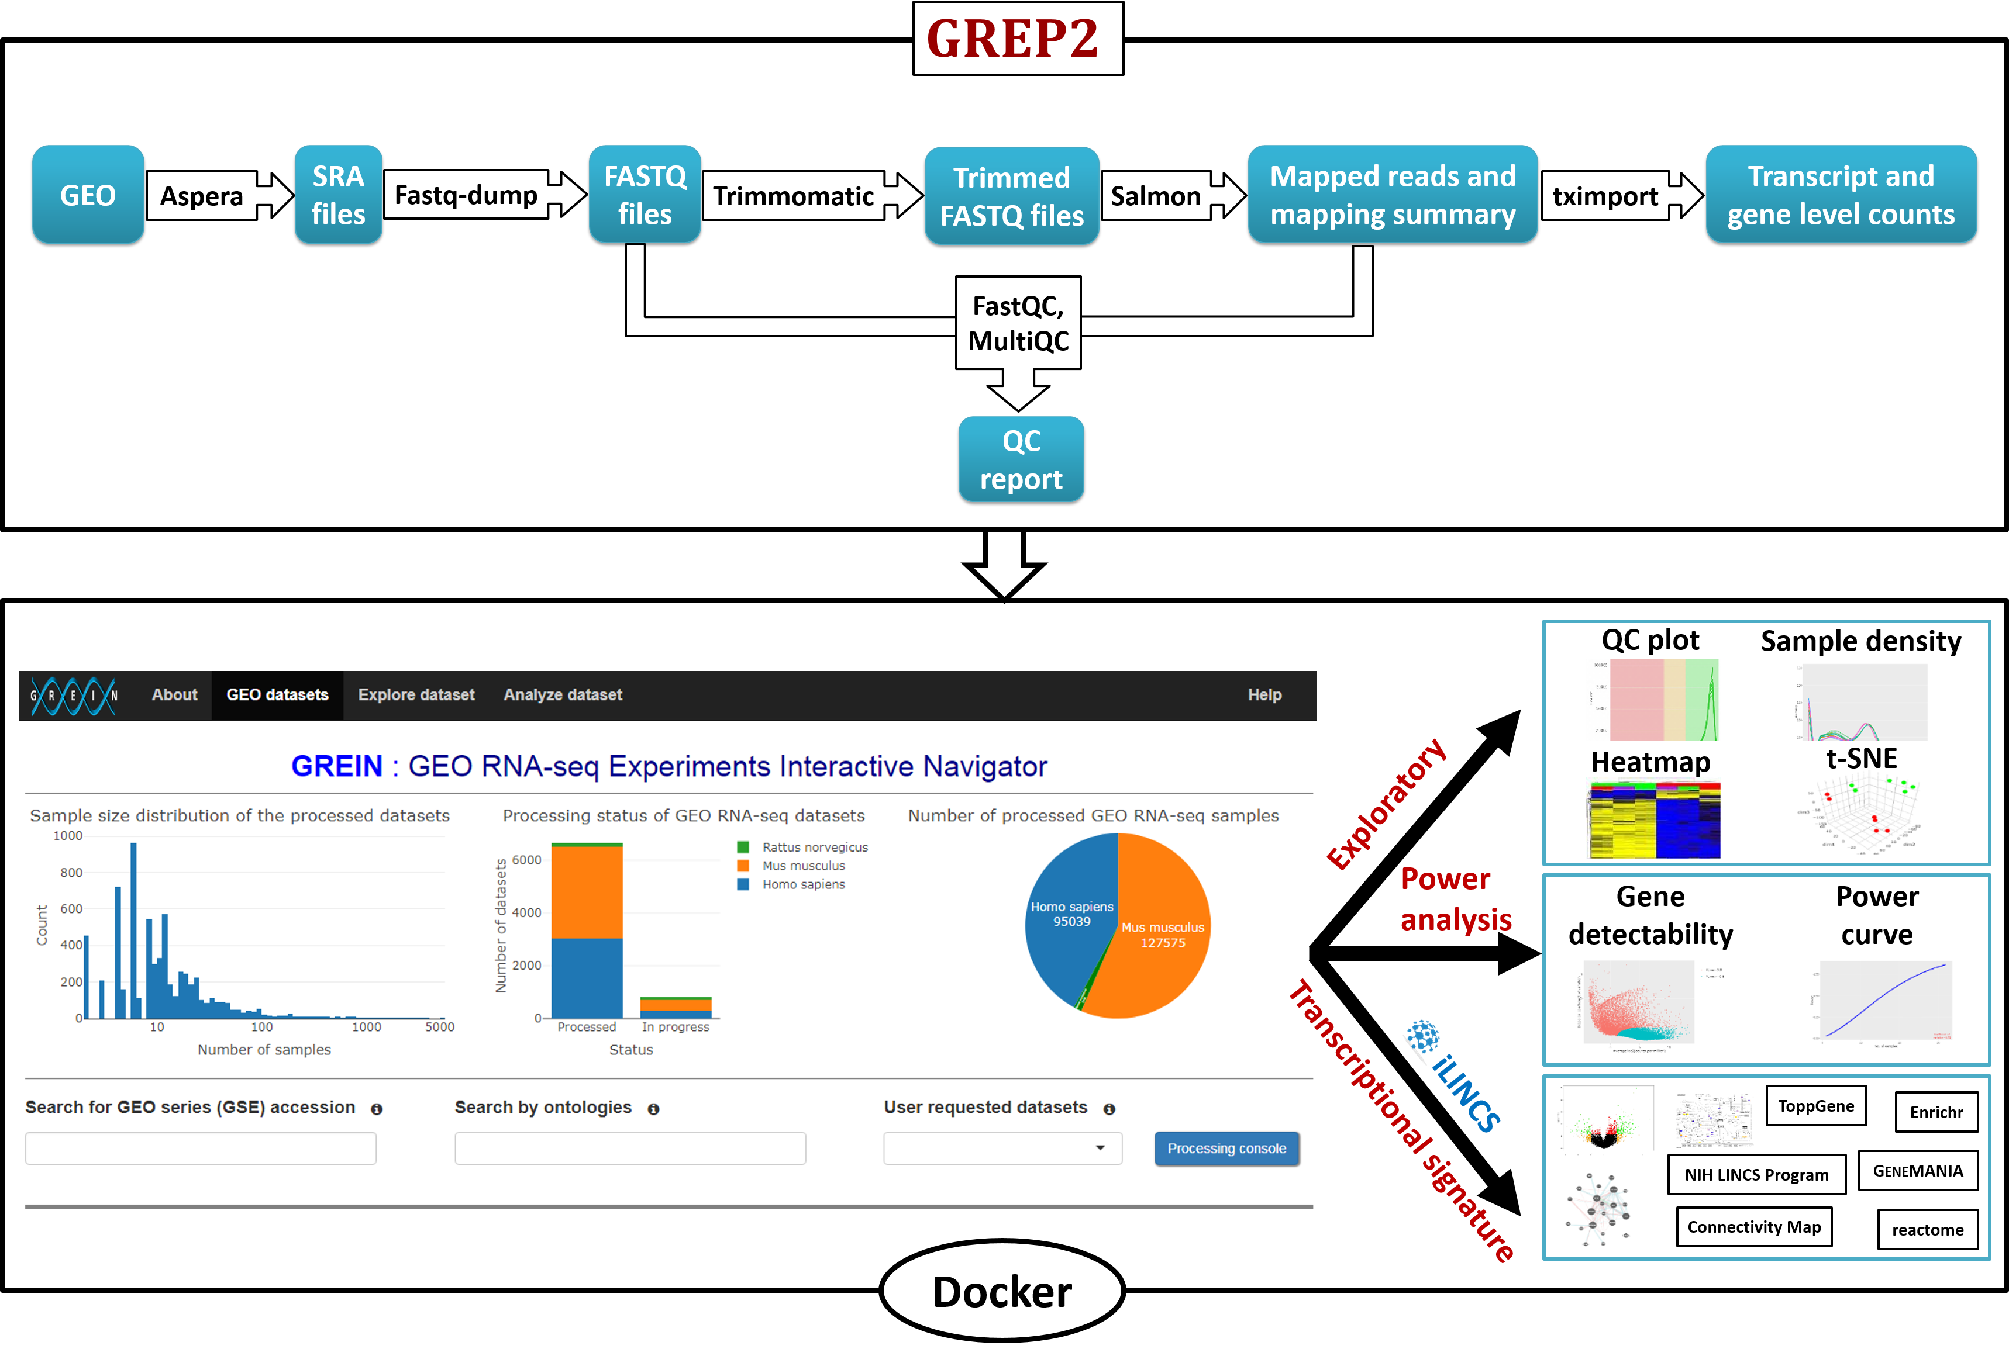
GREIN
workflow

Slide 7
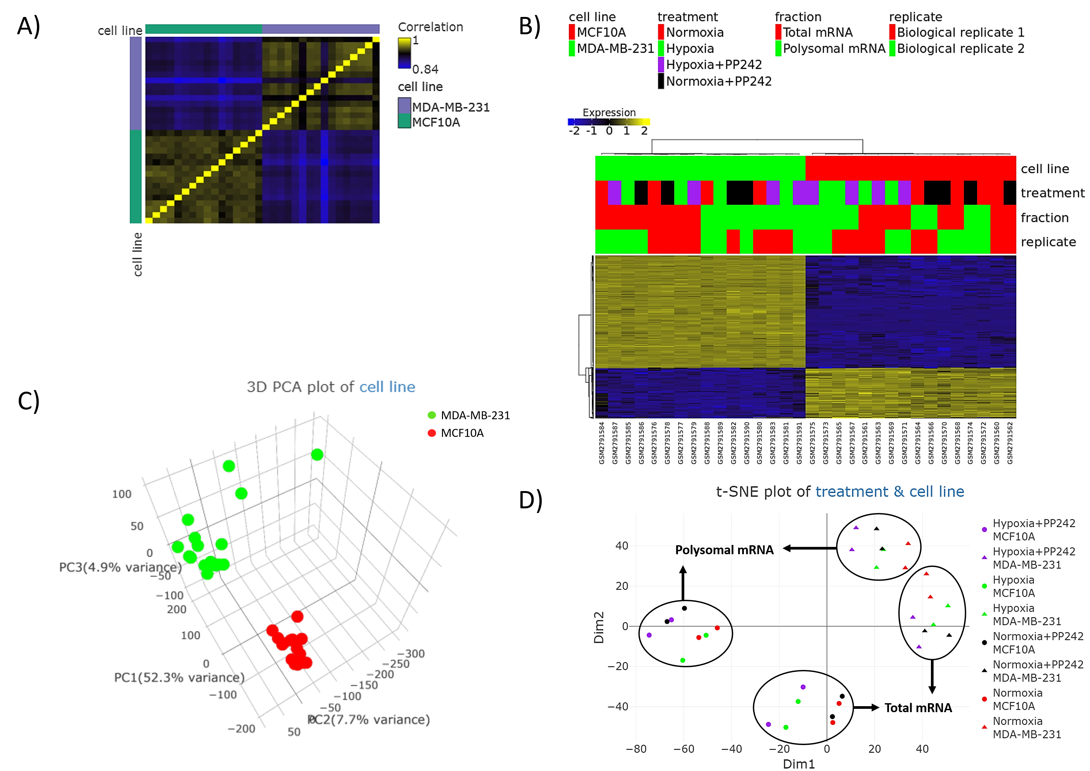
Exploratory
analysis

Slide 8
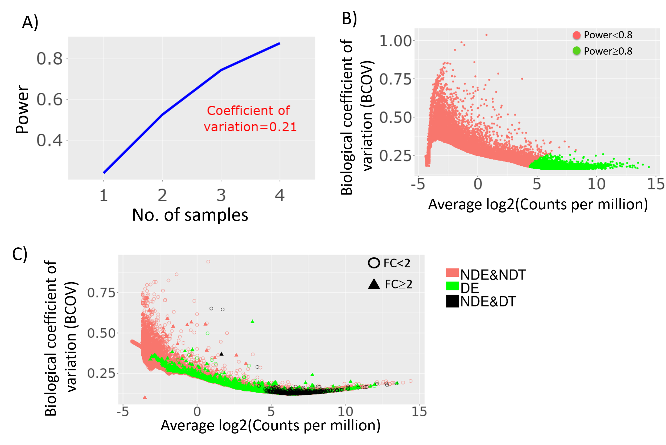
Power
analysis

Slide 9
GREIN is accessible at: https://shiny.ilincs.org/grein

Slide 10
Acknowledgement
Mario Medvedovic, PhD (Advisor)
Michal Kouril, PhD
Mehdi Fazel
Marcin Pilarczyk
NIH BD2K-LINCS (U54HL127624), CEG (P30ES06096)

Slide 11
Thank you!

