Slide 1
Using Convolutional Neural Networks to Automatically Classify Logos on Shopping Receipts
Émilie Mayer
Brian Lee
31/05/2019
Symposium on Data Science and Statistics

Slide 2
Overview
What is the Survey of Household Spending (SHS) ?
Idea
Neural Networks (NN) & Convolutional Neural Networks (CNN)
Automatic Logo Classification Strategy
Pre-trained NN
“Simpler” CNN
Things to Consider
Next Steps ?
1

Slide 3
Survey of Household Spending (SHS)
Statistics Canada household survey that collects information on household expenditures (ex: Shelter, Transportation, Education, Child Care, Food, Personal Care, etc.)
Data is collected in two parts.
2

Slide 4
Survey of Household Spending (SHS)
Data is collected in two parts:
1. Personal Interview (CAPI)
To obtain socio-demographic information, dwelling characteristics and information on a variety of expenditures
Questions on expenditures with varying recall periods (last payment, past month, past 3 months and past 12 months)
70% of expenditures are covered by the interview
3

Slide 5
Survey of Household Spending (SHS)
Data is collected in two parts:
2. Paper Diary
To record the household members’ daily expenditures for 1 week
Smaller and/or frequent expenditures (ex: groceries, personal care products, cleaning products, etc.)
Two options when completing the diary:
Transcribe each item bought in the paper diary
Provide the receipt for the purchase
4

Slide 6
Survey of Household Spending (SHS)
Each SHS cycle, about 30,000 receipts are collected from respondents.
Receipts are sent to headquarters, where they get scanned and then all the relevant information (store name, items bought, item price, date, etc.) are manually captured and coded.
The following study is a small scale research project to see if we can use machine learning algorithms to automate parts of the receipt capture process.
5

Slide 7
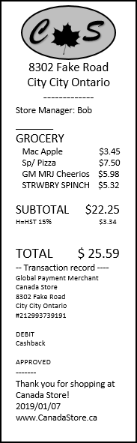

The Idea – Receipt Capture Automation
Information Extraction Based on Store Name
Scanning the receipt
Store Name Identification
The focus of this project.
Next Steps…
6

Slide 8

The Idea – Automatic Capture of the Store Name
1
Neural Network for Logo Classification
Convolutional Neural Network Algorithm
Crop Logo
Store Name
2
Optical Character Recognition (OCR)
Compare Results and Define Rules to Choose Between Contrasting Results
Perform OCR on Image of Receipt
Confront with Dictionary of Store Names
Store Name
Data!
7

Slide 9
Neural Networks (NN)
Neural Networks are powerful supervised machine learning algorithms.
Neural Networks are used in problems such as image classification, speech recognition, regression analysis, pattern recognition, filtering, etc.
Convolutional Neural Networks (CNN)
Convolutional Neural Networks are a type of NN often used in image recognition/classification tasks.
The usual CNN architecture includes a combination of convolutional layers, pooling layers and dense layers.

Slide 10
Convolution Neural Network (CNN)
Convolutional layers :
High computational heavy lifting
Small filters are slid over the input image and a dot product between the pixel values and filter values is performed to produce an activation map.
The role of the filters is to identify progressively more and more complex features (e.g. lines, curves, semi-circles,…etc.).
Pooling layers :
To reduce the dimensions of the activation map (down sampling) and help control for overfitting.
Max pooling and average pooling are commonly used.
Dense layers:
All neurons in a layers are connected to all neurons in the previous layer.
Performs classification on the features extracted from the convolutional and pooling layers.
Activation Map
Source: http://deeplearning.stanford.edu/wiki/index.php/Feature_extraction_using_convolution

Slide 11
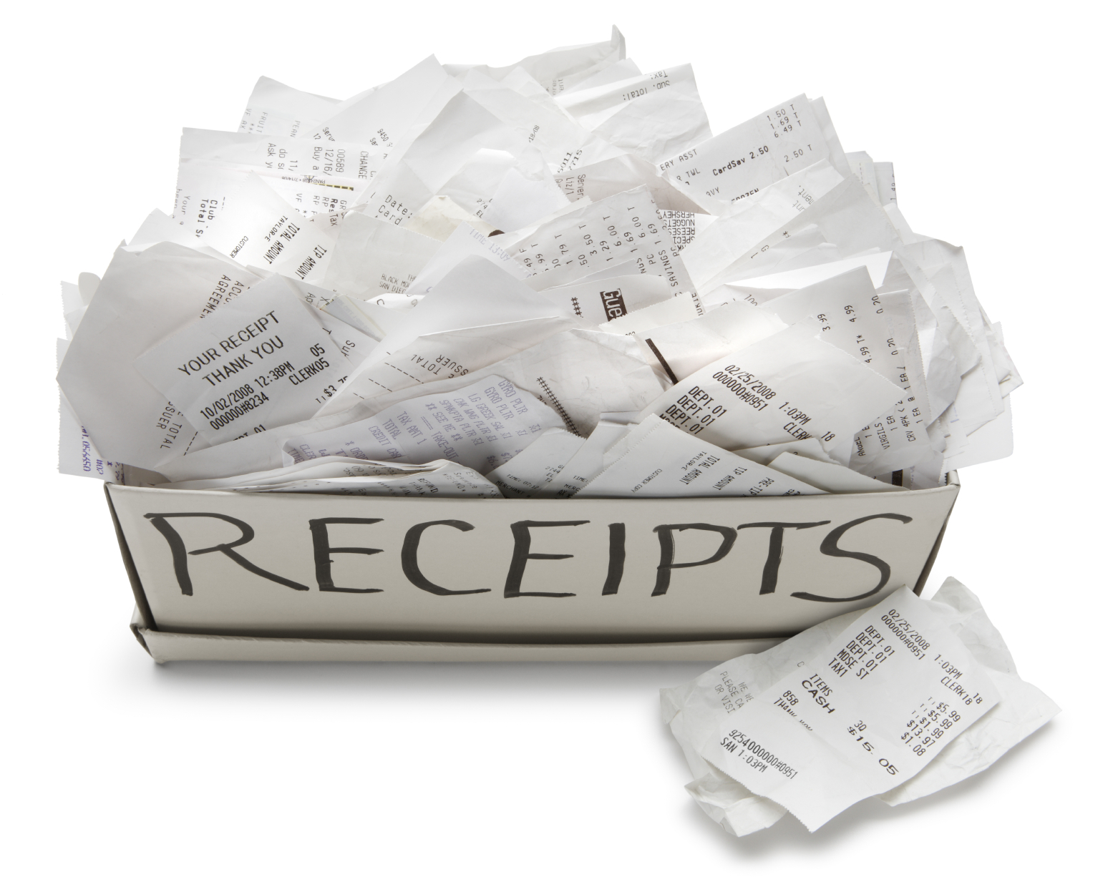

Automatic Logo Classification Strategy
ID | Receipt Number | Store Name
1 | 1 | Wharehouse +
1 | 2 | Great Store
1 | 3 | Canada Store
2 | 1 | Dollar Plus
2 | 2 | PriceCo
Wharehouse +
GreatStore
When combining the SHS 2015-2017, we have a total of over 100,000 captured and coded receipts.
After doing some cleaning, and only keeping logos of interest (Top 20 stores + Other category) we were left with:
Dollar
Plus
PRICECO
Training Set
(24,400 receipts)
Validation Set
(8,100 receipts)
Test Set
(8,100 receipts)
10

Slide 12
Automatic Logo Classification Strategy
We used R, Rstudio, the Keras package and the Tensorflow backend for this project.
Strategies involving Neural Network algorithms were tested:
Pretrained Neural Network Algorithm (Inception V3)
2. « Simpler » Convolutional Neural Network (CNN)
11

Slide 13
Pretrained Neural Networks
Pretrained NN are big, fairly complex Neural Networks that are already trained a very large dataset of images to recognize animals, objects, etc.
Transfer Learning
Algorithm is already trained to recognize patterns, lines, shapes, etc.
Make the bottom layers « untrainable » by freezing the weights and re-train only the top layers with your training data and new classes
Often, this is good solution for image classification projects with limited training data.
12

Slide 14
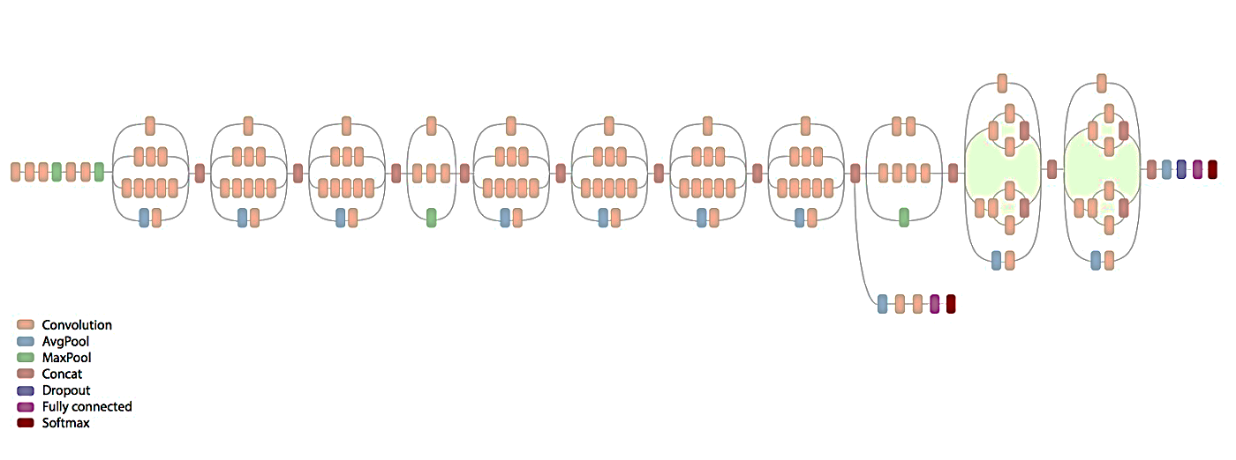
Pretrained Neural Network
InceptionV3:
Over 24 millions different parameters.
Trained on ImageNet (15 millions images with 1000 different classes)
Source: https://github.com/tensorflow/models/tree/master/research/inception
13

Slide 15
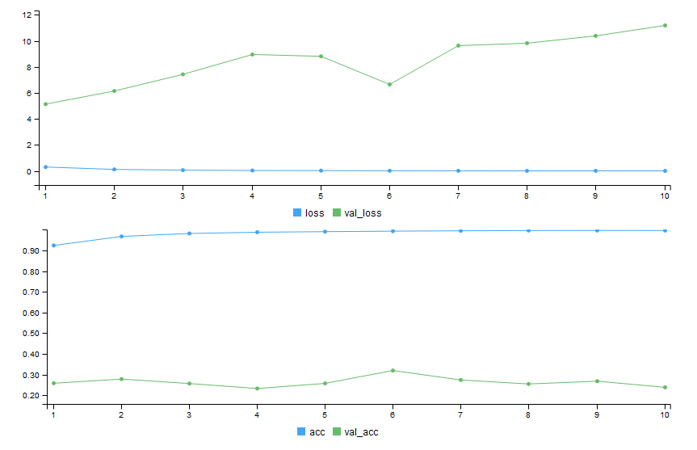
Pretrained Neural Network
Results:
Loss
Training loss decreasing; accuracy increasing
Validation loss is increasing; accuracy is decreasing
Epoch
99.7 %
Overfitting!
Accuracy
24 %
Epoch
14

Slide 16
Thoughts on Pretrained Neural Network
Perhaps the structure of InceptionV3 was too complicated for our problem.
Recognizing black and white store logos is much simpler than what the algorithm was originally trained to do.
Too many parameters for our problem. We tried techniques to reduce overfitting (regularization and dropouts) but obtained similar results.
Since logos are quite different than then what is found on ImageNet, we could have tried freezing less layers, but the time it takes to train the algorithm would have increased.
Set this idea aside for the time being.
Instead, we decided to build our own simpler CNN based only on our training data (no transfer learning).
15

Slide 17
CNN - Model
MODEL :
Input shape = (250, 80, 1)
Output = 21 classes (20 stores + 1 « Other » category)
Alternates between 3 convolutional layers with RELU activation function and Max Pooling Layers
A flatten layer and dense layers with Softmax activation function at the end of the CNN.
Optimizer: rmsprop
Loss function: Categorical Crossentropy
Total number of trainable parameters: 3,923,797
16

Slide 18
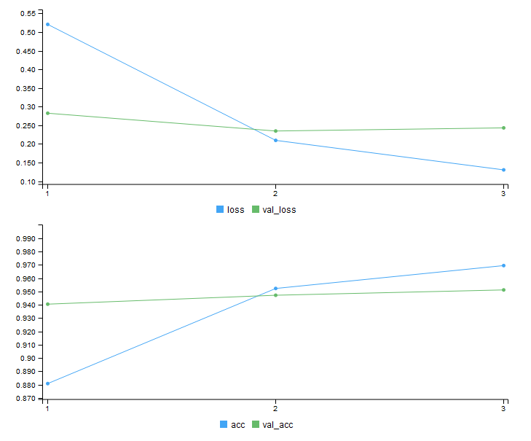
CNN – Training Results
RESULTS (after 3 Epochs):
Loss
Epoch
96.9 %
95.1 %
Accuracy
Epoch
17

Slide 19
CNN – Test Set Results
RESULTS : Test Set (8,144 logos)
The algorithm correctly classified 7,767 logos.
95.4%
So there were 377 classification errors in total in the test set…
272 were misclassified to the « Others » category
These cases would be sent to the next phase (OCR) or to manual capture so we do not consider them as « classification errors ».
How many logos were actually misclassified to the wrong store?
--- > 105 logos => 1.3% of test set
18

Slide 20

CNN – Performance Indicators by Store
 | Store #1 | Store #2 | Store #3 | … | Others
Sensitivity (True Positive Rate) | 0.9749 | 0.9813 | 0.5975 | … | 0.9687
Specificity (True Negative Rate) | 0.9968 | 0.9989 | 0.9998 | … | 0.9586
Precision (Positive Predicted Value) | 0.9738 | 0.9884 | 0.9556 | … | 0.8480
Balanced Accuracy | 0.9859 | 0.9901 | 0.7985 | … | 0.9637
= $\frac{Sensitivity + Specificity }{2}$
19

Slide 21
CNN – Error Analysis
Reasons for misclassification:
No logo on the receipt
The logo crop algorithm crops text on the receipt and it gets characterize as “Others”.
Bad cropping
Logo gets cut during cropping.
Logo were miscoded during manual coding
These shouldn’t be counted as errors.
20

Slide 22
Things to Consider
This project was the results of a small-scale research project.
The Top 20 stores receipts represent about 40% of all SHS receipts, therefore, with this strategy we estimate being able to correctly and automatically classify by store name a very high portion of these SHS receipts.
To boost this percentage:
1. Add more classes to our CNN algorithm (Top 30 stores?)
If logos have not changed, obtain training data from years prior to SHS 2015
If logos have changed, utilize data augmentation techniques?
2. If considered worth it, tweak hyper parameters to try to improve the prediction accuracy of the CNN
21

Slide 23
What could be the next steps?
Optical Character Recognition (OCR) strategy for recognizing store names
Develop an OCR strategy to automate the capture of other relevant information on the receipts (e.g. Date, Total, Method of Payment)
22

Slide 24
Thank you!
For more information or suggestions, please contact:
Émilie Mayer
Social Statistics Methods Division
Statistics Canada
emilie.mayer@canada.ca
The content of this presentation represents the position of the author and may not necessarily represent that of Statistics Canada.

