Slide 1
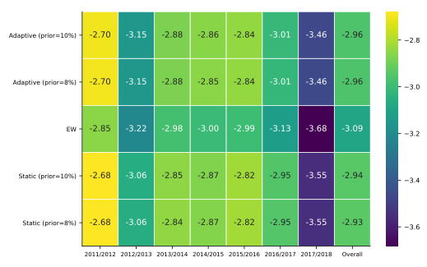
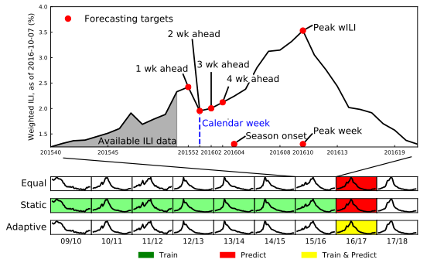
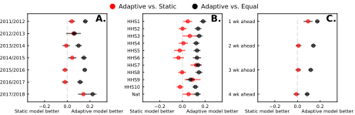
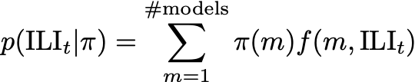


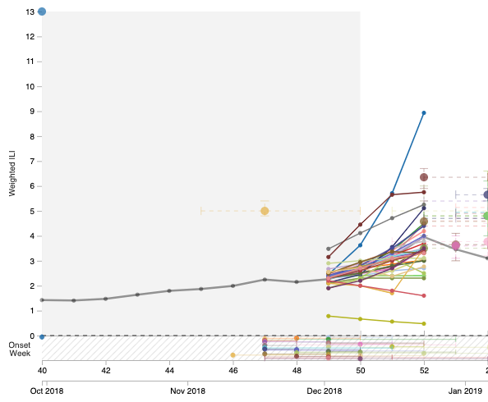




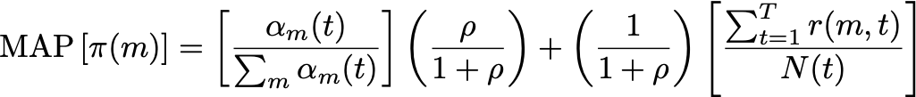



Adaptively stacked ensembles for influenza forecasting with incomplete data
Thomas C. McAndrew, Nicholas G. Reich
University of Massachusetts at Amherst, Dept. of Biostatistics and Epidemiology
Introduction
Methods
Seasonal Influenza infects an average 30 million people in the United States every year¹, overburdening hospitals during weeks of peak incidence. Named by the CDC as an important tool to fight the damaging effects of these epidemics, accurate forecasts of influenza and influenza like illness (ILI) forewarn public health officials about when, and where, seasonal influenza outbreaks will hit hardest.
Adaptive ensemble outperforms equal-weight and performs similar to static
At the end of each trial, the correct category was revealed and the subjects recorded the accuracy of their category guess.
Extending an existing ensemble implementation², we developed a new method for combining component models that relies on recently observed, in-season data to adaptively estimate a convex combination of models.
To protect the adaptive ensemble framework from relying too heavily on recent, revision-prone ILI data, we developed a Bayesian model that uses a time-dependent prior to regularize ensemble weights.
Assume ILI data is generated by a mixture of component models
Discussion
Data
Our adaptive ensemble can forecast from revision-prone, noisy ILI data by relying on a prior. We show this adaptive algorithm outperforms an equal-weight ensemble and shows similar, or better performance against a static ensemble.
Every week throughout the season, for 10 different reporting regions and a national average, the CDC publishes surveillance data on influenza-like illness (ILI). ILI is defined as the percentage of patients presenting with a fever~(greater than 100F) plus cough or sore throat with no known cause other than influenza.
Prior is time-dependent
find MLE
percent
training examples
Able to generate quick forecasts from sparse or noisy data, an adaptive ensemble could serve as a valuable tool to public health officials needing to make informed decisions under uncertainty
Multiple models forecast Influenza
MLE
MLE
MLE
MLE
21 Component model forecasts
models
Maximum aposteriori (MAP) is a convex combination btw prior and MLE
References
Thompson, M. G., et al. "Estimates of deaths associated with seasonal influenza-United States, 1976-2007." Morbidity and Mortality Weekly Report 59.33 (2010): 1057-1062.
Reich, Nicholas G., et al. "A Collaborative Multi-Model Ensemble for Real-Time Influenza Season Forecasting in the US." bioRxiv (2019): 566604.
Real-time forecasts from 2010/2011 to present
This work was funded by the National Institute of General Medical Sciences (NIGMS) Grant R35GM119582, and the Defense Advanced Research Projects Agency. The findings and conclusions in this manuscript are those of the authors and do not necessarily represent the views of the NIH or the NIGMS. The funders had no role in study design, data collection and analysis, decision to present, or preparation of the presentation.
The FluSight Challenge, supported by CDC’s Epidemic Prediction Initiative
The FluSight Network (FSN) is a collaborative group of influenza forecasters, using historical performance of models to build ensemble forecasts.
mcandrew@umass.edu
Notes:
Behavioral results: make bar graphs of RT?
fMRI results: labels, figure caption, make blues in graph the same color
References: add marcel 2004, add numbers, rearrange

Slide 2
Adaptively stacked ensembles for influenza forecasting with incomplete data
Thomas C. McAndrew, Nicholas G. Reich
University of Massachusetts at Amherst, Dept. of Biostatistics and Epidemiology
Introduction
Methods
Seasonal Influenza infects an average 30 million people in the United States every year¹, overburdening hospitals during weeks of peak incidence. Named by the CDC as an important tool to fight the damaging effects of these epidemics, accurate forecasts of influenza and influenza like illness (ILI) forewarn public health officials about when, and where, seasonal influenza outbreaks will hit hardest.
Adaptive ensemble outperforms equal-weight and performs similar to static
At the end of each trial, the correct category was revealed and the subjects recorded the accuracy of their category guess.
Extending an existing ensemble implementation², we developed a new method for combining component models that relies on recently observed, in-season data to adaptively estimate a convex combination of models.
To protect the adaptive ensemble framework from relying too heavily on recent, revision-prone ILI data, we developed a Bayesian model that uses a time-dependent prior to regularize ensemble weights.
Assume ILI data is generated by a mixture of component models
Discussion
Data
Our adaptive ensemble can forecast from revision-prone, noisy ILI data by relying on a prior. We show this adaptive algorithm outperforms an equal-weight ensemble and shows similar, or better performance against a static ensemble.
Every week throughout the season, for 10 different reporting regions and a national average, the CDC publishes surveillance data on influenza-like illness (ILI). ILI is defined as the percentage of patients presenting with a fever~(greater than 100F) plus cough or sore throat with no known cause other than influenza.
Prior is time-dependent
Add prior
percent
training examples
Able to generate quick forecasts from sparse or noisy data, an adaptive ensemble could serve as a valuable tool to public health officials needing to make informed decisions under uncertainty
Multiple models forecast Influenza
MLE
MLE
MLE
MLE
21 Component model forecasts
models
Maximum aposteriori (MAP) is a convex combination btw prior and MLE
References
Thompson, M. G., et al. "Estimates of deaths associated with seasonal influenza-United States, 1976-2007." Morbidity and Mortality Weekly Report 59.33 (2010): 1057-1062.
Reich, Nicholas G., et al. "A Collaborative Multi-Model Ensemble for Real-Time Influenza Season Forecasting in the US." bioRxiv (2019): 566604.
Real-time forecasts from 2010/2011 to present
This work was funded by the National Institute of General Medical Sciences (NIGMS) Grant R35GM119582, and the Defense Advanced Research Projects Agency. The findings and conclusions in this manuscript are those of the authors and do not necessarily represent the views of the NIH or the NIGMS. The funders had no role in study design, data collection and analysis, decision to present, or preparation of the presentation.
The FluSight Challenge, supported by CDC’s Epidemic Prediction Initiative
The FluSight Network (FSN) is a collaborative group of influenza forecasters, using historical performance of models to build ensemble forecasts.
mcandrew@umass.edu
Notes:
Behavioral results: make bar graphs of RT?
fMRI results: labels, figure caption, make blues in graph the same color
References: add marcel 2004, add numbers, rearrange

Slide 3
Adaptively stacked ensembles for influenza forecasting with incomplete data
Thomas C. McAndrew, Nicholas G. Reich
University of Massachusetts at Amherst, Dept. of Biostatistics and Epidemiology
Introduction
Methods
Seasonal Influenza infects an average 30 million people in the United States every year¹, overburdening hospitals during weeks of peak incidence. Named by the CDC as an important tool to fight the damaging effects of these epidemics, accurate forecasts of influenza and influenza like illness (ILI) forewarn public health officials about when, and where, seasonal influenza outbreaks will hit hardest.
Adaptive ensemble outperforms equal-weight and performs similar to static
At the end of each trial, the correct category was revealed and the subjects recorded the accuracy of their category guess.
Extending an existing ensemble implementation², we developed a new method for combining component models that relies on recently observed, in-season data to adaptively estimate a convex combination of models.
To protect the adaptive ensemble framework from relying too heavily on recent, revision-prone ILI data, we developed a Bayesian model that uses a time-dependent prior to regularize ensemble weights.
Assume ILI data is generated by a mixture of component models
Discussion
Data
Our adaptive ensemble can forecast from revision-prone, noisy ILI data by relying on a prior. We show this adaptive algorithm outperforms an equal-weight ensemble and shows similar, or better performance against a static ensemble.
Every week throughout the season, for 10 different reporting regions and a national average, the CDC publishes surveillance data on influenza-like illness (ILI). ILI is defined as the percentage of patients presenting with a fever~(greater than 100F) plus cough or sore throat with no known cause other than influenza.
Prior is time-dependent
norm
percent
training examples
Able to generate quick forecasts from sparse or noisy data, an adaptive ensemble could serve as a valuable tool to public health officials needing to make informed decisions under uncertainty
Multiple models forecast Influenza
post.
post.
post.
post.
21 Component model forecasts
models
Maximum aposteriori (MAP) is a convex combination btw prior and MLE
References
Thompson, M. G., et al. "Estimates of deaths associated with seasonal influenza-United States, 1976-2007." Morbidity and Mortality Weekly Report 59.33 (2010): 1057-1062.
Reich, Nicholas G., et al. "A Collaborative Multi-Model Ensemble for Real-Time Influenza Season Forecasting in the US." bioRxiv (2019): 566604.
Real-time forecasts from 2010/2011 to present
This work was funded by the National Institute of General Medical Sciences (NIGMS) Grant R35GM119582, and the Defense Advanced Research Projects Agency. The findings and conclusions in this manuscript are those of the authors and do not necessarily represent the views of the NIH or the NIGMS. The funders had no role in study design, data collection and analysis, decision to present, or preparation of the presentation.
The FluSight Challenge, supported by CDC’s Epidemic Prediction Initiative
The FluSight Network (FSN) is a collaborative group of influenza forecasters, using historical performance of models to build ensemble forecasts.
mcandrew@umass.edu
Notes:
Behavioral results: make bar graphs of RT?
fMRI results: labels, figure caption, make blues in graph the same color
References: add marcel 2004, add numbers, rearrange

